Slide 1
Update on GIS Activities
Jason Chapman
Darryl Mack
Jim Mitchell

Slide 2
Topographic Mapping

Slide 3
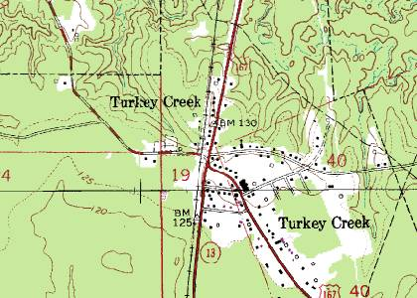
Topographic Mapping
A type of map characterized by large-scale detail and quantitative representation of relief, usually using contour lines.
Traditional definitions require a topographic map to show both natural and man-made features.

Slide 4
Act 782 of 2010 and Act 409 of 2012 La. R. S. 48:36 Topographic Mapping
DOTD shall develop and maintain a statewide digital geospatial database
Act as the state authority for geographic names
Set standards for the mapping of topographic features
Plan and manage data collection for incorporation into a statewide database
Promulgate rules and regulations… as are necessary for the planning and managing of the geospatial data.

Slide 5
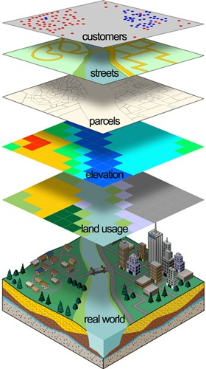
Topographic Layers
The Louisiana State Geodatabase (LSGDB) shall include ten (10) framework data layers:
Hypsography - elevations
Hydrography - water
Transportation
Vegetated Areas and Non-Vegetated Areas
Boundaries – parish, city, parks & parcels
Public Land Survey System (PLSS)
Geographic Names Information System (GNIS)
Survey Markers
Man-Made Structures
The Transportation Layer shall include Roads, Ferries, Railroads, Airports & Runways, Passenger Train Stations, Bus Terminals and Ports.

Slide 6
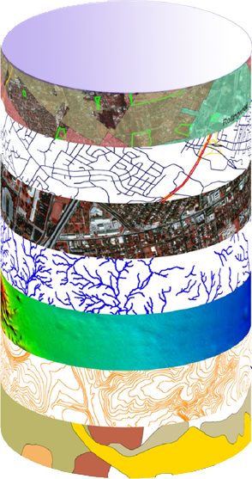
Data Layers Used By Many
ESSENTIAL
FUNCTIONS OF
GOVERNMENT
DOTD Geodatabase
FRAMEWORK DATA
Transportation
and
Infrastructure
Topography
Hydrography
Transportation
Agriculture
Natural Resources
Environmental Quality
Boundaries
Land Cover / Land Use
Manmade Structures
Public Safety
And
Homeland Security
Public Land Survey
Education
Health
Human Services

Slide 7
GIS Supports Shared Digital and Analog Activities
Framework Data Layers
Hydrology (rivers, lakes, ponds, watershed boundaries, NHD model)
Hypsography (elevation, breaklines, DEM)
Transportation (roads, bridges, railroads, transmission lines, pipelines)
Boundaries (Federal, state, parish, & local government;)
Man-Made Structures (government buildings, hospitals, schools, churches, emergency facilities)
Vegetation/non-vegetation coverage's (Including land use)
Public Land Survey System Grid
Mitigation Related Data Layers
Shelters (with capacities & Utilities availability)
Areas for Temporary Facilities (tent cities, manufactured housing, trailer parks; with available utilities)
Medical Treatment Sites

Slide 8
Essential Functions In All Agencies Are Supported From One Map
Emergency Preparedness – DOTD, State Police, and OEP used GIS to create the Louisiana Emergency Evacuation Plan
Emergency Response – DOTD, DWF, OEP, State Police, 911, and federal agencies collaborated with GIS
Statewide Hurricane Recovery – DOTD and DEQ collaborated in finding debris collection points, tabulating removal, and safely routing trucks
Coastal Restoration – DOTD, DNR, DEQ, and others collaborate on coastal restoration projects
Hazard Mitigation – GOHSEP must compile a State Hazard Mitigation Plan; GIS is essential in evaluating risk, as well as, sharing data and presenting it to the public
National Flood Insurance – DOTD is the lead agency for NFIP; GIS data can provide more accurate maps, faster and keep them up to date
Customer Service – Agencies maintain databases of customers, vendors, service locations, and other address information that can be shared and disseminated to the public via the Internet

Slide 9
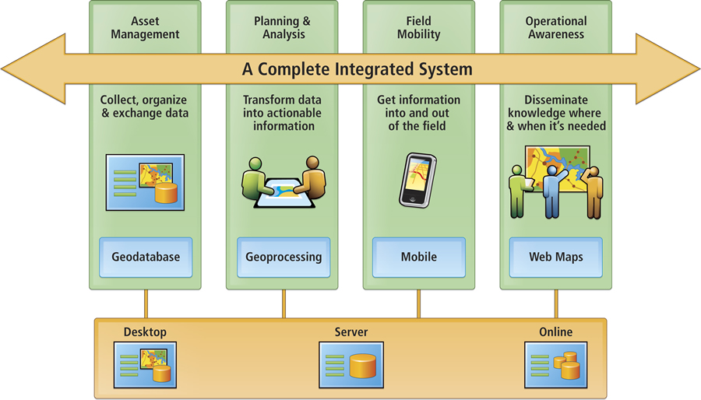
Enterprise GIS Framework

Slide 10
Projects Involved

Slide 11
DOTD Projects Contributing to the Effort
Basemap Develepment (GEC)
$900k?
3 years?
Hydrography Layer (GDM)
$cost
Timeline
Upcoming Task Order
IT Enterprise GIS Planning Report (PMG)
GIS study to gather information and provide direction regarding the use of GIS within DOTD
$cost
Local Road Data (Fugro Roadware)
Supplemented existing Pavement Management contract
Supply data for local road system
3 year addendum for total $10M
Enterprise LRS Implementation
Proposed 3 year retainer contract
Not to exceed $1M per year

Slide 12
IT Enterprise GIS Planning Report

Slide 13
Study Completed by
Conducted interviews with DOTD Engineering and IT Staff
Identified issues and made recommendations
Fully Implement Enterprise LRS
Define and Integrate Participating Business Systems
Define and Create Enterprise Applications
Implement Statewide Clearinghouse
Create Enterprise GIS Steering Committee

Slide 14
Transportation Layer Linear Reference System (LRS-ID)

Slide 15
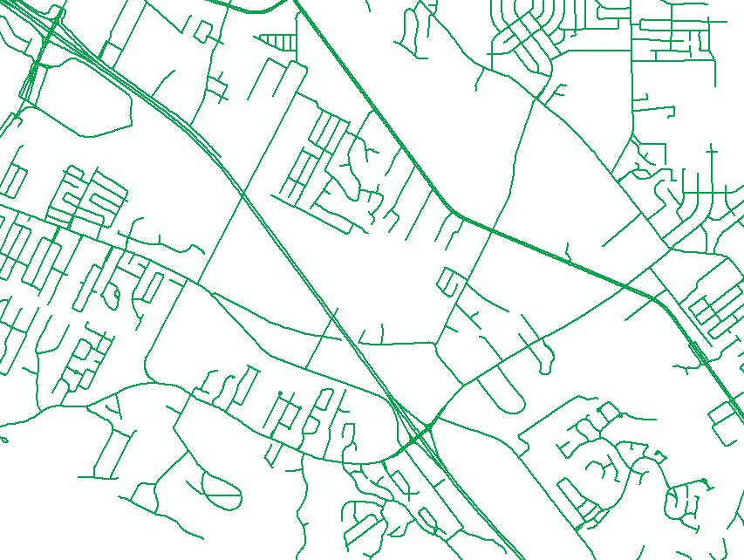
Assigning LRS-ID
Base map project completed by
Identify and create GIS lines for road network
Combination of Census Tiger data, DOTD and Local data
Assign LRS
Alignment cleanup
Aerial imagery
Roadware ARAN GPS points
State routes
Based on Control Section
9 Digit code
XXX-XX-F-LLL
Local roads
Based on Parish name and Street name
18 Digit code
PPP-X-NNNNNN-TTT-S-F-LLL

Slide 16
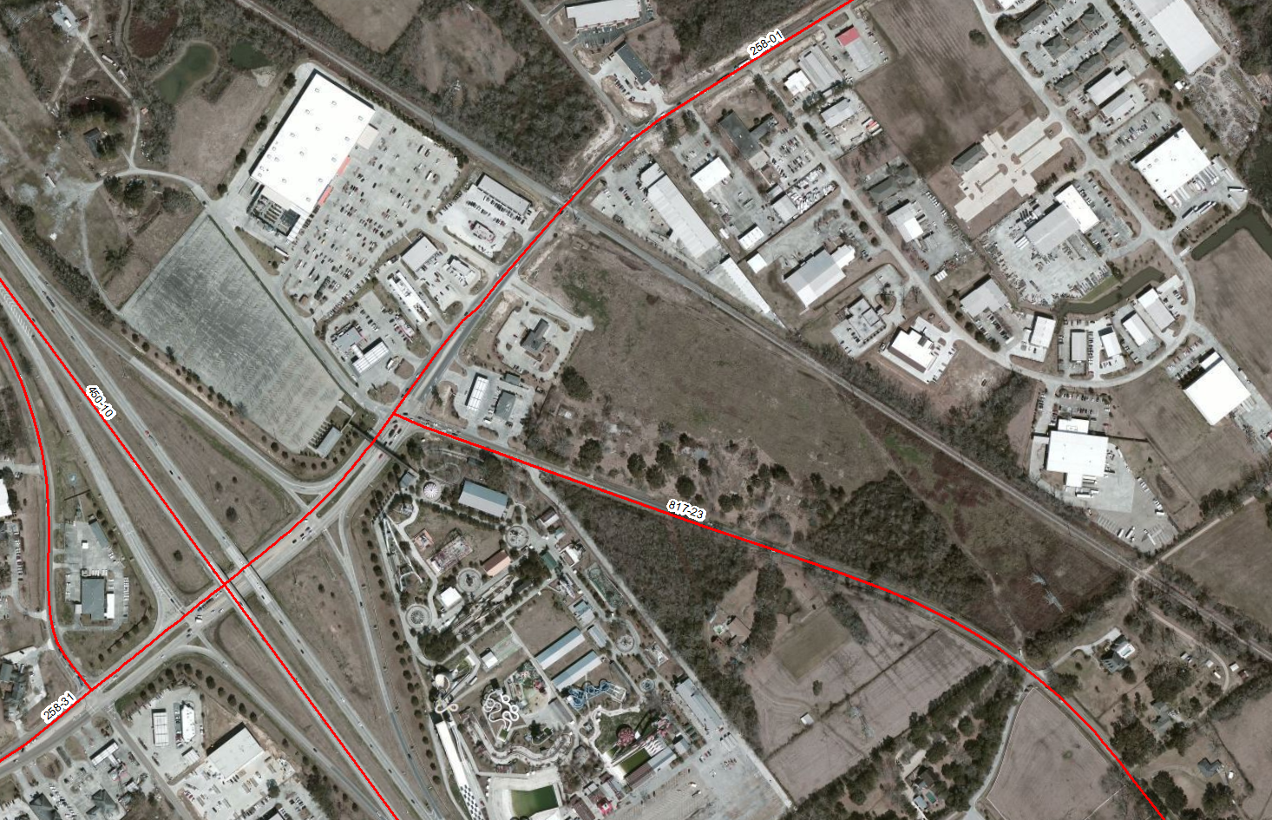
Control Section as LRS

Slide 17
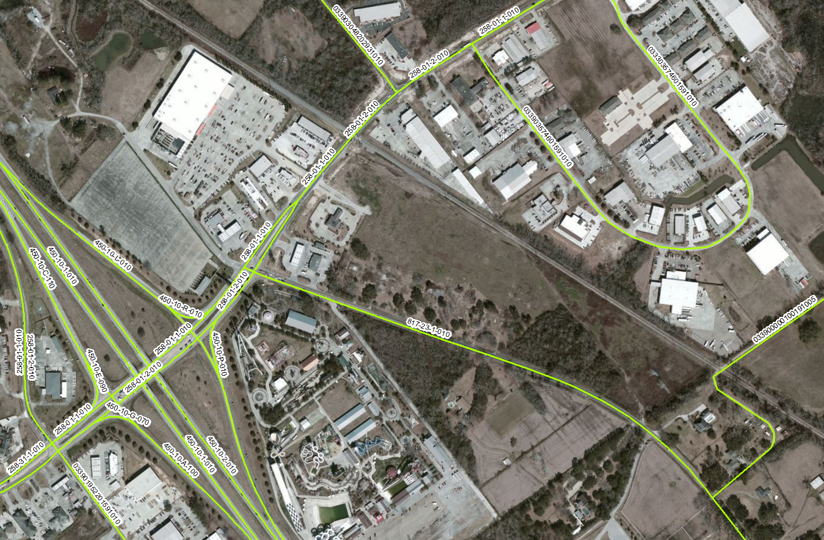
LRS Expanded

Slide 18
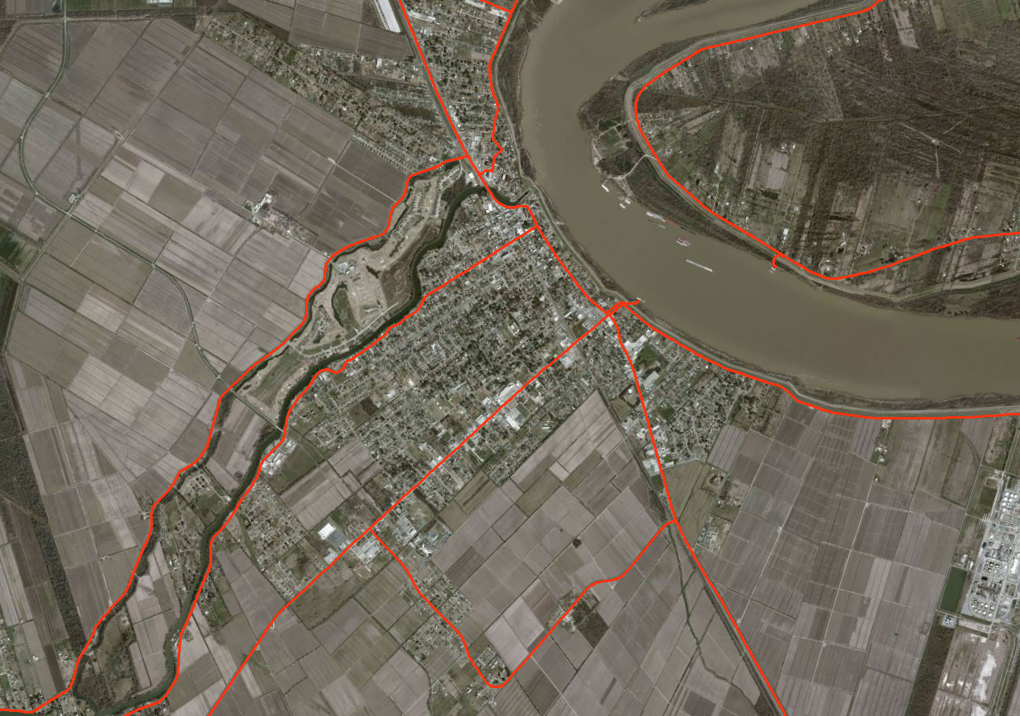
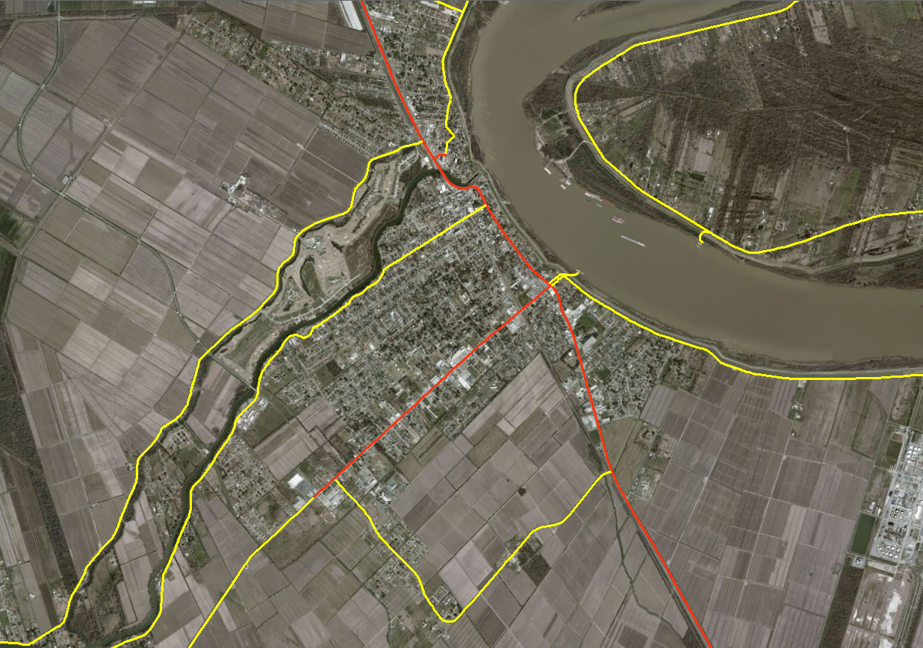
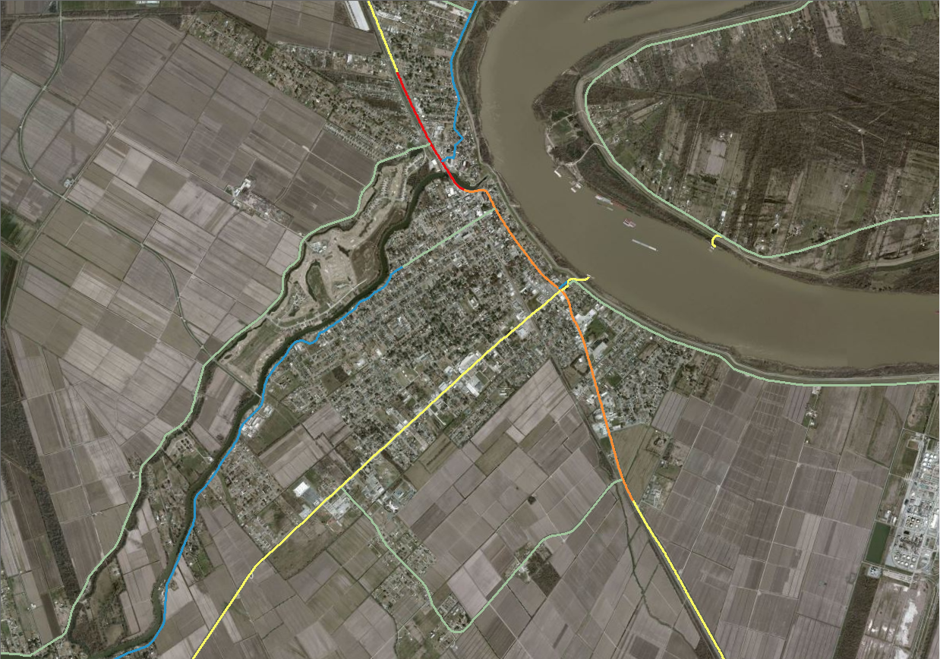
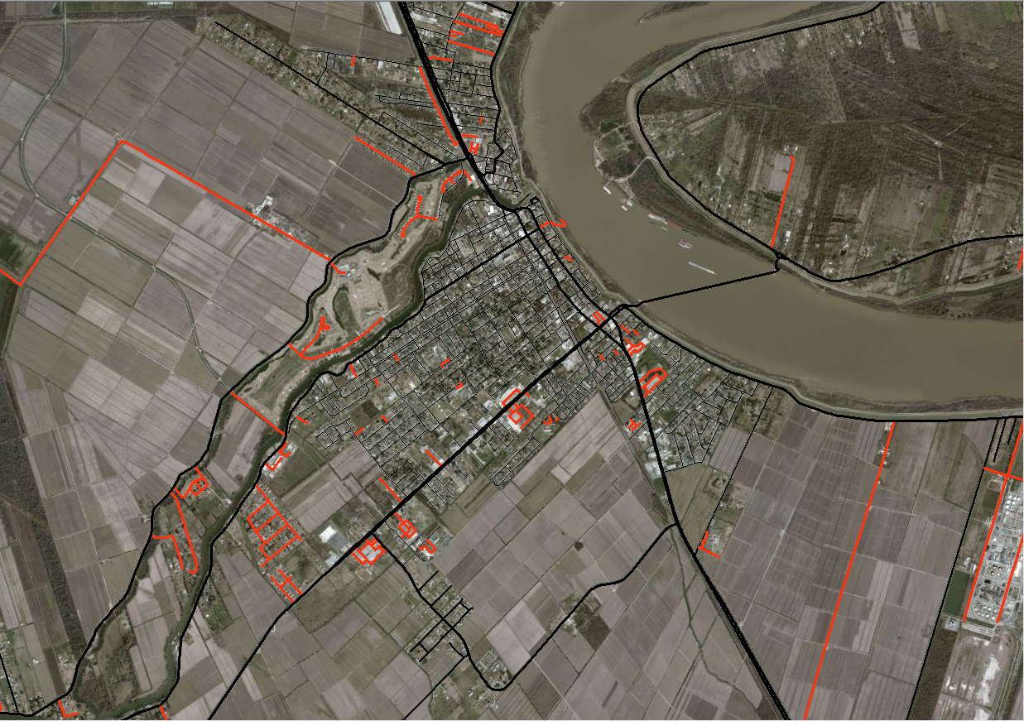
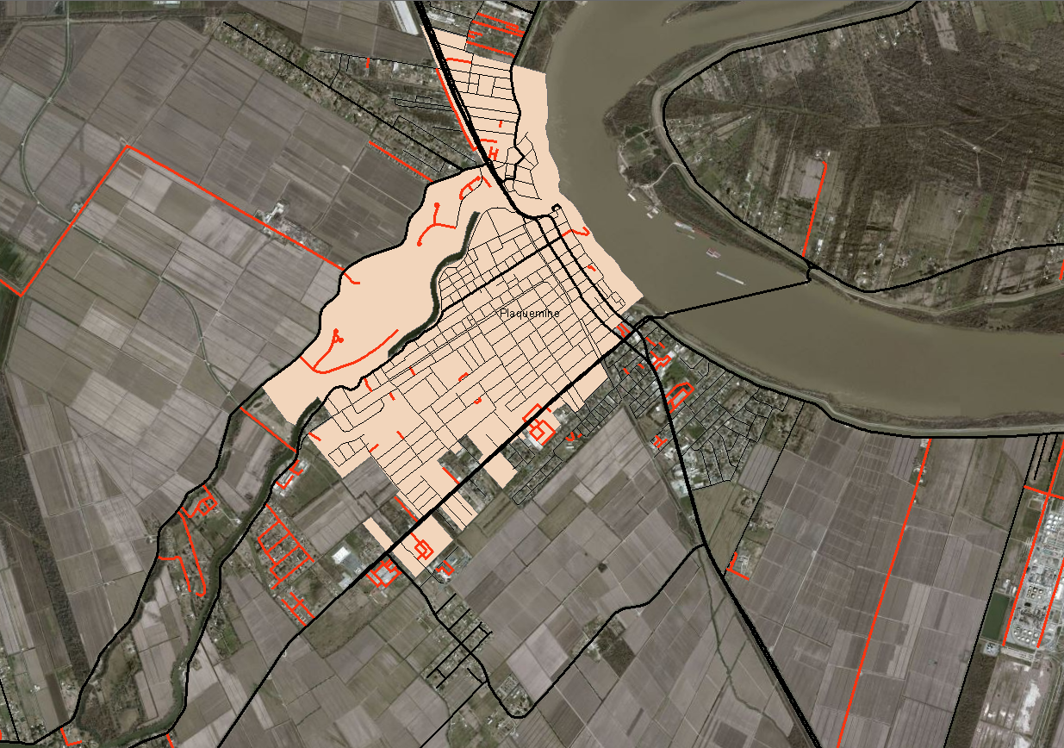
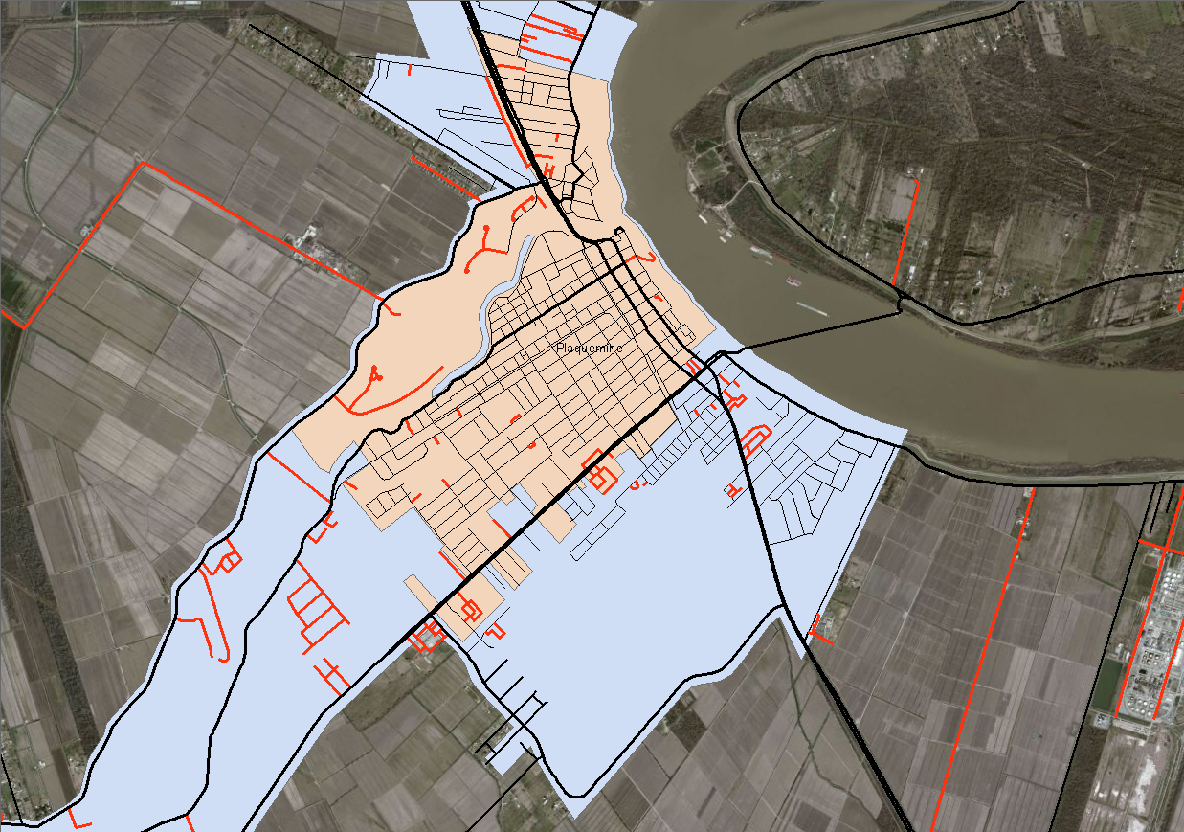
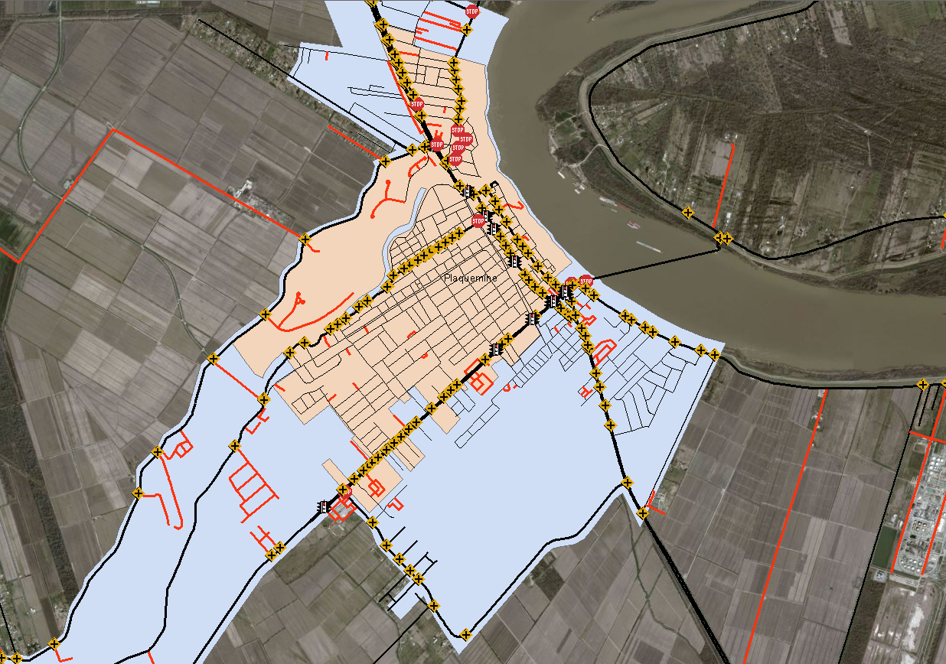
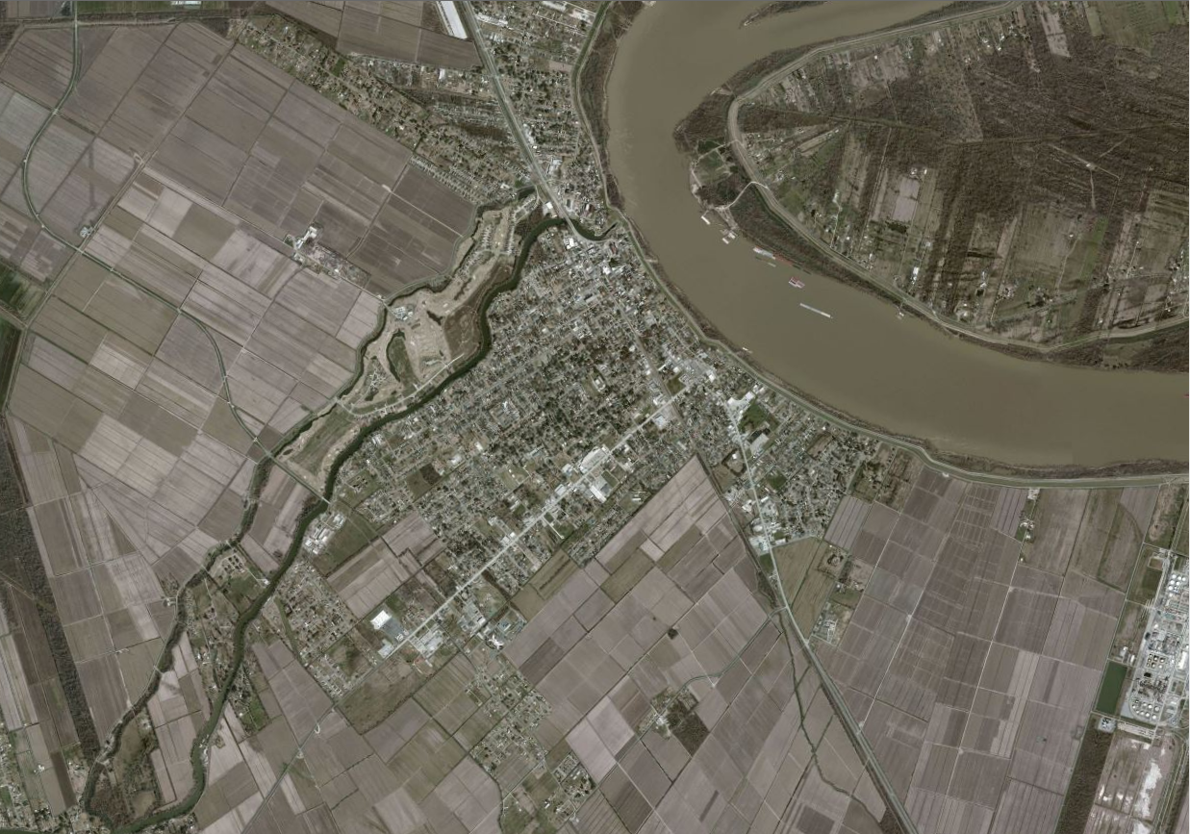
Layered GIS Data
Imagery
State System
Control Section
Lanes
AADT
All Roads
Boundaries
City
Urban Area
Assets
Intersection
Speed Signs

Slide 19
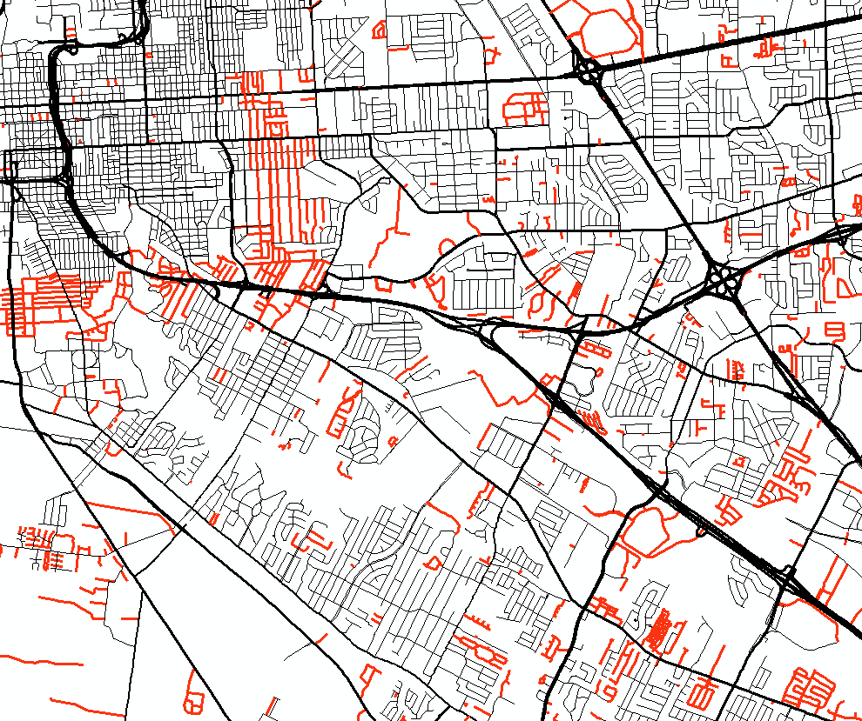
Need to Verify Mileage
Base map identified more miles
New local roads
State inventory maintained
Private roads
Unknown ownership
Farm roads
Not a road

Slide 20
NHD Project

Slide 21
Hydrographic Layer
Work performed by
HUCs updated and delivered to USGS for acceptance
Submit the data for upload to the National Geodatabase
Upcoming Task Order
Create Feature Modeling Guidelines and Data Modeling Specifications
Improve spatial accuracy and completeness of road data using GPS data and high resolution six inch accurate aerial imagery
Improve the address location accuracy
Improve the geospatial network for path finding (routing)

Slide 22
Transportation Data Collection Methods

Slide 23
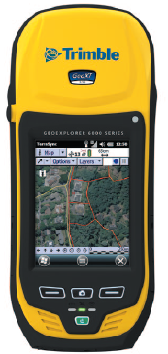
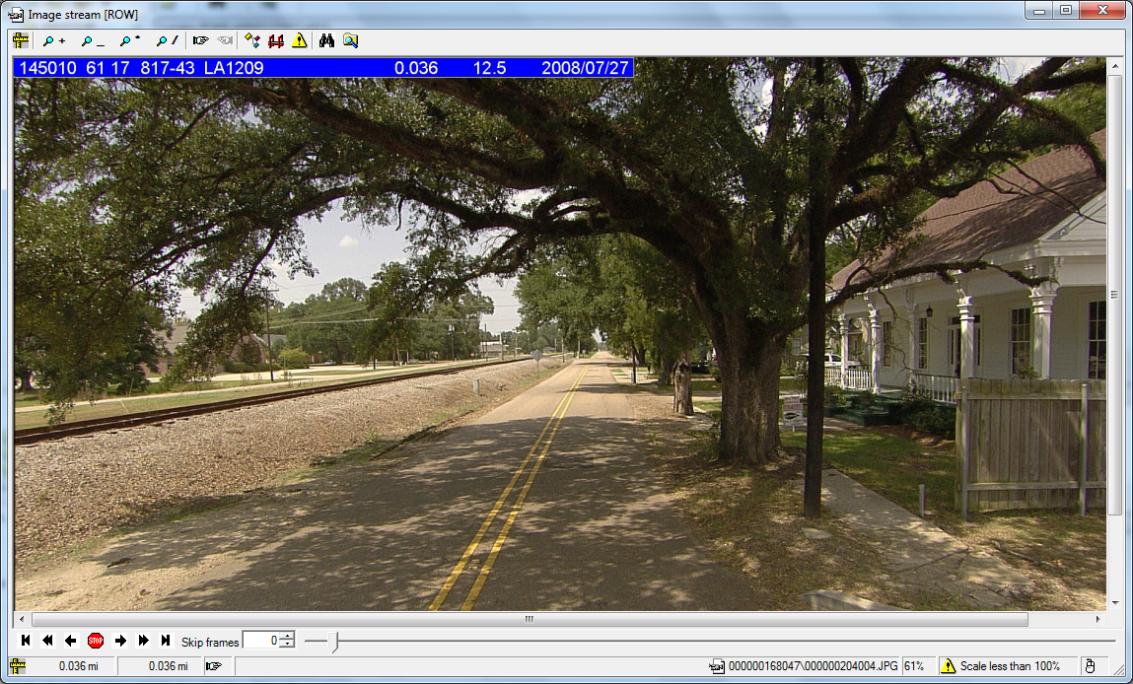
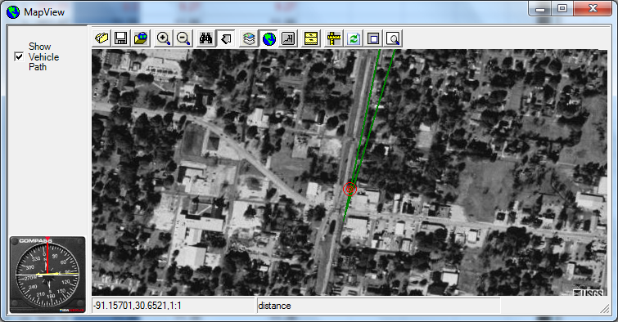
Highway Inventory Collection Tools
Trimble devices (GPS)
Distance measuring instrument
Pathfinder software
Surveyor software
Roadware video collection

Slide 24
Pavement Management Data Collection
Fugro Roadware
Automatic Road Analyzer (ARAN)
2 year collection cycle
Collects data on roads throughout Louisiana
State maintained highways
Interstates
HPMS routes
Off system NHS routes
Collects electronic data (IRI, faulting, rutting, etc.)
Records right of way and pavement images
Utilizes GPR unit during normal data collection

Slide 25
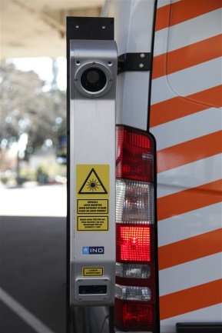
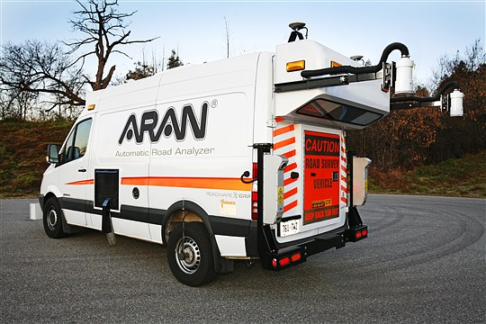
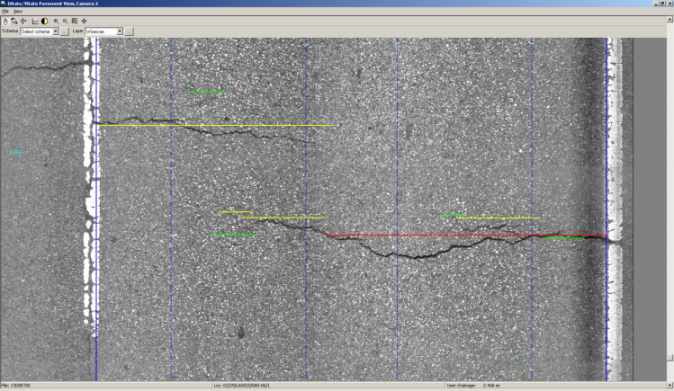
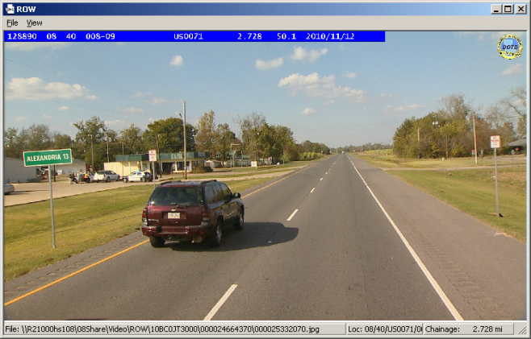
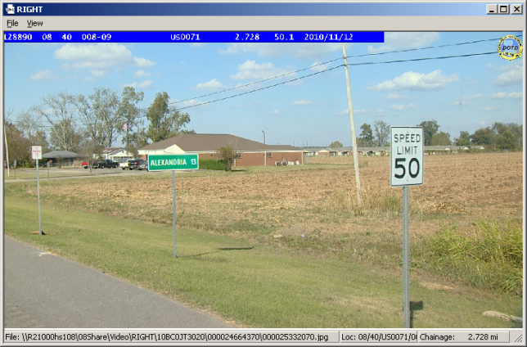
Collection Methods
Accelerometer sensors collect roughness
Rutting data is collected by the use of two scanning laser transverse profilers
Right of way images are captured using two high definition cameras (1920 x 1080 pixel resolution)
The images are recorded every 0.004 millimiles (20 ft)
100% of the driven lane is captured by two cameras and digitally stored for post processing of the ratings and quantification of the pavement distresses

Slide 26
Additional Attribute Data
Collected using video imagery
Post processed
Surveyor software
Clean up current Inventory
Satisfy data requirements for safety analysis
MIRE (Model Inventory of Roadway Elements)
Recommended listing of roadway inventory and traffic elements critical to safety management
HSM (Highway Safety Manual)

Slide 27
Post Processed Data
Number of Travel Lanes
Type of HOV operations
Number of HOV Lanes in both directions
Presence of Right Turn Lanes
Presence of Left Turn Lanes
Posted Speed Limit
Sections with Toll Charge
Type of Toll
Count of Signalized At-Grade Intersections
Count of At-Grade Intersections with Stop Signs
Count of Intersections without Stop Sign or Signals
Begin Bridge Location
End Bridge Location
Measure of Existing Lane Width
Type of Median
Measure of Existing Median Width
Type of Shoulder Material
Measure of Existing Right Shoulder Width
Measure of Existing Left Shoulder Width
On Route Parking Locations
Type of Terrain
Sample Section Meeting the Sight Distance for Passing
Surface Type of a Given Location
Presence of Curb
Presence of Rail Road Crossing
Start Location of Sidewalk Right
End Location of Sidewalk Left
Identify ADA Compliant Sidewalk

Slide 28
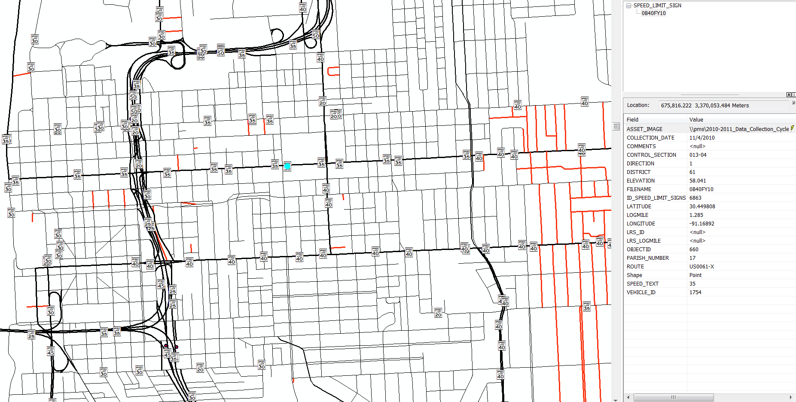
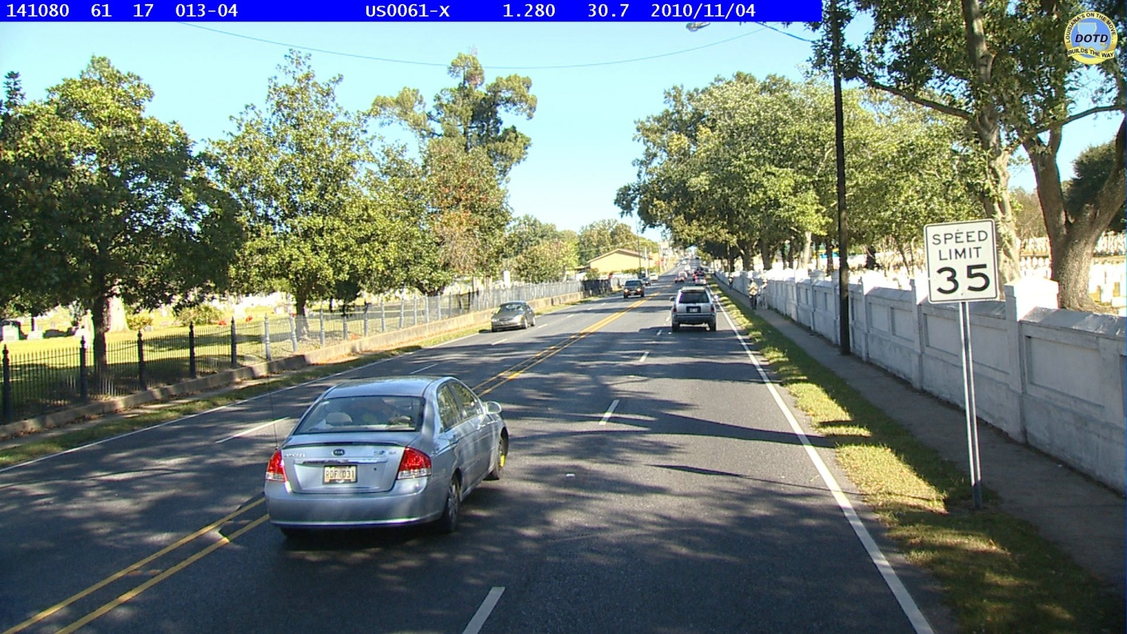
Speed Limit Signs

Slide 29
Road Data on Local Streets

Slide 30
Reconnecting with Local Govt.
Need for corrected data
DOTD informed of new roads
Make GIS available
Freely distributed to any agency for use
Meeting with locals for participation
Police Jury Association (PJA)
Louisiana Parish Engineers and Supervisors Association (LPESA)
Louisiana Municipal Association (LMA)
Metropolitan Planning Organizations (MPO)
Regional Planning Commissions (RPC)

Slide 31
Updating Local Road Data
Collect Roadware video images for all local roads
Post process attribute data
Identify ownership
Satisfy FHWA mileage reporting
Make images and data available for locals use
Receive updates from locals
Newly constructed roads
Changed road characteristics
Re-establish local road updates with local governments
Some states have passed legislation requiring local agencies to submit updates

Slide 32
Opportunity To Collect Performance Data

Slide 33
Moving Ahead for Progress in the 21st Century Act
On July 6, 2012, President Obama signed into law P.L. 112-141, the Moving Ahead for Progress in the 21st Century Act (MAP-21).
MAP-21 creates a streamlined, performance-based, and multimodal program to address the many challenges facing the U.S. transportation system.
Setting the course for transportation investment in highways, MAP-21 –
Strengthens America’s highways
MAP-21 expands the National Highway System (NHS) to incorporate principal arterials not previously included. Investment targets the enhanced NHS
Establishes a performance-based program
Under MAP-21, performance management will transform Federal highway programs and provide a means to more efficient investment of Federal transportation funds by focusing on national transportation goals, increasing the accountability and transparency of the Federal highway programs, and improving transportation investment decision-making through performance-based planning and programming.
Creates jobs and supports economic growth
MAP-21 authorizes $82 billion in Federal funding for FYs 2013 and 2014 for road, bridge, bicycling, and walking improvements.
Supports the Department of Transportation’s (DOT) aggressive safety agenda
MAP-21 continues the successful Highway Safety Improvement Program, doubling funding for infrastructure safety, strengthening the linkage among modal safety programs, and creating a positive agenda to make significant progress in reducing highway fatalities.
Streamlines Federal highway transportation programs
The complex array of existing programs is simplified, substantially consolidating the program structure into a smaller number of broader core programs.
Accelerates project delivery and promotes innovation
MAP-21 incorporates a host of changes aimed at ensuring the timely delivery of transportation projects.

Slide 34
Proposed Local Road Collection Cycles

Slide 35
Implementation of an Enterprise LRS

Slide 36
Fully Implement LRS
Request for Qualifications Released Oct. 2013
Three proposals being reviewed
Retainer contract over 3 years
All components will be geospatial in nature and thoroughly integrated to enable unified management. These components, listed in priority, are:
Enterprise LRS
Road Inventory / HPMS
Enterprise ad-hoc query and viewing tools
Based on Roads and Highways software by

Slide 37
Distribution of Data
ArcGIS.com services
Louisiana Proposed Functional Class
Statewide clearinghouse
Other DOT successes
Utah’s Uplan
Utah’s Ugate

Slide 38
Thank you Questions?

