Slide 1

DOTD Topographic Mapping Program Building the Digital Geodatabase of Louisiana
James E. Mitchell, Ph. D. IT GIS Manager State of the Coast New Orleans, Louisiana – June, 2012
Notes:
Presentation by James E. Mitchell, Ph. D. at the 2012 State of The Coast Conference, sponsored by the Coalition for Coastal Louisiana, New Orleans, LA, June 25, 2012.

Slide 2
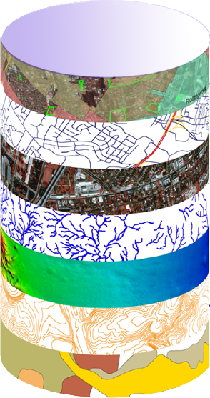
What Data Are on a Topographic Map and How Are They Used?
ESSENTIAL
FUNCTIONS OF
GOVERNMENT
DOTD
Geodatabase
FRAMEWORK DATA
Transportation
and
Infrastructure
Topography
Hydrography
Transportation
Agriculture
Natural Resources
Environmental Quality
Boundaries
Land Cover / Land Use
Manmade Structures
Public Safety
And
Homeland Security
Public Land Survey
Education
Health
Human Services

Slide 3
History of Topographic Mapping in the United States
1879 - US Geological Survey established
1882 - Topographic Mapping Program begins
1980s – Last 7½-Minute Quad map done in Louisiana
2000 – Funds for USGS mapping terminated
2002 – USGS creates The National Map program to start digital mapping

Slide 4
History of Topographic Mapping in Louisiana
1928 - Act 159 establishes topographic mapping as a responsibility of the State Engineer.
1974 – Act 159 of 1928 is adopted by reference into the new Louisiana Constitution and eventually becomes the responsibility of DOTD.
1990s - DOTD has been the lead in Louisiana for the USGS Cooperative Topographic Mapping Program since its inception. By 2001, DOTD is spending nearly $200,000 per year for map revisions by USGS. This partially updates 12-20 paper maps (of ~900) in Louisiana. No digital data are ever updated.
In 2007 USGS declares:
“We have 5 quads to finish up for Louisiana, and have
no plans to do anymore, anywhere.”

Slide 5
Topographic Mapping Today in Louisiana
2010 - The Louisiana Legislature passes Act 782, establishing Revised Statute 48:36, “Topographic Mapping,” stating that DOTD, “may develop and maintain a statewide digital geospatial database.”
2012 - The Louisiana Legislature passes Act 409, revising La. R. S. 48:36, to state that DOTD, “shall develop and maintain a statewide digital geospatial database.”
DOTD is in the process of promulgating rules for building and maintaining the geodatabase of Louisiana
DOTD continues funding statewide geodatabase development (mapping) with grants and cooperative agreements

Slide 6
Act 782 of 2010 and Act 409 of 2012
La. R. S. 48:36 Topographic Mapping
DOTD shall develop and maintain a statewide digital geospatial database
Act as the state authority for geographic names
Set standards for the mapping of topographic features
Plan and manage data collection for incorporation into a statewide database
Promulgate rules and regulations… as are necessary for the planning and managing of the geospatial data.

Slide 7
The Current Status of Paper Maps
(Updated January, 2012)

Slide 8
How Up to Date are
Louisiana’s Maps?
    All paper maps are 6 years or older
    97% of paper maps are 10 years or older
    77% of paper maps are 15 years or older
    60% of paper maps are 20 years or older
    37% of paper maps are 25 years or older
    21% of paper maps are 30 - 112 years old
Digital map data were never updated when paper maps were updated. As a result, digital data are older than the paper maps.
(Updated January 2012)

Slide 9
Storm Crossings Since 1900

Slide 10
Why Is Louisiana’s Geospatial Data So Difficult to Keep Up to Date?
    Louisiana is largely in the Mississippi River Delta
      One of the most active deltaic systems in the world
      Deltaic geology is inherently unstable
      The Birdfoot Delta juts far into the Gulf of Mexico
      All of these factor combine to make coastal Louisiana susceptible to hurricane and tropical storm damage
    Subsidence
      Anisotropic and heterogeneous effects of subsidence create a response that is spatially dispersed and inconsistent across the landscape
    Sea Level Rise
      Compounds all of the above
All of these factors combine to continuously create new geographic features, while, changing and destroying old geographic features

Slide 11
Why Are Up To Date Geospatial Data Important to Louisiana?
    Geospatial data provide information about where people, infrastructure, and government services are located and how to connect them
    Geospatial data provide a framework for transparency, planning, and delivering services. It promotes good government and interaction across all levels of government
    Geospatial data provide information essential to plan, promote, and market economic development opportunities
    Geospatial data provides a common operational picture (COP) for emergency mitigation, preparation, and response

Slide 12
The “AAAAA” Data Standard
 | Factor | Contribution to Data Quality
 | Accurate | The data adequately represents the state of the world in space and time. Locations have sufficient precision for their scale of use and data are current.
 | Authoritative | The source of the data provides sufficient quality control to ensure its veracity and reliability.
 | Actionable | The data are well documented with metadata, require little further assessment or manipulation, and can be put to immediate use.
 | Accessible | The data are discoverable and available through direct download or Service Oriented Architecture (SOA). Data can be searched directly, selected, and accessed without intervention by its provider.
 | Affordable | The data can be accessed with little or no cost to the user.
Notes:
The “AAAAA” data quality standard describes the essential elements of data quality that must be attained when developing and maintaining an enterprise GIS database.

Slide 13
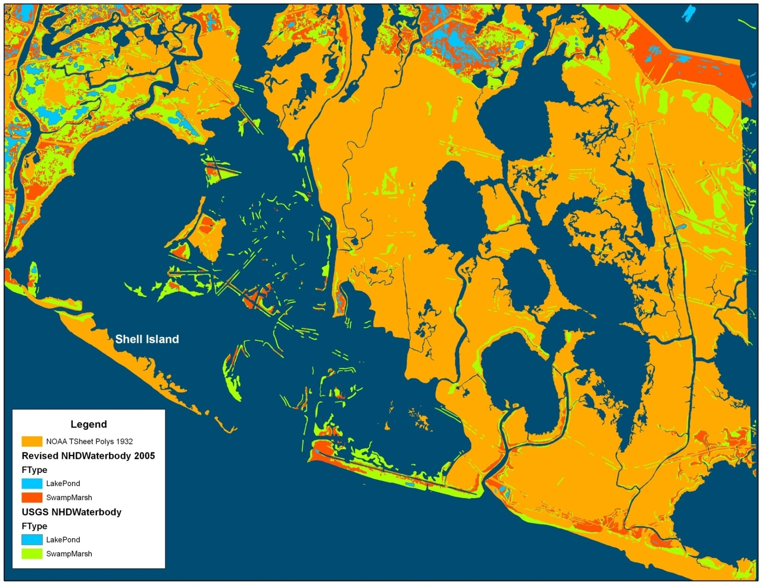
Where Has All the Coastline Gone?
Red features are from the NHD. Orange polygons are areas represented by NOAA as land in 1940 (most current data). These are now open water in the NHD.

Slide 14
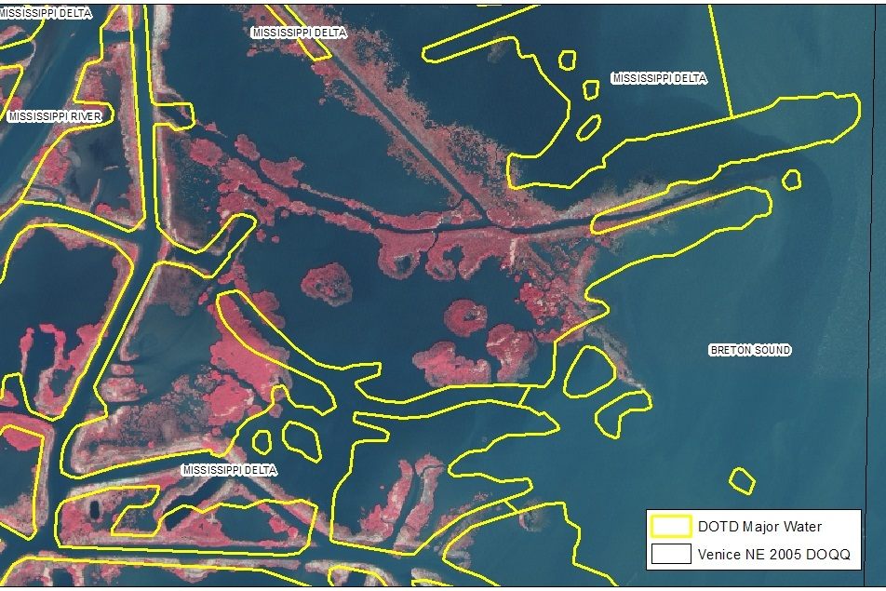
Maps, Data, & Imagery Do Not Match
The yellow lines are where best-available digital data show the land-water boundary. The image is post hurricane orthophotography. Neither match the maps.

Slide 15
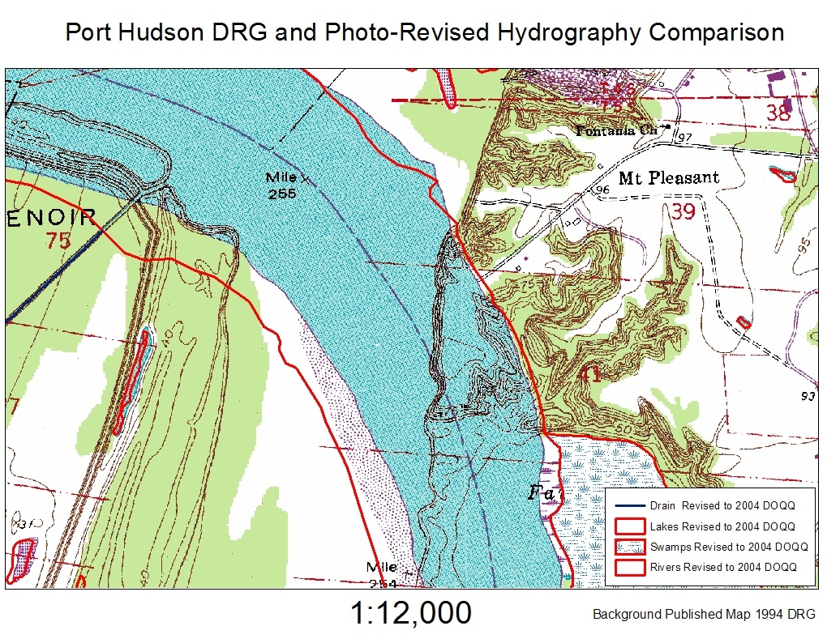
Vertical Disintegration
USGS maps are comprised of seven “framework themes” (water, elevation, transportation, boundaries, benchmarks, vegetation, and structures). USGS d id not update all themes simultaneously. On this map, USGS has not updated the hypsography theme. So, the old elevation contours (brown) lie in the updated water (blue). The thick red lines show the photo-revised shoreline and other water features from the 2004 orthophotos.

Slide 16
Would you Drive Across the Us Using a 30-year Old Map?

Slide 17
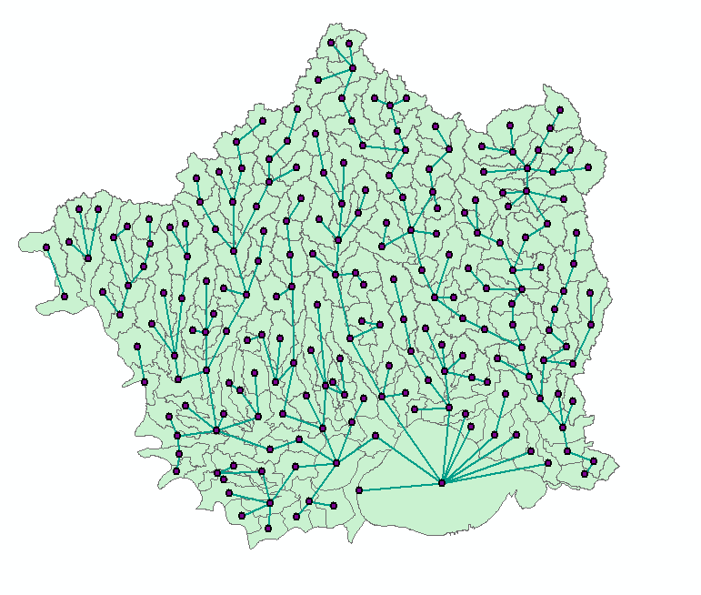
Geospatial Technology “Connects the Dots” in the Lake Pontchartrain Basin
One output to the Gulf of Mexico
Lake Pontchartrain has 9 input watersheds

