Slide 1
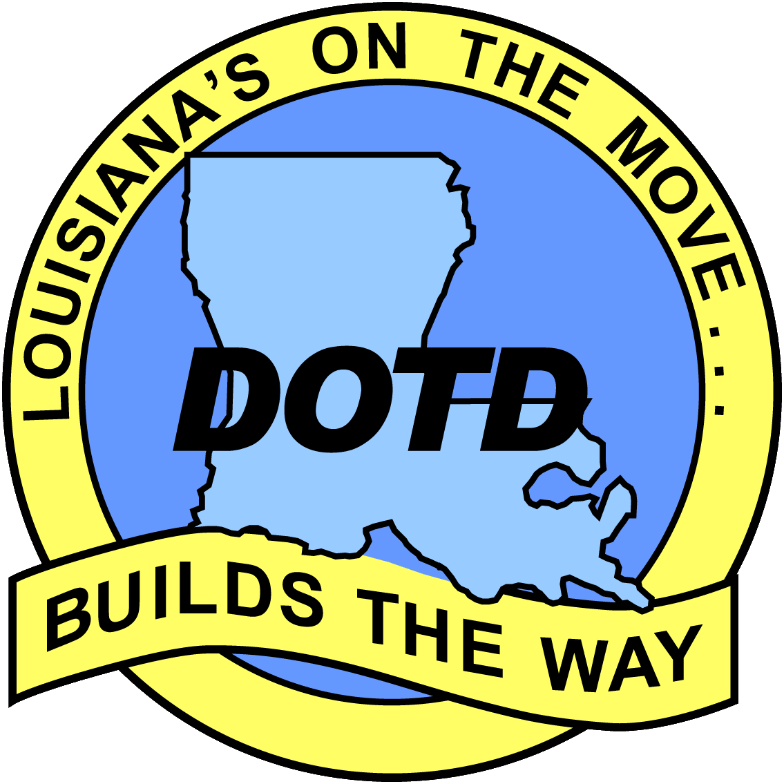

New Protocol for NHD Coastal Watershed Revision and Updating
James E. Mitchell, Ph.D.
IT GIS Manager
&
Kurt L. Johnson
IT GIS Technical Specialist
Louisiana Department of Transportation and Development
Sean Deinert
Director, Technical Operations
GeoDigieal Mapping, International Services
ESRI International User’s Conference
San Diego, CA, July 2012

Slide 2
Why Does the NHD Require Updating?
High Resolution NHD was built from “best available” data… old USGS Quad maps and imagery
Source maps were never edge-matched, so created inconsistencies as features crossed map boundaries
Adjacent maps were not contemporaneous, so hydrography may change across map boundaries
Map revisions never kept pace with the rate and frequency of coastal landscape change

Slide 3
How Old Are Louisiana’s Paper Maps?
(Updated January, 2012)

Slide 4
Louisiana’s Tropical Storms and Hurricanes Since 1900
Through 2005, paper maps were revised in Louisiana, however digital geospatial data and digital raster graphics (DRG) were not.

Slide 5
What Makes Louisiana’s Hydrology Different?
“Backward” distributary basins
Extensive wetlands (almost no beaches)
Hurricane and tropical cyclone frequency
Deltaic geomorphology
  Non-stationary subsidence and land-loss issues

Slide 6
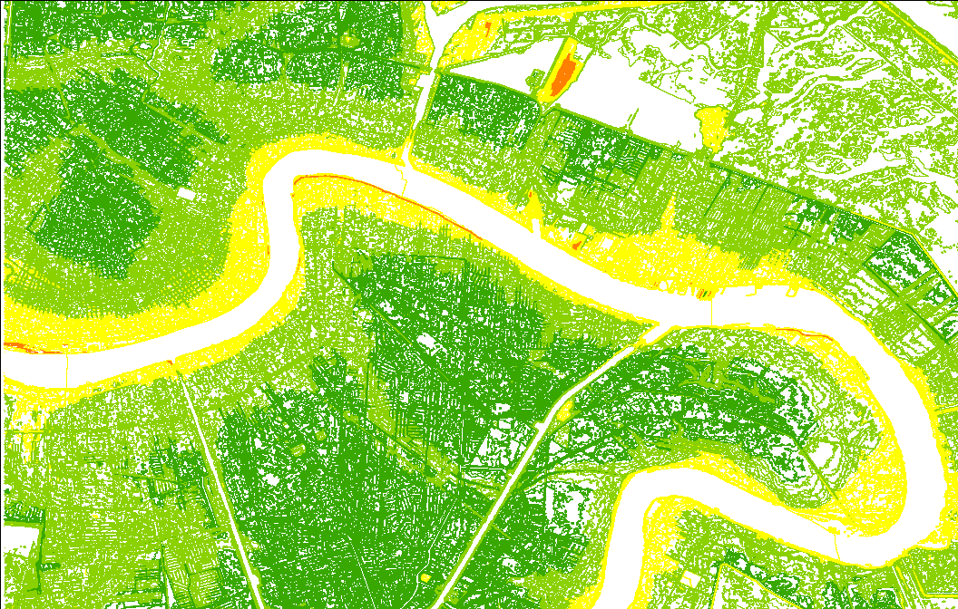
“Backward” Distributary Basins
The levees are the high ground and the water flows away from the Mississippi River

Slide 7
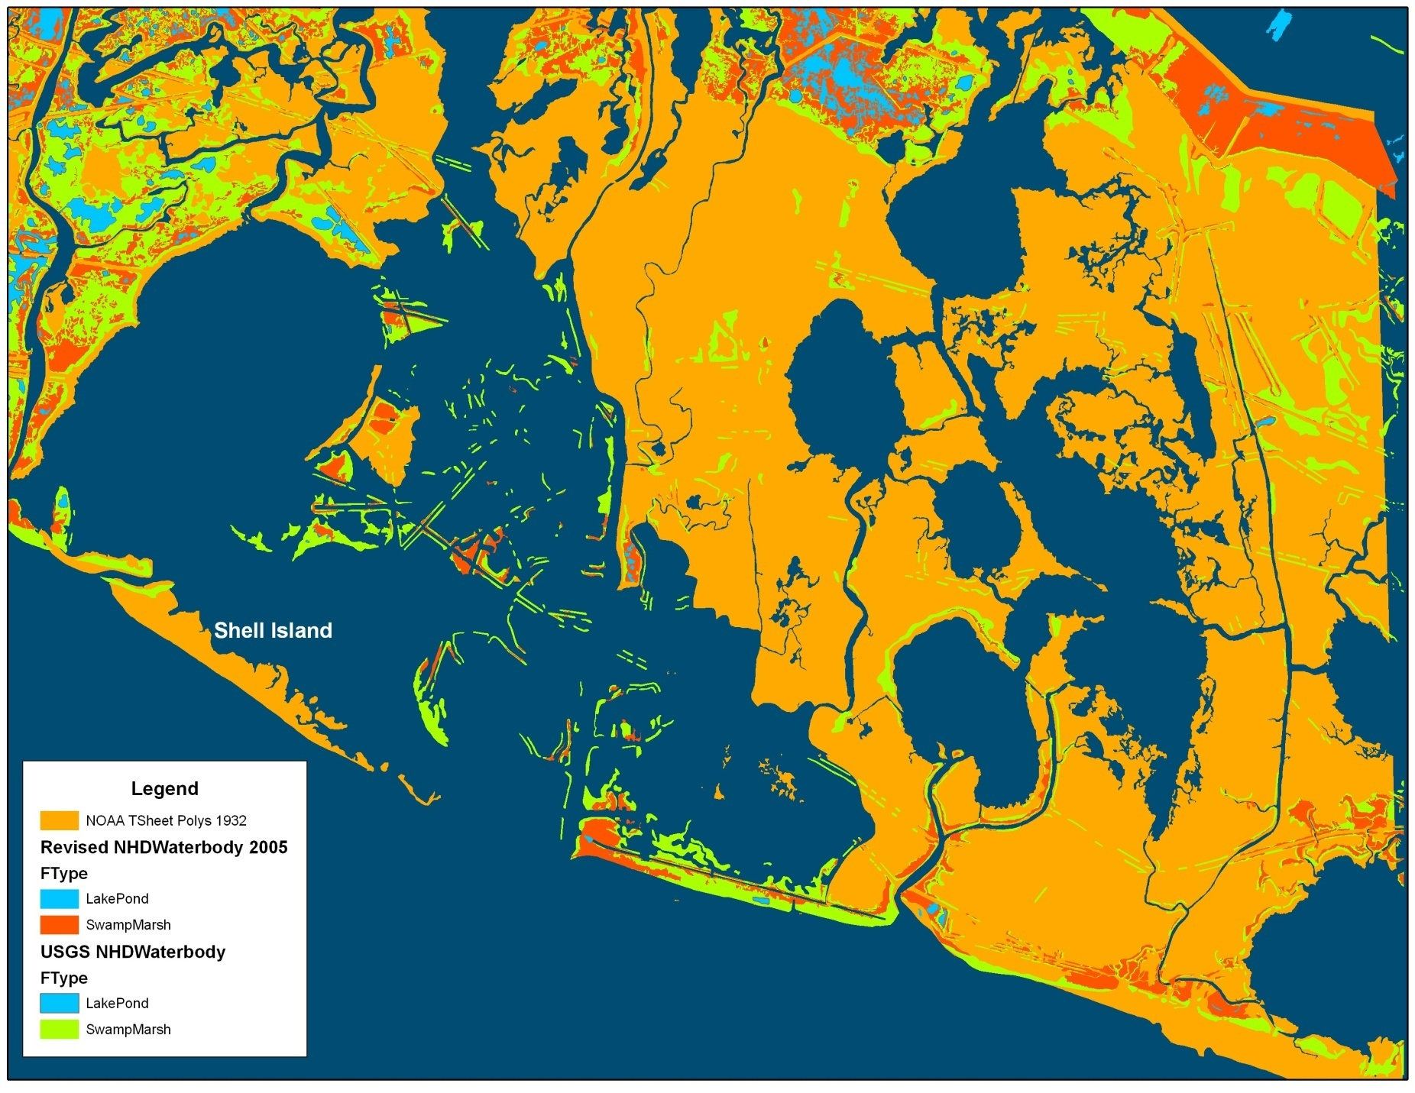
Where Has All The Coastline Gone?
Red features are from the NHD. Orange polygons are areas represented by NOAA
as land in 1940 (most current data). These areas are now open water in the NHD.

Slide 8
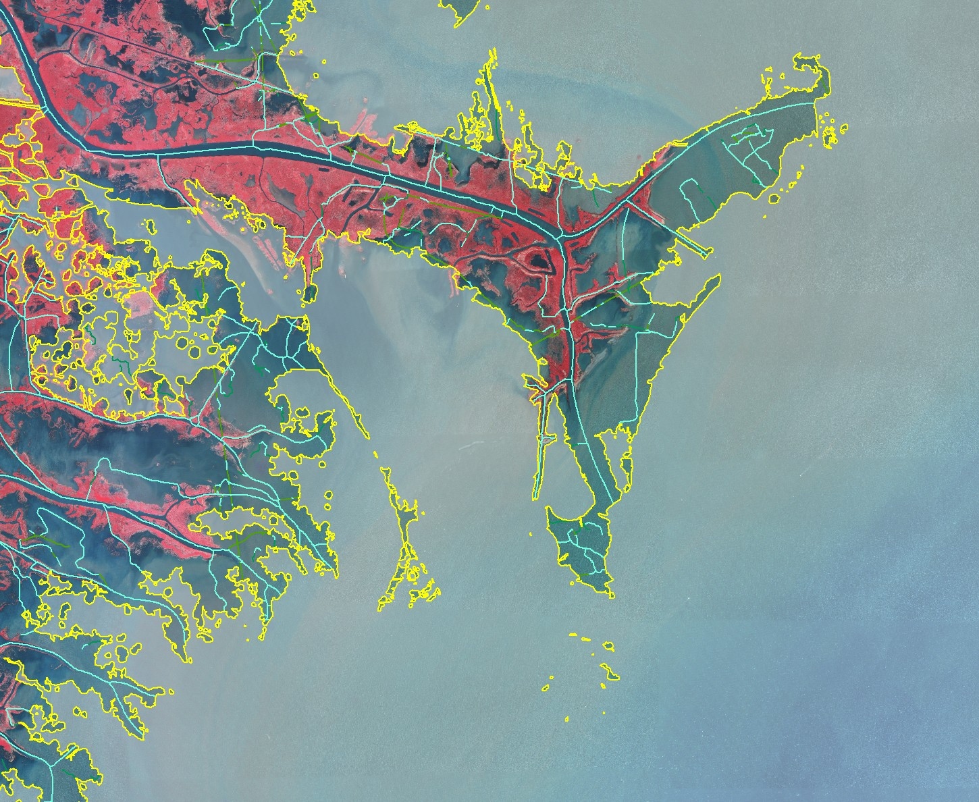
NHD Land-Water Interface
Pass a Loutre WMA
Redfish
Bay
Southeast Pass
Yellow line is the NHD shoreline. Adjacent dark areas are open water in the background

Slide 9
08070204
Lake Maurepas Pilot Project
Out of date data sources (USGS Quad Maps) require extensive revisions
Manual revision with NHD GeoEdit
  Photorevision
  Manual deletion of all features and accompanying NHDStatus records
  Manual allocation of ReachCodes
  Manual tabulation of NHDCrossReference
  Appropriate Add/ModifyGeometry NHDStatus records

Slide 10
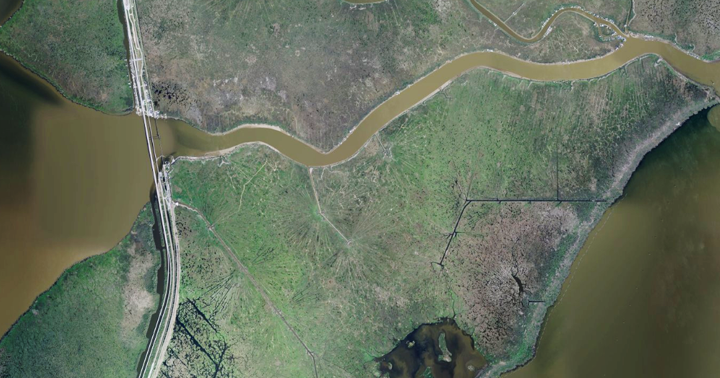
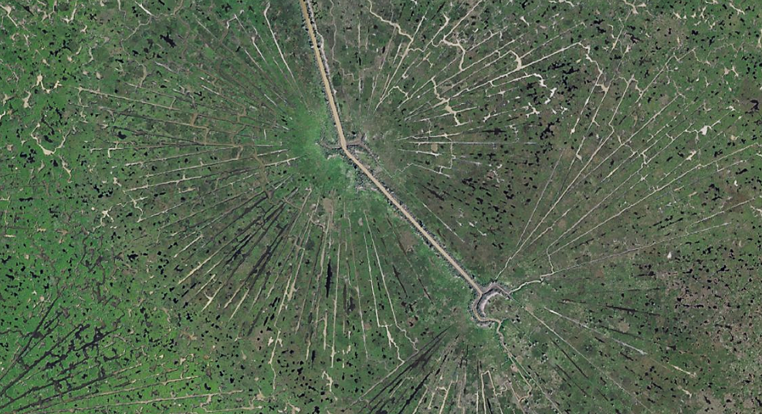
Lake Maurepas Learning Curve
First experience with “Coastal Louisiana”– Pass Manchac

Slide 11
Photorevision Overestimates Land
Redfish
Bay

Slide 12
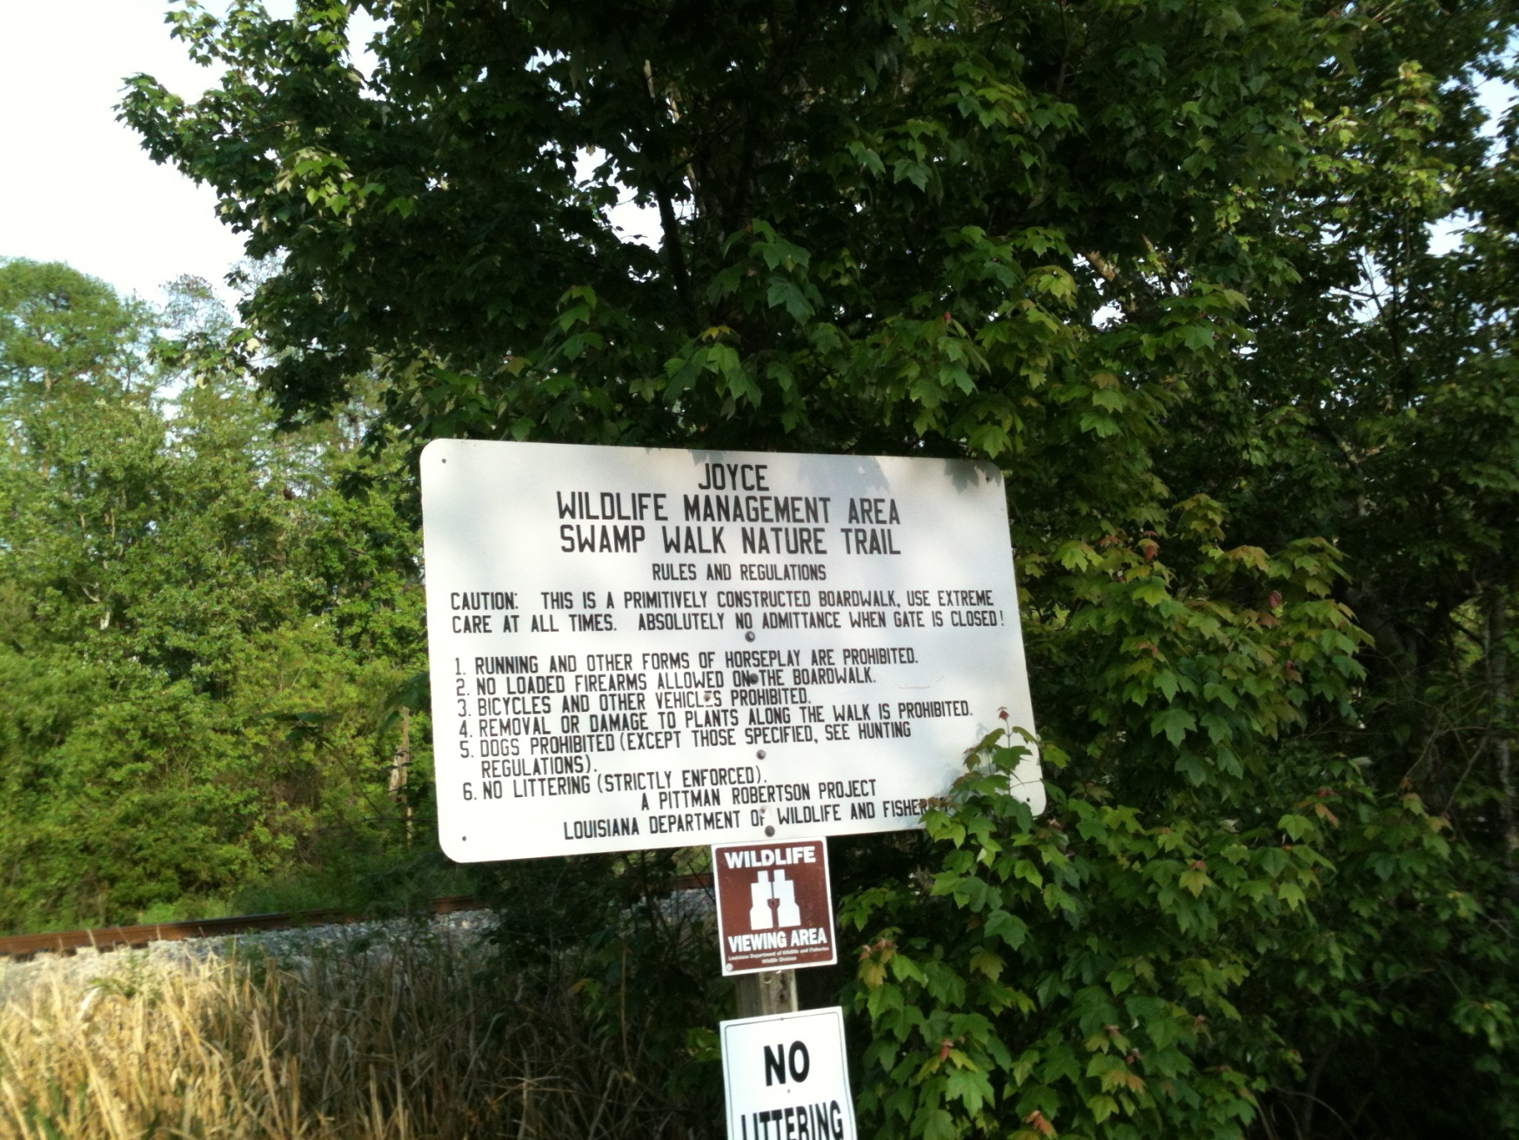
Joyce Wildlife Management Area
Swamp Walk Nature Trail
Redfish
Bay

Slide 13
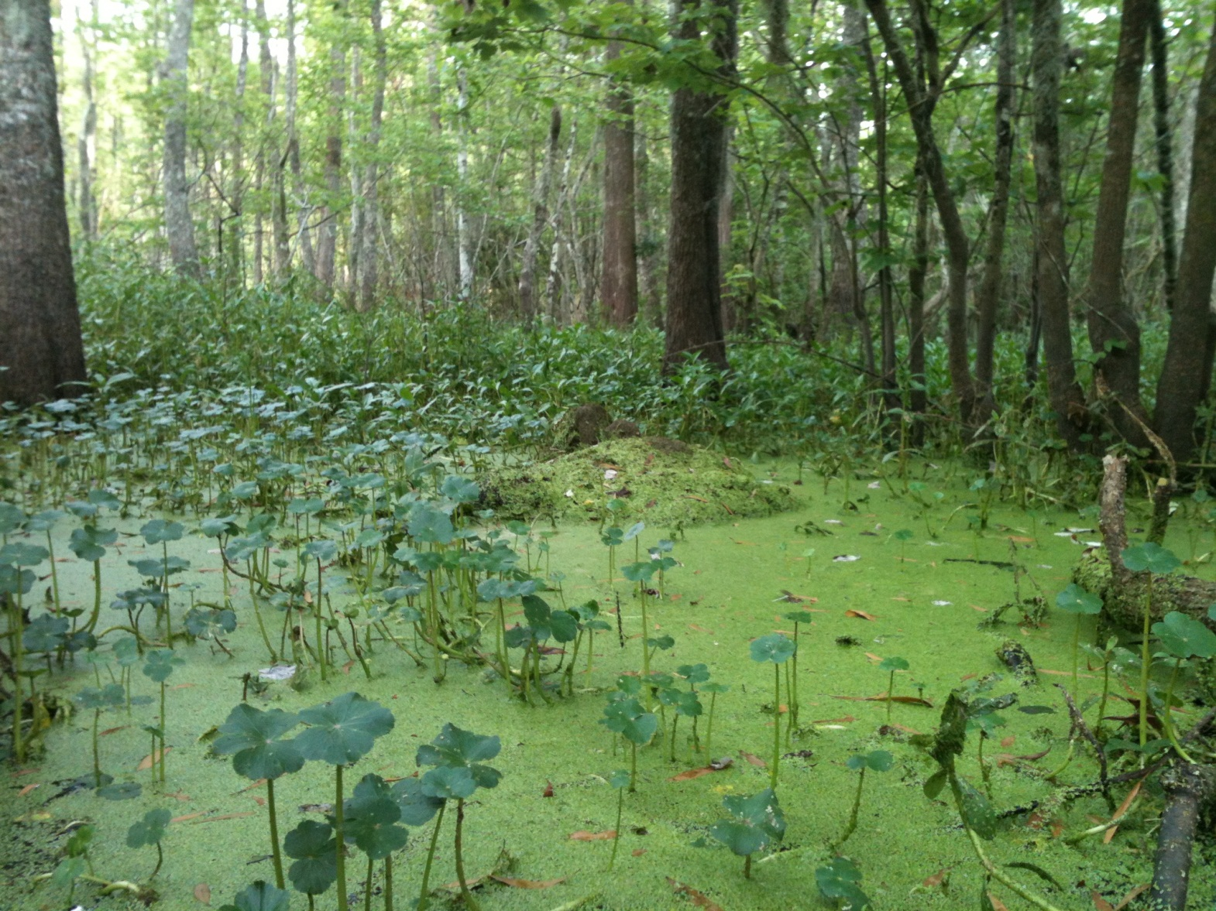
Duck Weed Choked “Open” Area Along the Boardwalk
Redfish
Bay
The forest floor is inundated, under a constant level of water. This is a contiguous waterbody, blow the forest canopy.

Slide 14
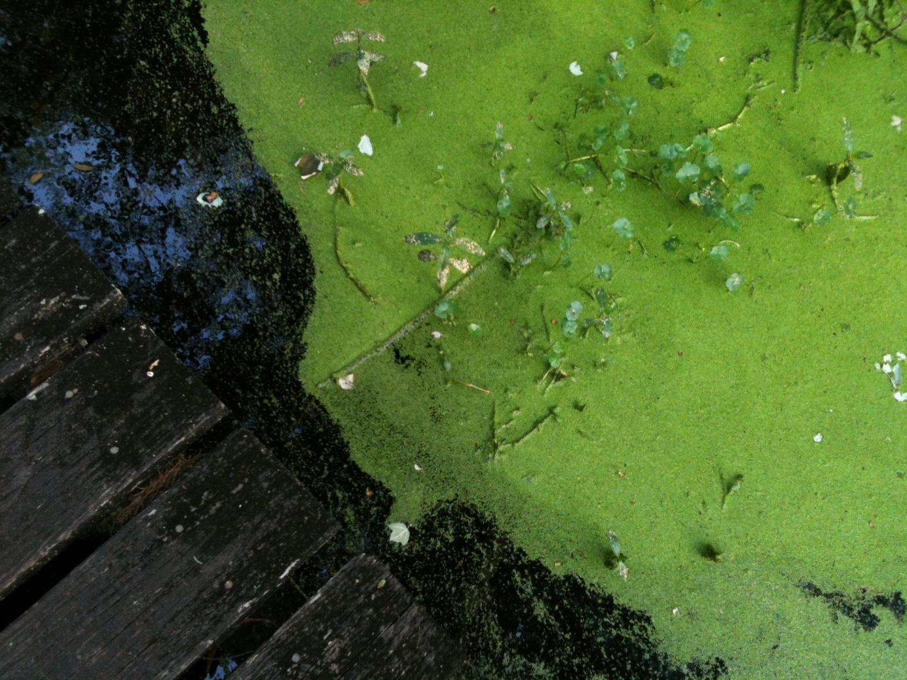
The Swamp is Alive with Plants and Animals All Living in the Water
Redfish
Bay
At the time of this photo, in late March, water is slowly flowing from north to south.

Slide 15
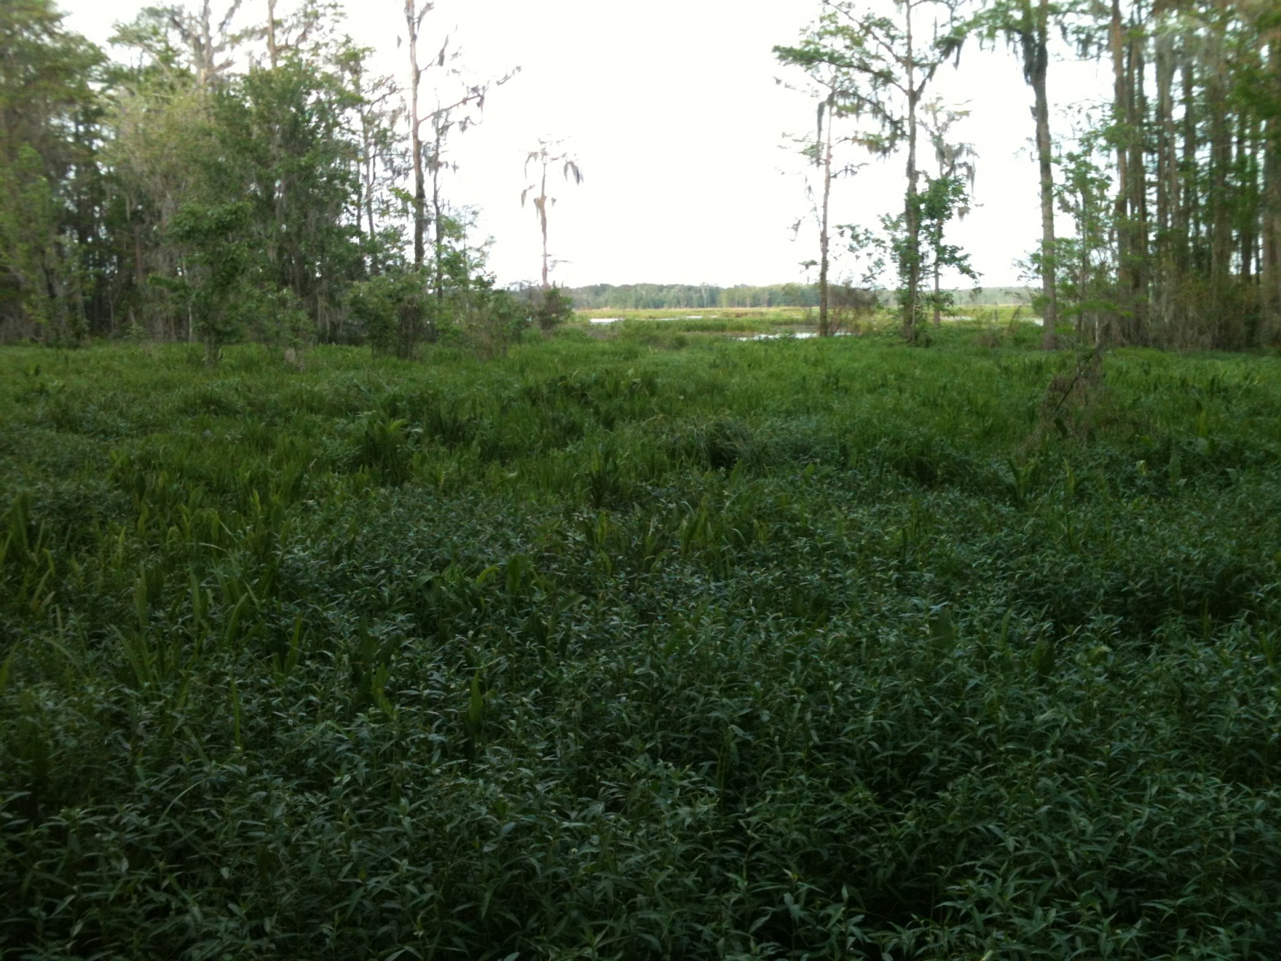
At the End of the Boardwalk
Looking East-northeast
Redfish
Bay
The early spring vegetation is very overgrown and the underlying water is not apparent. This location is almost 12 miles from the shore of Lake Pontchartrain.

Slide 16
Photorevision Overestimates Land
Redfish
Bay

Slide 17
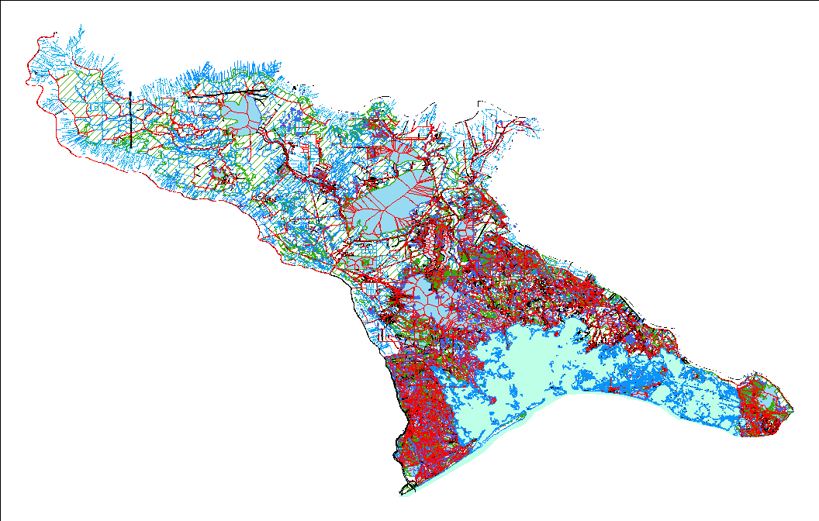
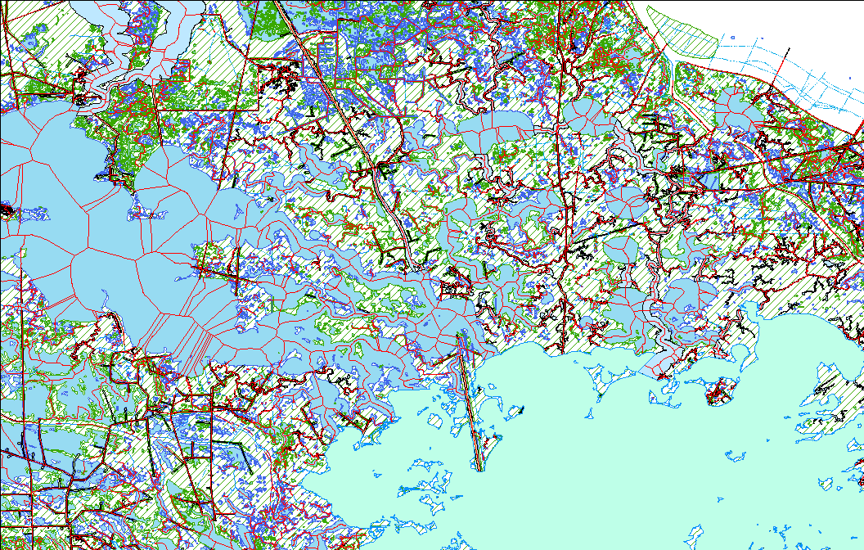
08090301
East Central Louisiana Coastal

Slide 18
08090301 Revision Timeline
Initial Photorevision process begun in summer 2008 with 2005 post-Katrina imagery
January 2009 - Production halted due to lack of resources
Fall 2009 – Began reassessment of the practicality of revising 08090301
February and June, 2010 - NHDGeoEdit Tool Workshops conducted by USGS NHD Staff
March 2011 Revision completed and submitted

Slide 19
Challenges Encountered on 08090301
Time
  Revisions are extensive and time-consuming
    The amount (number and aerial extent) of updates
    The saltatory nature and erratic rate of feature change
    The dataset size (number of FlowLine elements) and topological complexity (ArtificialPaths)
    The NHDGeoEdit Tool is designed for single, isolated revisions, not wholesale feature replacement
Cost
  Frequent, protracted revisions will greatly increase maintenance cost

Slide 20
Solution - Step 1
Analyze Basin Flow Regime
Assess basin for flow network complexity
Classification into three flow regimes:
  1. Upper basin - downstream freshwater dominated flow
  2. Mid basin - freshwater/saltwater tidal mixing regime
  3. Lower basin - saltwater tidal dominated tidal regime
Develop strategy to simplify the flow network

Slide 21
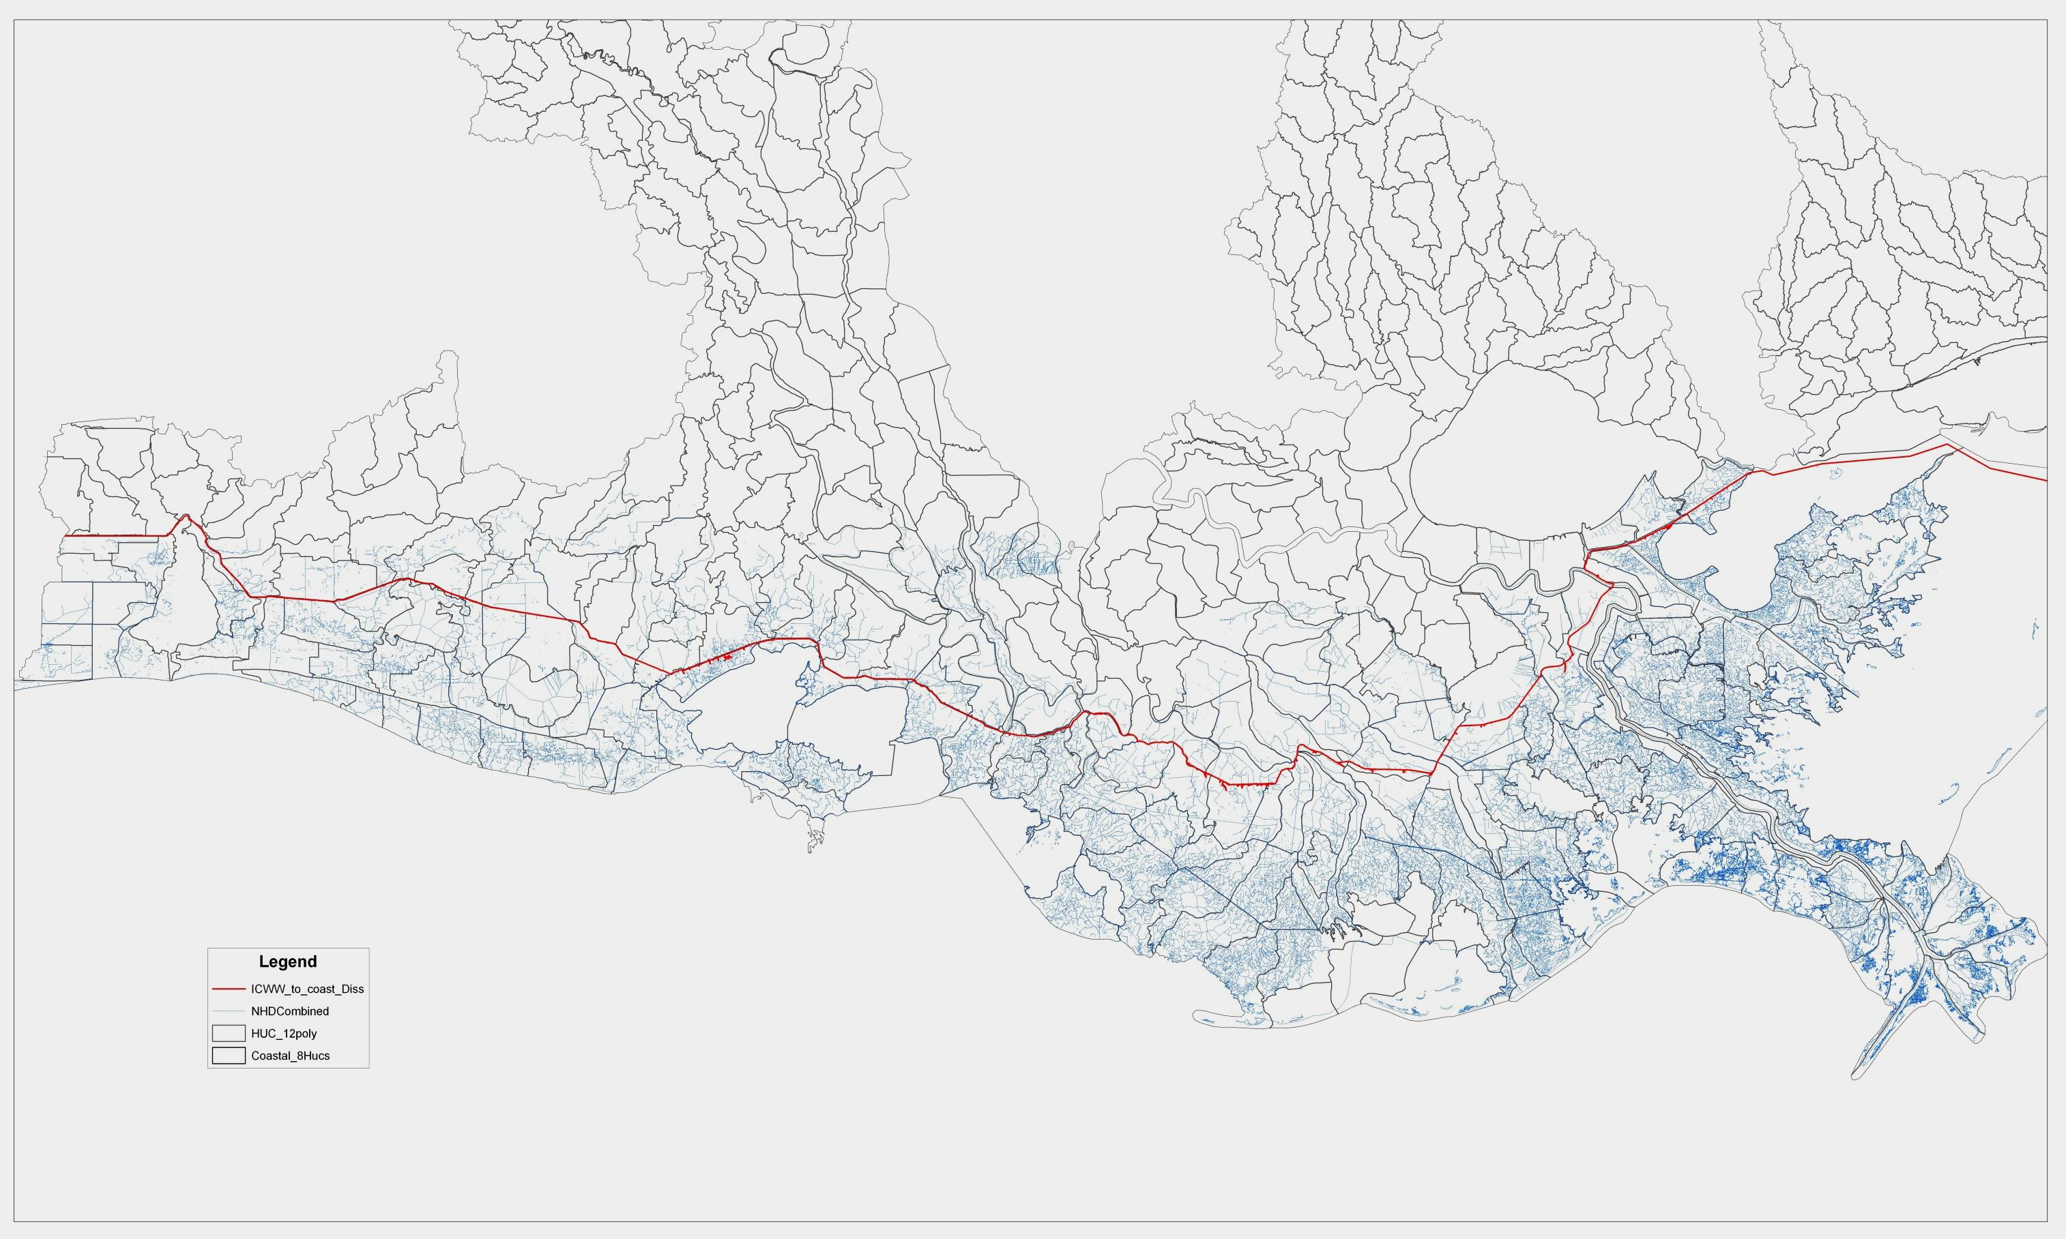
Upper “Non-Coastal” Basin Delineation
The Intercoastal Waterway creates both a HUC 12 and physical flow barrier

Slide 22
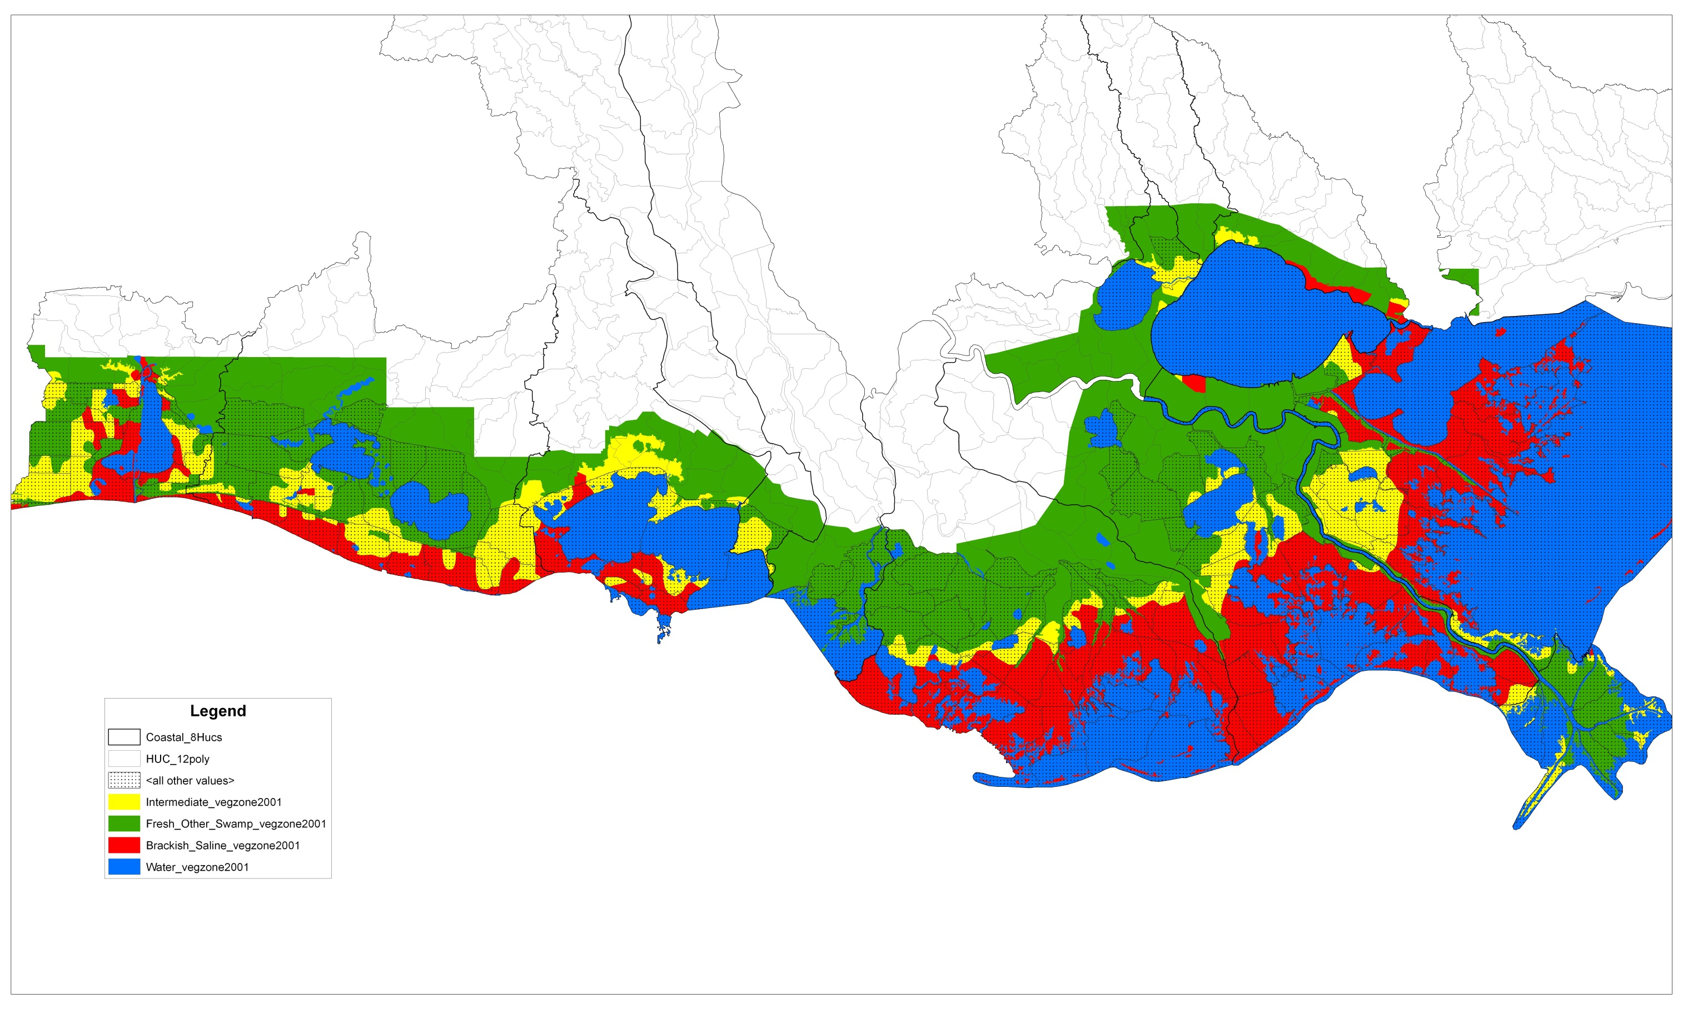
Mid and Lower Basin Delineation
The Chabreck–Linscombe vegetation classes identify saltwater habitats
Green – Fresh Marsh, Non-Marsh, & Swamp
Yellow – Intermediate Marsh
Red – Saline Marsh

Slide 23
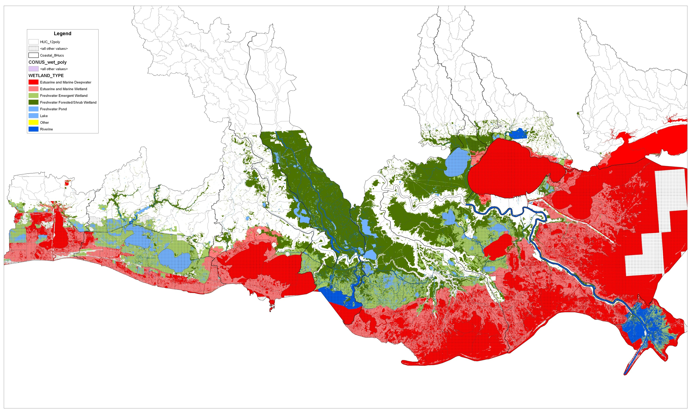
National Wetlands Inventory Classification

Slide 24
“Non-Coastal” and “Coastal“ Flow Regimes

Slide 25
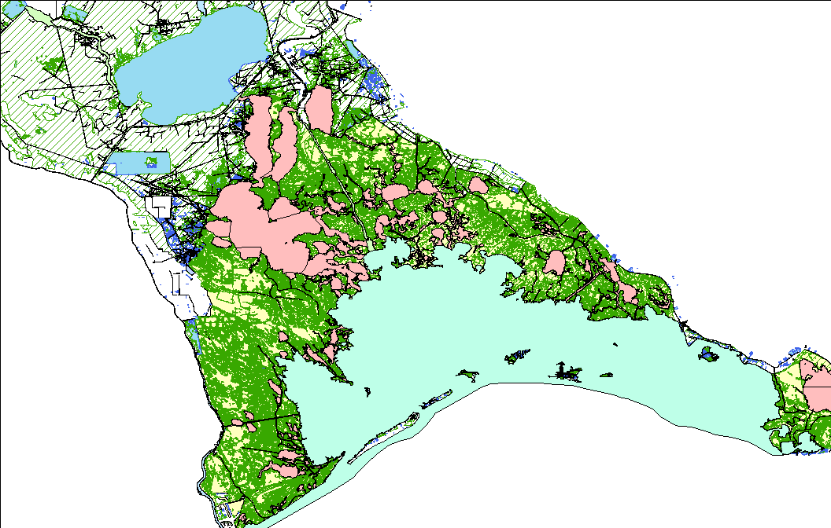
Revision Solution - Step 2
“Prune” and Simplify Flow Paths
Modify “Estuary” features and adjust Artificial Paths
  Identify and Delineate Bays and other named features within Estuary
  Remove (dissolve) Swamp/Marsh from Estuary
    Create a separate Swam/Marsh feature (use as “Water Cover)
    Reclassify Swamp/Marsh as Estuary (water)
  Keep only Artificial Paths to support:
    Names – GNIS or other local features
    Other target events – Water quality stations, oyster leases, etc.
    HUC12 connectivity – support Watershed Boundary Database topology

Slide 26
08090301 East Central Louisiana Coastal
Pre-Revision

Slide 27
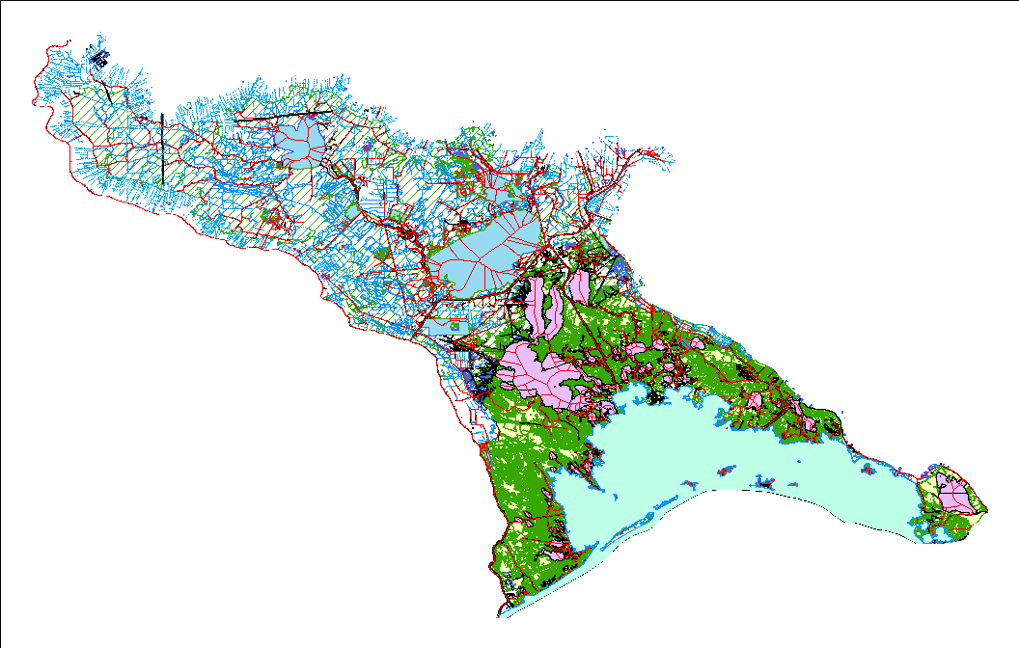
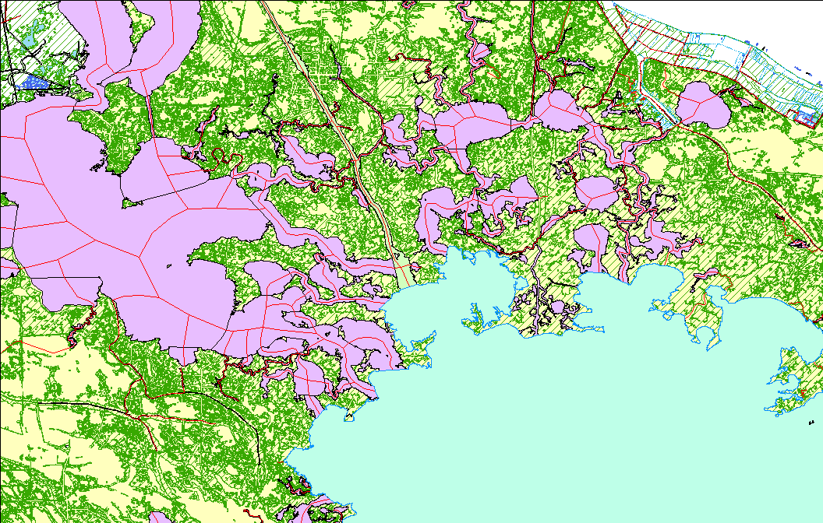
08090301 Post-Revision

Slide 28
Revision Solution - Step 3
Conflation for Wholesale Revisions
NHD GeoConflation Toolset
  Provides for revisions using large-area datasets
  Automates NHDStatus, NHDReachCrossReference, etc., automatically generated

Slide 29
08090301 Comparing Results
Old method:
  60,000+ features revised
  8 months+ to update and revise
  Manual table generation
New Method
  31,000+ features revised
  ~5 months to update and revise
  Automated table generation

Slide 30
08090301 Lessons Learned
Remaining Concerns
  XML Extract size
  Computer Limitations – Editor and USGS
  Robustness of New Protocol
    Will this work for other basins?

Slide 31
Benefits of the New Protocol
Reduction in time and cost for initial NHD revision
Provides a method for assessment/revision following catastrophic natural events at the HUC12 level
Streamlines regular HUC8 maintenance as well as, post-event (floods, storms) updates

Slide 32
Louisiana NHD Update Status July 2012

