Slide 1

Providing Geography for Topology;
A Schematic View of the National Watershed Boundary Dataset (WBD)
James E. Mitchell, Ph.D.
IT GIS Manager
Kurt L. Johnson
IT GIS Technical Specialist
2012 ESRI International User’s Conference
San Diego, California – July, 2012 (Revised January, 2013)
Notes:
Presentation by James E. Mitchell, Ph. D. at the 2012 State of The Coast Conference, sponsored by the Coalition for Coastal Louisiana, New Orleans, LA, June 25, 2012.

Slide 2
The Watershed Boundary Database
A national database defining hydrologic boundaries
  Based on the USGS Hydrologic Unit Codes
Hierarchical organization that aggregates basins into
  Regions – “HUC 2”
  Subregions – “HUC 4”
  Basins – “HUC 6”
  Subbasins – “HUC 8”
  Watersheds – “HUC 10”
  Subwatersheds – “HUC 12”
An areal depiction of the organization of watersheds and the flow of water across the landscape

Slide 3
Lake Pontchartrain Basin
from the WBD Database
“Out of the box,” it is easy to see basin delineations. However, flow direction is less evident. As complexity increases and topography decreases relationships are unclear.

Slide 4
Lake Pontchartrain Basin
Symbolized by HUC 10 Basins
Drainage patterns are more evident, using symbology. However detail is still lacking and relationships in complex areas are not clearly revealed.

Slide 5
Lake Pontchartrain Basin
Showing WBD Downstream Topology
A schematic visualization of the Lake Pontchartrain Basin drainage pattern. This clearly depicts the drainage network in geographic space.

Slide 6
Creating a Schematic Diagram to Using Schematics to Represent the Hierarchical Topology of Adjacent WBD Polygons
Use the downstream HUC 12 attribute (ToHUC) to define the flow relationship between WBD Basins
Create a centroid point to represent each WBD basin polygon (Feature to Point Tool, in ArcToolBox)
  Force the centroid to lie within the polygon
Create a schematic diagram
  Use the basin centroids to define the schematic nodes
  Use the ToHUC field to develop the link to the next downstream node
Examine diagram for topology errors and “loose ends”

Slide 7
Step 1 – Create Basin Centroids
Centroids placed within each HUC 12 basin polygon contain the attribute information form their originating polygon. This is used to create links between up and down stream.

Slide 8
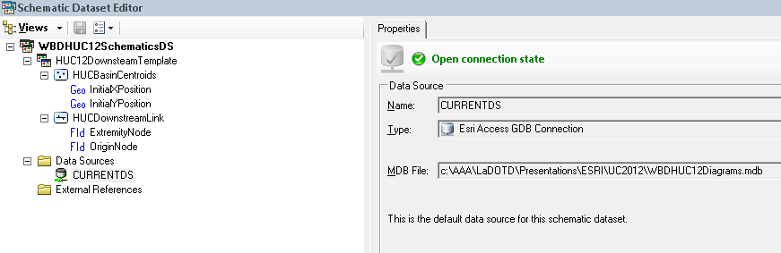
Step 2 – Identify a Schematic Dataset
In a geodatabase, create a new Schematic Dataset
or use an existing Diagram Template
The Diagram Template defines the style and elements in the diagram
The first element of this template is a schematic node feature that captures the X,Y position of each centroid point from its Shape field
The second element of this template is a schematic link (line) feature that uses a query to select a starting point (centroid) and end point (downstream centroid from ToHUC) and transfers the X,Y position of each to the link origin and extremity nodes

Slide 9
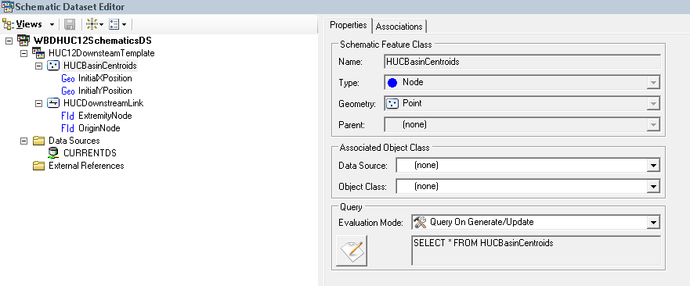
Step 3 – Schematic Node Featureclass Created from Basin Centroids
Properties of the schematic nodes
The new features will be a “Node” type schematic feature
The geometry of the schematic features will be “Point” type

Slide 10
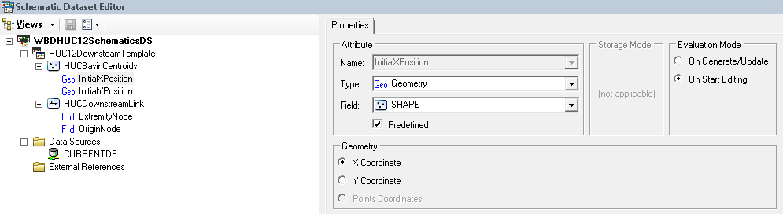
Step 4 – Transfer X,Y to Schematic Nodes from Basin Centroids
Create attributes for the schematic nodes – “InitialXPosition” and “InitialYPosition”
The new “InitialXPosition” attribute is named and set to a Type of “Geo Geometry”
The Field dropdown is set to “Shape” and “X Coordinate” is selected for Geometry
The same process is used to create the “InitialYPosition” attribute

Slide 11
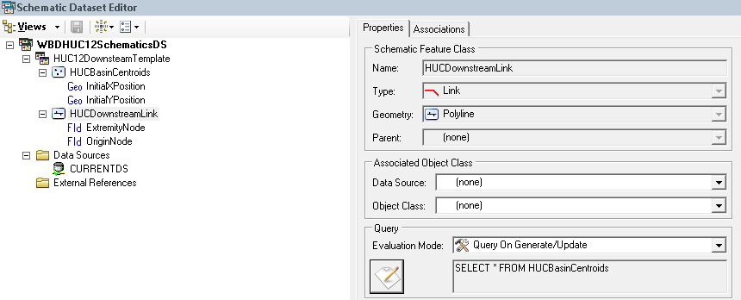
Step 5 – Schematic Link Featureclass Created from Basin Centroids
Properties of the schematic links
The new features will be a “Link” type schematic feature
The geometry of the schematic features will be “Polyline” type

Slide 12
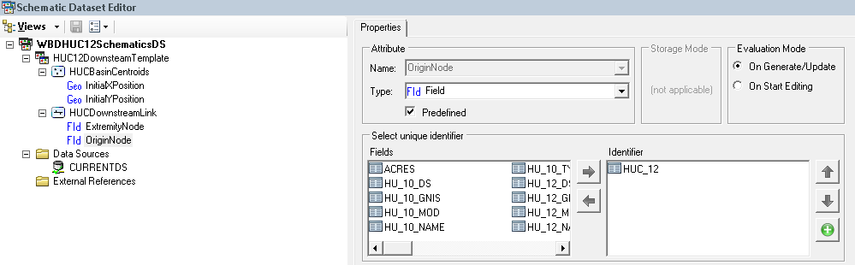
Step 6 – Create Schematic Links by Defining Origin and Extremity Nodes
Create attributes for the schematic links – “OriginNode” and “ExtremityNode”
The new “OriginNode” attribute is named and set to a Type of “Field”
The Field is used to define a query to erect the centroid node at the beginning of the link (HUC12)
The same process is used to create the “ExtremityNode” attribute, specifying the ToHUC field, to select the node (centroid) at the end of the link

Slide 13
Lake Pontchartrain Basin
Initial Schematic Diagram
Terminal nodes have no downstream element with which to link. This can be used as a means to examine, diagnose, and correct topological errors and anomalies.

Slide 14
Lake Pontchartrain Basin
Examining and Correcting Topology
Four topology errors become immediately apparent. One is a basin outside of Lake Pontchartrain. The others relate to missing or incorrect downstream links.

Slide 15
Lake Pontchartrain Basin
After Correcting Topology
After correcting the topology errors, the new diagram is complete and only requires the removal of the arbitrary terminal node.

Slide 16
What Can Be Done with this Schematic Diagram?
WBD QA/QC
Identify flow relationships
  Upstream/downstream (including multiple pourpoints
  Flow accumulation
  Diversions and interbasin transfers
Visualize the flow network in different formats (styles)
Trace flow paths
  Connect pollution sources to water quality impacts

Slide 17
Flow Topology Applications
Connecting Upstream and Downstream
Schematic diagrams can be “traced” and selections propagated into the data frame

Slide 18
Lake Pontchartrain Basin
Geographic and Schematic Diagrams
Maps and diagrams are linked allowing selections to be propagated between them. The schematic depiction of these basins provides a clear view of their topology

Slide 19
Lake Pontchartrain Basin
Hierarchical Smart Tree Diagram
The diagram provides a simplified depiction of the topology of the Lake Pontchartrain Basin. Up and downstream traces can be executed and transferred to the map.

Slide 20
Lake Pontchartrain Basin
Hierarchical Diagram/Orthogonal Corners
Diagrams can be edited and reformatted using varies options. Using this capability, diagrams can be designed to satisfy essential operational and functional requirements.

Slide 21
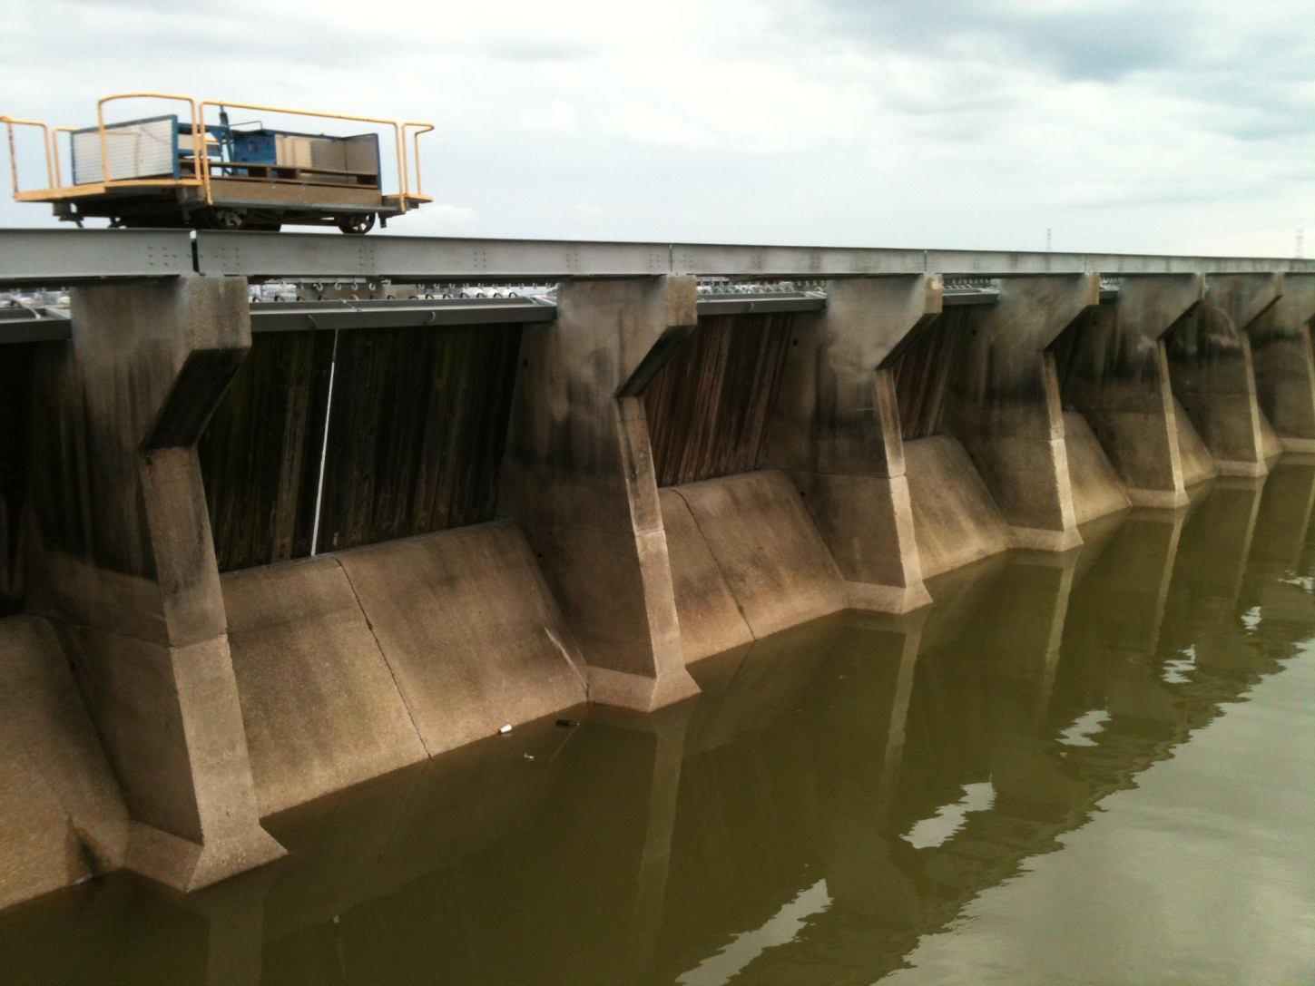
Interbasin Transfer
The Bonnet Carré Spillway
The Bonnet Carré Spillway is opened to relieve pressure on New Orleans’ levees from the Mississippi River and moves water into the Lake Pontchartrain Basin.

Slide 22
Interbasin Transfers in the
Watershed Boundary Dataset
Interbasin transfers or diversions can be accounted for by adding additional points to the centroids data and modifying the WBD attribute table for proper routing.

Slide 23
Conclusions
Schematics provide a powerful tool for visualizing topological relationships
  “Geographic” space
  “Logical” space
Schematics can be used to investigate, reconcile, and ensure topological integrity (QA/QC)
Schematics can be used to extend the capabilities of geospatial data, such as the Watershed Boundary Dataset by:
  Creating a logical network representing the flow through geographic elements
  Augmenting simple topology with complex networks
  Extending the capabilities of the data with tools that can navigate through the network

