Slide 1
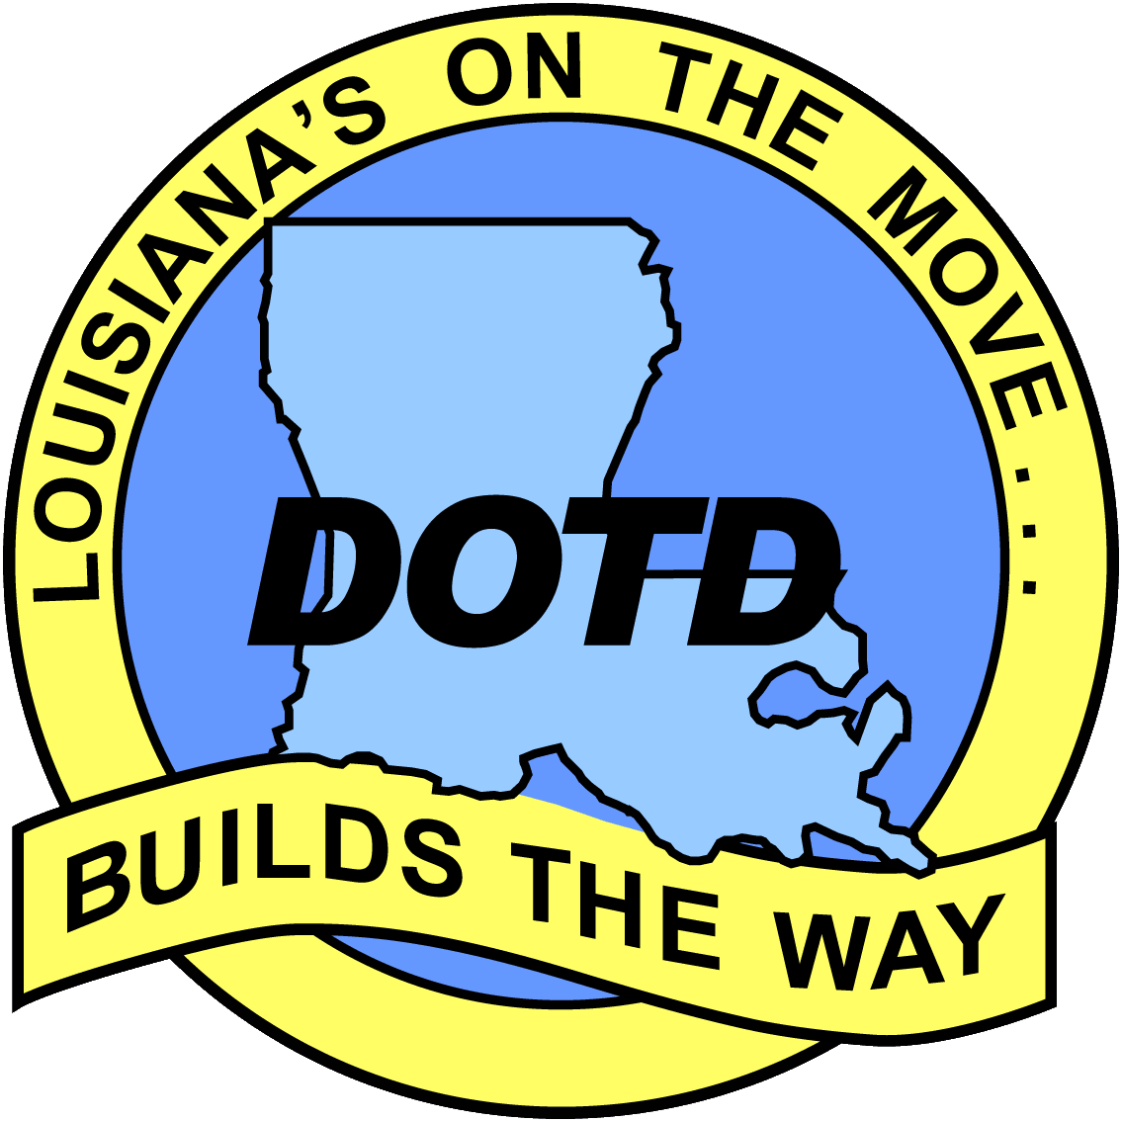

Where Are the Land and the Water?
NOAA and LADOTD
Developing the Common Framework to Support Mapping, Charting, and Geospatial Data Development
James E. Mitchell, Ph.D.
IT GIS Manager
&
Kurt L. Johnson
IT GIS Technical Specialist
Louisiana Department of Transportation and Development
Tim Osborne
National Oceanic and Atmospheric Administration
Office of Coast Survey
for the Eastern Gulf

Slide 2
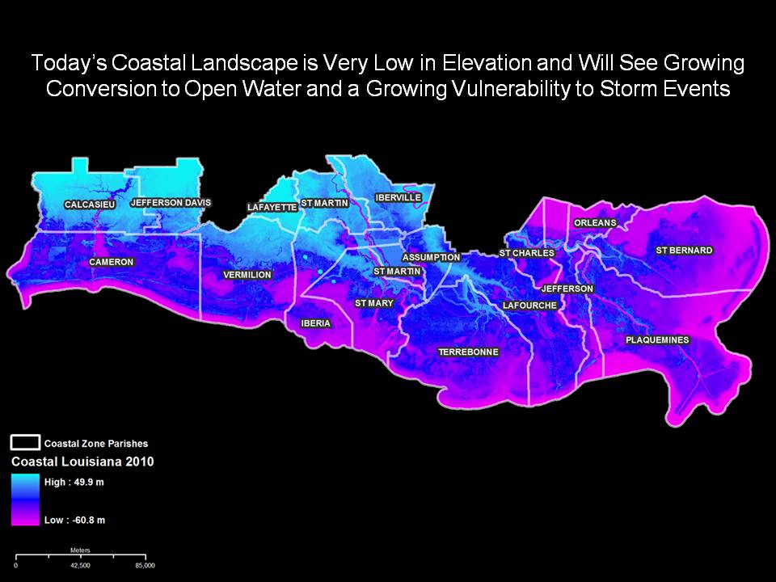

Slide 3
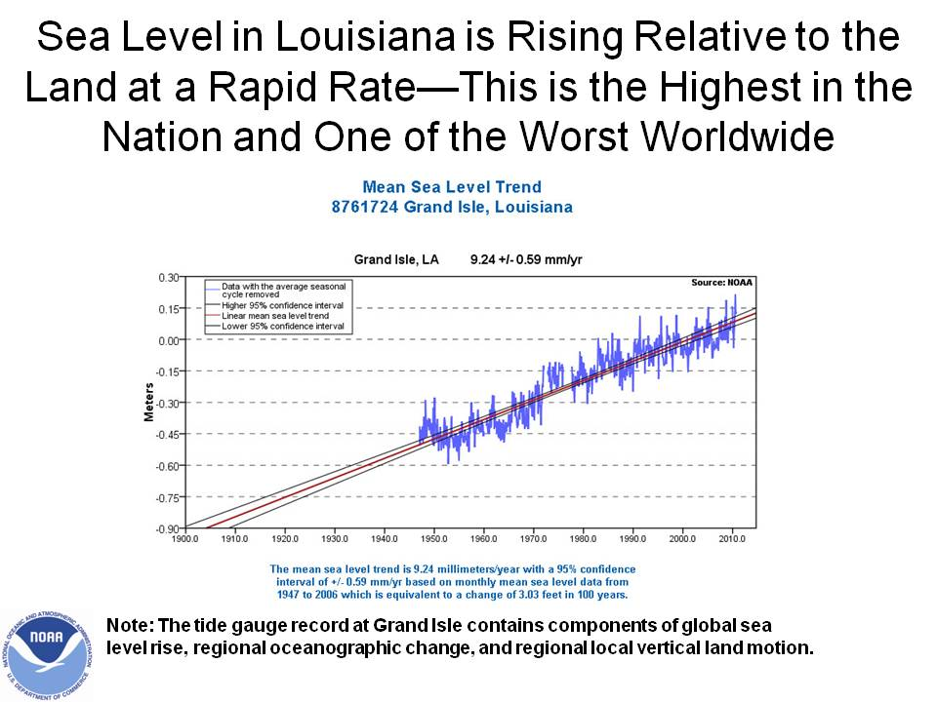

Slide 4
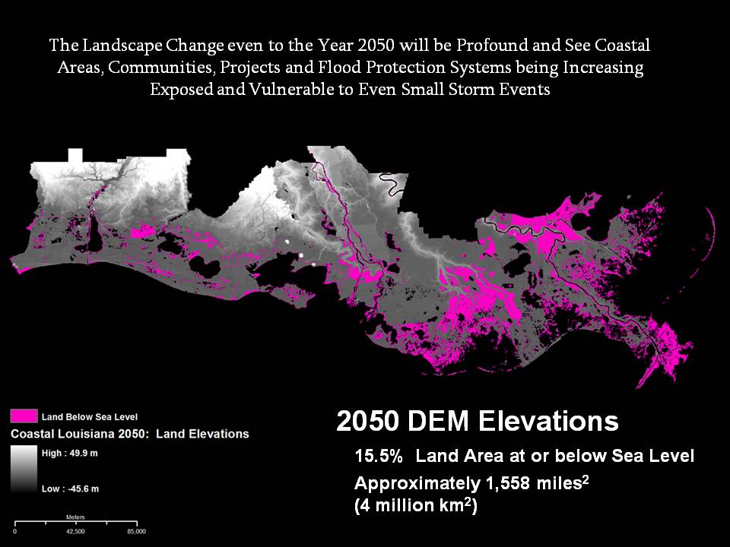

Slide 5
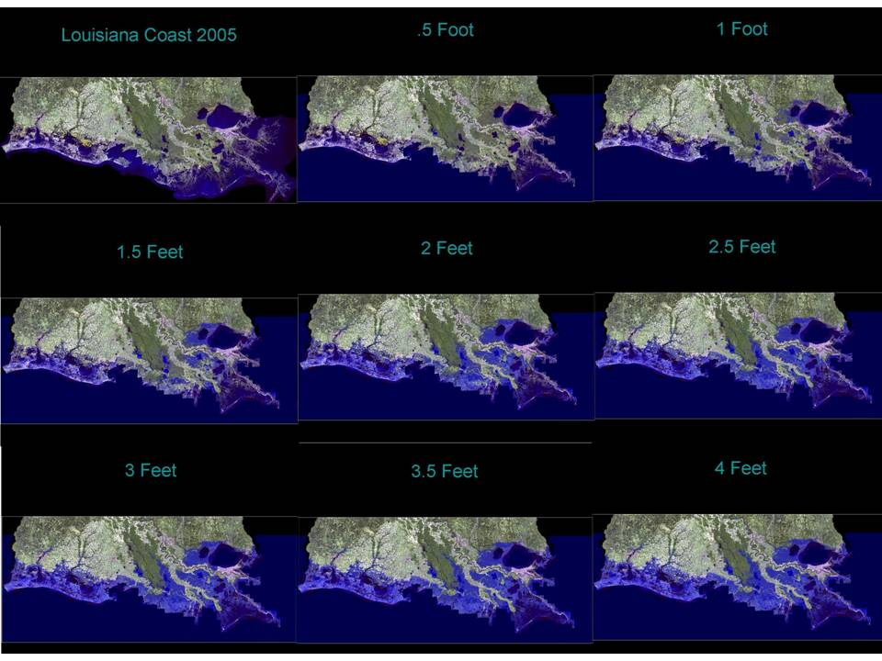

Slide 6
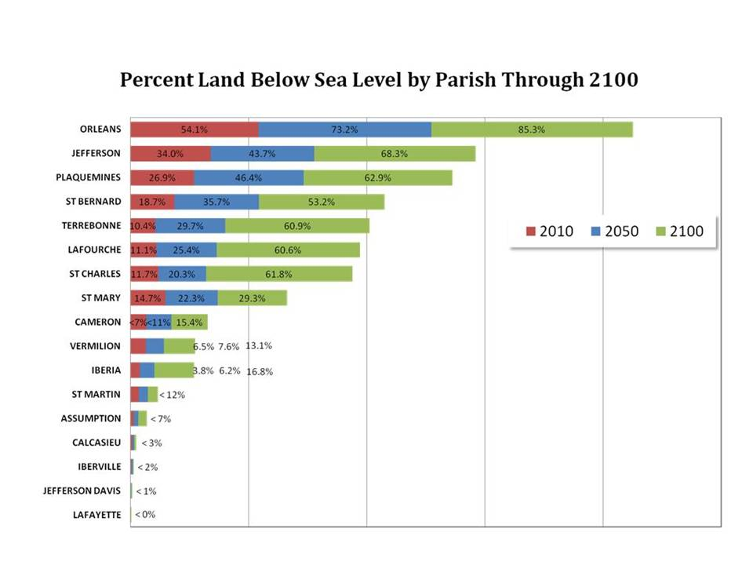

Slide 7
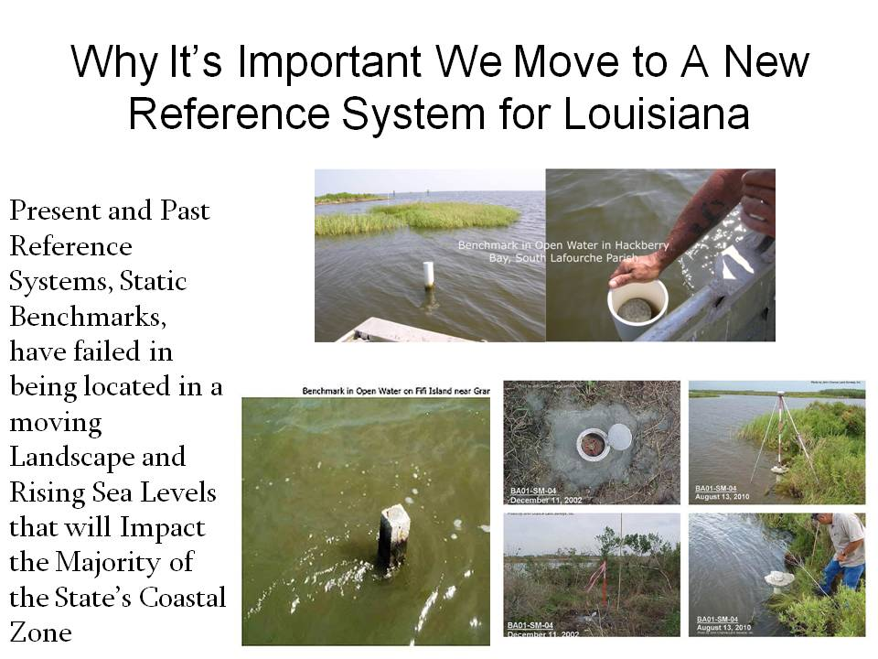

Slide 8
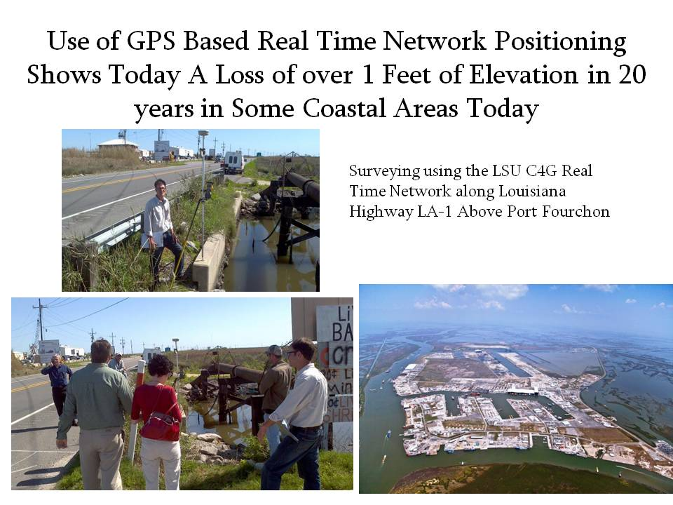

Slide 9
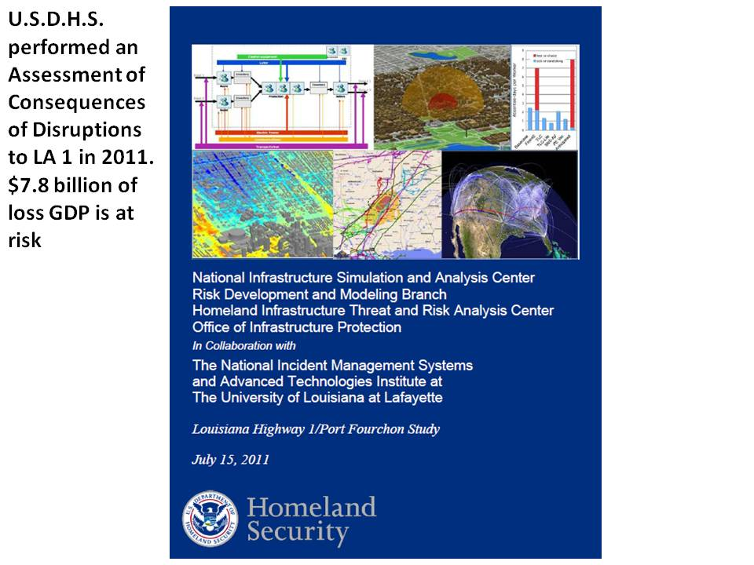

Slide 10
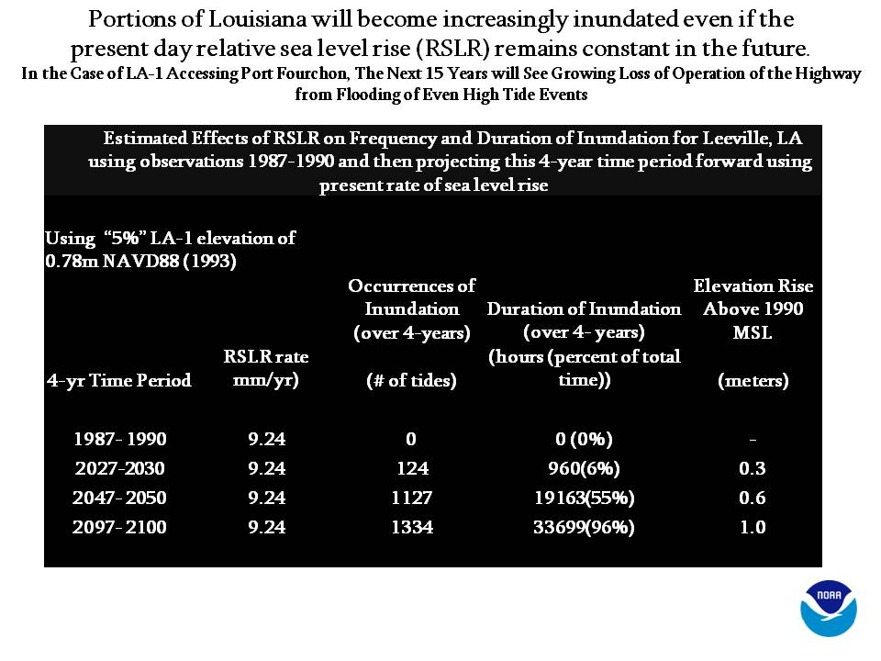

Slide 11
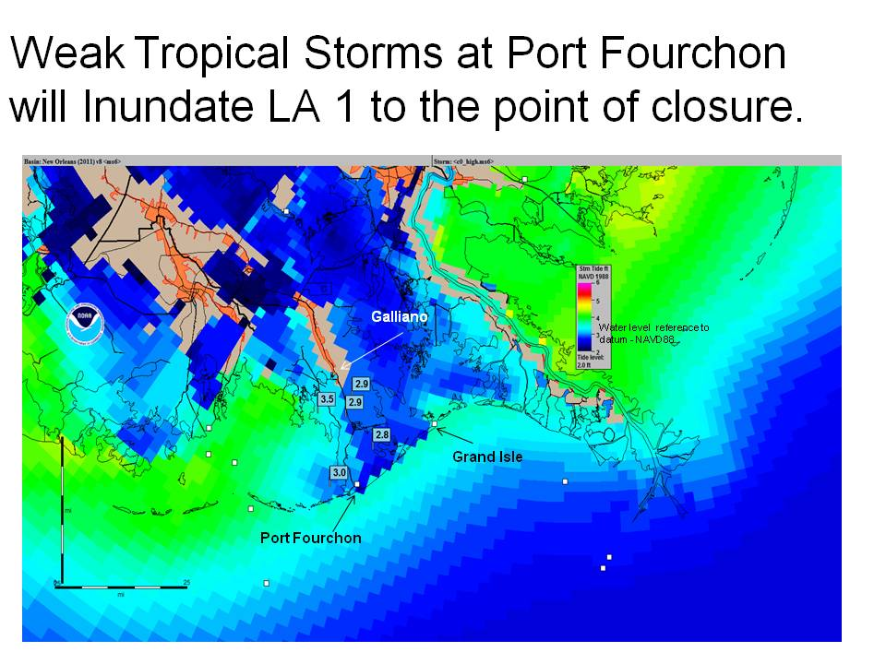

Slide 12
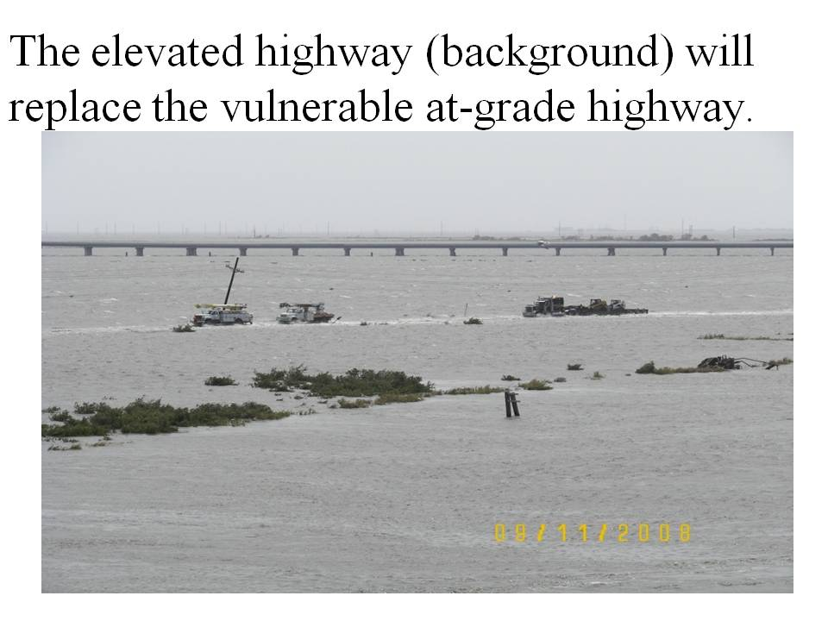

Slide 13
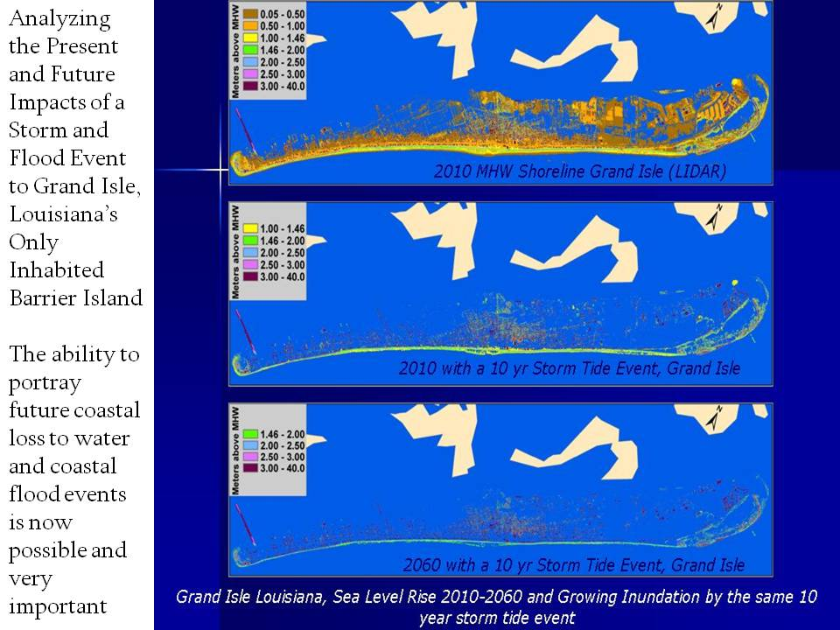

Slide 14
Why the NHD requires updating…
High Resolution NHD was built from “best available” data……old maps and imagery
Eliminate inconsistencies related to the lack of contemporaneous source data from the original USGS maps
Keep pace with the rate and frequency of change in the Louisiana coastal landscape

Slide 16
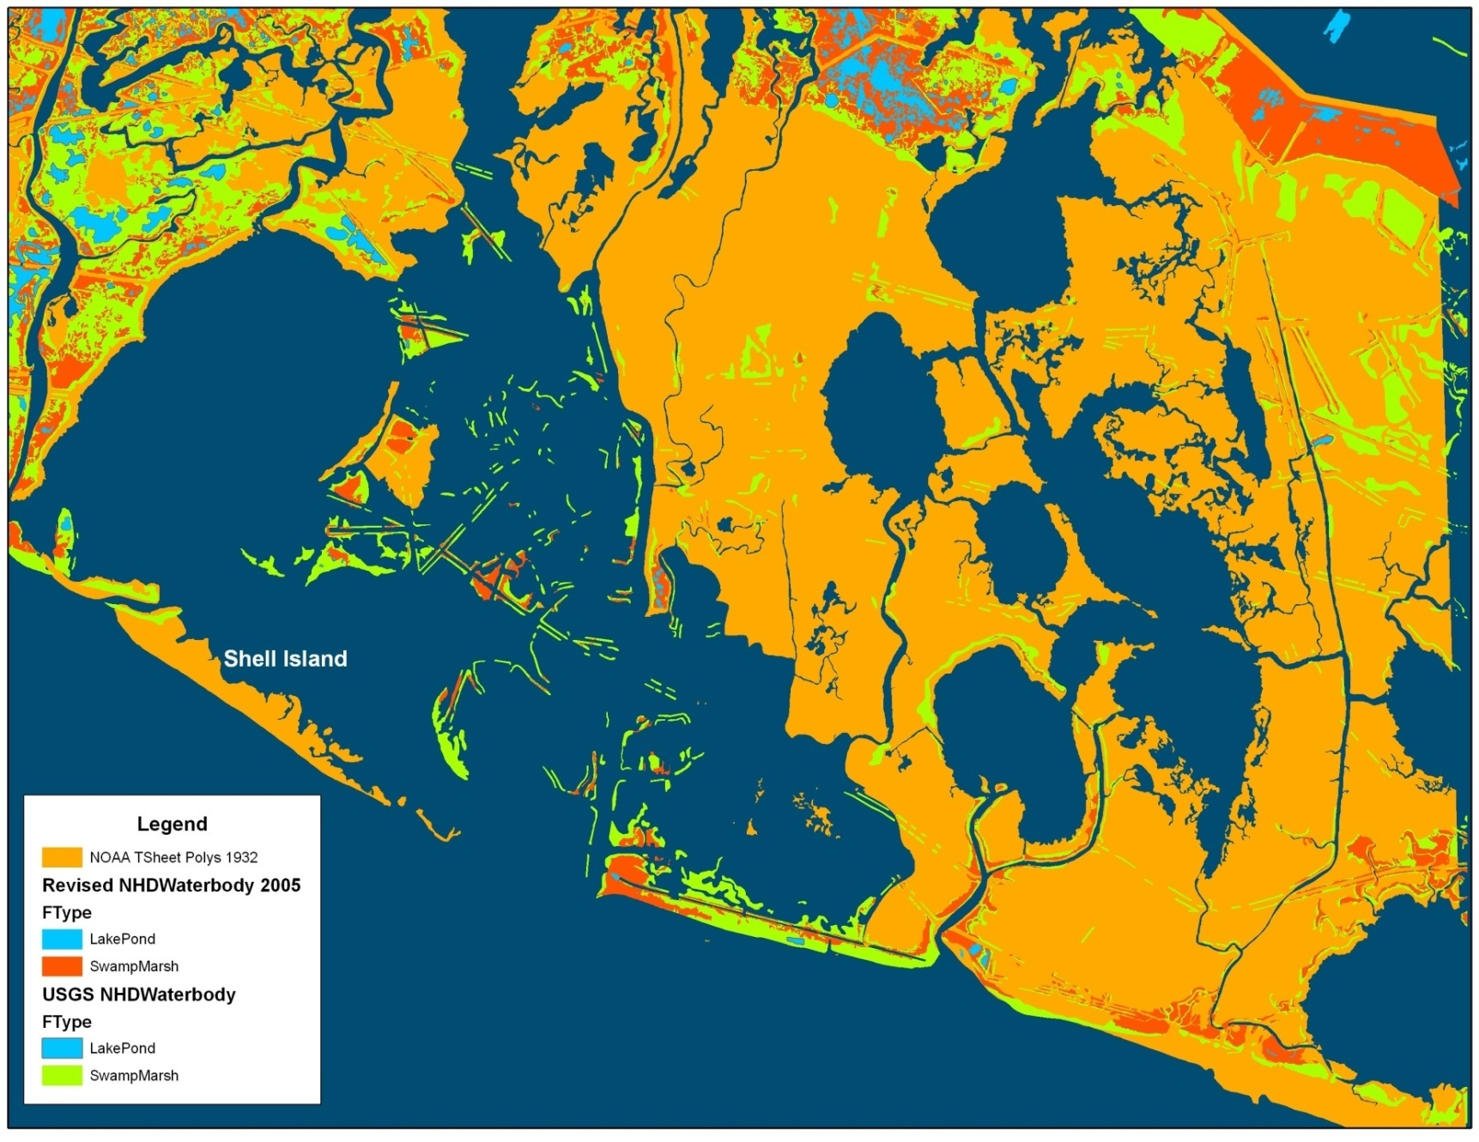
Where has all the coastline gone?
Red features are from the NHD. Orange polygons are areas represented by NOAA
as land in 1940 (most current data). These areas are now open water in the NHD.

Slide 17
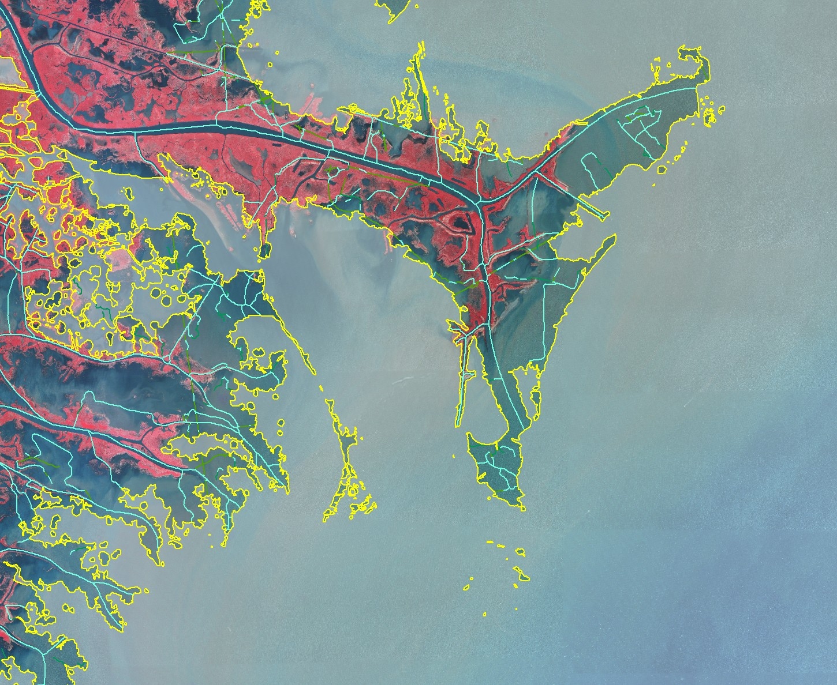
NHD land/water interface
Pass a Loutre WMA
Redfish
Bay
Southeast Pass

Slide 18
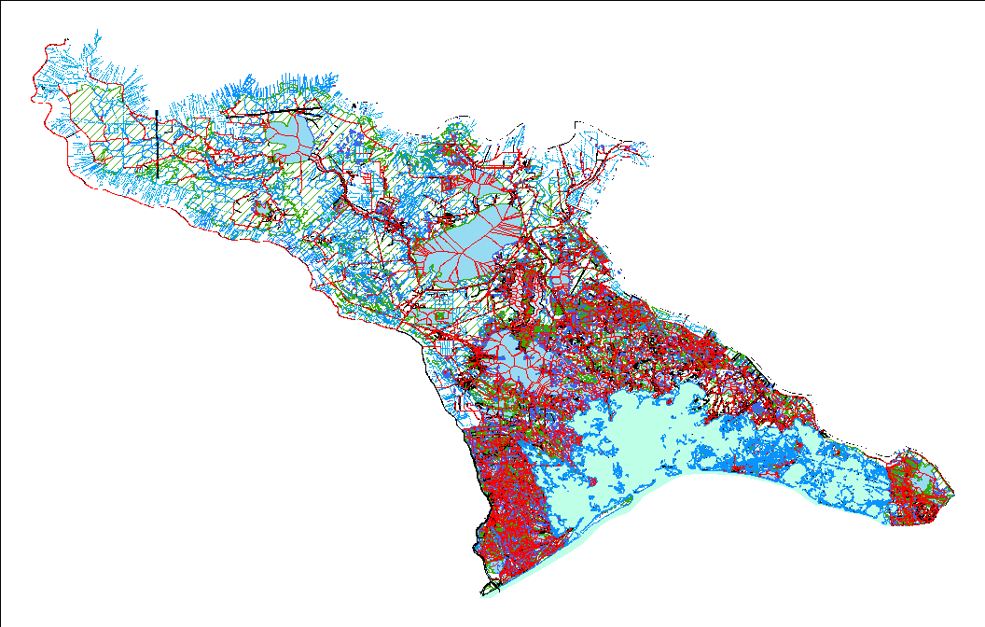
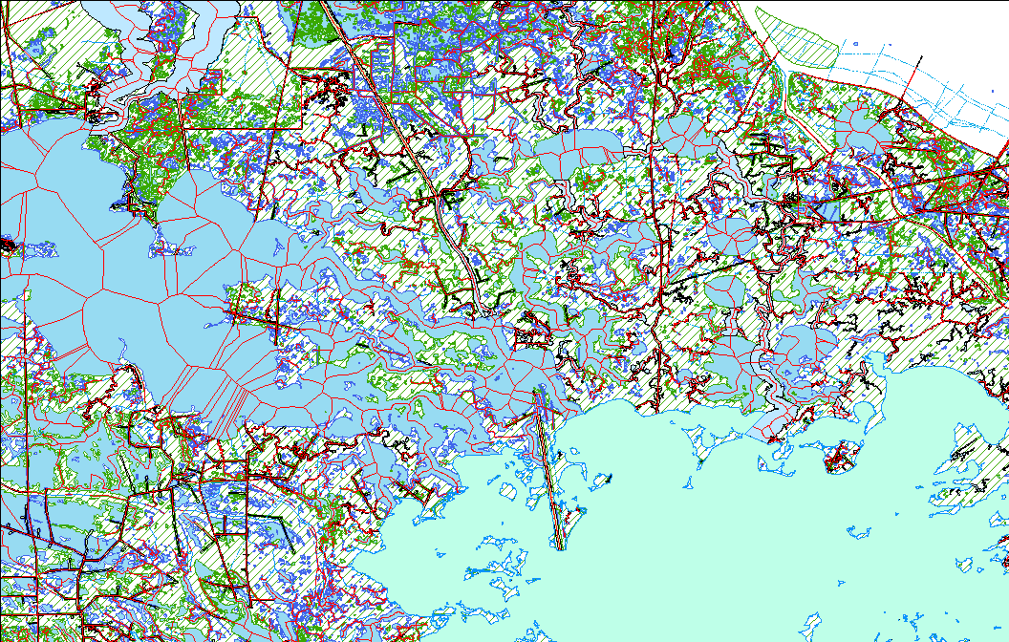
08090301 Pre-Revision
East Central Louisiana Coastal

Slide 19
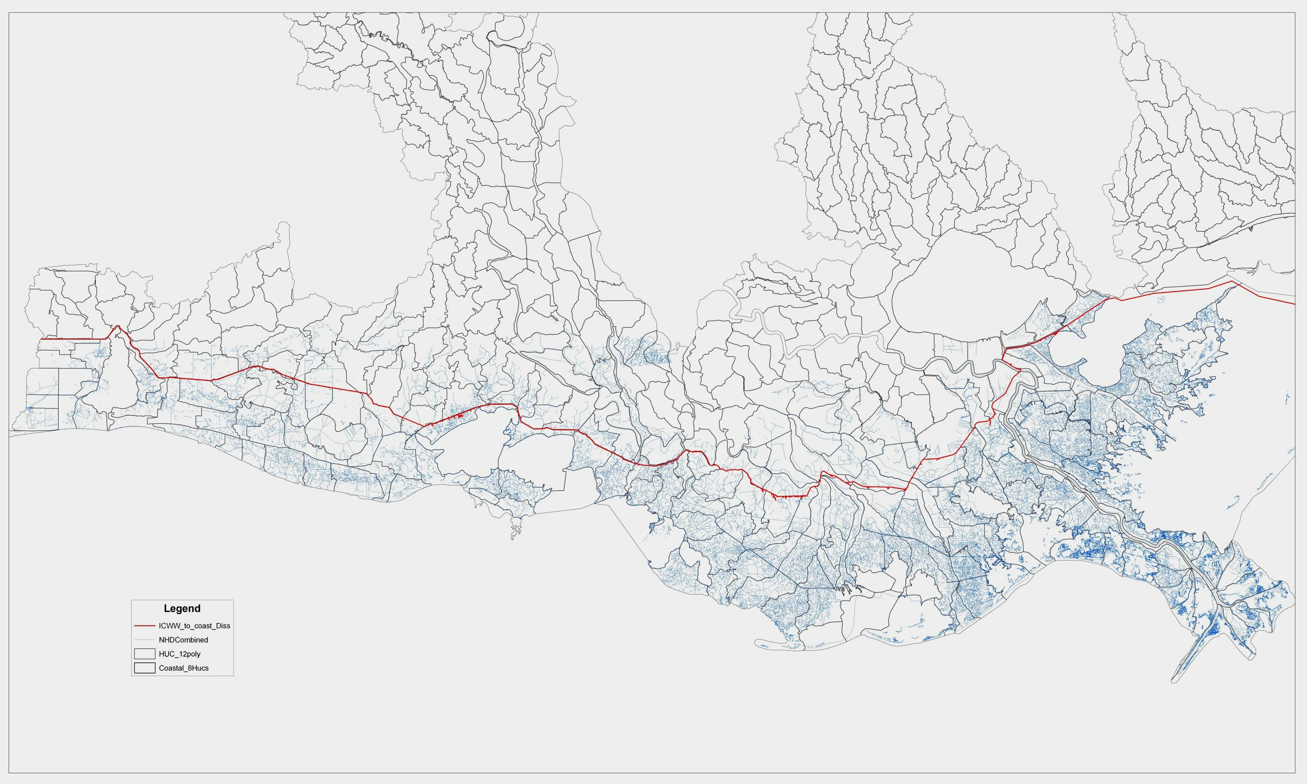
Upper Basin Delineation
Intercoastal Waterway – HUC 12 and Physical Barrier

Slide 20
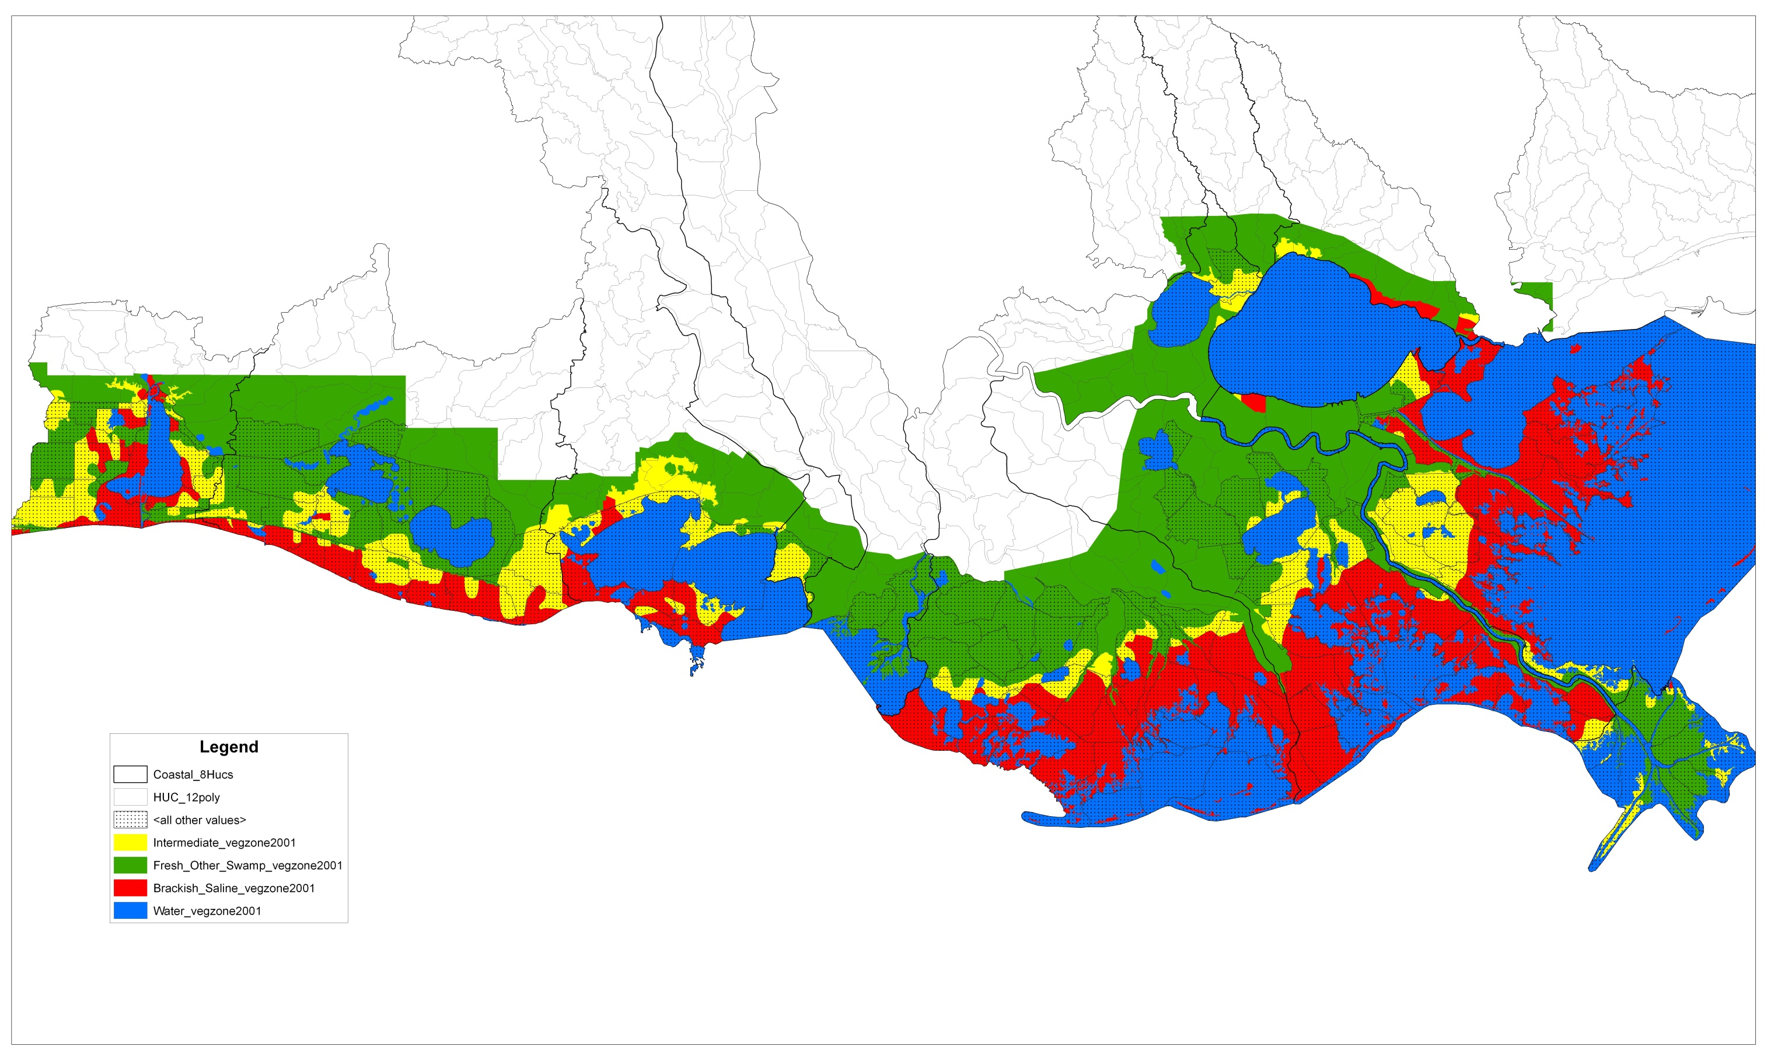
Mid & Lower Basin Delineation
Chabreck – Linscombe vegetative classification for determining saltwater species
Green – Fresh Marsh, Non-Marsh, & Swamp
Yellow – Intermediate Marsh
Red – Saline Marsh

Slide 21
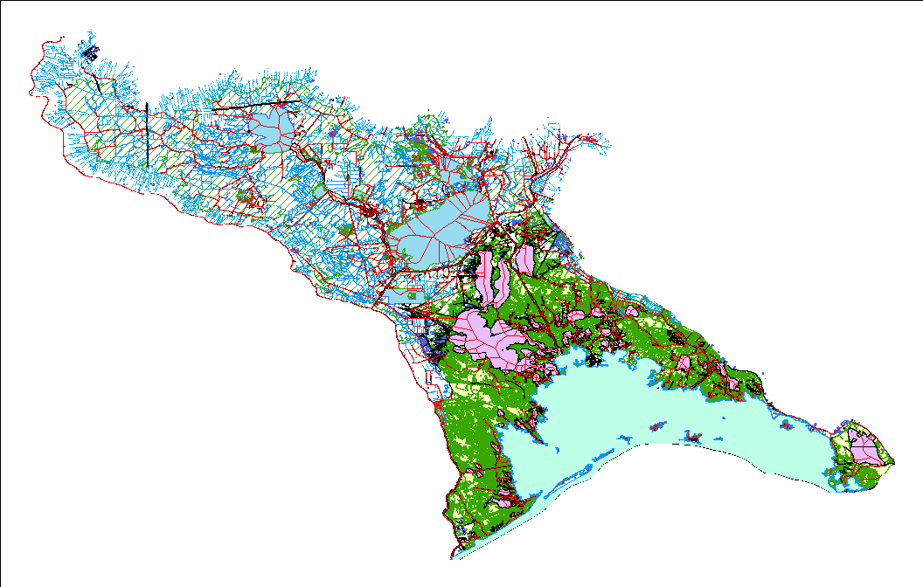
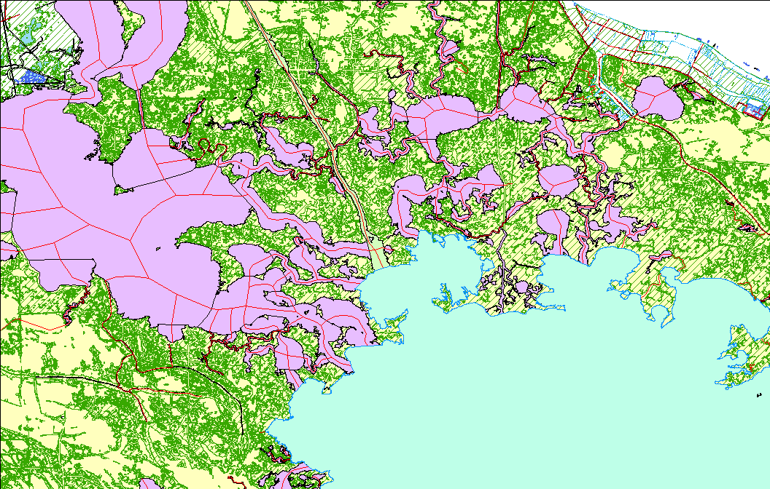
08090301 Post-Revision

