Slide 1
Should there be Internet Technology Training (ITT) at Family and Youth Services Center(FYSC) ?
A pre-proposal discussion of the need for training dis-enfranchised youth in 22nd Century technology to engage with the job market and increase digital equity in Louisiana

Slide 2
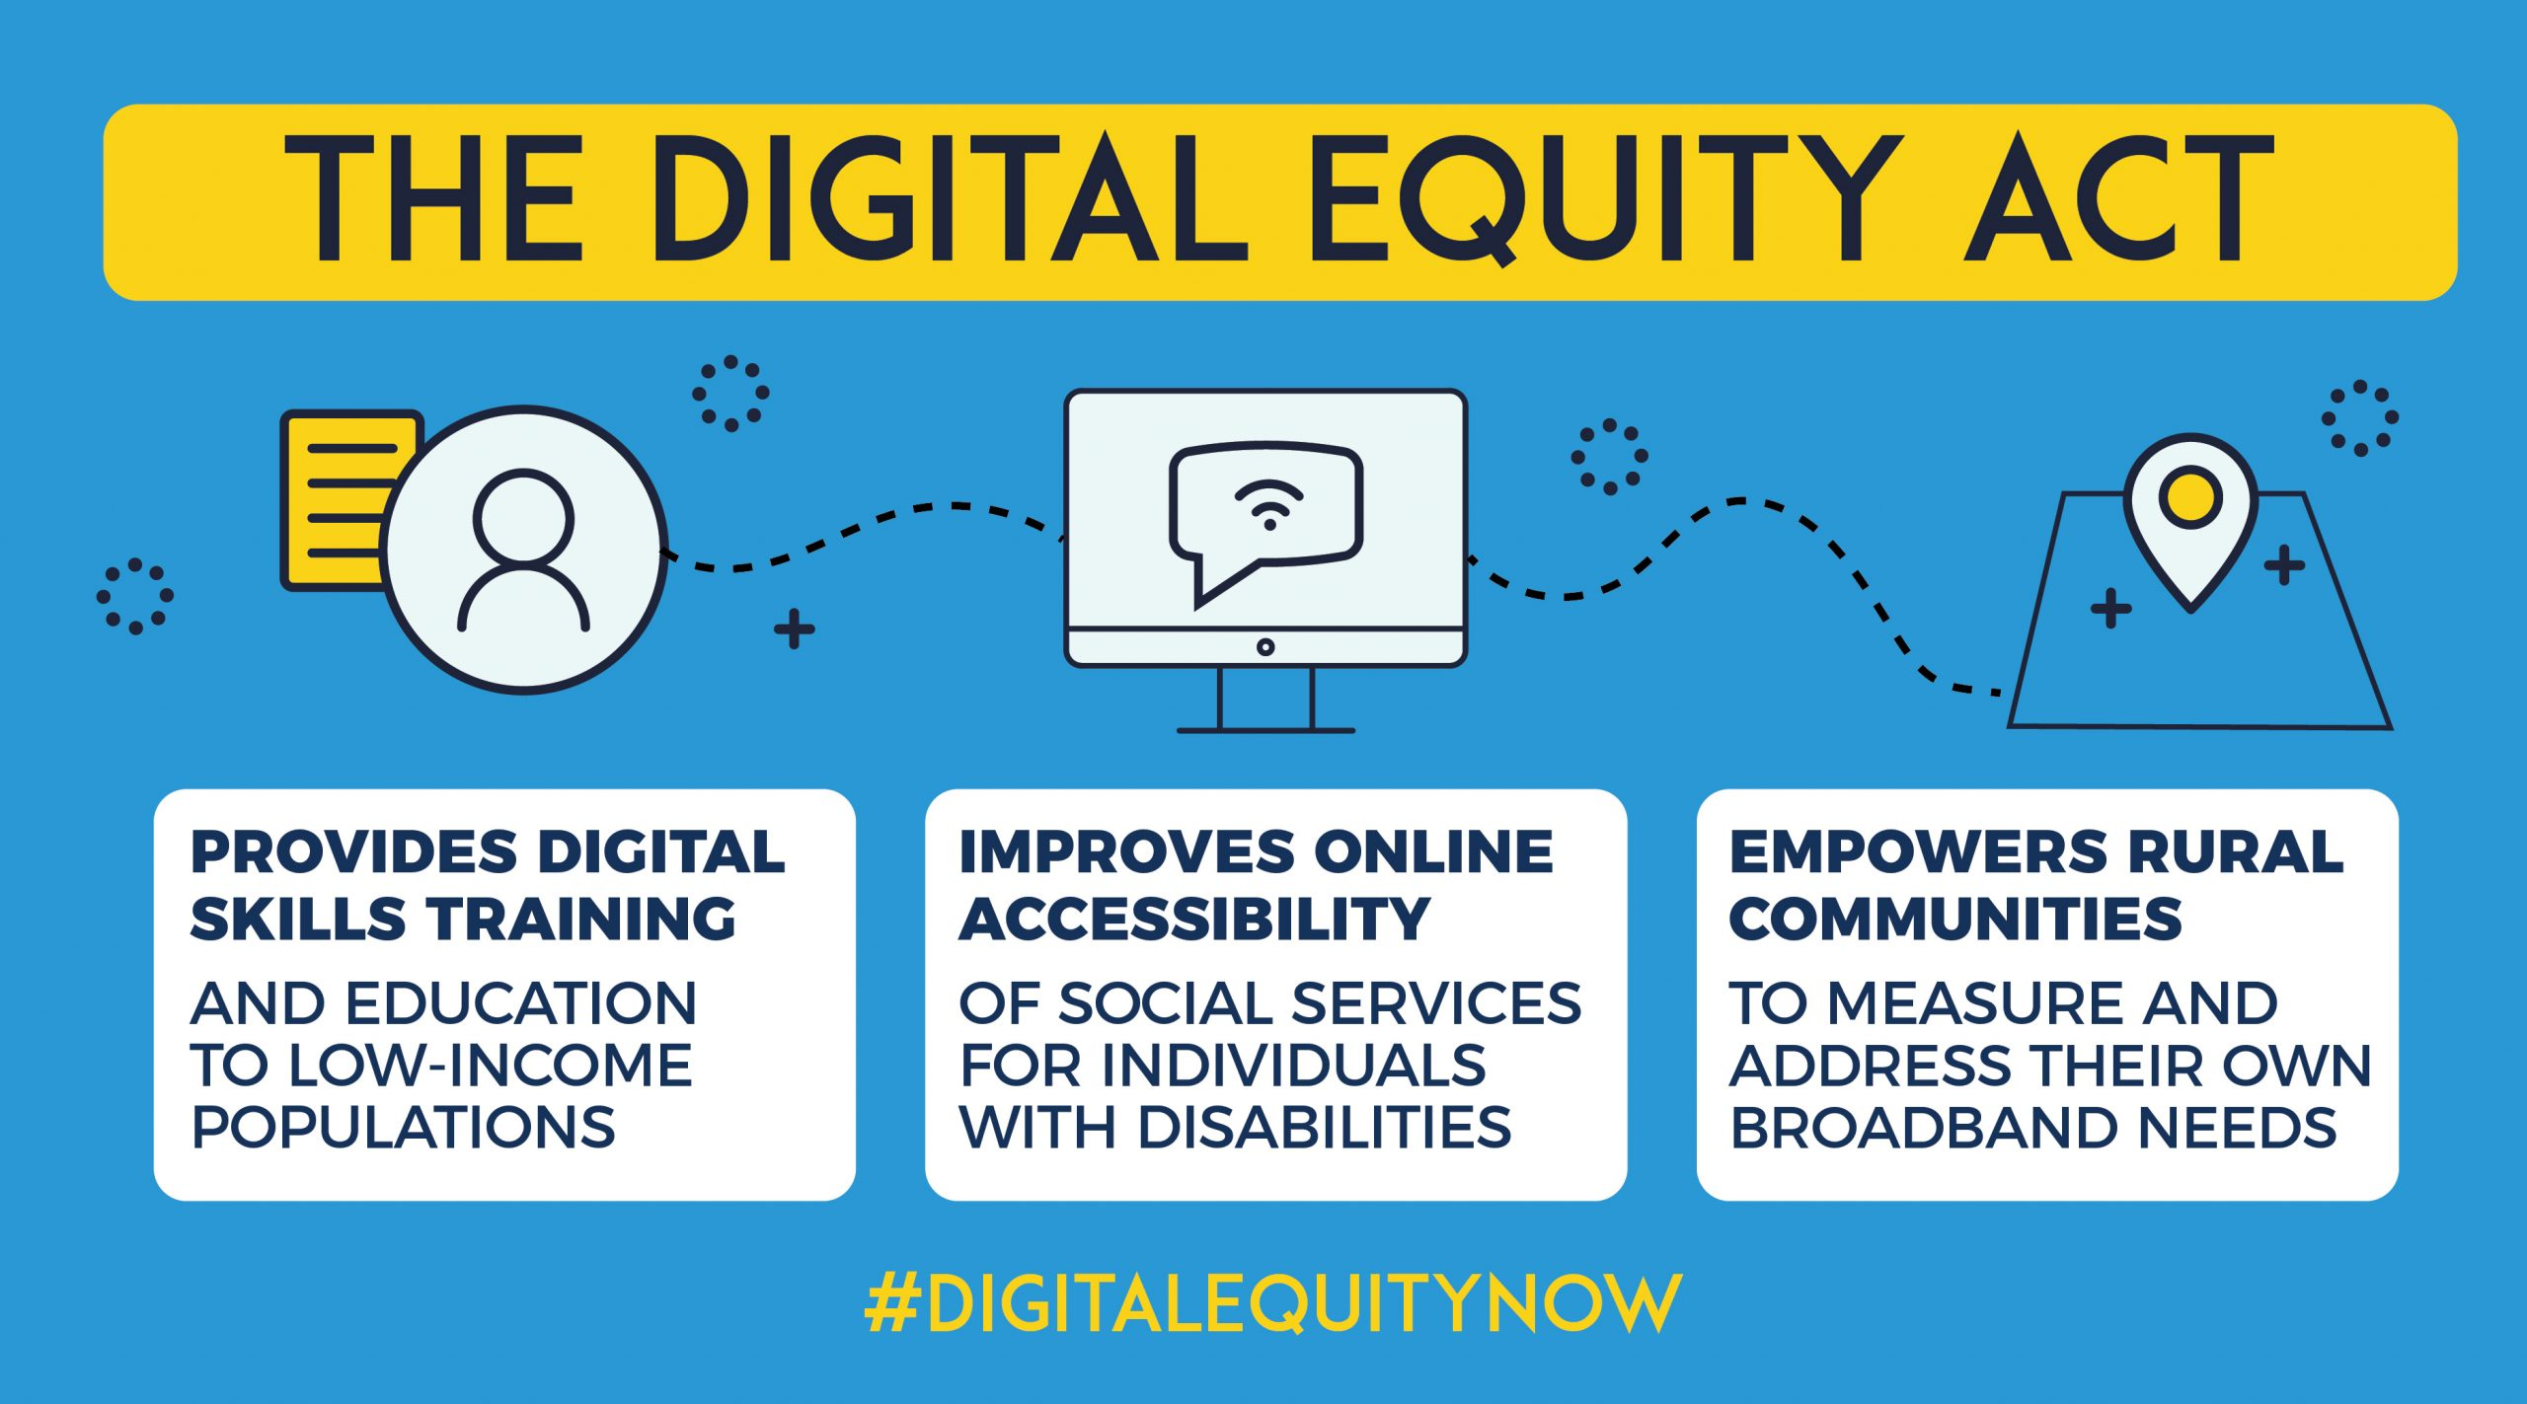

Slide 3
The Broadband Equity, Access, and Deployment (BEAD) Program, provides $42.45 billion to expand high-speed internet access by funding planning, infrastructure deployment and adoption programs in all 50 states, Washington D.C., Puerto Rico, the U.S. Virgin Islands, Guam, American Samoa, and the Commonwealth of the Northern Mariana Islands. https://broadbandusa.ntia.doc.gov/news/latest-news/biden-harris-administration-approves-louisianas-internet-all-initial-proposal

Slide 4
Why Internet Technology Training?
Louisiana Unveils GUMBO, a $90M Broadband Expansion Program
Louisiana's Office of Broadband Development and Connectivity is running a new grant program called Granting Unserved Municipalities Broadband Opportunities (GUMBO). Grants initiated in Summer, 2022
Source of funding: https://broadbandusa.ntia.gov/funding-programs/digital-equity-act-programs

Slide 5
Utility Theory & Economics Promotes Expansion of the Population of Internet Users
ConnectLA is moving forward rapidly to connect end-user who have long been without high-speed internet connectivity. As the internet has become a major component of our consumer culture, this expansion makes good economic ‘sense’ as an investment between private sector and government agencies.
Most modern, significant social and economic processes and transactions require internet connectivity. The outcome of GUMBO will be more users of this service utility. (Estimates in Louisiana may be +40% more users)
However, how will this new internet technology be used?

Slide 6
New Opportunity for Training Students for Jobs in this New Wave of Economic Internet Expansion
The National Digital Inclusion Alliance (NDIA
NDIA was founded in May 2015 under the auspices of
the PAST Foundation in order to be "a unified voice for
local technology training, home broadband access, and
public broadband access programs."^{[7][8]} NDIA is a
membership-based organization, and is an independent
501(c)(3) as of 2021.^{[9]} As of October 2021, NDIA had
604 affiliated organizations.^{[10] (Source: Wikipedia, 2024)}

Slide 7
Louisiana Digital Equity Plan (DEP)
In 2023, under guidance from the Broadband Equity, Access and Deployment program of the US federal National Telecommunications and Information Administration, the state of Louisiana contracted to initiate a study to develop a statewide digital equity program (DEP). Members of the Governor’s Advisory Council on Disabilities Affairs provided technical assistance to ensure that unique functional needs of persons with disabilities were addressed in state planning efforts. Louisiana was recognized as the first state in the U.S. to have developed a DEP: https://connect.louisiana.gov/media/fc2pdo4y/la-draft-digital-equity-plan.pdf

Slide 8
STEMM-Up is a job readiness program. It prepares jobseekers for careers in science, technology, engineering, mathematics, and medicine. The program combines learning modules, mentorship, job shadowing, and paid internships. Project partners include Michigan Rehabilitation Services (MRS), Louisiana Rehabilitation Services (LRS), Michigan State University (MSU), and Southern University-Baton Rouge (SUBR): https://stemmup.org/background/

Slide 9
Vocational Rehabilitation Program
Vocational Rehabilitation, the flagship program of Louisiana Rehabilitation Services, is a one-stop career development program that offers individuals with disabilities a wide range of services designed to provide them with the skills, resources, attitudes, and expectations needed to compete in the interview process, get the job, keep the job, and develop a lifetime career
https://www.laworks.net/WorkforceDev/LRS/LRS_Rehabilitation.asp

Slide 10
Department of Labor O-Net Occupation Groups and Job Titles
15-0000 | Computer and Mathematical Occupations
15-1200 | Computer Occupations
15-1230 | Computer Support Specialists
15-1232.00 | Computer User Support Specialists
SOC Occupation Groups
https://www.onetcodeconnector.org/ccreport/15-1232.00

Slide 11
Digital Navigator Model
Digital navigators are individuals who address the whole digital inclusion process — home connectivity, devices, and digital skills — with community members through repeated interactions.
With on-demand services or through appointments, digital navigators support both urgent needs and long-term goals. Most digital navigators provide general support, and some offer specialized support for specific topics, such as healthcare, and for specific populations, including people with disabilities, returning citizens, higher education students, and caregivers to K-12 students.
https://www.digitalinclusion.org/digital-navigator-model/

Slide 12
Northstar Partnership
LOUIS is pleased to announce a partnership with Literacy Minnesota to bring their Northstar digital literacy testing center capacity to Louisiana along with a professional development series on testing center administration and delivery of digital literacy educational programming.
Background
As part of the Governor’s CARES Act for the Governor’s Emergency Education Relief Fund (GEER) program, LOUIS: The Louisiana Library Network (LOUIS) has been tapped to implement a digital literacy program under the direction of the Commissioner of Higher Education, Dr. Kim Hunter Reed and LOUIS Executive Director, Laurie Blandino. This program was developed through the Board of Regents (BoR) Digital Inclusion Strategic Action Team, which identified improving digital literacy as one strategy the Louisiana higher education community could embrace to address the negative impact of the digital divide during the COVID-19 pandemic

Slide 13
Northstar Digital Literacy
NORTHSTAR DIGITAL LITERACY PLATFORM
Many postsecondary institutions have implemented the Northstar Digital Literacy platform on their campus. Learners have access to a variety of digital skills learning opportunities. Some examples include:
Online, self-guided assessments measure mastery of basic skills in each of 14 areas.
Test takers can receive certificates and/or digital badges when they pass Northstar assessments in a proctored environment at a Northstar testing location. When test takers are logged in to Northstar Online Learning, the Northstar assessment result page links to self-directed online learning practice for skills not yet mastered. Once test takers pass the Northstar assessments, which certify basic skills, they are qualified to pursue more advanced training, certifications, or career pathways elsewhere.
Classroom curricula provide detailed lesson plans for instructors.
Lesson plans are learner-centered and interactive and can be used in one-on-one or group instruction. The lessons give learners multiple opportunities to build digital literacy skills through practice tasks. Each lesson plan includes a detailed teacher prep guide. Lessons are structured to include warm-ups, daily objectives, practice tasks, digital literacy vocabulary work, and wrap-ups.
Northstar Online Learning (NSOL) provides individualized online instruction and practice.
NSOL provides original online content that learners can access independently. When learners complete an assessment, they are automatically directed to the NSOL content corresponding to what they still need to learn.

Slide 14
The Family and Youth Service Center (FYSC) The Family and Youth Services Center of East Baton Rouge (FYSC) is dedicated to empowering individuals and families to thrive, grow, and succeed. Our mission is to provide comprehensive support, resources, and opportunities that enhance the well-being and future prospects of our East Baton Rouge neighbors. We work in collaboration with onsite agency partners to remove obstacles, provide options, and accelerate success for those who need us most: https://www.fysc-ebr.org/

Slide 15
This slide will include talking points, Q&A generated at a future ZOOM, TEAMS, or face-to-face meeting to discuss a possible new program at the Family and Youth Service Center (FYSC) and what alliances and agreements need to be considered going forward. John Schweitzer: johnrschweitzer@gmail.com 225-326-2849 Notice of funding opportunity: https://www.digitalinclusion.org/blog/2021/12/09/digital-inclusion-funding-in-the-infrastructure-investment-jobs-act/

