Slide 1
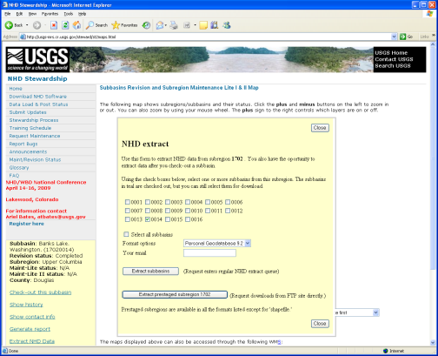
Flow Diagram for NHD Maintenance Process
NHD Stewardship Web site
XML Extract
Reproject
XML2pgdb
1804_alb
1804_alb.mdb
All edits performed on this mdb
1804_qc
1804_qc1.mdb
Copy of NHD75464.mdb with transactions applied
Extract from database NHD75464.zip
Corrections?
Yes
UnZip
Reproject
No
Make copy of final 1804_geo.mdb and name it
1804_geo_load.mdb
1804_orig
1804_orig.mdb
Save zip file in this
folder
1804_geo
1804_geo.mdb
1804_alb.mdb reprojected to geographic
1804_geo_load
1804_geo_load.mdb
Used for build flow, releveler and final XML extract

