Slide 1
Landcover Photorevision Overestimates Land
Redfish
Bay

Slide 2
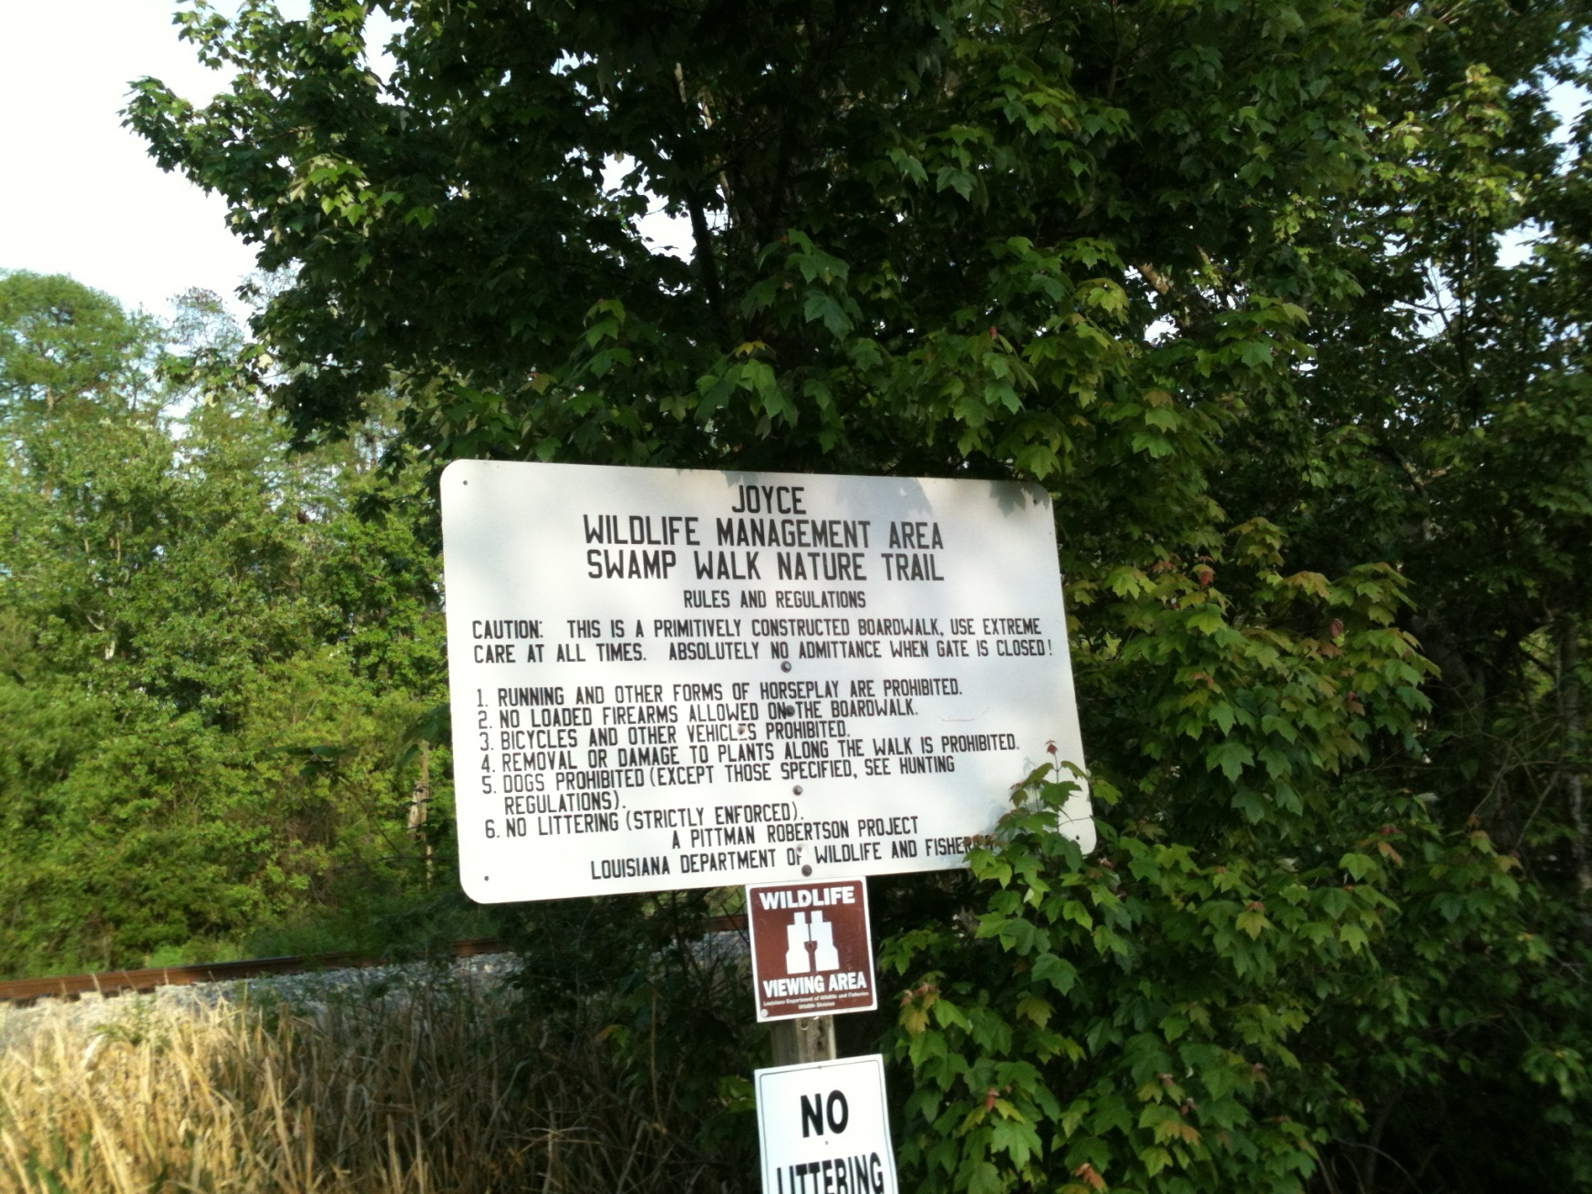
Joyce Wildlife Management Area
Swamp Walk Nature Trail
Redfish
Bay

Slide 3
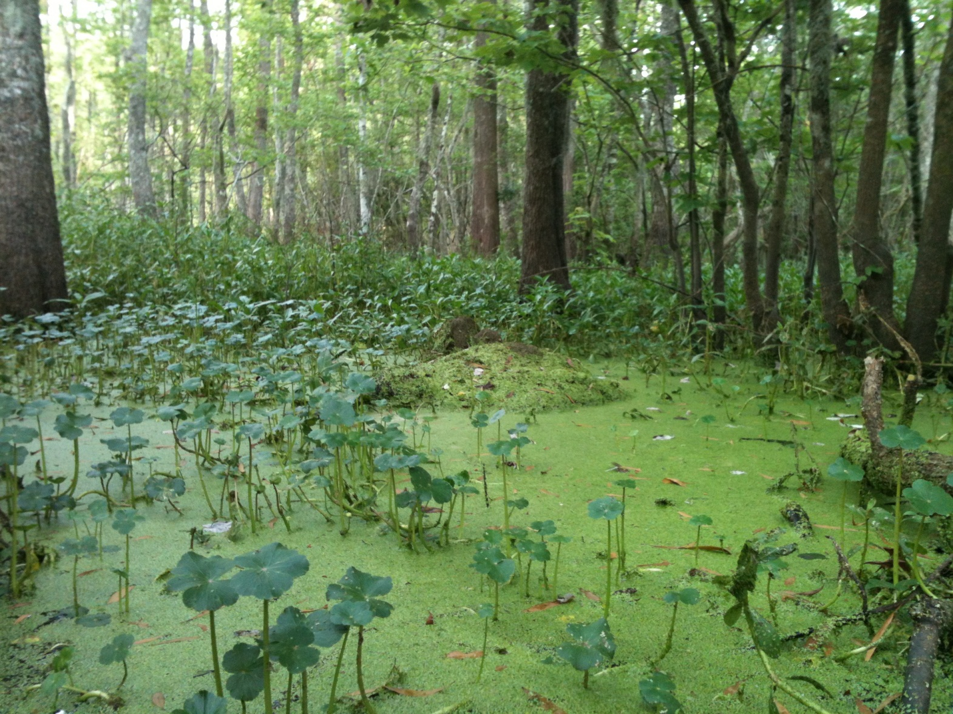
Duck Weed Choked “Open” Area Along the Boardwalk
Redfish
Bay
The forest floor is inundated, under a constant level of water. This is a contiguous waterbody, blow the forest canopy.

Slide 4
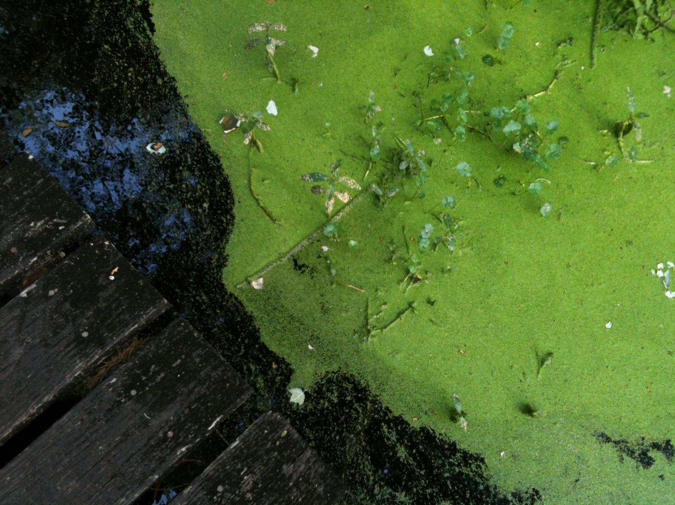
The Swamp is Alive with Plants and Animals All Living in the Water
Redfish
Bay
At the time of this photo, in late March, water is slowly flowing from north to south.

Slide 5
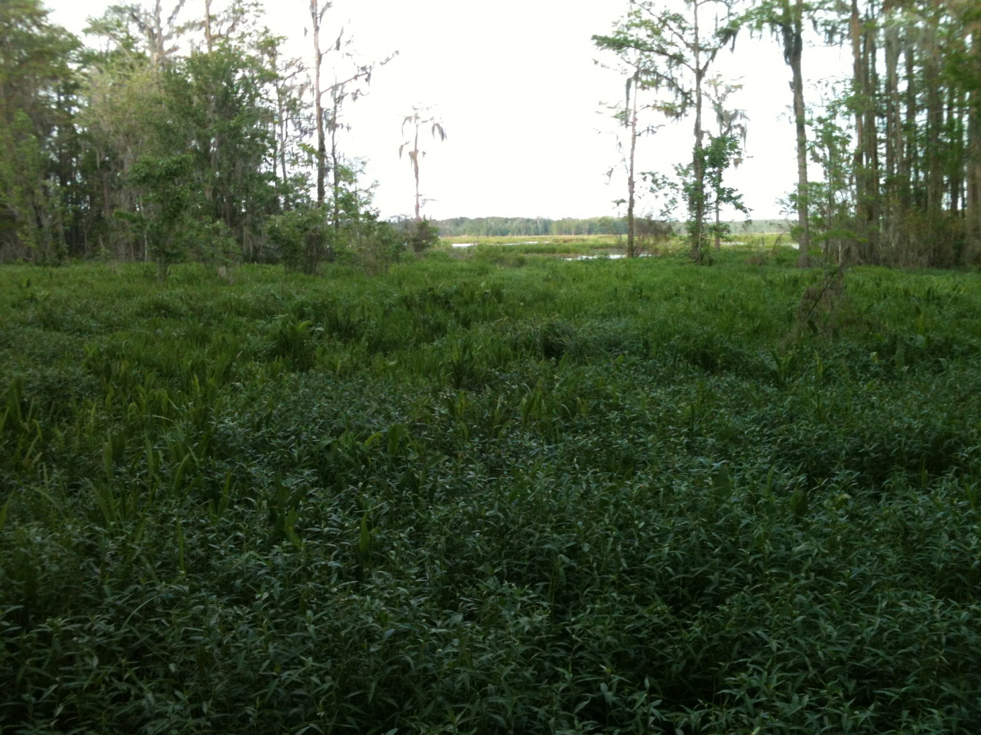
At the End of the Boardwalk
Looking East-northeast
Redfish
Bay
The early spring vegetation is very overgrown and the underlying water is not apparent. This location is almost 12 miles from the shore of Lake Pontchartrain.

Slide 6
Photorevision Overestimates Land
Redfish
Bay

