Slide 1

GIS & Emergency Operations
Before, During, and After the Hurricanes of 2005
by James E. Mitchell, Ph. D, IT GIS Manager

Slide 2
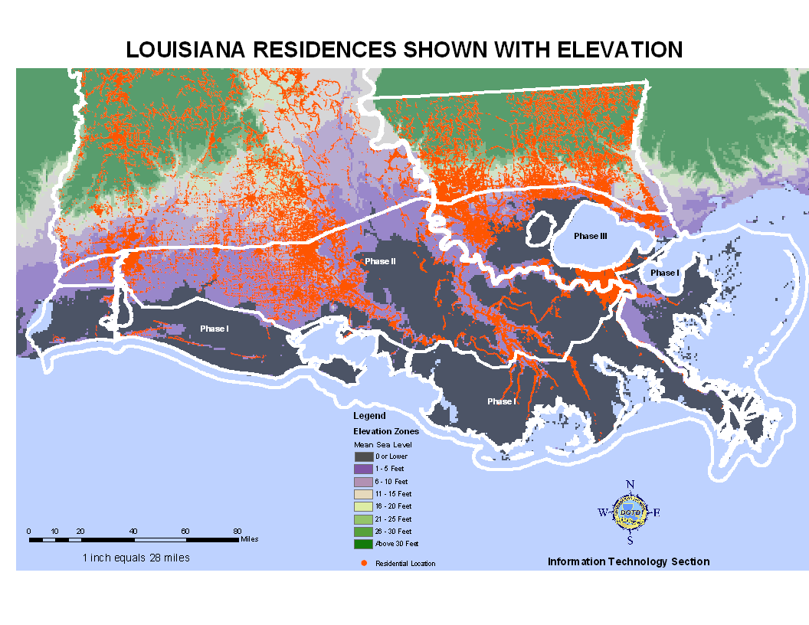
GIS Analysis to Support
the Evacuation Plan
Notes:
A year before the storms, LADOTDE and LA State Police teamed up to create the Louisiana Emergency Evacuation Plan. It started with a spatial analysis of residential locations (in red) and land surface elevations (background map). Three Phases were defined. Phase I was the outer coast, outside of the Intercoastal Waterway. Phase II between the Intercoastal and Interstate 10. Phase three involves Contaflow and includes New Orleans and he Lake Pontchartrain Basin.

Slide 3
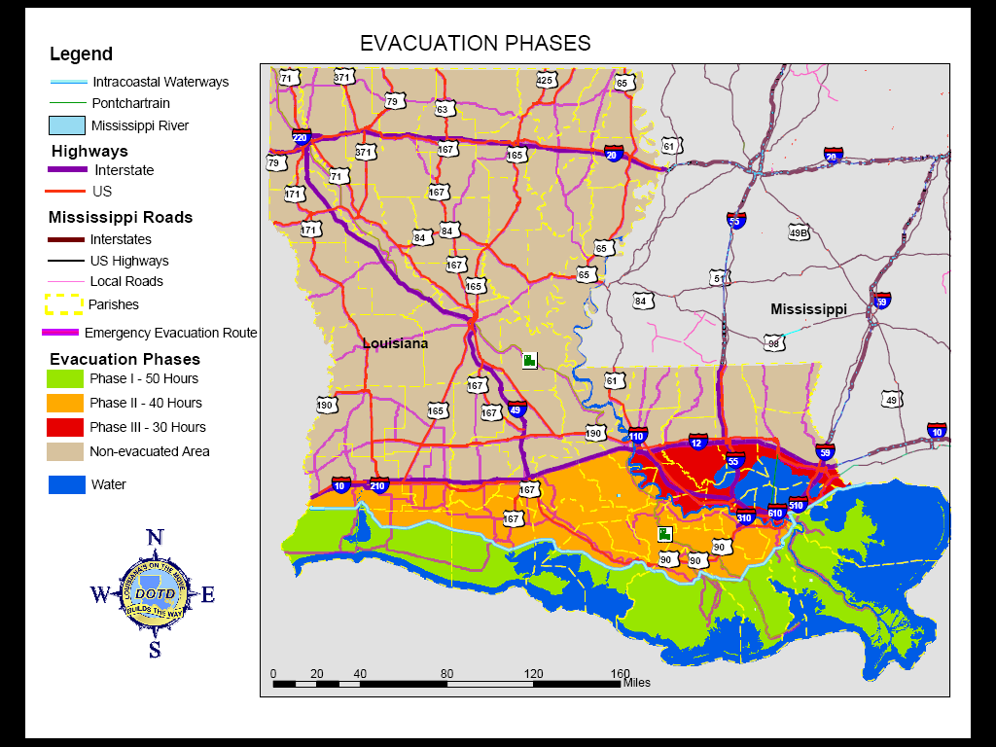
Evacuation Phases Based on GIS Analysis
Notes:
This is the map initially created for dissemination to the public. The map was produced by DOTD and LA State Police. LSP chose these colors. After discussions, the color scheme was changed to show the Phase I area as red and Phase II as yellow.

Slide 4
Louisiana
Emergency Evacuation Plan
72 hrs from Tropical Storm Wind Landfall
Stage Assets and Personnel
50 hrs from Tropical Storm Wind Landfall
Evacuate Phase I
40 hrs from Tropical Storm Wind Landfall
Evacuate Phase II
30 hrs from Tropical Storm Wind Landfall
Evacuate Phase III - Contraflow
6 hrs from Tropical Storm Wind Landfall Terminate Contraflow – Secure Assets and Personnel
Duck!
Notes:
This is a brief description of the LEEP. A key point is that milestones are linked to the time when Tropical Storm force winds (39 mph) reach landfall, not the eye of the hurricane. Tropical Storm force winds are strong enough to create problems with transportation systems; closing bridges, slowing traffic, blowing over vehicles.

Slide 5
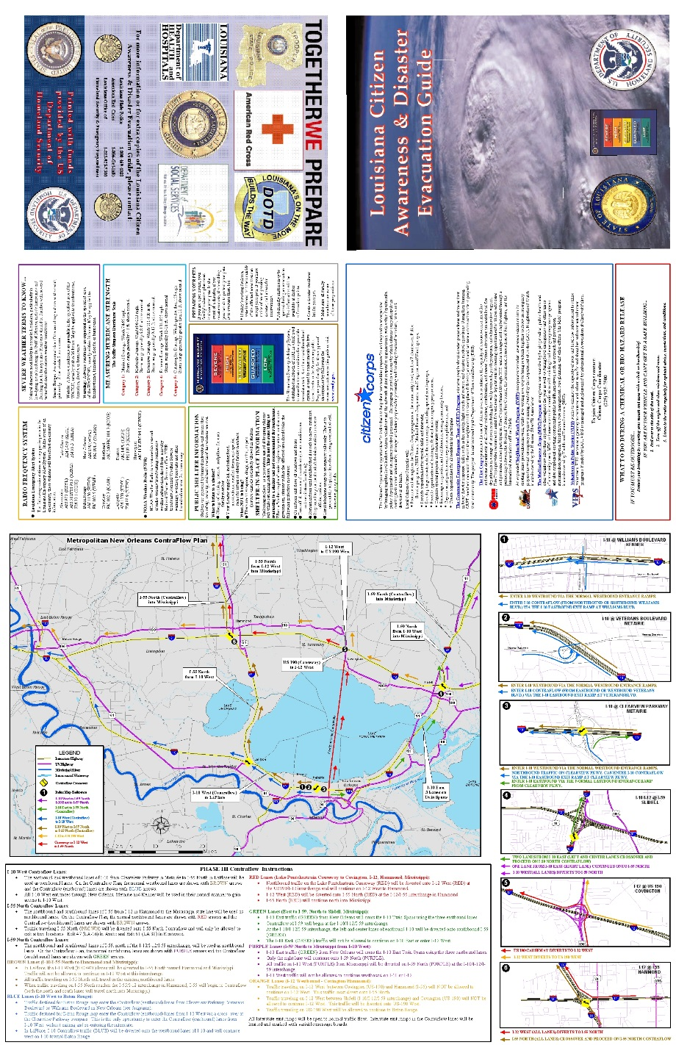
One Million Maps Distributed
Notes:
A million maps were produced for distribution to the public. It included information on emergency evacuations, maps of routes, maps of interchanges and how to enter Contraflow. The program was a great success.

Slide 6
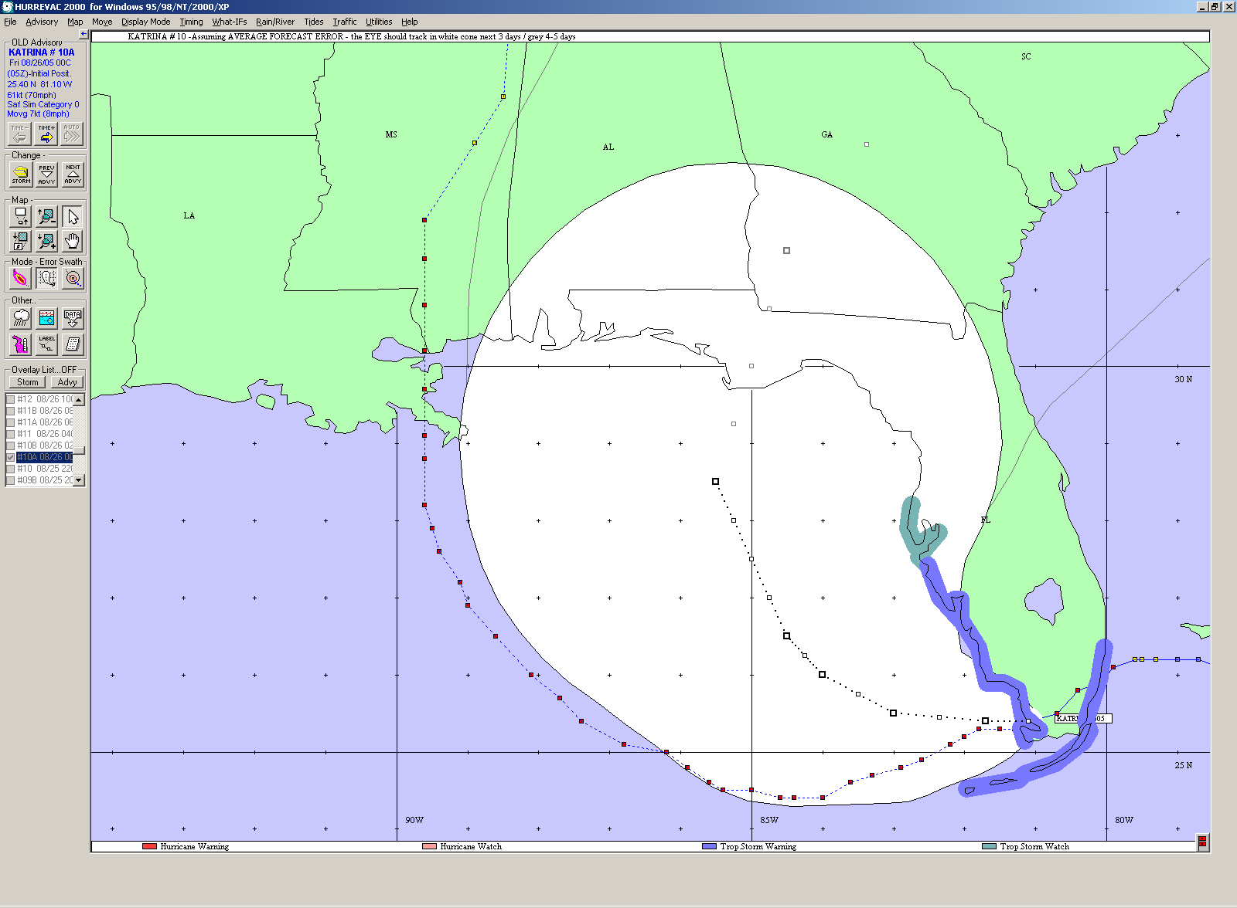
HURREVAC – Friday August 26 Forecast Path
Notes:
HURREVAC is a program that is supported by FEMA, US Army Corps, and NOAA. It provides access to NHC advisories in a map interface. Before a storm DOTD GIS staff use this software to monitor the approaching storm. Different views are available. This is the storm track and error zone on Friday morning 8/26/2005. Note that at this time the storm is headed to western Florida. The actual storm path is displayed just outside of the western margin of the zone of uncertainty.

Slide 7
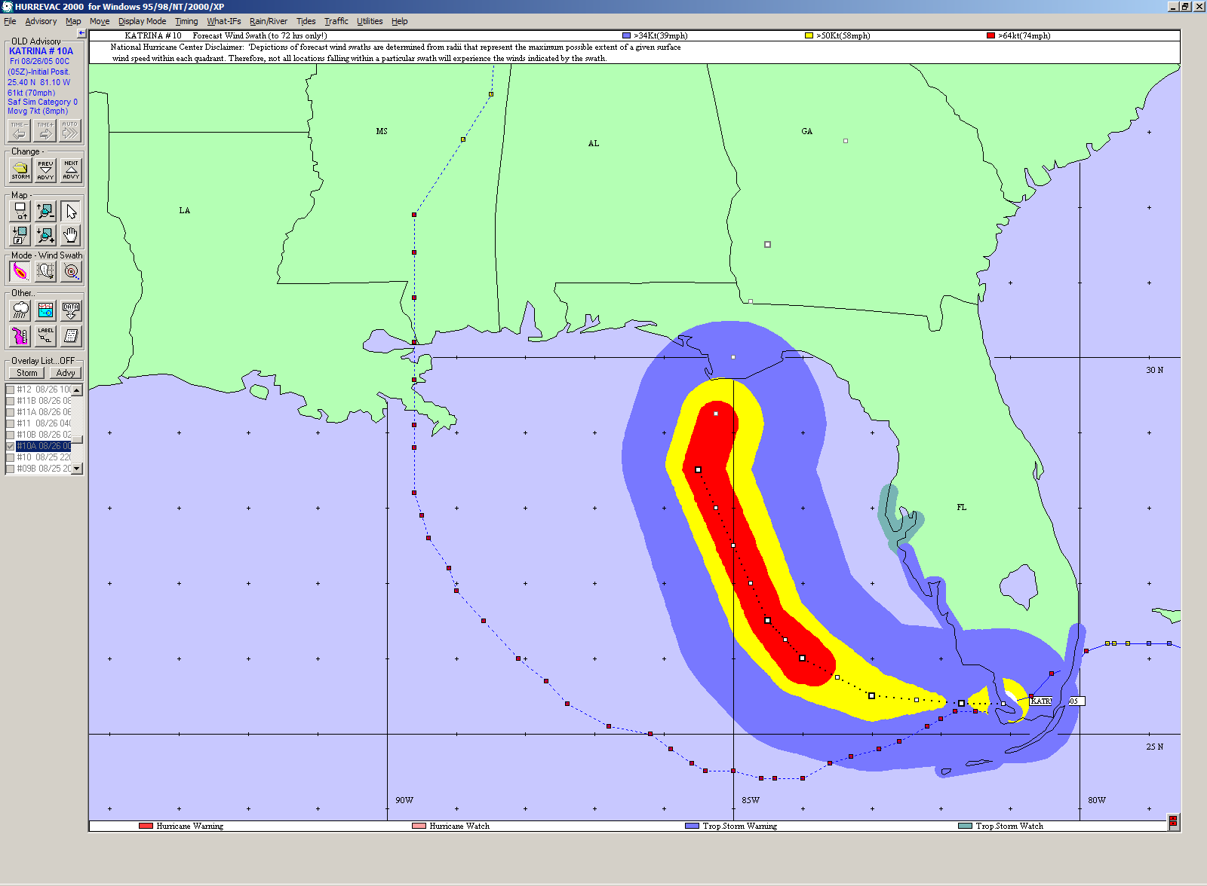
HURREVAC – Friday August 26 Forecast Winds
Notes:
This is the same forecast of 8/26/2005, except the wind paths are displayed. The blue zone denotes Tropical Storm force winds, yellow is Gale force winds and red is Hurricane force winds. Note that on Friday morning, 72 hours before the storm hit, it appeasers to be headed to Florida’s Apalachicola Peninsula.

Slide 8
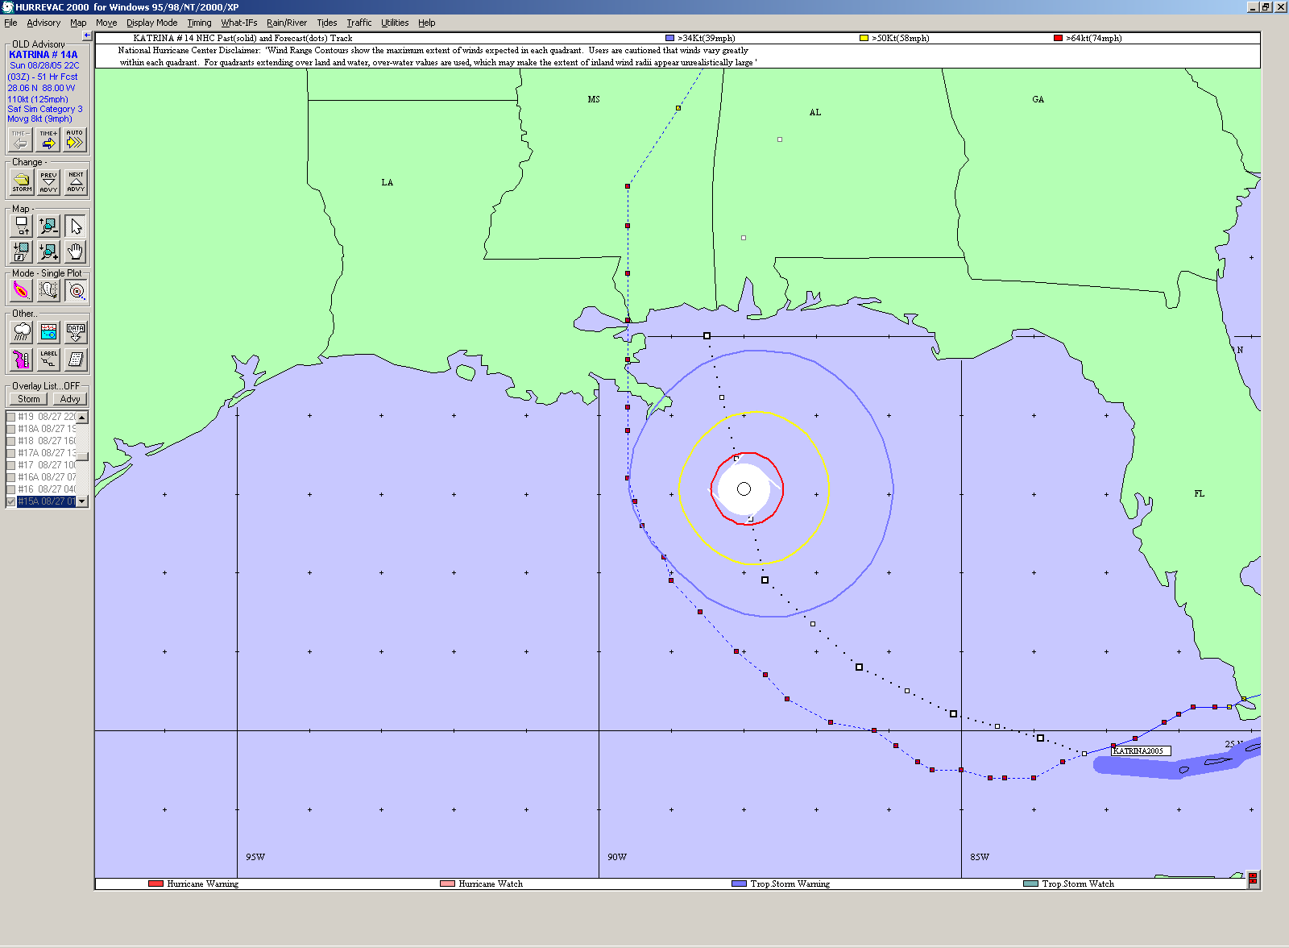
HURREVAC – Saturday August 26 72-hourForecast
Notes:
On Saturday morning, 8/27/2005, the forecast path has moved west. This view shows the “wind Rings” and the projected position of the storm in 72 hours. The speed of the storm increased in forward speed and actually came ashore in two days. On Saturday, the DTD Emergency Operations Center was activated on Saturday morning.

Slide 9
Pre-storm Information Delivery
Notes:
Data from HURREVAC are downloaded and combined with other DOTD data to prepare products that can be emailed to emergency response and DOTD personnel. As hyperlinks to websites, these can be viewed on wireless, mobile devices such as Blackberrys.

Slide 10
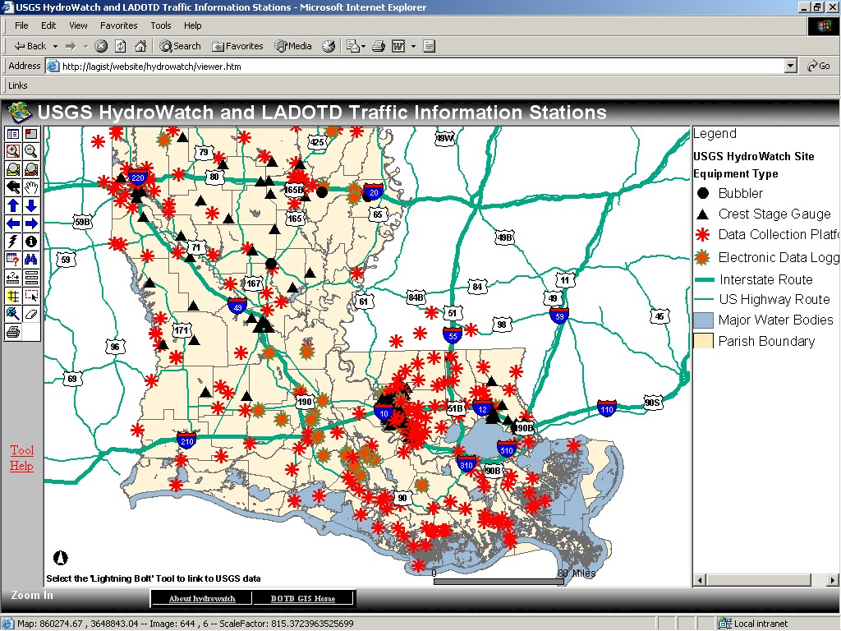
HydroWatch Website
Notes:
The HydroWatch website was developed during Hurricane Isadore, in 2002, to provide real-time information on the USGS stream gauge network. Many of these sites are located on DOTD bridges. This is an ArcIMS web service.

Slide 11
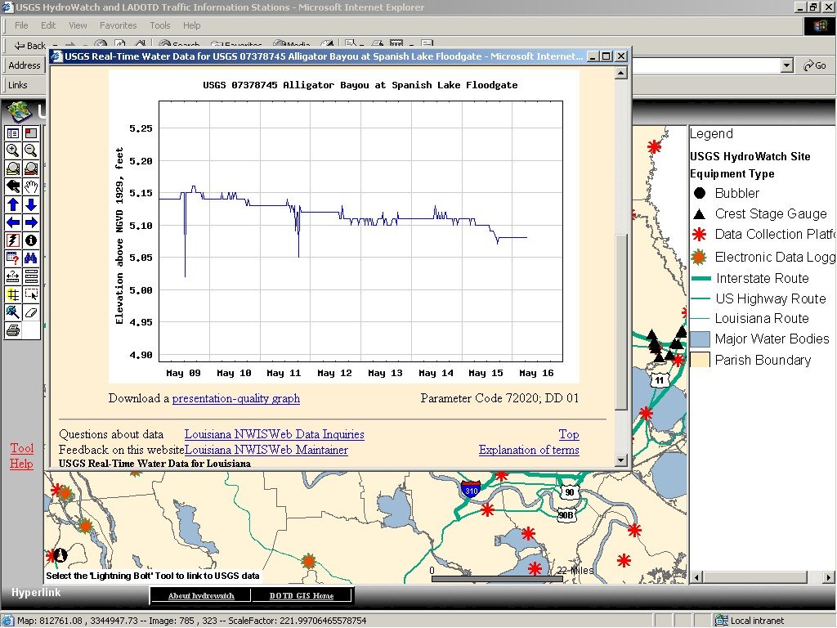
Access to Real-time Data
Notes:
Users of this website can zoom to a location, and hyperlink directly to the USGS website for that stream gauge. The data are transmitted every 15 mintues from the site into the USGS network.

Slide 12
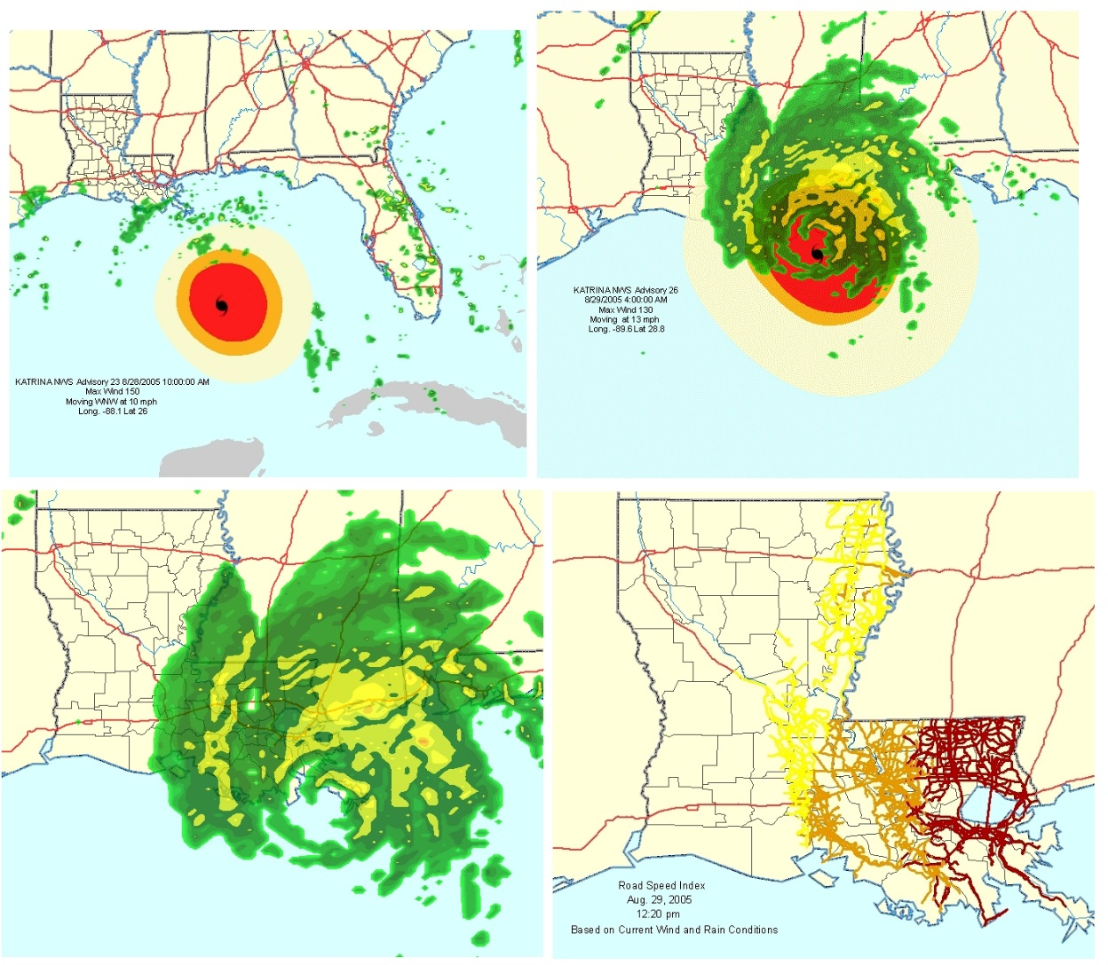
Real-time Weather Data from Meteorlogix
Notes:
As the storm approaches, GIS weather data are provided by Meteorlogix. These data feed websites that automatically update and show storm path, wind rings, rain bands, etc. The website is automated so GIS staff can concentrate on other support activities. In addition, ArcGIS users can access these sites, directly in ArcMap, and combine the weather data from DOTD with their own data.

Slide 13
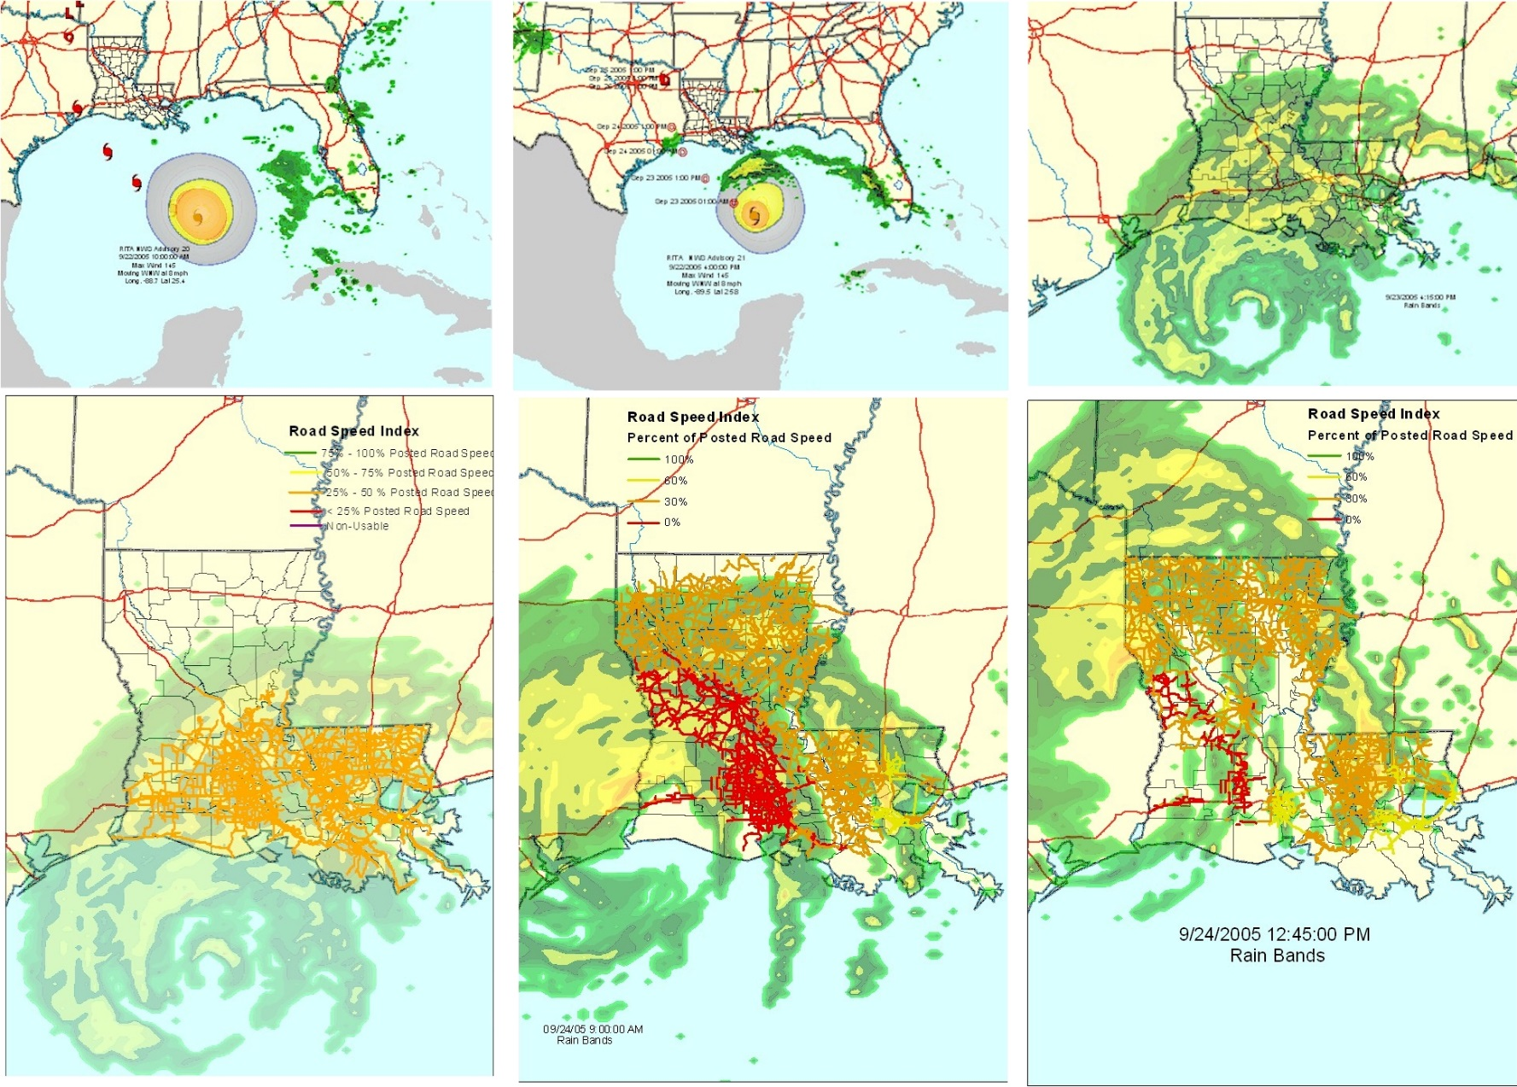
Road Speed Impact for Hurricane Rita
Notes:
These images of Hurricane Rita highlight Meteorlogix’s Road Speed Impact (RSI). RSI is a theoretical calculation that combines wind and rain data effects on traffic to create a number between 0.0 and 1.0. This number represents the proportion of normal traffic speed that can be attained on that segment, under those conditions. RSI is depicted on the map in reed, orange, yellow, and green tones to symbolize these values.

Slide 14
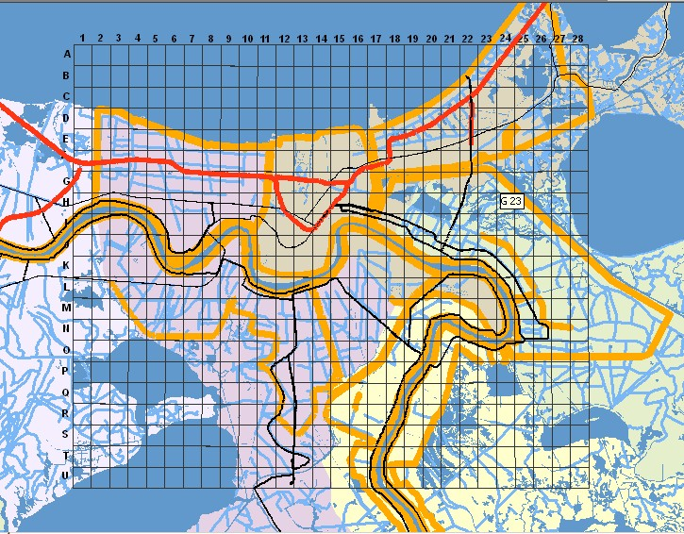
Search & Rescue Operational Grid
Notes:
After the storm hit, search and rescue activities began. First responders came from all over the US. An operational grid was created by DOTD and paced on thousands of paper maps that went into the field and to the Louisiana Emergency Operations Center. It was placed on an ArcIMS website to facilitate distribution to anyone who needed it. The grid made it easy to dispatch responders to locations that were geocoded, identified by cell ID (A-7, H-23, etc.). Helicopters and boats were equipped with Tom Tom Mobile GPS units donated by TeleAtlas North America.

Slide 15
Finding the Forgotten
Notes:
After the storm, it became clear that facilities such as nursing homes ma have been left without evacuating residents. DOTD used data from Experian Corporation to locate and map these locations for the Louisiana Department of Health and Hospitals. These maps were provided to helicopter pilots who used tom Tom units to travel to those locations and search for survivors.

Slide 16
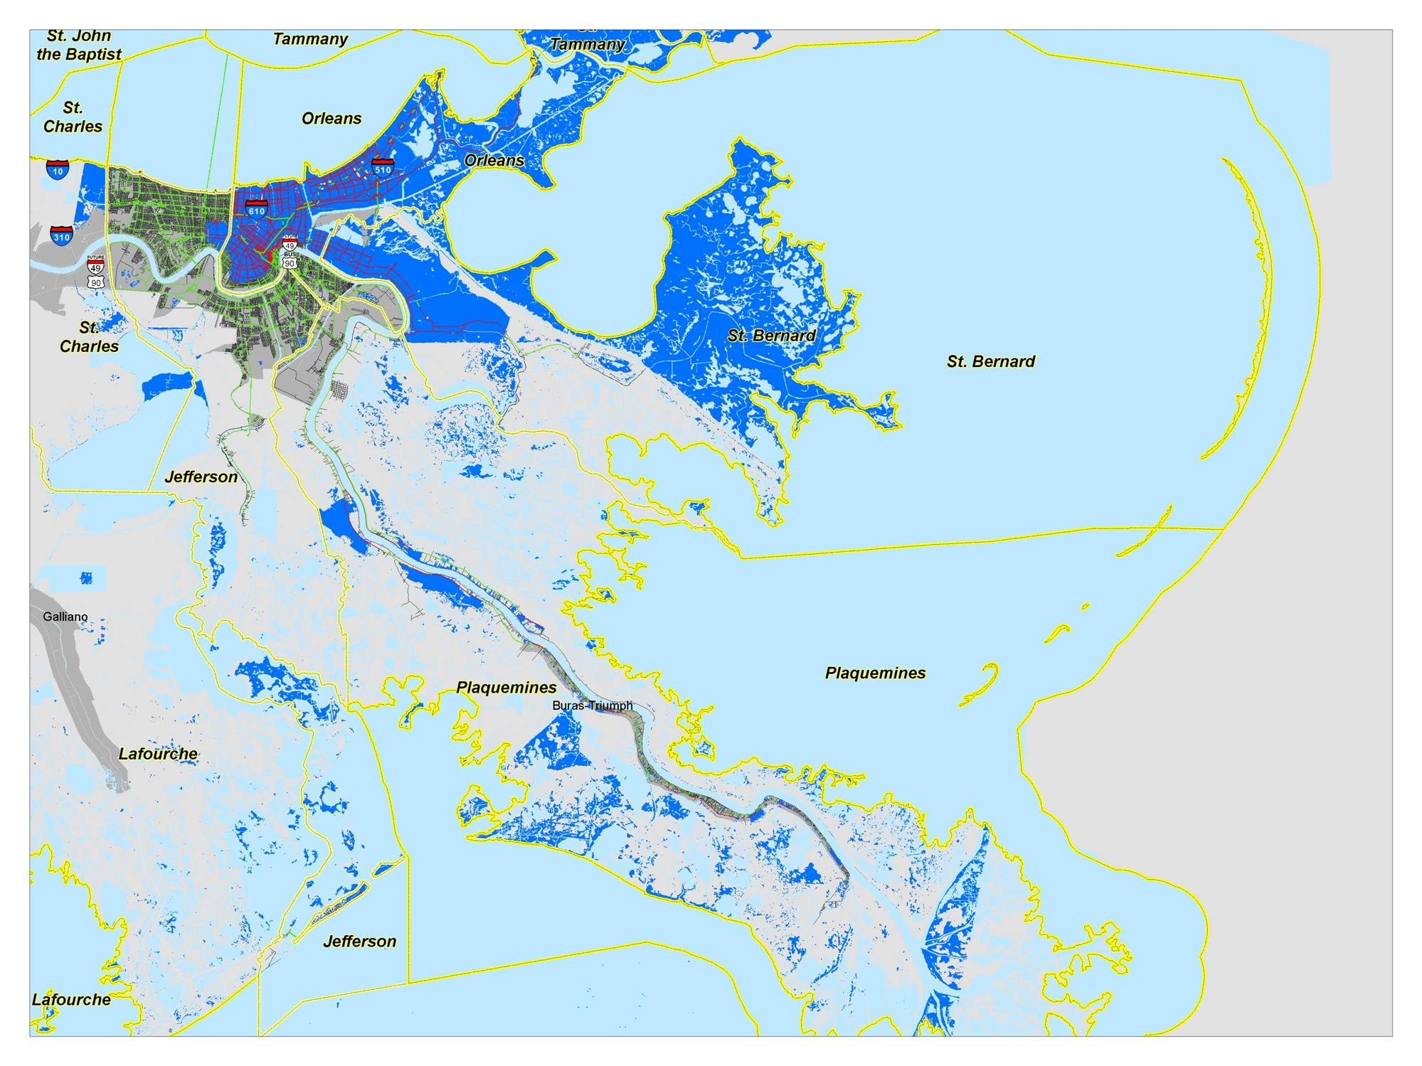
LAKE PONTCHARTRAIN
MISSISSIPPI RIVER
NOTE: FLOODED AREA DATA PROVIDED BY FEMA
2 SEPTEMBER 2005 SOUTH LOUISIANA FLOODED ROADWAYS
Notes:
Satellite imagery provided valuable information on areas inundated with flood waters. Imagery provided a quick and accurate data source in the days following the storm, before responders could enter the area and report conditions.

Slide 17
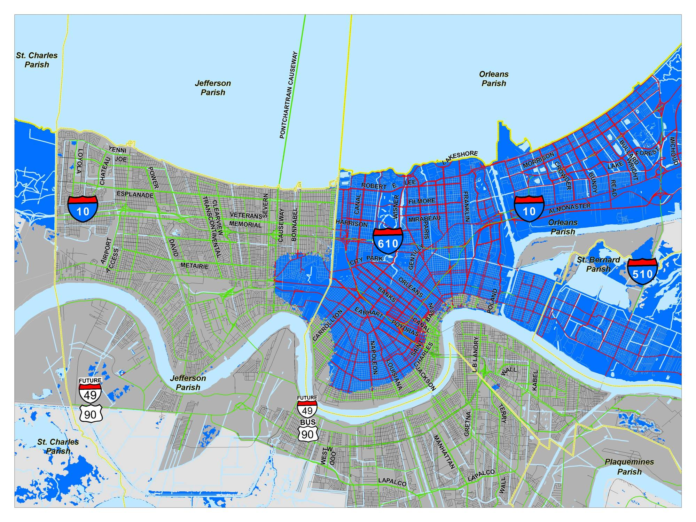
LAKE PONTCHARTRAIN
MISSISSIPPI RIVER
NOTE: FLOODED AREA DATA PROVIDED BY FEMA
2 SEPTEMBER 2005 NEW ORLEANS FLOODED ROADWAYS
Notes:
This is a close-up, showing the flooded areas of Jefferson, Orleans, and St. Bernard Parishes.

Slide 18
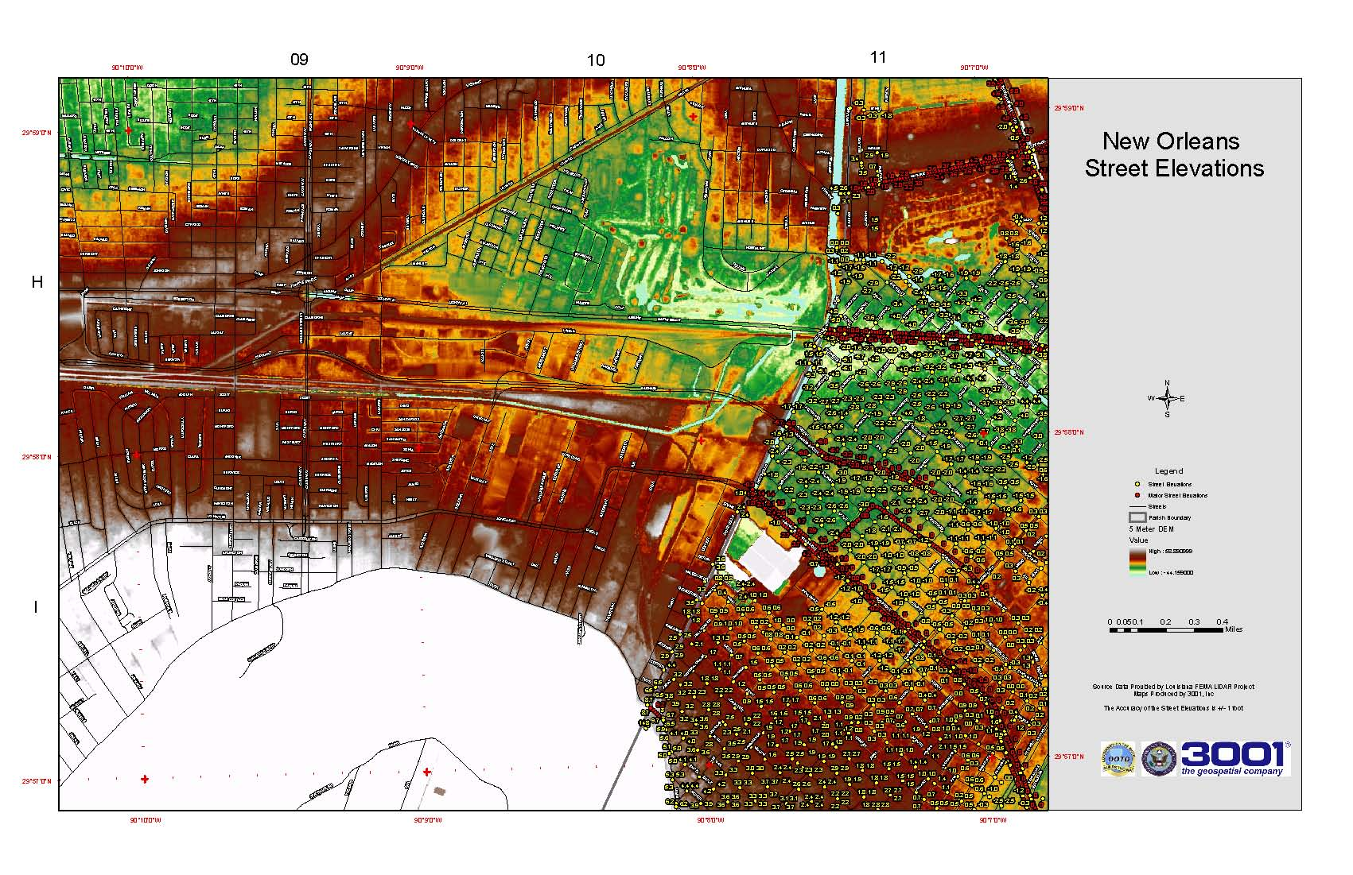
Flooded Street Elevations
Notes:
First responders needed to know where roads were flooded and impassible. DOTD teamed with 3001 Inc, to develp these data from Lidar and DEMs. Paper maps were made in small formats that could be used in vehicles in the field.

Slide 19
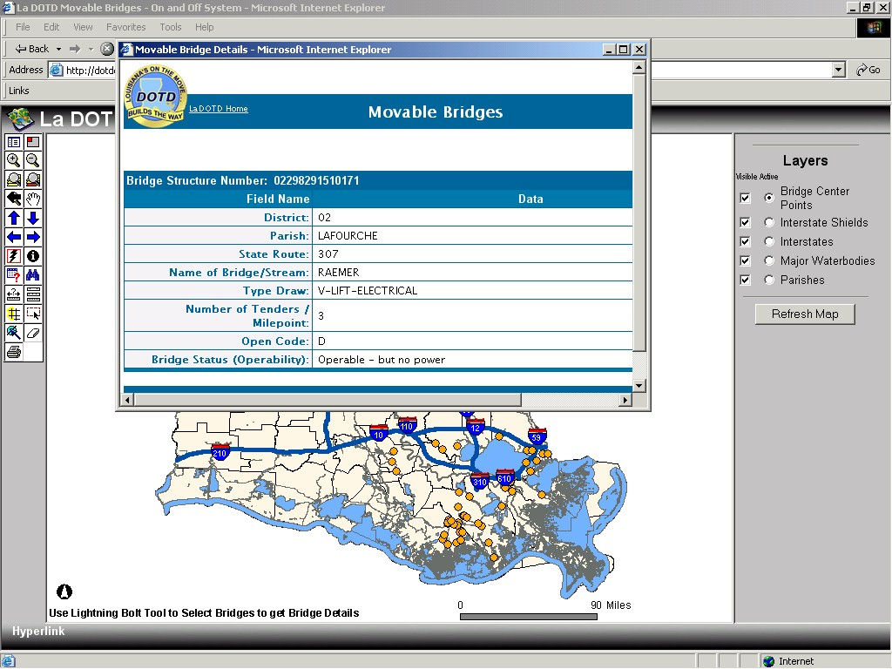
Damage Assessment – Moveable Bridges
Notes:
The bridge maintenance staff at DOTD had to assess all bridges, especially moveable bridges (draw, swing, lift, pontoon, etc.). This ArcIMS website was produced, in short order, to provide the public with he current status of bridges across the sate. Users can zoom into the area they want to see and hyperlink directly into the DOTD bridge database.

Slide 20
2 SEPTEMBER 2005 ESTIMATED FLOODED ROADWAYS, BY PARISH
Notes:
Damage assessment included quantifying the miles of flooded roads. TeleAtlas data were used for this. The flooded area polygons developed from satellite imagery were used to perform the overlay analysis.

Slide 21
FEMA Disaster Reporting
02 SEPTEMBER FLOODED ROADS (miles)
 |  | NOT FLOODED | FLOODED | TOTAL | % NOT FLOODED | % FLOODED
JEFFERSON | FHWA | 298.39 | 14.42 | 312.81 | 95.39% | 4.61%
 | FEMA | 1432.59 | 63.66 | 1496.25 | 95.75% | 4.25%
JEFFERSON Total |  | 1730.98 | 78.08 | 1809.06 | 95.68% | 4.32%
ORLEANS | FHWA | 82.72 | 244.81 | 327.52 | 25.25% | 74.75%
 | FEMA | 310.27 | 1079.78 | 1390.05 | 22.32% | 77.68%
ORLEANS Total |  | 385.32 | 1270.06 | 1655.39 | 23.28% | 76.72%
PLAQUEMINES | FHWA | 133.06 | 130.65 | 263.72 | 50.46% | 49.54%
 | FEMA | 382.52 | 70.56 | 453.08 | 84.43% | 15.57%
PLAQUEMINES Total |  | 485.97 | 103.49 | 589.45 | 82.44% | 17.56%
ST. BERNARD | FHWA | 8.33 | 53.84 | 62.17 | 13.41% | 86.59%
 | FEMA | 40.93 | 223.19 | 264.11 | 15.50% | 84.50%
ST. BERNARD Total |  | 49.26 | 277.02 | 326.29 | 15.10% | 84.90%
TOTAL |  | 2670.17 | 1804.79 | 4474.96 | 59.67% | 40.33%
2 SEPTEMBER 2005 ESTIMATED FLOODED ROADWAYS, BY PARISH
Notes:
Road damage had to be quantified by FHWA and FEMA routes. This was done using functional class, with larger roads being funded by FHWA and smaller roads repaired with FEMA funds.

Slide 22
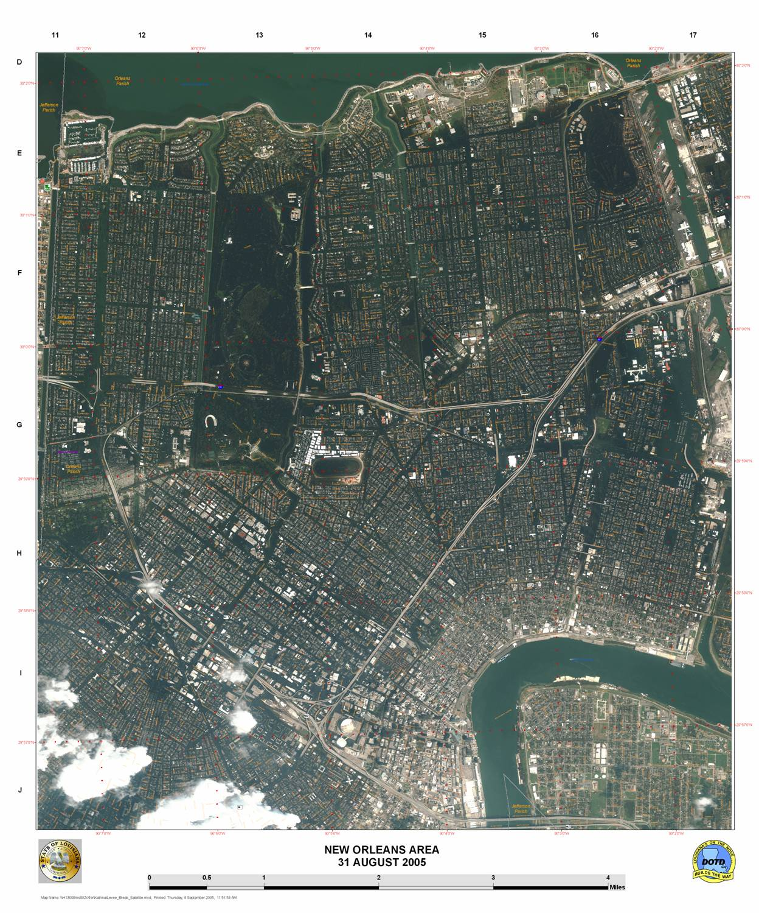
31 AUGUST 2005 GOOGLE-EARTH IMAGE OF NEW ORLEANS FLOODING
Notes:
Google Earth was used to provide before and after images and information to the public.

Slide 23
7 SEPTEMBER 2005 TM IMAGE OF NEW ORLEANS AREA
Notes:
This is a TM-image of the New Orleans area. The dark areas are flooded.

Slide 24
DOTD PLANNING MAP SHOWING ROUTES ELIGIBLE FOR FHWA AND FEMA FUNDING
Notes:
Parish maps wee used to identify FEMA and FHWA routes, as well as used for debris mapping after the storm.

Slide 25
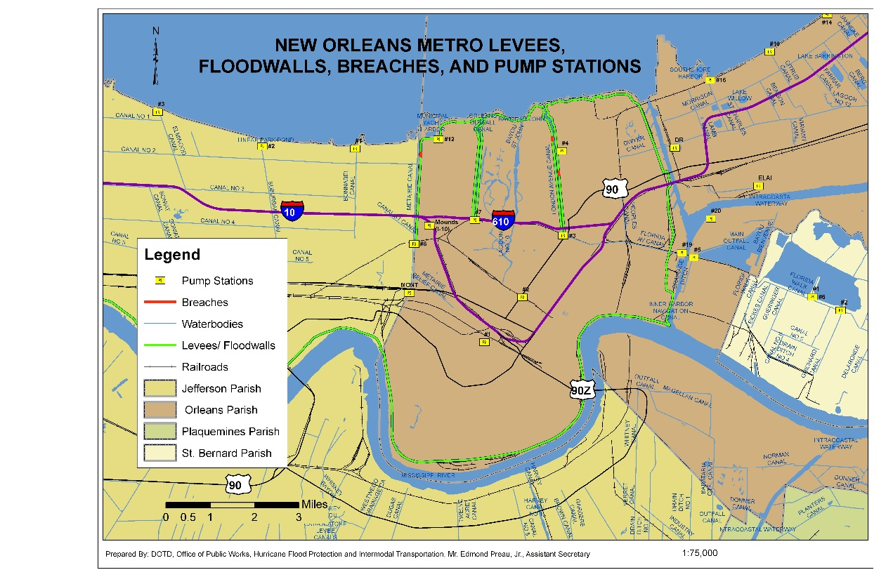
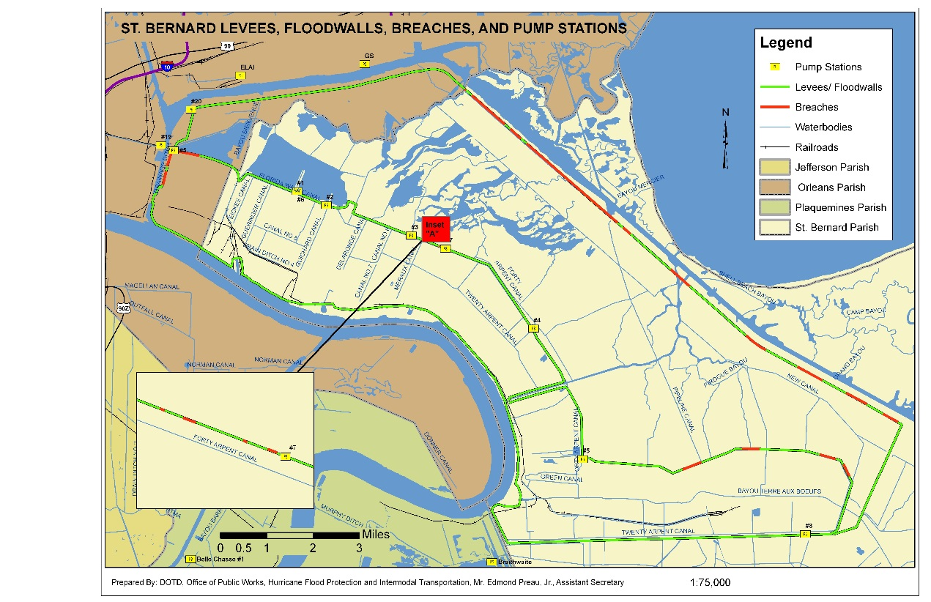
Levees and Pump Stations
Who knew?
Notes:
Levees and Pump Stations were important features in protecting and dewatering the flooded New Orleans area. Before the storm, neither these features were well mapped. They had to be added to the DOTD database during emergency operations, by staff from the Department’s Public Works Section. Since the storm, more attention has been paid to better maintaining these data. Note the red-colored levees, depicting locations where levees were breeched.

Slide 26
1 MINUTE LONG/LAT GRID (RED) AND 500 METER UTM NATIONAL GRID (GREEN)
Notes:
Finally, a grid system needs to be adopted to support search and rescue operations. The grid needs to provide unambiguous, unique locations. In addition, a simple nomenclature needs to be used to identify cells on the grid. The UTM-based “National Grid” is not intuitive to local and state-level users. To complicate issues in Louisiana, the state occupies two UTM zones. This means that there are multiple National Grid systems in various parts of the state. In May, 2006, the Louisiana Geographic Information Systems Council adopted a 15-second Longitude/Latitude search & rescue grid.

Slide 27
Mapping Debris Removal
Notes:
After the storms, millions of cubic yards of debris had to be collected and properly disposed of. Louisiana Department of Transportation and Development and Louisiana Department of Environmental Quality produced maps of debris collection sites and tracked the removal of debris across the state.

Slide 28
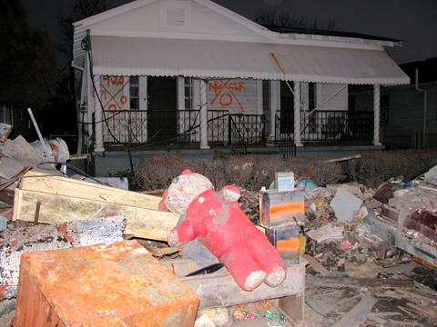
This presentation is dedicated to the
IT Professionals who worked tirelessly to serve the State of Louisiana in the wake of Hurricanes Katrina and Rita
Their efforts, although largely unsung,
saved lives and property, and made a difference

