Slide 1

What Comes First, the Data or the Disaster?
by James E. Mitchell, Ph. D.
IT GIS Manager
Presented at the 2010 DHS HIFLD Conference, San Diego, CA
Notes:
“What Comes First, the Data or the Disaster” a presentation by James E. Mitchell, Ph. D., IT GIS Manager at the Louisiana DOTD; at the 2010 USDHS Homeland Infrastructure Foundation-Level Data (HIFLD) Working Group Conference at San Diego State University.
Dr. Mitchell has been involved in emergency management and response, since the 2002 Hurricane Season, when e worked Hurricanes Isidore and Lili. In 2004, he headed a team of GIS specialists developing the Louisiana Emergency Evacuation Plan. The plan, based on GIS analysis, was executed to evacuate southeast Louisiana before Hurricane Katrina. This operation evacuated 1.38 million people and was the most successful evacuation of a major metropolitan area in history. The plan was also evoked for Hurricanes Rite (2005), Gustav (2008), and Ike (2008).
LADOTD is responsible for ESF-1 – Transportation and ESF-3 – Pubic Works and Engineering during statewide emergency operations. In addition, they have secondary responsibility for eleven other Essential Support Functions and primary responsibility for debris removal from the transportation network.

Slide 2
Panelist Questions
1. How do you use HSIP data to support your mission?
2. Which HSIP data do you use the most?
3. Which HSIP data do you use the least, or not at all?
4. Do you know of additional data that could be included in HSIP that would benefit the community?
5. What additional data would you like to see in HSIP?
Notes:
Each panelist was asked to address these five questions in their presentation.

Slide 3
Panelist Answers
The only time I used HSIP (Gold) was during Hurricane Gustav.
It took a long time to find the gas station data I needed.
After examination, my own data was clearly better (more records, more up to date).
During an event, there is no time to try to learn how to use the database.
I know of good data; we keep ours up to date and as current as possible for our own operational needs.
Notes:
HSIP was not available for Hurricane Katrina. The only experience LADOTD had with HSIP Gold was during Hurricane Gustav, in 2008. Because it was the first time, unfamiliarity with the data structure and content made it very difficult to use. A primary mission for LADOTD was to find the locations of gas stations for public use. After hours of searching, it was determined that the state had many more locations in its database and HSIP was abandoned.

Slide 4
How Can We Make Data Useful for Emergency Operations?
Standards
  Scale and Currency Sufficient to Use
  Consistent Content
  Reliable Quality
Interoperability
  Direct Entrée
  Seamless Access
Discoverability
  Complete and Up to Date Metadata
  Statements of Data Scale and Accuracy
Notes:
The characteristics of data that make it useful include:
Standards
Standard data formats and field definitions make the data more easily usable. Accuracy standards can make data more reliable and speak to the data’s ability to fit a particular purpose.
Interoperability
Data interoperability is essential to avoid the cost in time and resources to transform data into a usable form by end-users. It can often be accomplished through Service Oriented Architecture (SOA) that can provide data directly from is source to the end-user.
Discoverability
If the data cannot be found, it is of no use. This characteristic speaks to the need for meaningful metadata. Metadata needs to include useful statements of accuracy, currency, and reliability of the data.

Slide 5
The “AAAAA” Data Standard
 | Factor | Contribution to Data Quality
 | Accurate | The data adequately represents the state of the world in space and time. Locations have sufficient precision for their scale of use and data are current.
 | Authoritative | The source of the data provides sufficient quality control to ensure its quality.
 | Actionable | The data are well documented with metadata, require little further assessment or manipulation, and can be put to immediate use.
 | Accessible | The data are discoverable and available through direct download or Service Oriented Architecture (SOA). Data can be searched directly, selected, and accessed without intervention by its provider.
 | Affordable | The data can be accessed with little or no cost to the user.
Notes:
The “AAAAA” data quality standard describes the essential elements of data quality that must be attained when developing and maintaining an enterprise GIS database.

Slide 6
“BEST AVAILABLE” is NOT a Data Standard
It is an Excuse for BAD Data
Notes:
There is NO excuse for bad data. If data are not sufficient to perform a task, it should not be used. This includes feature accuracy, currentness, or scale. If it is not suited to do the work, it should not be used. If you find yourself using “best available” data; you should start looking for good data.

Slide 7
The Current Status of USGS Maps
(Upated January 2010)

Slide 8
How Up to Date are Louisiana’s Maps?
100% of paper maps are 5 years or older
83% of paper maps are 10 years or older
69% of paper maps are 15 years or older
42% of paper maps are 20 years or older
26% of paper maps are 25 years or older
Digital map data have never been updated
and are older than the paper maps
(Updated January 2010)

Slide 9
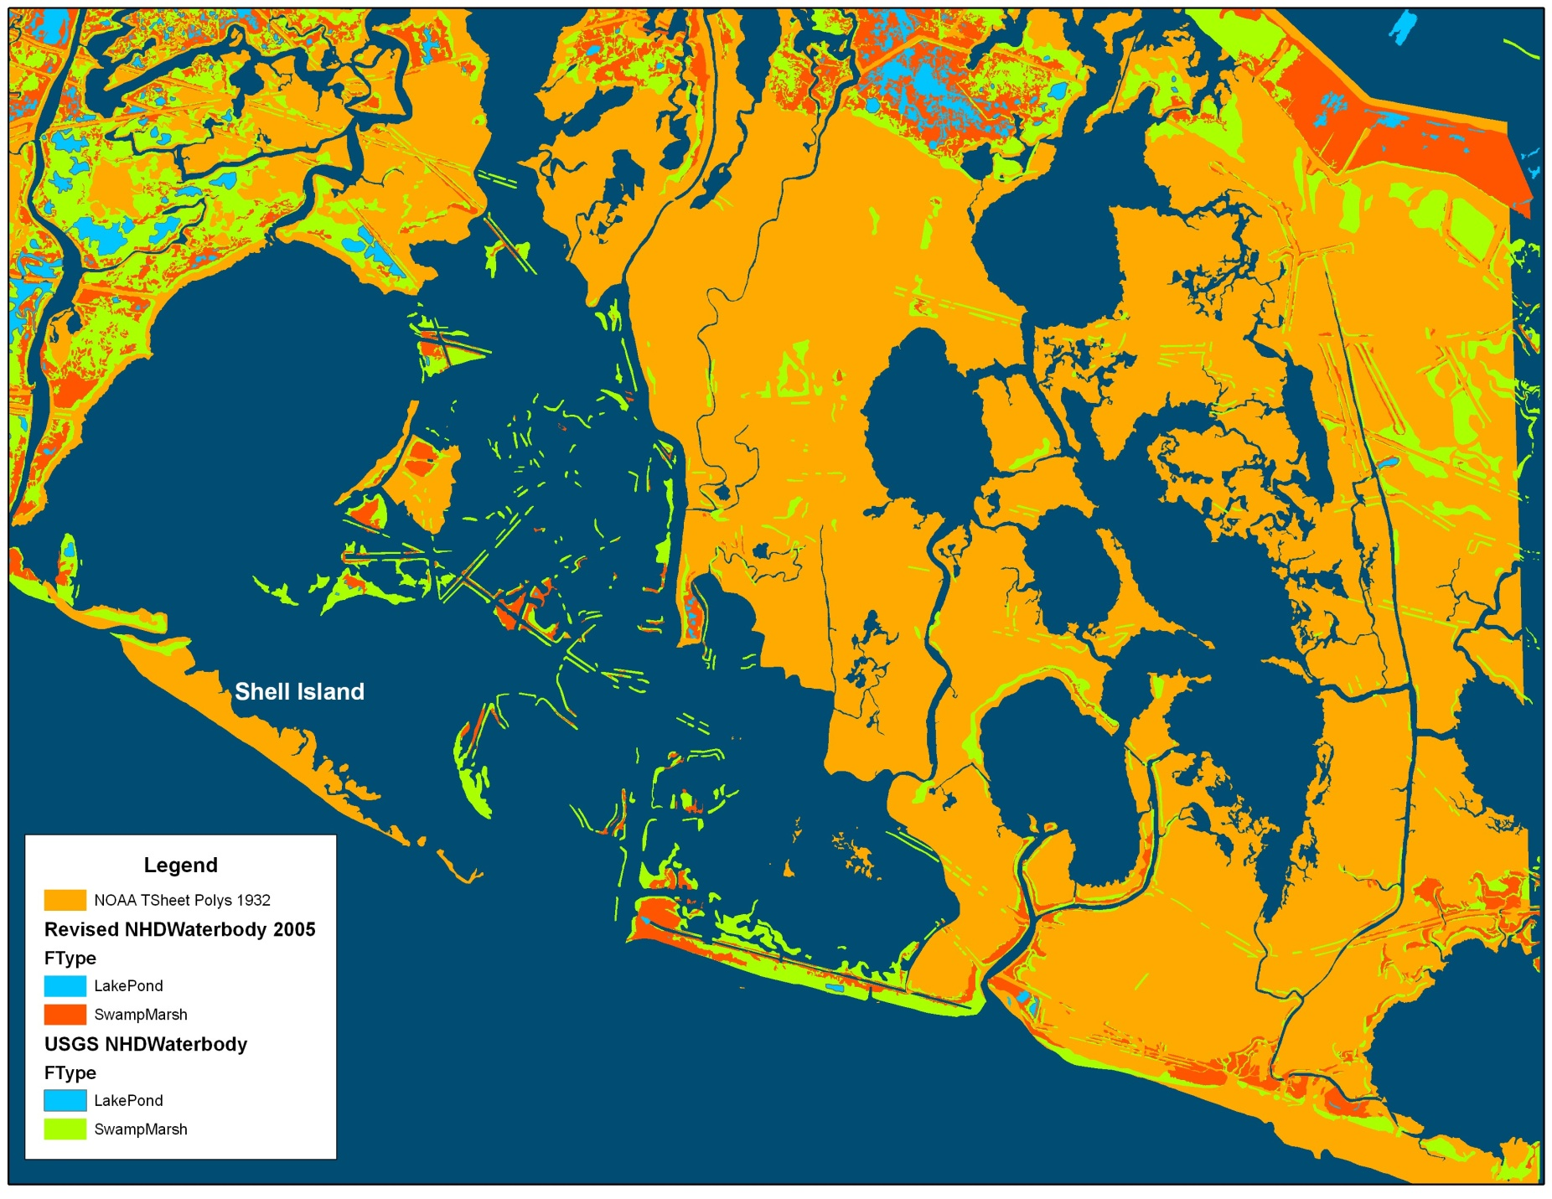
Where Has All the Coastline Gone?

Slide 10
“One Map”
The Foundation of Interoperability
What are Base Map data?
  Elevation (grid and other raster formats)
  Hydrography (NHD formats)
  Transportation (comprehensive roads, railroads, air, and ports)
  Boundaries (governmental units, flood zones, public land survey, etc.)
  Land Cover (natural vegetation, crops, etc.)
  Land Use (urban, agricultural, forestry, etc.)
  Manmade Structures (significant structures)
Notes:
The “Base Map” forms the foundation for data interoperability. It is the common operating environment over which all business data are placed. The base map is comprised of those layers that are common to most maps:
Water
Transportation
Boundaries
Land Cover
Land Use
Manmade Structures

Slide 11
Service Oriented Architecture
A Means to Situational Awareness
  Real-time Data Delivery
  Feature Services
    Direct data access
    Data distribution
    Security and access control
  Geoprocessing Services
    Extending functionality to those who do not have a GIS
  All provided from the source directly to the user, seamlessly and without institutional intervention
Notes:
SOA – “Service Oriented Architecture” is a technology that can be used to broadcast information from its source, seamlessly and without intervention to end-users, anywhere, at any time.

Slide 12
A CASE STUDY
  How did Louisa evacuate 1.38 million people from southeast Louisiana
  before Hurricane Katrina in 2005
  and
  2 million ahead of
  Hurricanes Gustav and Ike in 2008?
Notes:
Necessity is the mother of invention. Louisiana has borne the brunt of some of the nation’s largest geospatial disaster events. What are the lessons learned?

Slide 13
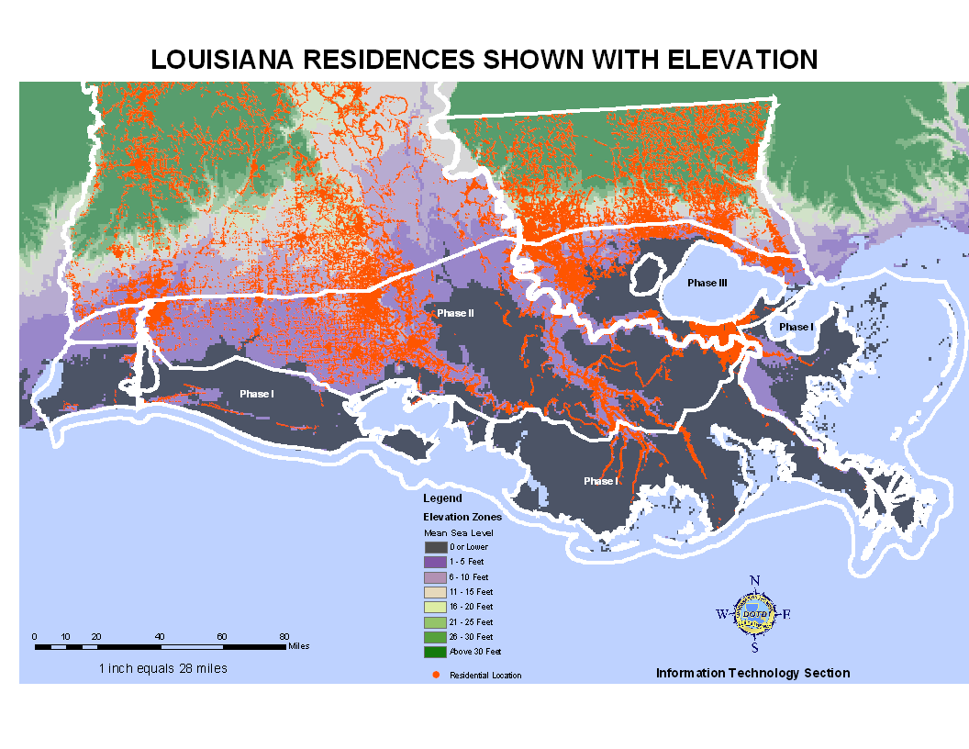
It Started with Data on a Map
Notes:
A year before the storms of 2005, LADOTDE and LA State Police teamed up to create the Louisiana Emergency Evacuation Plan. It started with a spatial analysis of residential locations (in red) and land surface elevations (background map). Three Phases were defined. Phase I was the outer coast, outside of the Intercoastal Waterway. Phase II was between the Intercoastal Waterway and Interstate 10. Phase III involved Conta-flow and included New Orleans and he Lake Pontchartrain Basin (The area between Interstate-10 and Interstate-12).

Slide 14
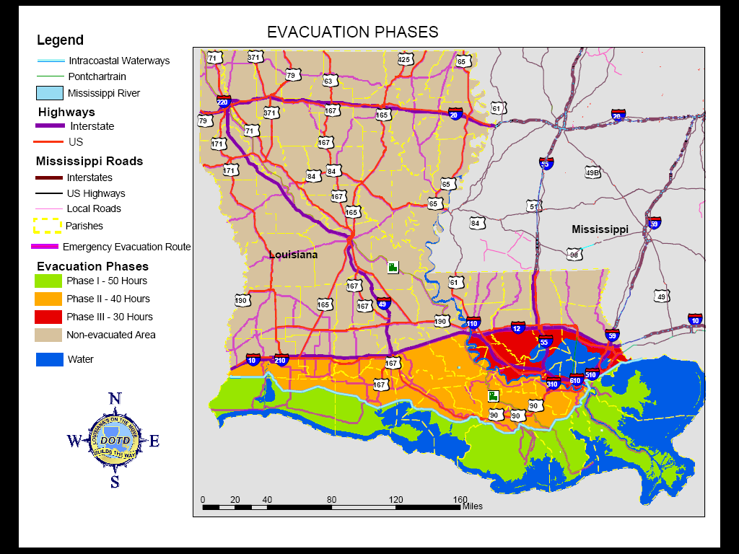
Evacuation Phases Based on GIS Analysis
Notes:
Data turns into information on a map. This is the map was initially created by the Louisiana State Police for dissemination to the public. LSP chose these colors. After discussions with LADOTD, the color scheme was changed to show the Phase I area as red, Phase II as yellow, and Phase III as orange to reflect the urgency of evacuating the coastal areas farthest from high ground. In 2006, the plan was extended to develop phase III, contra-flow plans foe central and southwestern Louisiana.

Slide 15
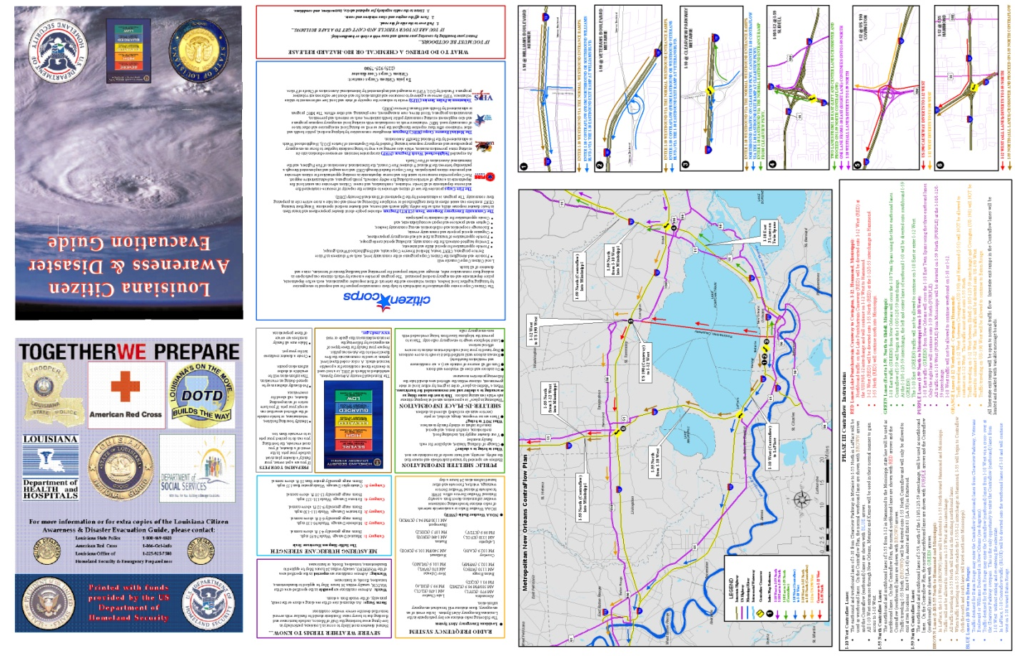
One Million Households
One Million Maps Produced & Distributed
Notes:
Louisiana Emergency Evacuation Plan distributed to the public.

Slide 16
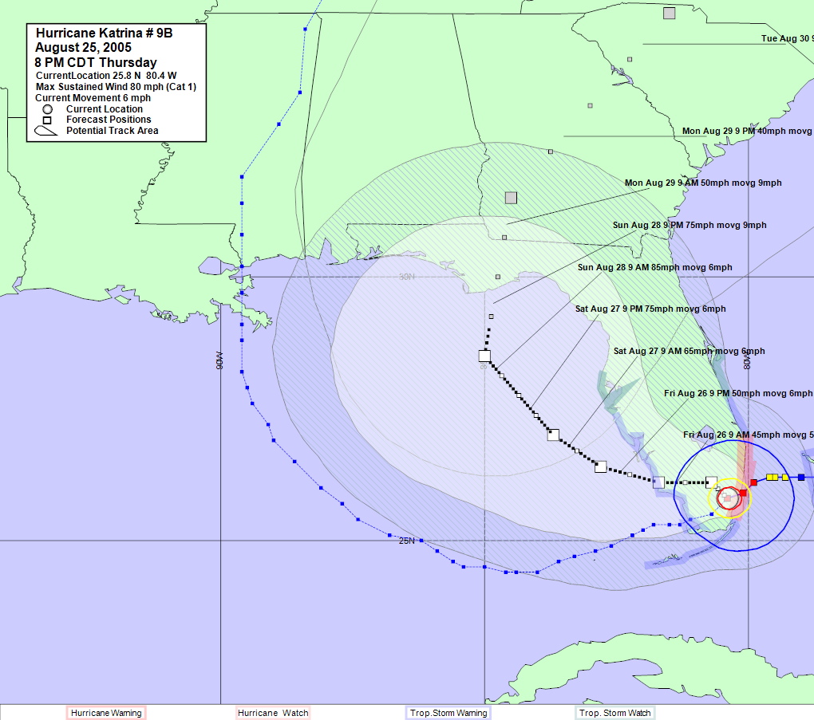
HURREVAC – “AAAAA” Data for Emergency Managers
Notes:
HURREVAC is a program supported by FEMA, US Army Corps of Engineers, and the NOAA-National Hurricane Center. It provides access to NHC advisories in a map interface, as well as other emergency management functions. During Hurricane Season, LADOTD IT-GIS staff use this software to monitor tropical weather conditions and approaching storms. Different views of storm characteristics are available. This is the storm track and “error cone” on Thursday morning, 8/25/2005. Note that at this time the storm is headed to western Florida. The actual storm path is also displayed. It appears just outside of the western margin of the cone of uncertainty. One-third of all storms take tracks outside of the cone of track uncertainty. Katrina was one of those storms.

Slide 17
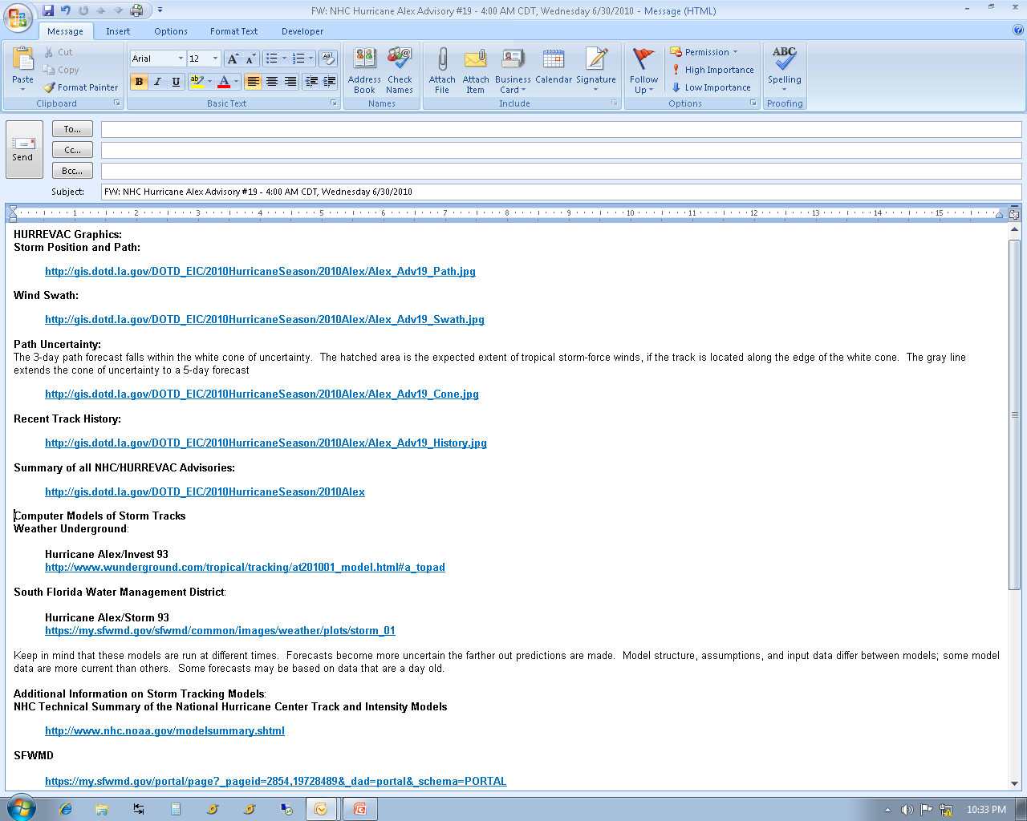
HURREVAC – Situational Awareness for Decision Makers
Notes:
Information from HURREVAC, the NHC web page, and other sources on the web are monitored throughout Hurricane Season. Tropical Weather Outlooks are released by the NHC at 1 AM, 7 AM, 1 PM, and 7 PM, daily. This information is gathered, digested, and put into plain terms, with links to graphics. The information is sent to over 200 state, federal, and local officials to promote situational awareness. When tropical storms arise and HURRECAC starts issuing NHC Advisories, this information is disseminated in a like manner. This approach has evolved over the past decade, starting with email messages, then to mobile device-friendly posts, and is well received by its audience.

Slide 18
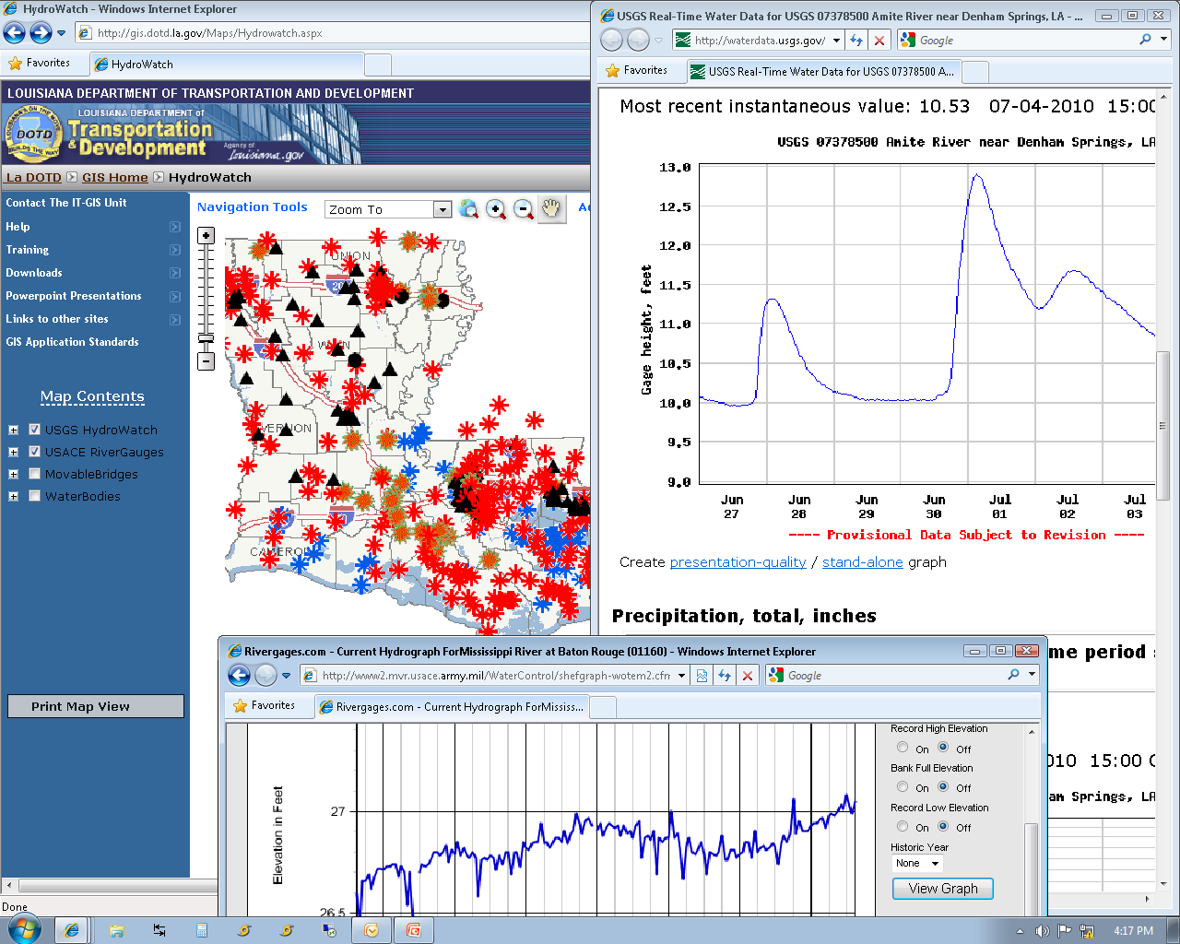
USGS HydroWatch – USACE RiverGages
Access to Real-time Data
Notes:
LADOTD hosts a number of ArcGIS Server services. This one is the HydroWatch Service. Users of this website can zoom to a location, and hyperlink directly to the USGS website for that stream gauge. The data are transmitted every 15 minutes from the site into the USGS network. In 2009, the USACE River gauge network was incorporated into the site. Now users have access to both near real-time data sources.

Slide 19
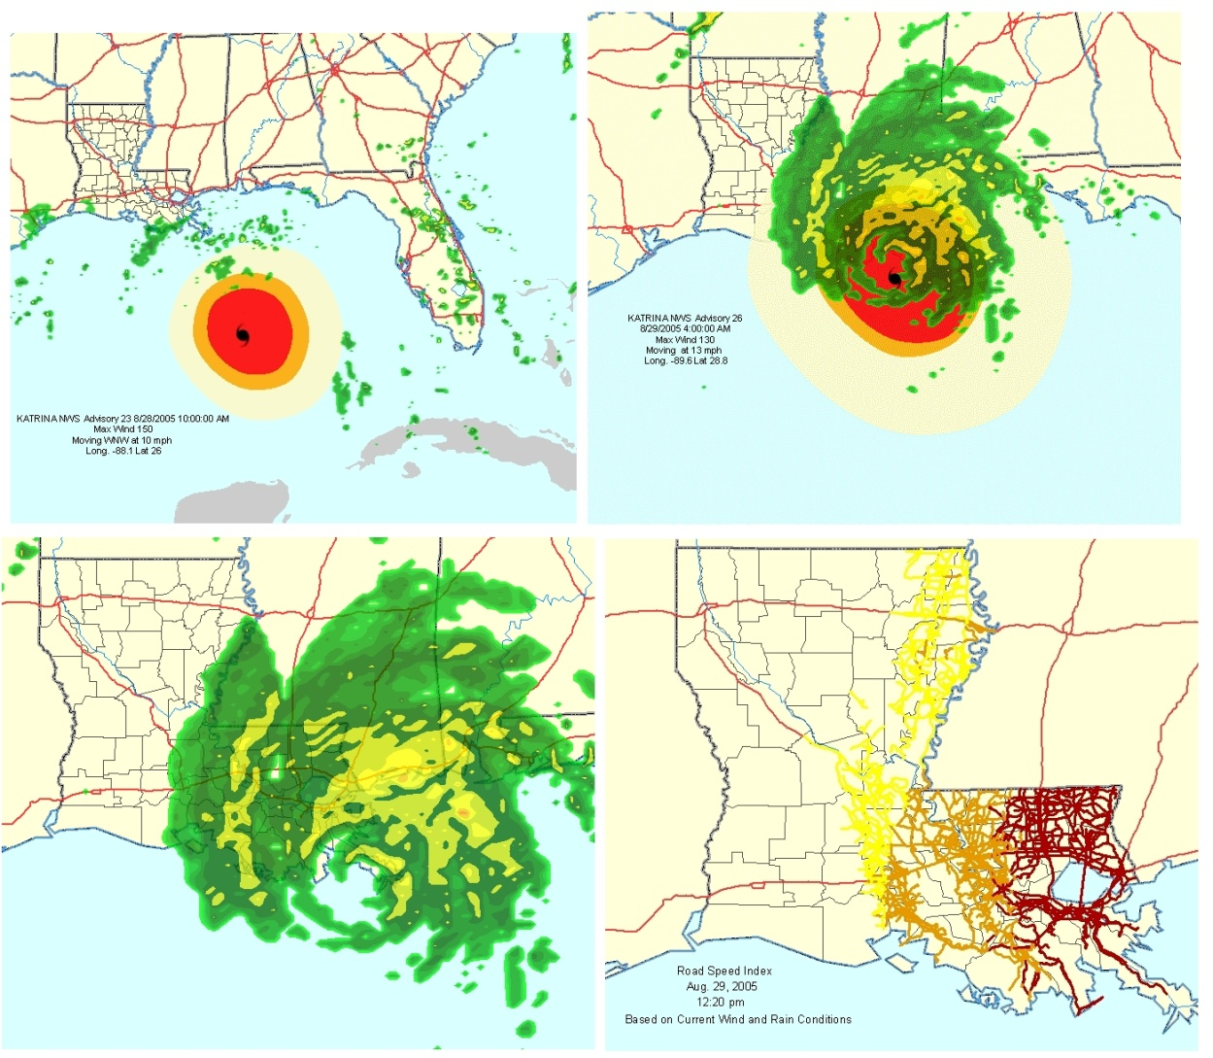
Real-time Weather Data
Notes:
As a storm approaches, GIS weather data, provided here, by DTN/Meteorlogix is invaluable. These data feed websites that automatically update and show storm path, wind rings, rain bands, etc. The website is automated so GIS staff can concentrate on other support activities. In addition, ArcGIS users can access these sites, directly in ArcMap, and combine the weather data with their own, mission-specific information.

Slide 20
Where are the Nursing Homes?
Notes:
After Katrina, it became clear that facilities such as nursing homes might have been left without evacuating residents. LADOTD used data from Experian Corporation to locate and map these locations for the Louisiana Department of Health and Hospitals. These maps were quickly produced and provided to helicopter pilots who used them to support search and rescue missions.

Slide 21
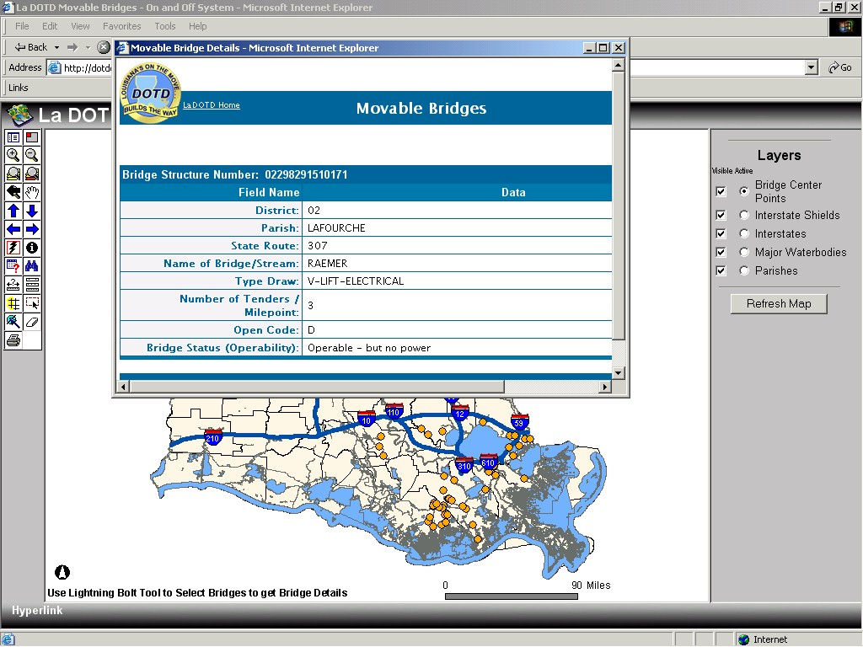
Damage Assessment – Moveable Bridges
Notes:
There are a large number of movable bridges (draw, lift, swing, etc.) in Louisiana. After a storm, the bridge maintenance staff at LADOTD had to assess all bridges, especially moveable bridges and certify them for safe use. This website was produced, in short order, to provide LADOTD staff, first-responders, and the public; with the most current status of bridges across the state. Users can zoom into the area they want to see and hyperlink directly into the LADOTD bridge database, with the click of a mouse.

Slide 22
7 SEPTEMBER 2005 TM IMAGE OF NEW ORLEANS AREA
Notes:
This is a TM-image of the New Orleans area. The dark areas are flooded. Using image analysis techniques, these pictures were converted to GIS data that could be used to identify flooded homes, facilities, and infrastructure.

Slide 23
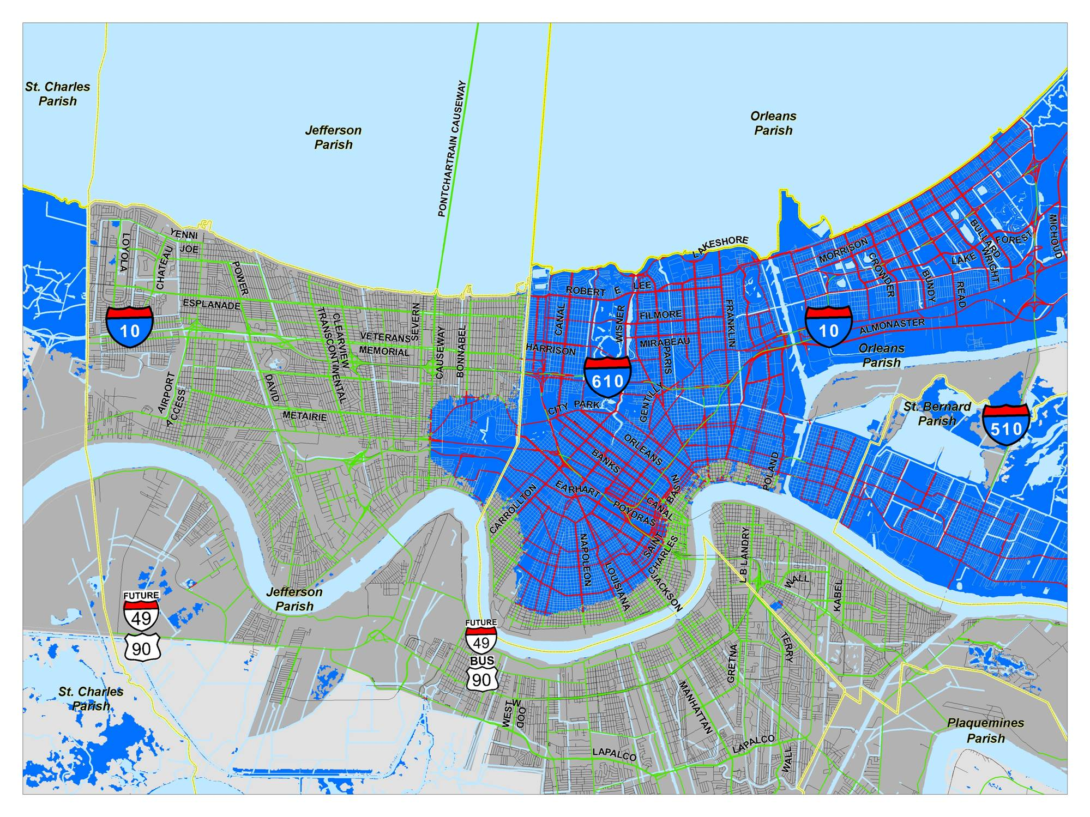
2 SEPTEMBER 2005 NEW ORLEANS FLOODED ROADWAYS
LAKE PONTCHARTRAIN
MISSISSIPPI RIVER
NOTE: FLOODED AREA DATA PROVIDED BY FEMA
Notes:
The flooded areas polygons produ8ced using image analysis was used to determine the miles of flooded roads to “jump-start” federal assistance. This map shows the flooded roadways of Jefferson, Orleans, and St. Bernard Parishes.

Slide 24
2 SEPTEMBER 2005 ESTIMATED FLOODED ROADWAYS, BY PARISH
Notes:
GIS data can be readily turned into presentation graphics to visualize damage. In this case, damage assessment included quantifying the miles of flooded roads. Tele Atlas data were used for this. The flooded area polygons developed from satellite imagery were used to perform the overlay analysis.

Slide 25
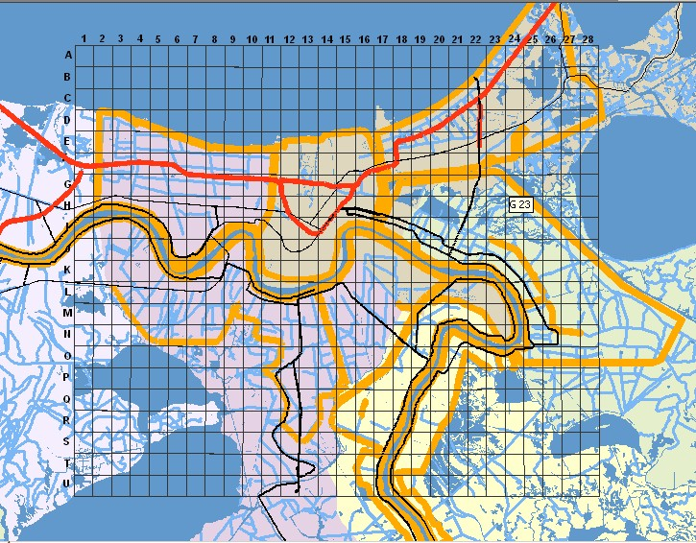
Search & Rescue Operational Grids
Notes:
After Katrina, search and rescue activities began. First-responders came from all over the US. An operational grid was created by LADOTD and posted on thousands of paper maps that went into the field and to the Louisiana Emergency Operations Center. LADOTD made it available, as a GIS web service to facilitate interoperability and distribution to anyone who needed it. The grid made it easier to dispatch responders to locations that were initially geocoded, then identified by cell ID (A-7, H-23, etc.). Aircraft, ground vehicles, and boats were also equipped with TomTom mobile GPS units donated by Tele Atlas North America.

Slide 26
Search & Rescue Grids the Crossroads of Interoperability
In Katrina, the USNG did not work
  No one had copies of the USNG
  Louisiana spans two UTM Zones
  The USNG is not a single grid but many panels
  USNG panels overlap and create confusion
The Louisiana GIS Council, Emergency Data Committee
  Met with state and federal ESF-9 participants
  Examined existing and potential reference systems
  Decided a grid system based on geographic
  coordinates works best for coordinating air and
  surface water search and rescue operations
http://gis.dotd.la.gov/Maps/SearchAndRescueGrid.aspx
Notes:
The Louisiana GIS Council, Emergency Data Committee, with representatives from the US Coast Guard, FEMA, Louisiana State Police, Louisiana Department of Wildlife and Fisheries (ESF-9 Search & Rescue Lead Agency), Louisiana Department of Transportation and Development, Louisiana Department of environmental Quality, and other interested parties, dev eloped the Louisiana Search and Rescue Grid (LASAR). The grid is based on longitude and latitude. It is broken down into successive, hierarchical subdivisions. The smallest unit is ¼-minute of a degree in size. This approach was a compromise between the various search and rescue operations participants, who all used different grid systems and approaches in their efforts.

Slide 27
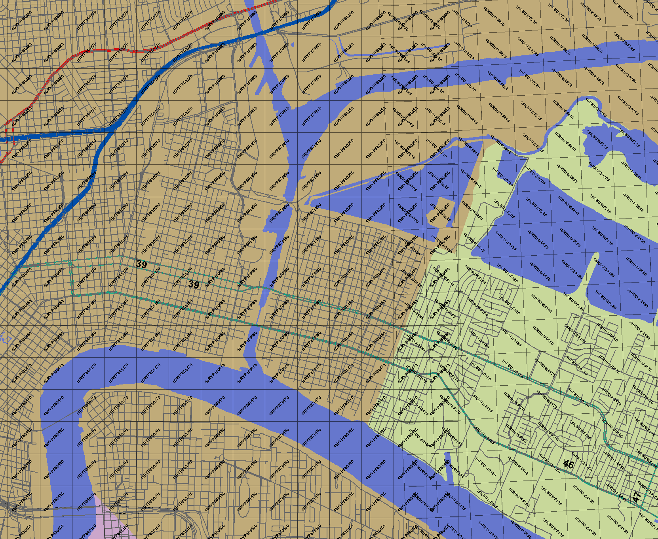
New Orleans East with USNG
Notes:
The US National Grid (USNG) was a failure in New Orleans because it did not provide unique locations for the New Orleans area. New Orleans is split by the 90W Meridian, which also splits two UTM Zones (15 and 16). The USNG is based on these coordinates. This creates an overlap between two separate tiles (“grids”) of the USNG. The problem can be seen in this map, in the area where the labels from the west tile and the east tile overlay and make a cross (“X”) on the map. Because of the nature of the UTM coordinate system, this will happen everywhere there is a zone boundary. There is no single, unique national grid using the USNG.

Slide 28
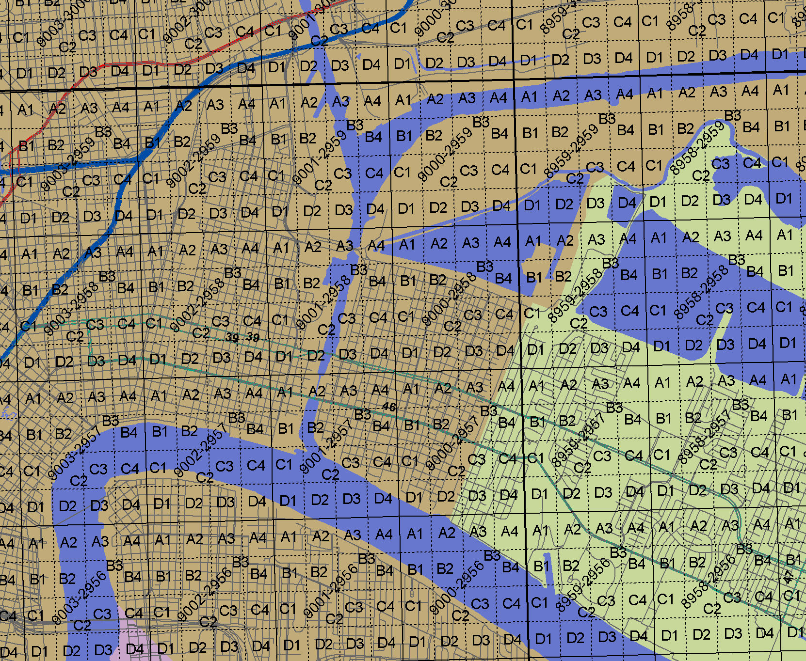
New Orleans East with the Louisiana Search and Rescue Grid
Notes:
The Louisiana Search & Rescue Grid, is based on longitude and latitude. This creates a hierarchy of grid cells at one degree, one minute, and one-quarter minute. Degree cells are identified b their lower right corner (e.g., 90-30); minute cells are similarly identified (e.g., 9000-3059). Within a one-minute cell are 16 quarter-minute cells named A1 – D4, from the upper left corner (e.g., 9000A1-3059D4).
The LASAR is available at:
http://gis.dotd.la.gov/Maps/SearchAndRescueGrid.aspx

Slide 29
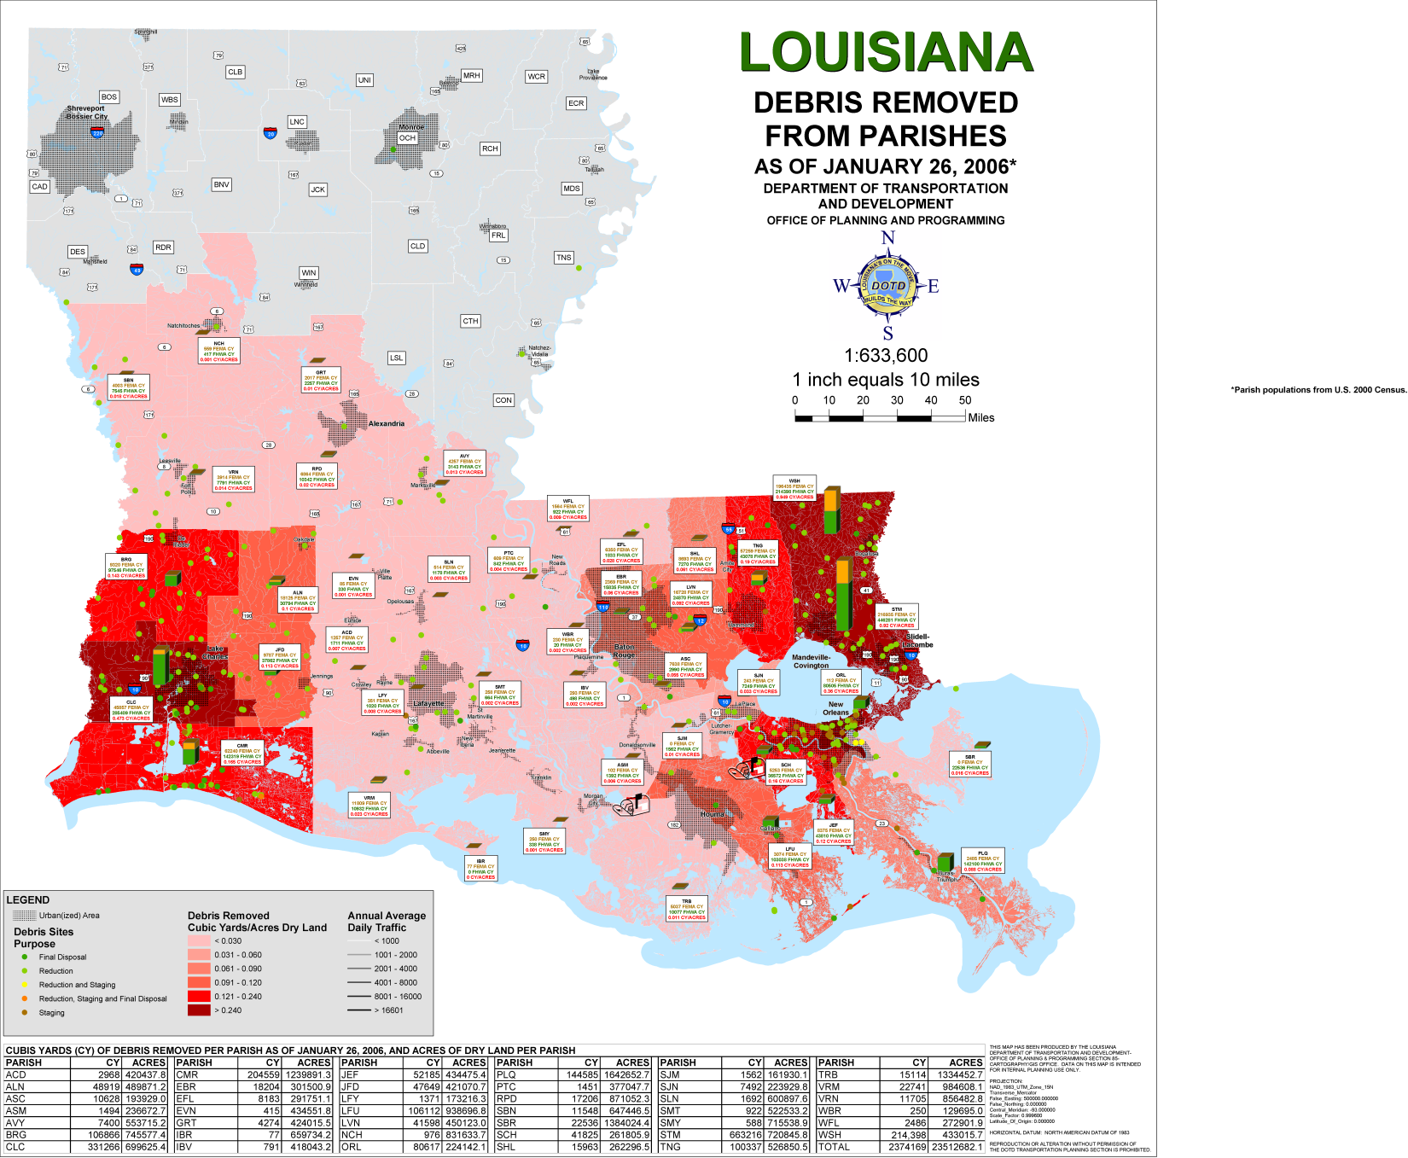
Mapping Debris Removal
Notes:
After storm events, millions of cubic yards of debris had to be collected and properly disposed of. Louisiana Department of Transportation and Development, and Louisiana Department of Environmental Quality produced maps of debris collection sites and tracked the removal of debris across the state.

Slide 30
CONCLUSIONS
Data Standards must be set and maintained
Data Interoperability is essential
Data Discoverability requires meaningful metadata
State and local data collection efforts should be promoted and supported
HSIP/HIFLD data needs to be part of training, drills, and programs such s HAZUS

