Slide 1

Katrina- Lessons Learned and
How GIS Can Do It Better, Now
by James E. Mitchell, Ph. D,
Presented at the ESRI International Users Conference
June, 2016
Notes:
In August, 2005, Hurricane Katrina hit the north-central coast of the Gulf of Mexico. Most of southeast Louisiana was heavily impacted, as well as, coastal Mississippi, which experienced the highest storm surge heights on record. This became largest geospatial disaster in history. In 2006, GIS professionals working for the state of Louisiana were too busy with recovery and restoration efforts (abstracts were due in the Fall of 2005) to make presentations at the ESRI International Users Conference. Ten years later, recovery continues.

Slide 2
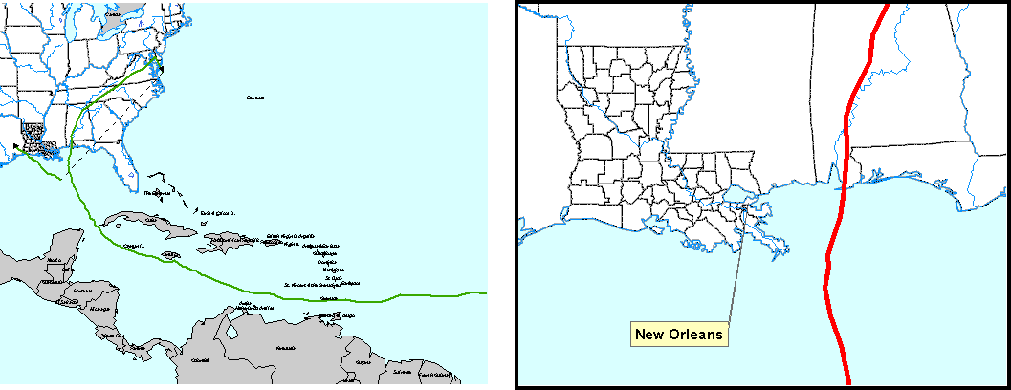
1998 Hurricane Georges
2004 Hurricane Ivan
Notes:
Interest in Contra-flow increased in 1998, when Hurricane Georges made a “bee-line” toward New Orleans. That event stimulated a large exodus from New Orleans. That evacuation created a traffic jam from the city to Baton Rouge. A trip that normally takes 90 minutes, took more than 12 hours. In 2004, Hurricane Ivan punctuated the concerns of emergency managers, with another near-miss. Improvements in traffic management reduced he travel time to 10 hours. More significantly, the Louisiana Emergency Evacuation Plan was conceived, including a phased evacuating, ending with contraflow – all Interstate lanes outboundfrom New Orleans.

Slide 3
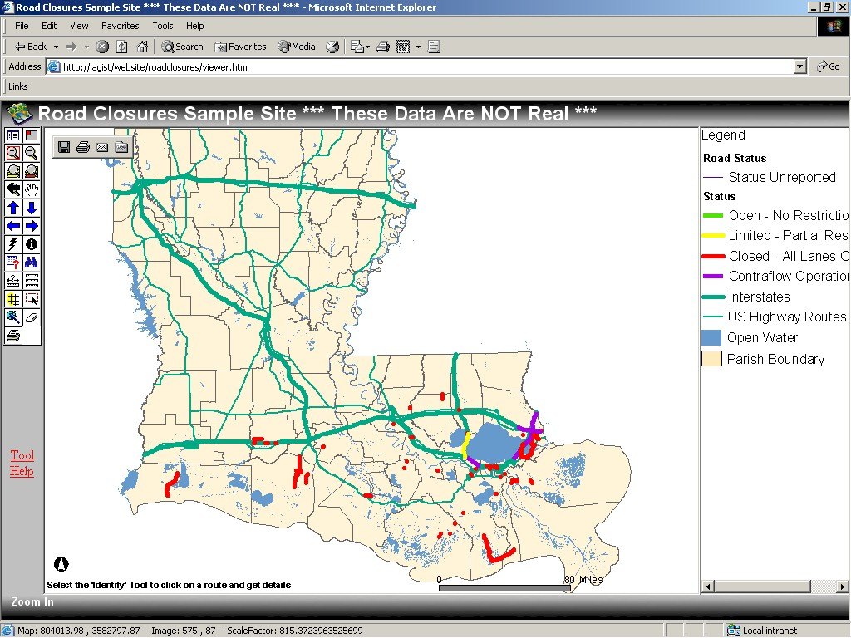
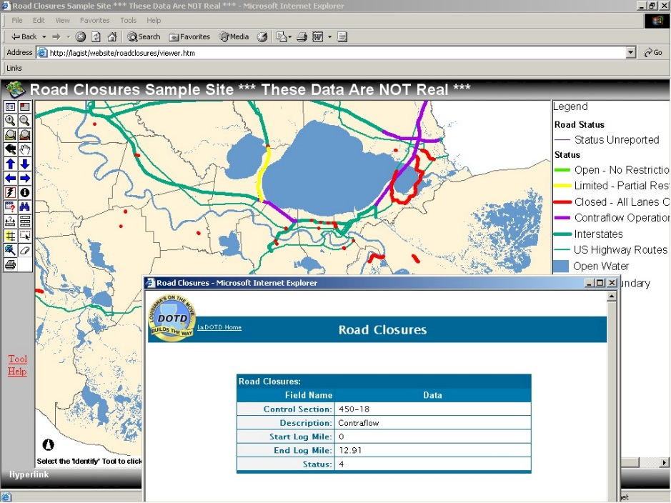
Hurricane Isidore
September 2002
Delivering the big picture, at a glance
An after-action mock-up of the Road Closure Map used in Hurricane Isidore. This website is based on ArcIMS technology
and delivering information with a click
Notes:
In 2002, Louisiana experienced two hurricane landfalls; Hurricane Isidore and Hurricane Lili. Enterprise GIS was new at LADOTD, but was able to provide situation awareness, using ArcIMS, the state-of-the-art web-based GIS technology, at that time. Users were able to identify and click on a road closure to get additional information in an ASP-based pop-up screen.

Slide 4
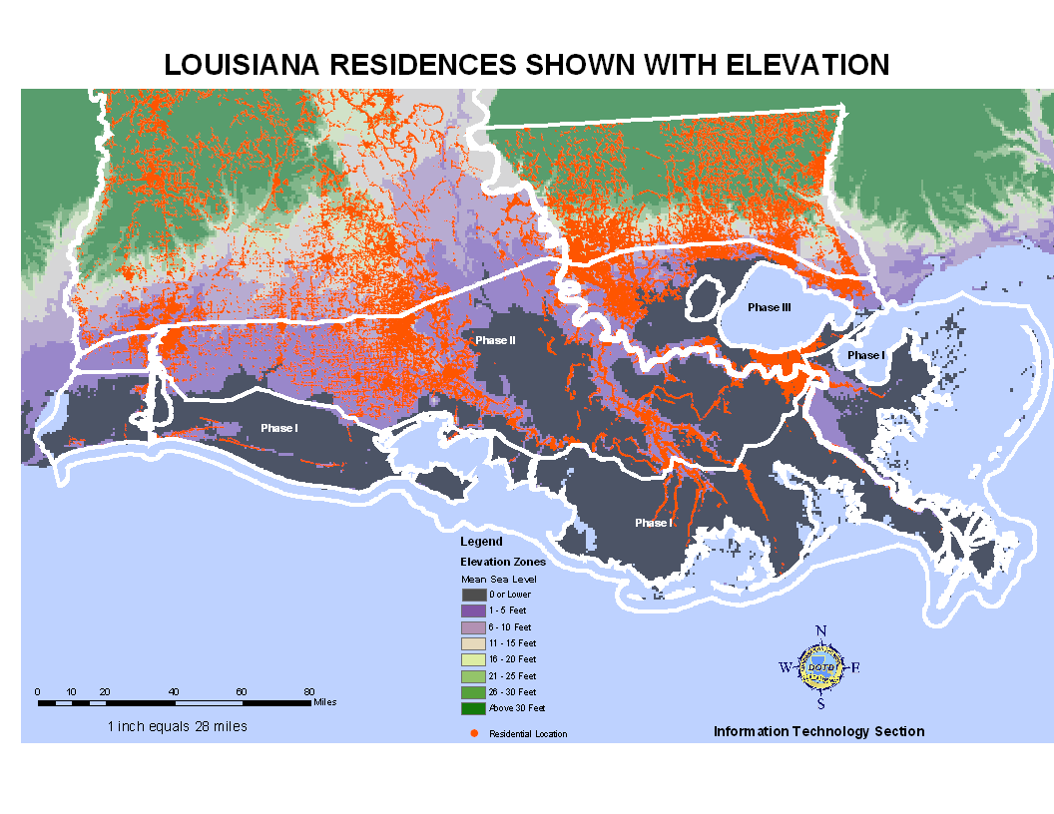
Analysis of Household and Business
Locations to Support Evacuation Plans
Notes:
A year before the Katrina, LADOTD and LA State Police (LSP) teamed up to create the Louisiana Emergency Evacuation Plan. It started with a spatial analysis of residential locations (in red) and land surface elevations (background map). As a result, three Phases were defined. Phase I was the outer coast, outside of the Intercoastal Waterway (ICWW). Phase II lies between the ICWW and Interstate 10. Phase three involves Contraflow from New Orleans and the area surrounding Lake Pontchartrain, up to Interstate 12. The I-10/I-12 corridor was built along the first relatively high ground across southern Louisiana.

Slide 5
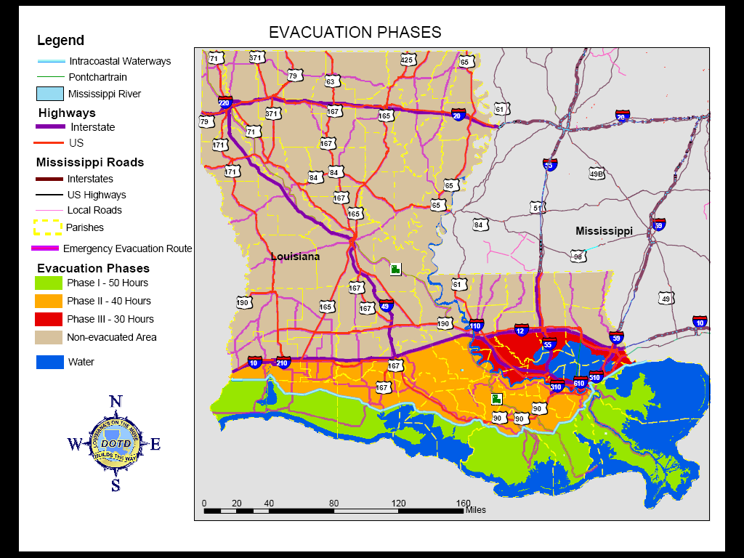
First Draft
Evacuation Phases Based on GIS Analysis
Notes:
Two Important features of this plan are 1) the phased approach and 2) the use of well-recognized and easily identifiable landmarks to delineate the phase boundaries. This is the DRAFT map created by LSP for dissemination to the public. LSP chose these colors. After discussions, between LADOTD and LSP, the color scheme was “flipped” to show the Phase I area as red, Phase II as orange, and phase II as yellow.

Slide 6
Final Stages of the Louisiana
Emergency Evacuation Plan
72 hours from Tropical Storm Winds Landfall
Stage Assets and Personnel
50 hours from Tropical Storm Winds Landfall
Evacuate Phase I
40 hours from Tropical Storm Winds Landfall
Evacuate Phase II
30 hours from Tropical Storm Winds Landfall
Evacuate Phase III - CONTRAFLOW
6 hours from Tropical Storm Winds Landfall Terminate Contraflow – Secure Assets and Personnel!
Notes:
This is a brief description of the final stages of the LEEP. A key point is that milestones are linked to the time when tropical storm-force winds (39 mph) make landfall, in Louisiana (H-0 or “zero-hour”). It is NOT when the eye of the hurricane reaches land. Tropical storm-force winds are strong enough to disrupt surface transportation systems; closing bridges, slowing traffic, blowing over vehicles.
However, Katrina did not “follow this script.” The initial forecast path, along Florida’s west coast, suddenly “jumped” across the Gulf of Mexico and headed toward southeast Louisiana. This 72-hour timeline was actually started at H-49.5 and contraflow was kept active for 10 additional hours, until H+4. Yet, it was still successful and represented the largest evacuation of a major metropolitan area, in history.

Slide 7
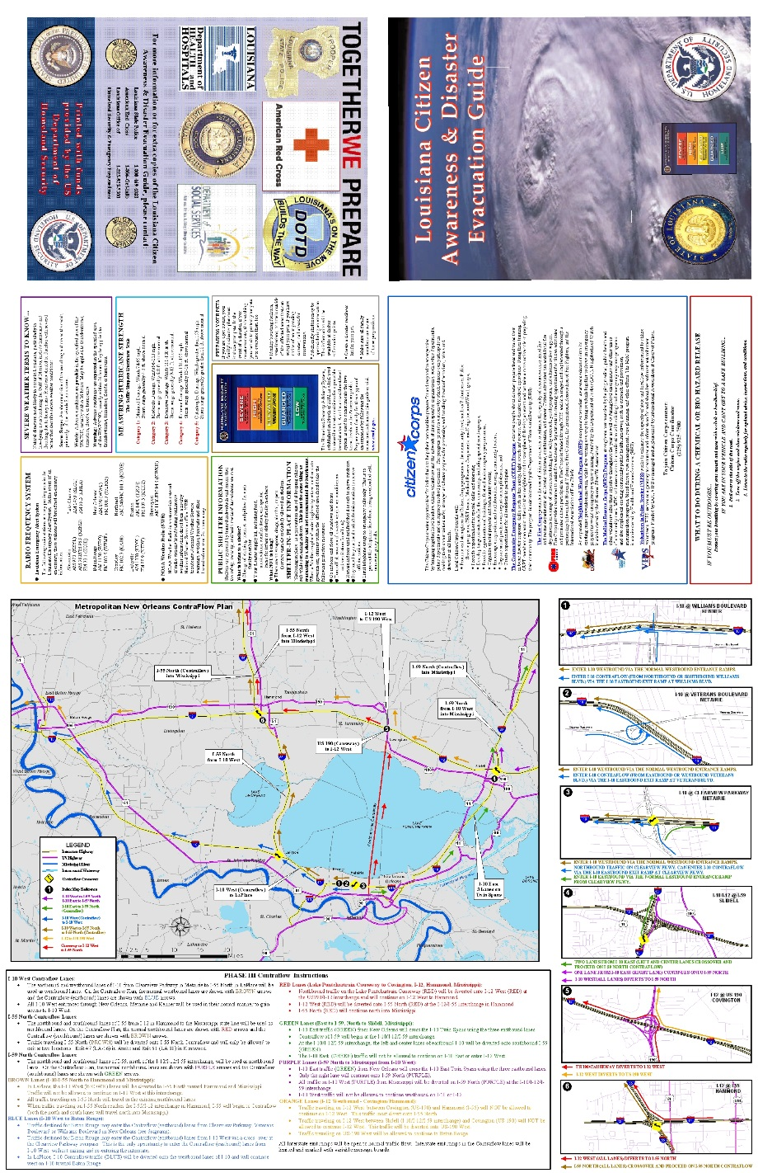
1 Million Households - 1 Million Maps
First Draft
Proof-sheet
Notes:
A million maps/brochures were produced for distribution to the public. They included information on emergency evacuations, maps of routes, maps of interchanges, and how to enter and exit Contraflow. The program was very effective, as measured by the great success in moving nearly 1.4 million people out of harm’s way.

Slide 8
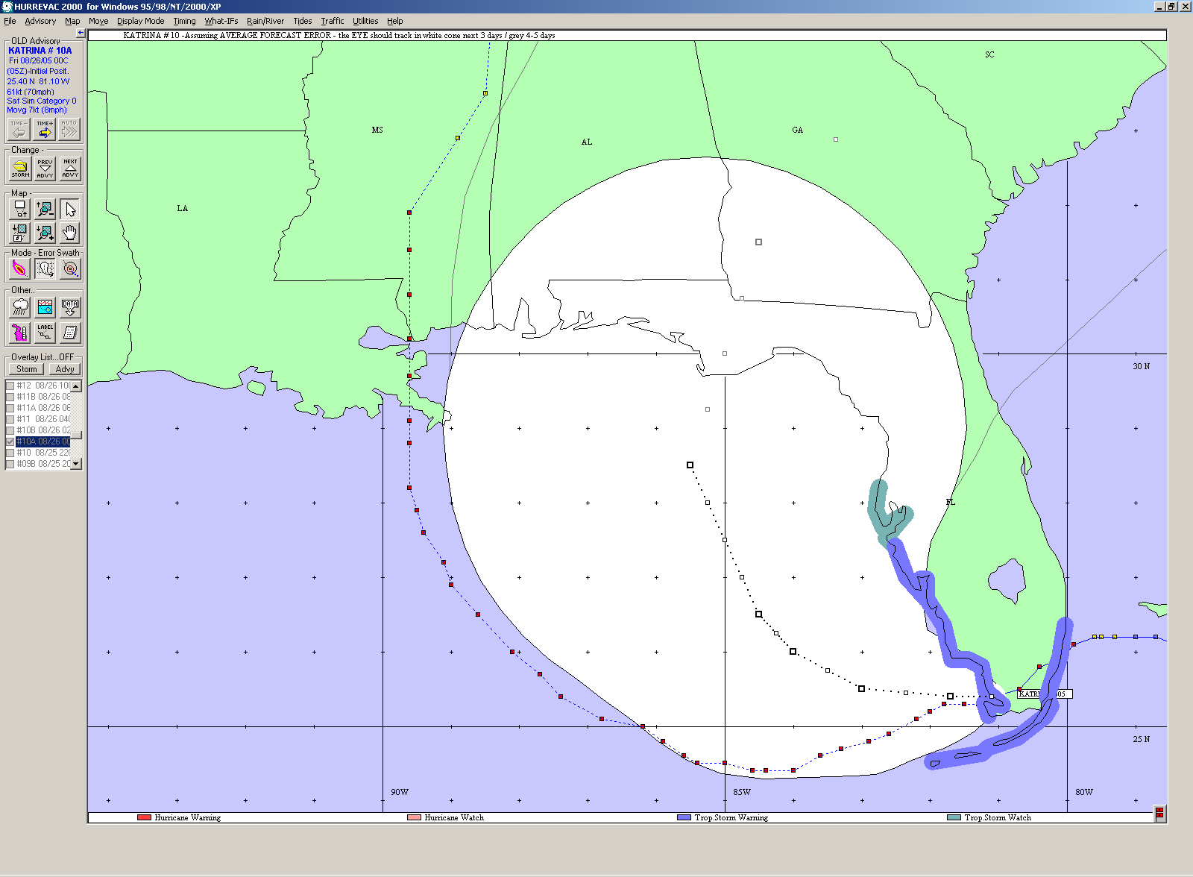
HURREVAC – Situational Awareness
2 AM CDT Friday 8/26 Path/Cone of Uncertainty Forecast
Notes:
HURREVAC is a program that is supported by FEMA, US Army Corps of Engineers, and NOAA. It provides access to NHC advisories in a map interface. Before a storm LADOTD GIS staff use this software to monitor the approaching storm. Several different presentations are available. This is the storm track and “error cone” on Friday morning 8/26/2005. Note that at this time, the storm is headed to western Florida. The actual storm path is displayed, just outside of the western margin of the cone of uncertainty. In subsequent forecasts, the path moves markedly west, toward southeast Louisiana.

Slide 9
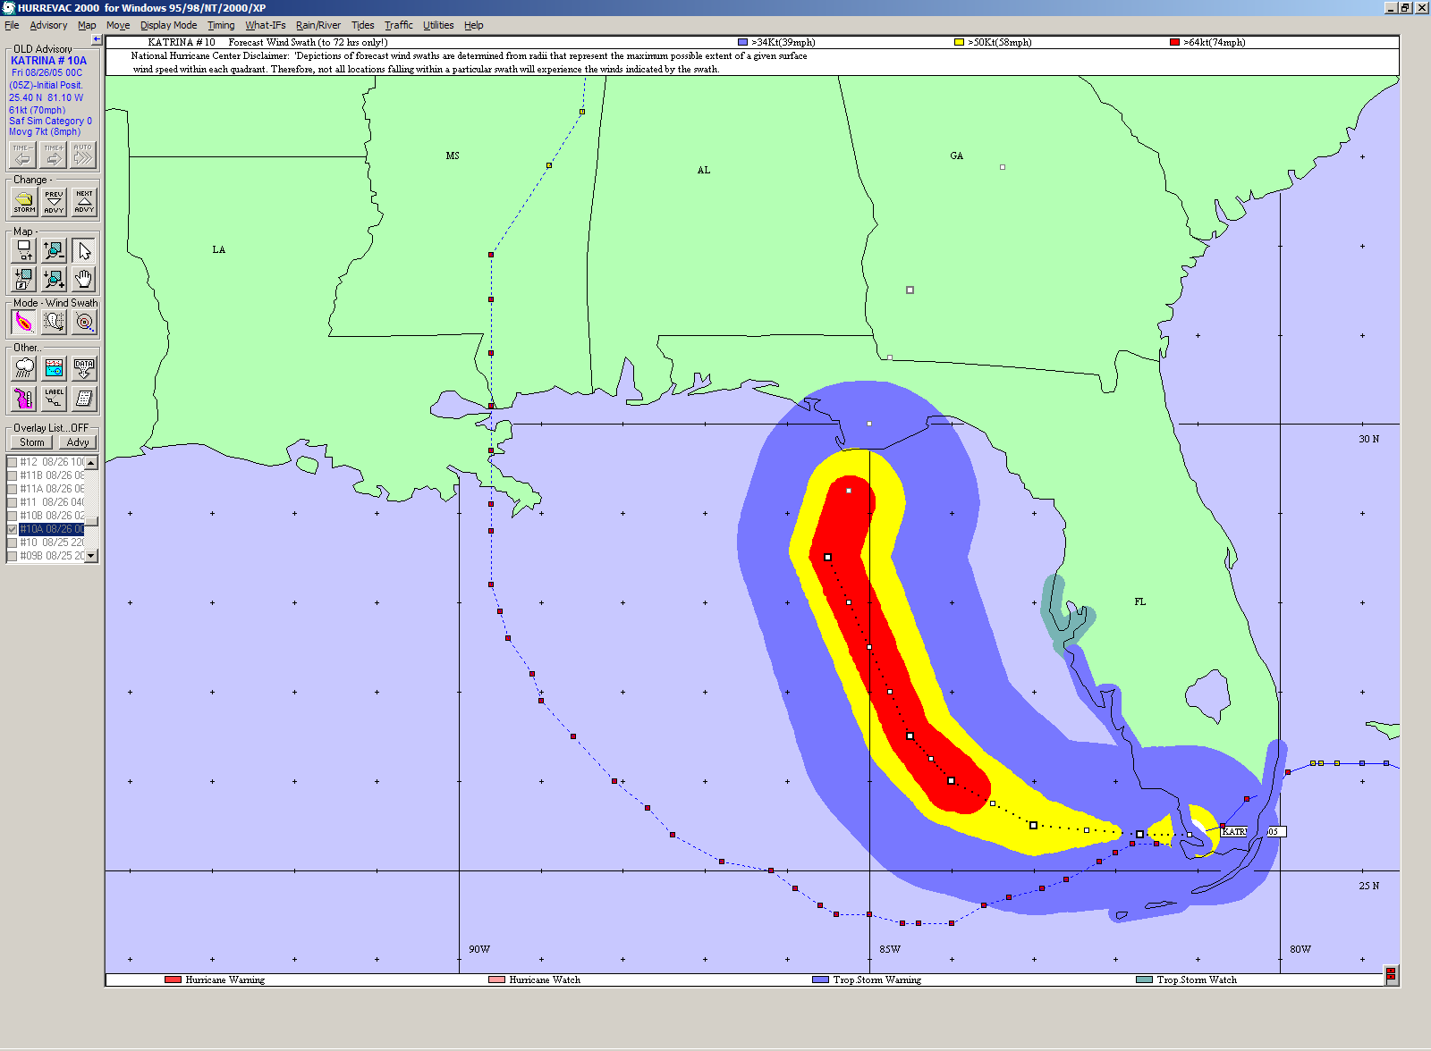
HURREVAC – Situational Awareness
2 AM CDT Friday 8/26 Forecast Wind Swath
Notes:
This is the same forecast of 8/26/2005, except that it depicts the wind swath associated with this forecast. The blue zone represents tropical storm force winds, yellow is strong tropical storm -force winds, and red is hurricane-force winds. Note that on Friday morning, about 50 hours before the storm hit (tropical storm-force winds reached Louisiana), the forecast track and winds are headed to Florida’s Apalachicola Peninsula.

Slide 10
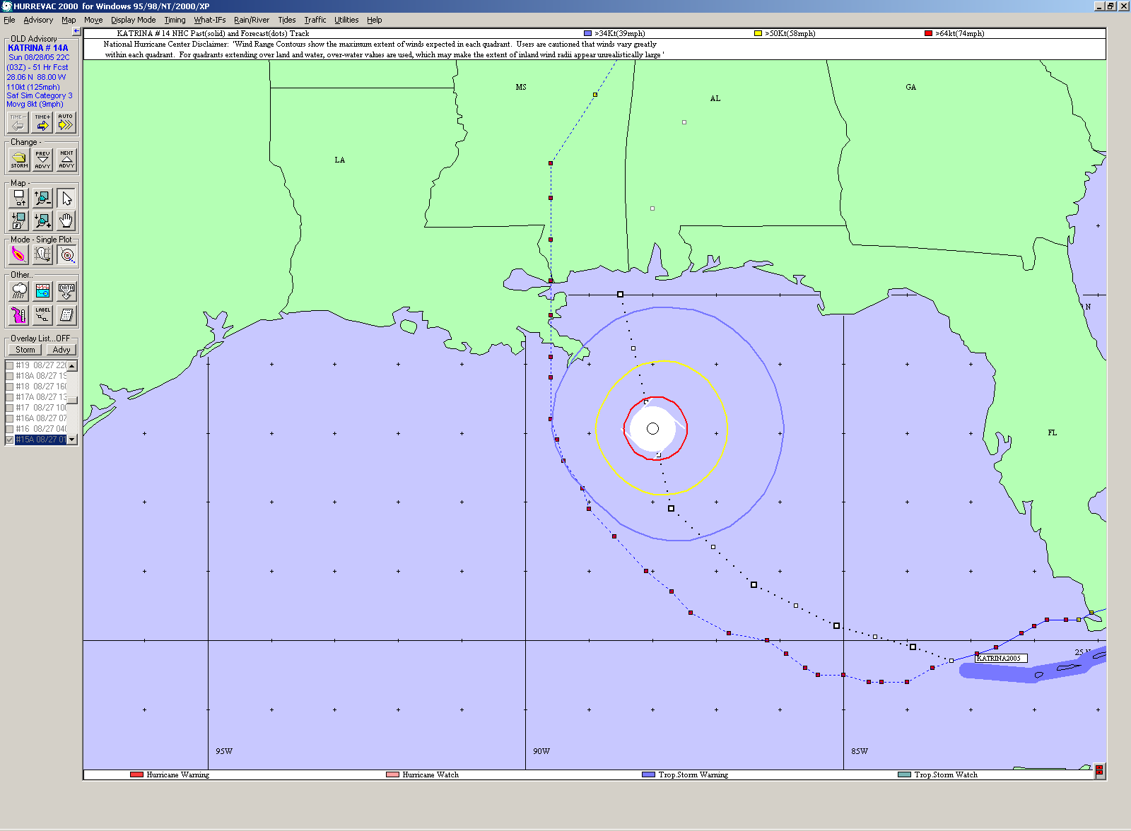
HURREVAC – 0-Hour
54-hour Forecast Position at 4 PM CDT Friday 8/26
Notes:
BY Friday afternoon, 8/26/2005, the forecast path has moved west. This view shows the “Wind Rings” and the projected position of the storm in 54 hours (10 PM CDT Sunday, 8/28/2005). The speed of the forward storm increased and the size of the storm also increased. This ad the effect of Katrina making landfall in slightly less than two days. By the time the effect of the forecast “jump” across the Gulf was realized, Emergency Operations were already behind the LEEP time-line.

Slide 11
Pre-storm Information Delivery
Notes:
Data from HURREVAC are downloaded and, using GIS, combined with other LADOTD data to prepare graphical products that were emailed to emergency managers and DOTD personnel. Eventually, they were provides as hyperlinks to websites. This reduced the size of emails and made them viewed on wireless, mobile devices, such as Blackberrys (state-of-the-art at the time!).

Slide 12
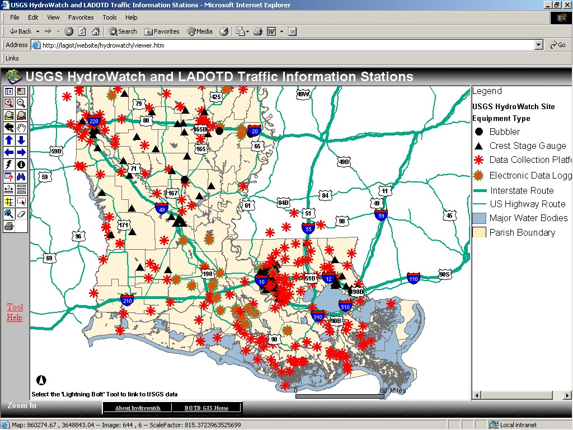
Situational Awareness – Flooding
USGS HydroWatch ArcIMS site
Notes:
LADOTD’s USGS HydroWatch website was developed during Hurricane Isidore, in 2002, to provide real-time information on the USGS stream gauge network. Many of these sites are located on LADOTD bridges. Pop-ups provide near-real-time data, including some that measured traffic counts. This is an ArcIMS web service.

Slide 13
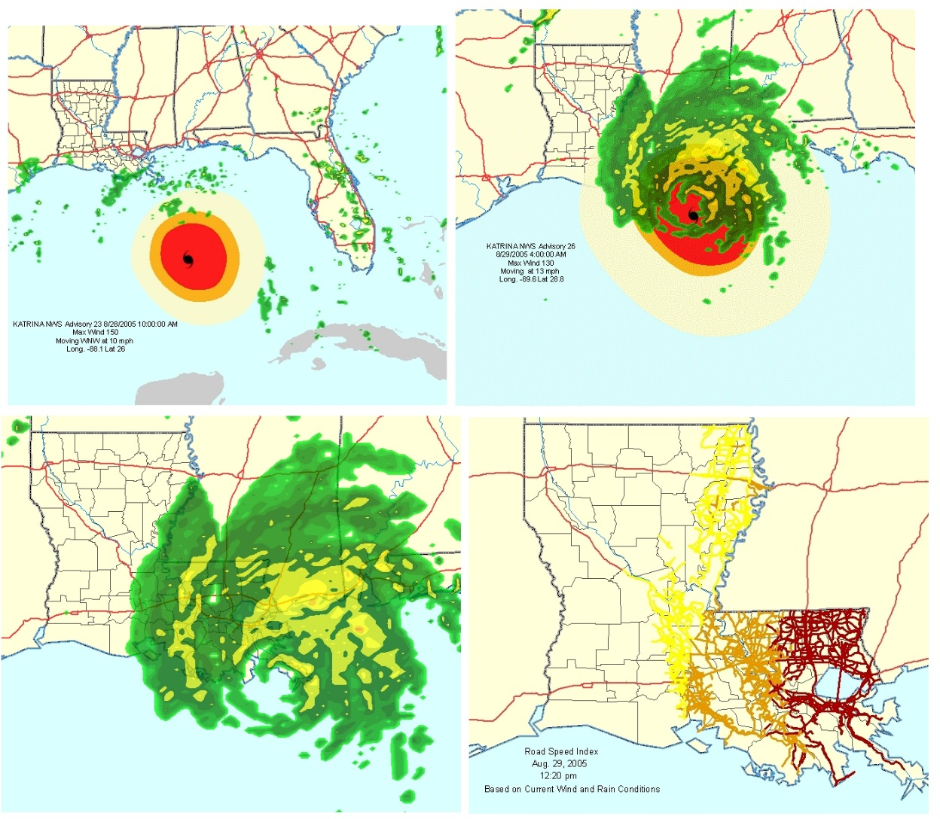
Real-time Weather Data
Delivered by Meteorlogix
Using ArcIMS Web Services and Web Applications
Notes:
As the storm approaches, GIS weather data were provided by Meteorlogix®. These data downloads fed websites that automatically update and showed storm path, wind rings, rain bands, etc. The entire process is automated so GIS staff can concentrate on other support activities. In addition, ArcGIS users can access the ArcIMS web services, directly in ArcMap, and use the weather data from LADOTD with data on their own desktop.

Slide 14
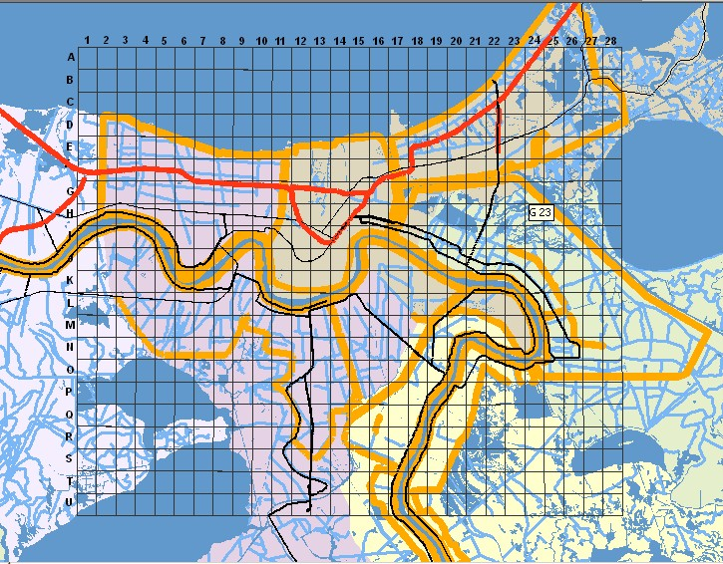
Search & Rescue Operational Grid
Notes:
After the storm hit, search and rescue activities began. First responders came from across the US. An operational grid was created by LADOTD and paced on thousands of paper maps that went into the field and to the Louisiana Emergency Operations Center. The grid was served in an ArcIMS web service and mad available through a website to facilitate distribution. Anyone who needed it could access it via the website or ArcMap. The grid made it easy to dispatch responders to locations that were geocoded, identified by cell ID (A-7, H-23, etc.). Aircraft and boats were equipped with TomTom Mobile GPS units donated by TeleAtlas North America.

Slide 15
Finding Nursing Homes
Notes:
After the storm, it became clear that facilities such as nursing homes may have been unable to evacuate residents. LADOTD used data from Experian Corporation to locate and map these locations for the Louisiana Department of Health and Hospitals. These maps were provided to helicopter pilots who also used TomTom GPS units to travel to those locations and search for survivors.

Slide 16
Post-Storm Damage Assessment - September 7, 2005 TM Image of New Orleans Area
Notes:
This is a TM-image of the New Orleans area. In this type of imagery, the dark regions represent inundated areas.

Slide 17
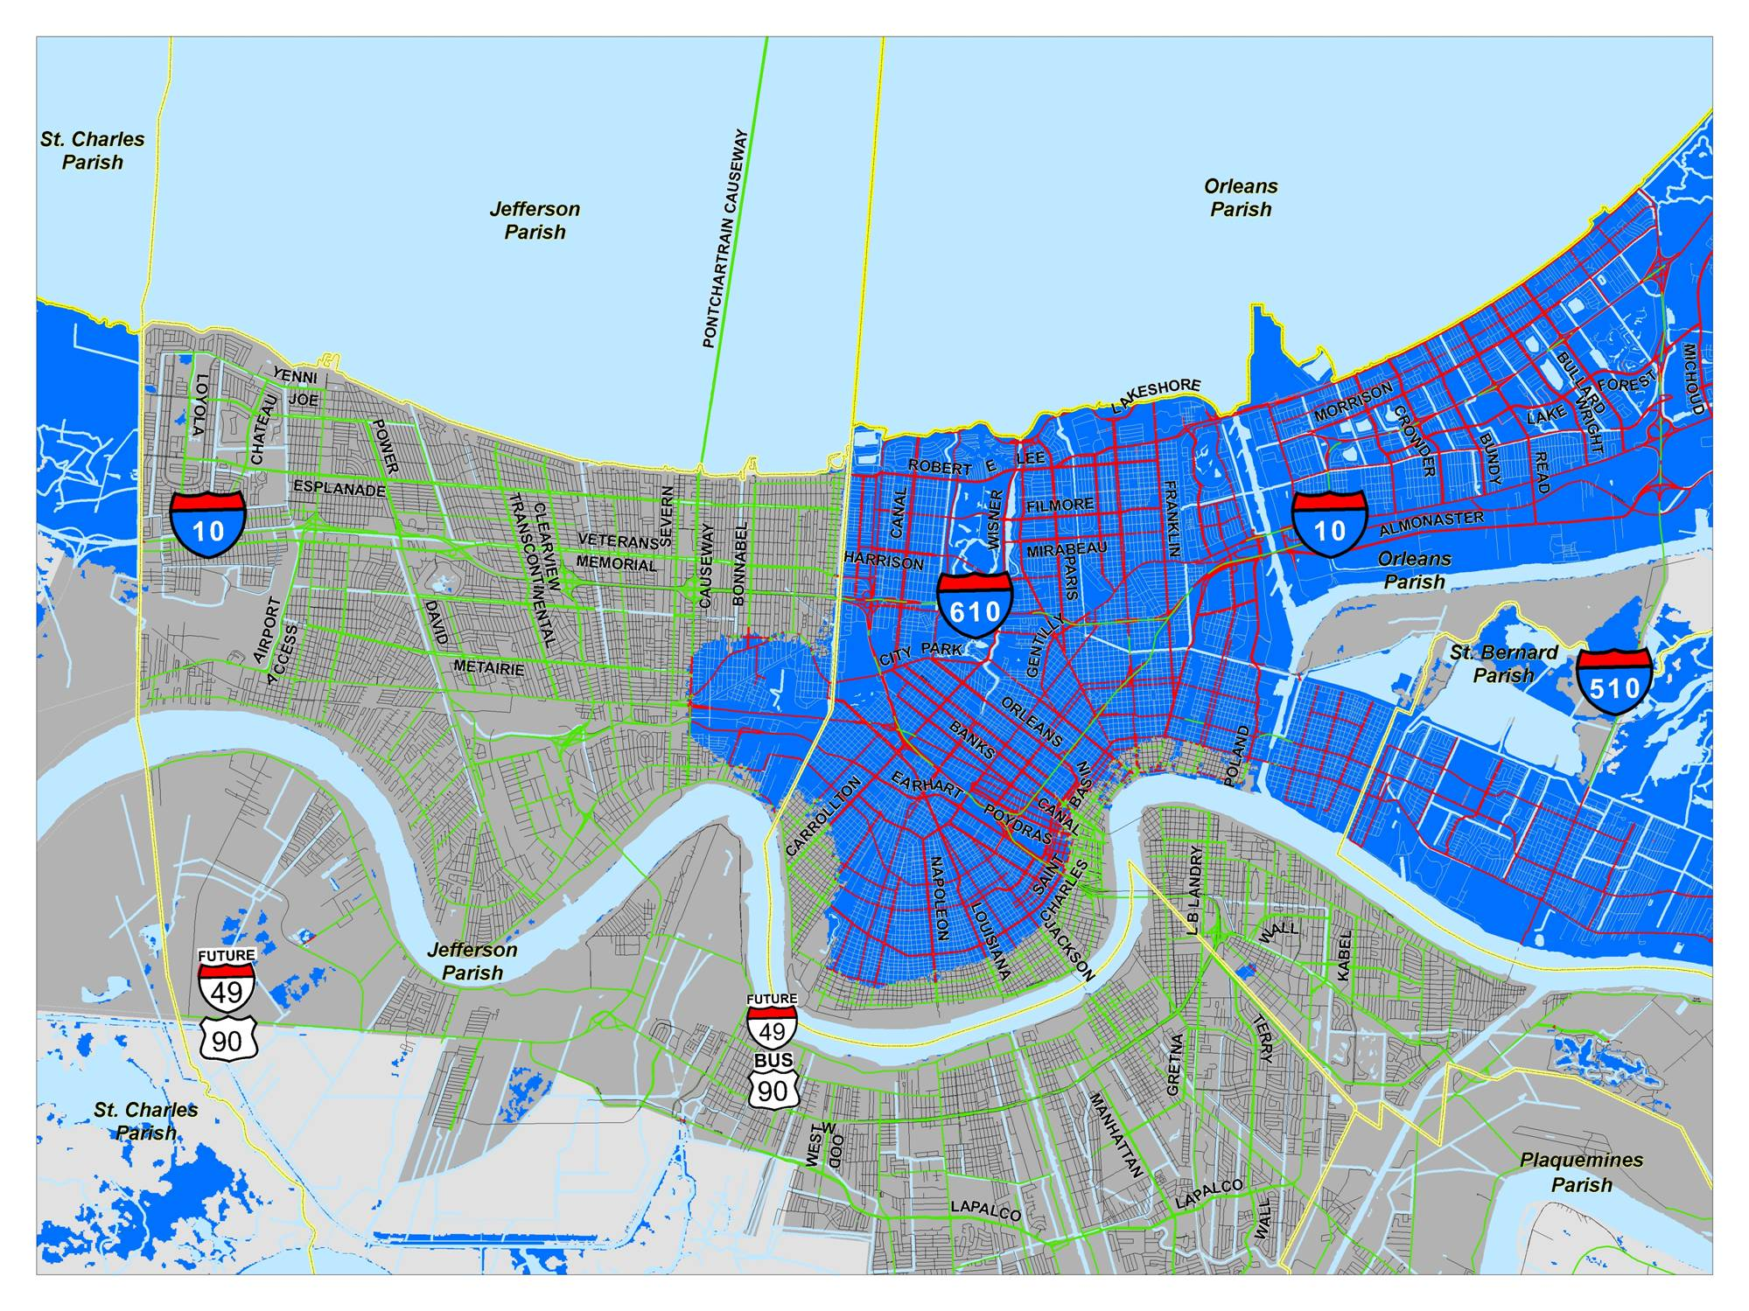
Damage Assessment Maps from Imagery - September 2, 2005 2, 2005 Flooded Roads
LAKE PONTCHARTRAIN
MISSISSIPPI RIVER
NOTE: FLOODED AREA DATA PROVIDED BY FEMA
Notes:
Imagery was converted into geospatial data products, represented inundation. This is a map, showing the interpreted flooded areas of Jefferson, Orleans, and St. Bernard Parishes.

Slide 18
Estimated Flooded Roadways, by Parish - September 2, 2005
Notes:
For LADOTD, the ESF-3 (Public Works) Lead, damage assessment included quantifying how many miles of flooded roads. TeleAtlas data were used for this. The flooded area polygons developed from satellite imagery were used to perform the overlay analysis. Repeated imagery made it possible to quickly and effectively assess the maximum extent of flooded roads and estimate recovery costs.

Slide 19
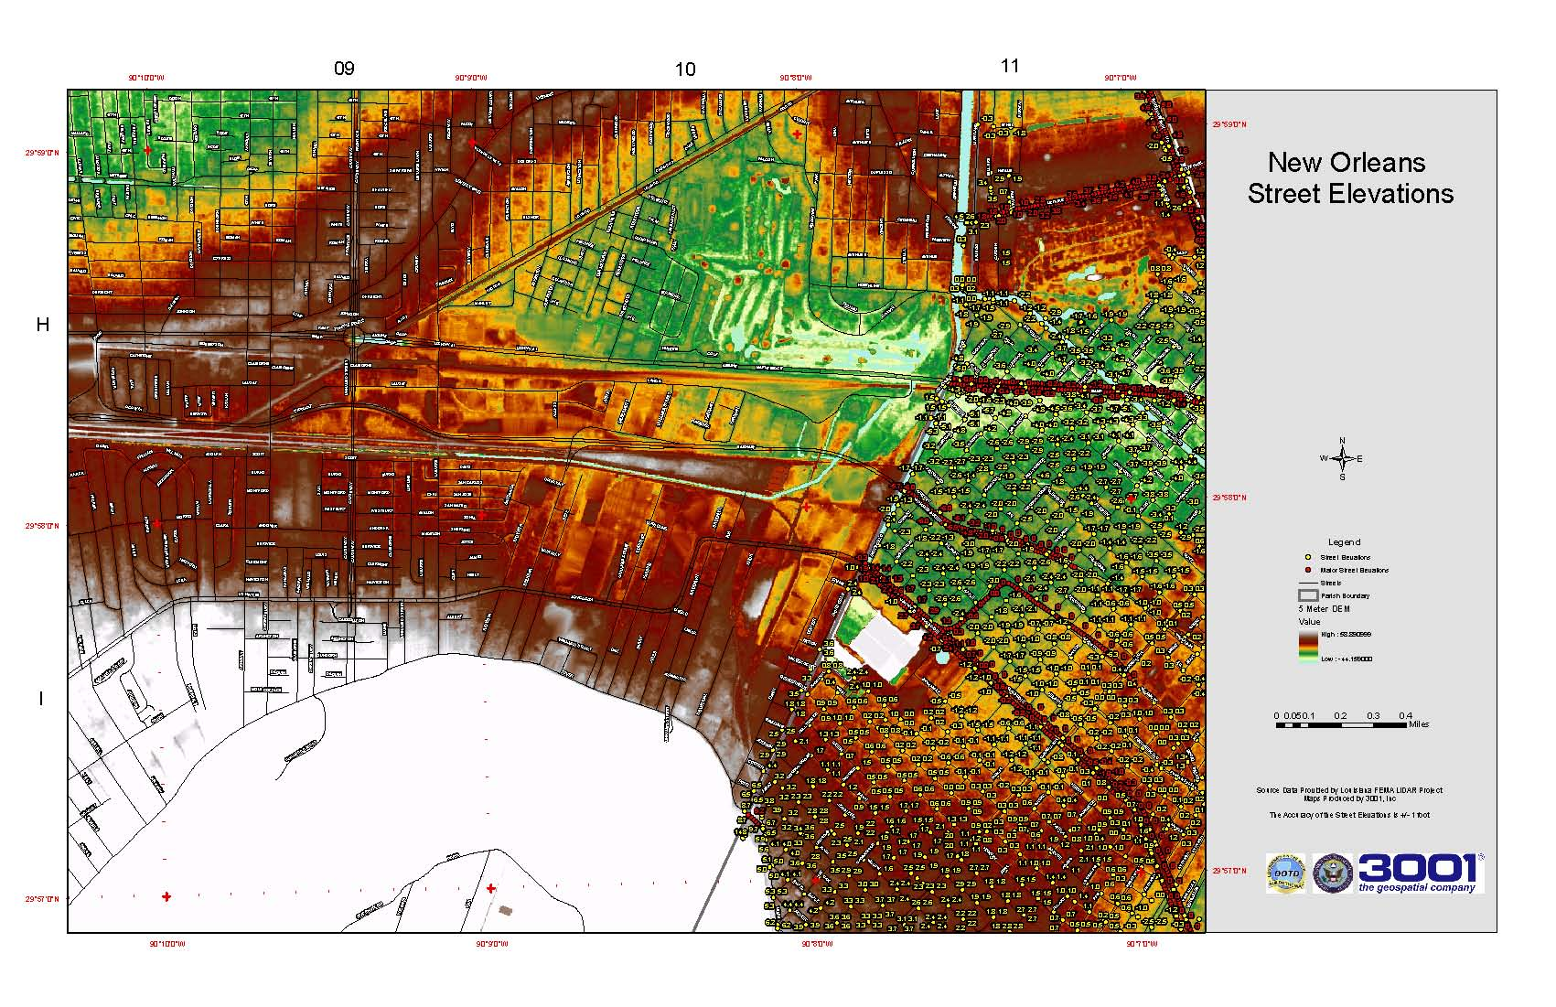
Situational Awareness – Paper Maps of
Flooded Street Elevations for Rescue Vehicles
Notes:
In the field, first responders needed to know where roads were flooded and impassible. LADOTD teamed with 3001 Inc, to develop these data from LiDAR-based DEMs. Paper maps and map books were made in small formats that could be used in vehicles, in the field.

Slide 20
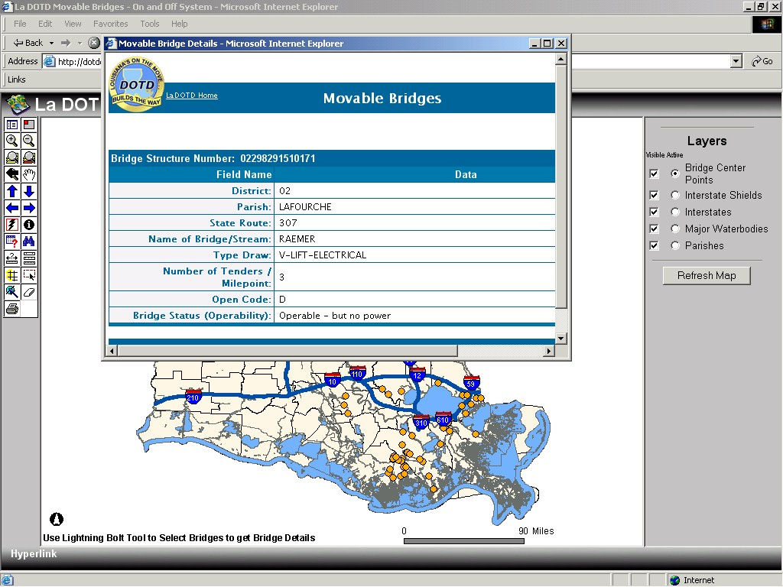
Damage Assessment – Moveable Bridges
Notes:
Movable bridges (lift, draw, swing, etc.) are important features in the Louisiana transportation System. The bridge maintenance staff at LADOTD had to assess all bridges, especially moveable bridges, for safety and operability. This ArcIMS website was produced, in short order, to provide the public with the most current status of bridges across the state. Users can zoom into an area they want to see, and hyperlink directly into the LADOTD bridge database.

Slide 21
LADOTD Planning Map Showing Routes Eligible for FHWA or FEMA Aid Funding
In 2005, the LADOTD road databases only included
a single-line representation of state-maintained roads
Notes:
Parish maps were used to identify FEMA and FHWA routes, as well as, used for debris removal mapping after the storm. However, in 2005, LADOTD only kept a database of state maintained roads (no “local” roads). Highways were represented by a single line. So, divided highways, rams, and other highway facilities were not present on the map.

Slide 22
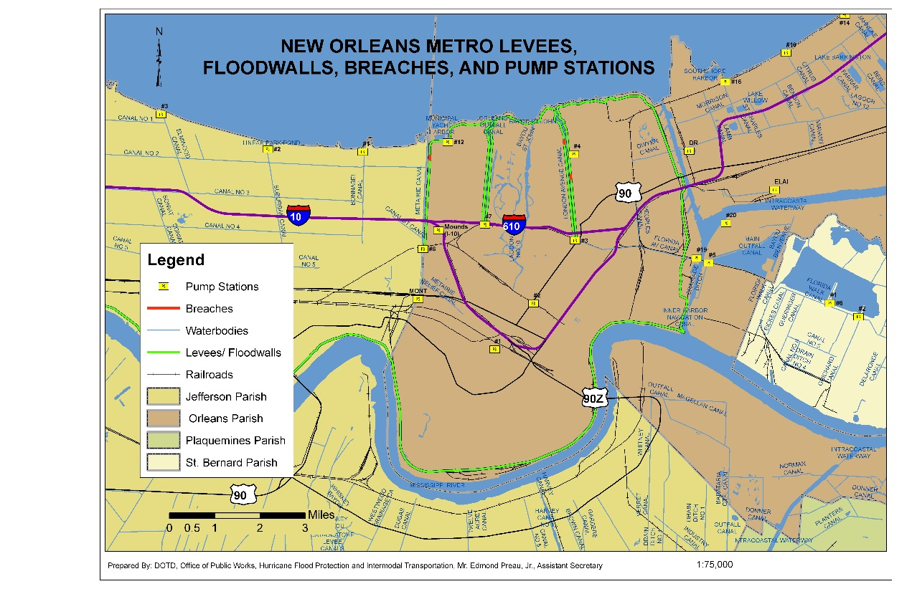
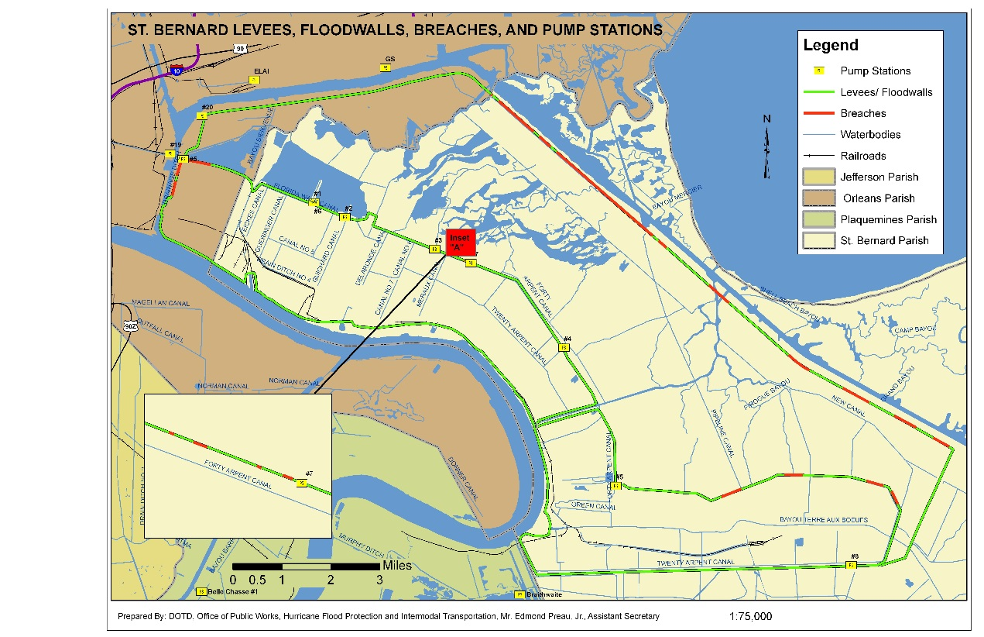
Levees and Pump Stations
Who knew?
Notes:
Levees and Pump Stations were important features in the flood protection system. However, they are the responsibility of, and operated by, levee boards and local government. They were responsible for dewatering the flooded New Orleans area. Before the storm, neither of these features were well mapped. They had to be added to the LADOTD database, “on the fly,” during emergency operations. One evening, staff from the LADOTD’s Public Works Section entered the EOC with a paper list of pump stations and their location. Since the storm, more attention has been paid to better maintaining these data. Note the red-colored levees, depicting locations where levees were breeched.

Slide 23
Locating Search and Rescue Targets Using Grid-based Systems
LADOTD 1-Minute Long/Lat Grid (red) and 500-Meter UTM US National Grid (green).
USNG created a problem, with overlapping grid cells at 90° W, in New Orleans East.
Notes:
The US National Grid (USNG) was a failure during Katrina for two primary reasons: 1) the Louisiana GIS community was largely unfamiliar with it and 2) There is a UTM Zone transition at 90°W, right in the middle of the disaster, in New Orleans East. Because of the latter, it was impossible to represent the entre disaster on a single grid (it was too big and spanned both UTM Zones 15 and 16). In addition, areas near the transition existed in both grids.
In May, 2006, the Louisiana Geographic Information Systems Council adopted a 15-second Longitude/Latitude Search & Rescue Grid. Some progress has been made in addressing the USNG issues in multiple zones. However, it is not clear what will happen if this problem arises, again, in Louisiana.

Slide 24
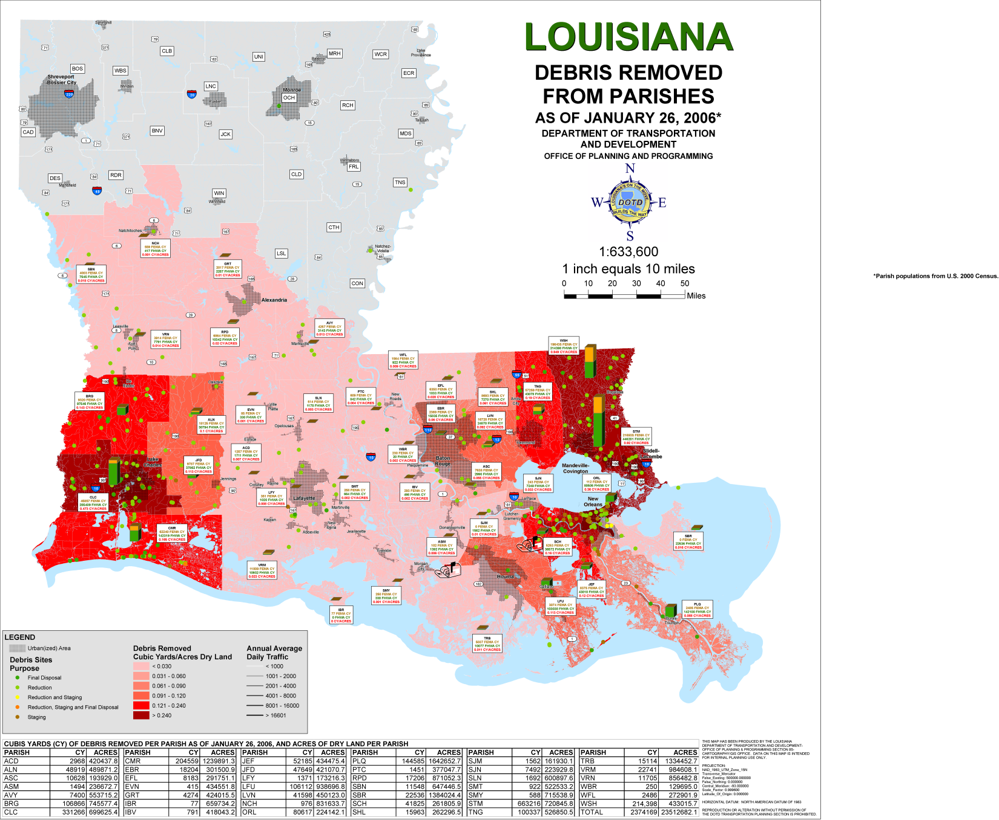
Mapping Debris Removal
Notes:
After the Katrina and Rita storms, millions of cubic yards of debris had to be collected and properly disposed of. Louisiana Department of Transportation and Development and Louisiana Department of Environmental Quality collaborated in this effort. LADOTD produced maps of debris collection sites and tracked the removal of debris across the state.
The effect of Hurricane Katrina can be seen in the shading in eastern Louisiana, while the shading in western Louisiana is primarily due to Hurricane Rita.

Slide 25
Today GIS Web Services Are the Key to Interoperability
Data sharing is not sufficient to meet the real-time data demands of emergency operations – this requires interoperability
  Downloading and ingesting data (ETL) takes too much time
  Most ETL processes cannot keep up with real-time data streams
Service Oriented Architecture (SOA)
  Automated, seamless interoperability provide from the source are limited only by the source system and network availability
  Authoritative data is provided directly from the source
  Actionable information provide directly by GIS services to the consumer of the service – no ETL
  Distribute information directly to desktop GIS or through AGO, web applications, and mobile devices
Notes:
Today, GIS web services form the backbone of real interoperability between disparate systems. Using a Service Oriented Architecture (SOA), authoritative sources can collect, process, and serve data according to discipline–specific standards. This makes data, Accurate, Authoritative, Actionable, Accessible, and Affordable (“AAAAA” Data Standard).

Slide 26
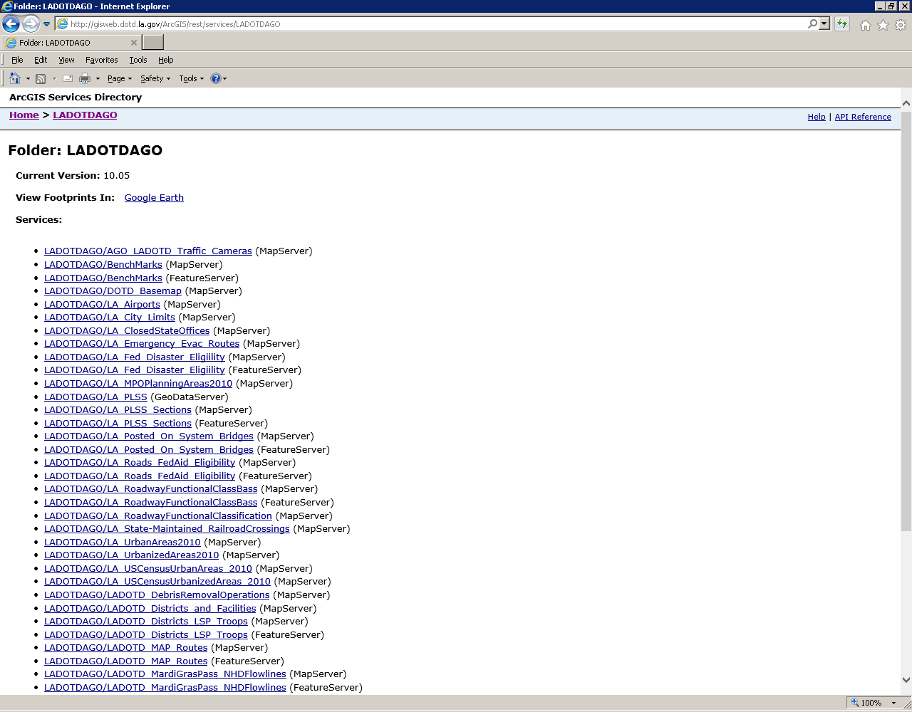
ArcGIS Server Services Folder http://GISweb.dotd.la.gov/ArcGIS/rest/services
Notes:
This is a typical ArcGIS Server Services Folder. It provides the means to share data an information to both web-based applications and desktop GIS. With the appropriate authority/security, anyone can use a web browser to explore the contents of this folder. It may contain subfolders, o organize the services, as desired. Users can select a MapServer or FeatureServer and open them in different applications, such as ArcGIS Online, ArcGIS Desktop, or JaveScript web mapping application. Limited descriptive information or metadata are also available.

Slide 27
LADOTD
Emergency-Related Web Services
Web Services Folder/Service Name
LADOTDAGO/AGO_LADOTD_Traffic_Cameras
LADOTDAGO/DOTD_Basemap
LADOTDAGO/LA_Airports
LADOTDAGO/LA_ClosedStateOffices
LADOTDAGO/LA_Emergency_Evac_Routes
LADOTDAGO/LA_Fed_Disaster_Eligiility
LADOTDAGO/LA_Posted_On_System_Bridges
LADOTDAGO/LADOTD_DebrisRemovalOperations
LADOTDAGO/LADOTD_Districts_and_Facilities
LADOTDAGO/LADOTD_Districts_LSP_Troops
LADOTDAGO/LADOTD_MAP_Routes
LADOTDAGO/Louisiana_DSNAP_Sites
LADOTDAGO/Psurge_StormSurge
LADOTDAGO/USACE_River_Gauges
LADOTDAGO/USGS_HydroWatch_Gauges
MapServicesCached/EvacuationRoutes
MapServicesCached/LADOTD_Levee_Centerlines
MapServicesCached/OperationsGrid
Notes:
This is a brief listing of emergency operations-related web services available from LADOTD. Most of these services are designed to ArcGIS Online presentations. However, they are also available to ArcGIS Desktop users, as well as, anyone else who can consume the REST web services.

Slide 28
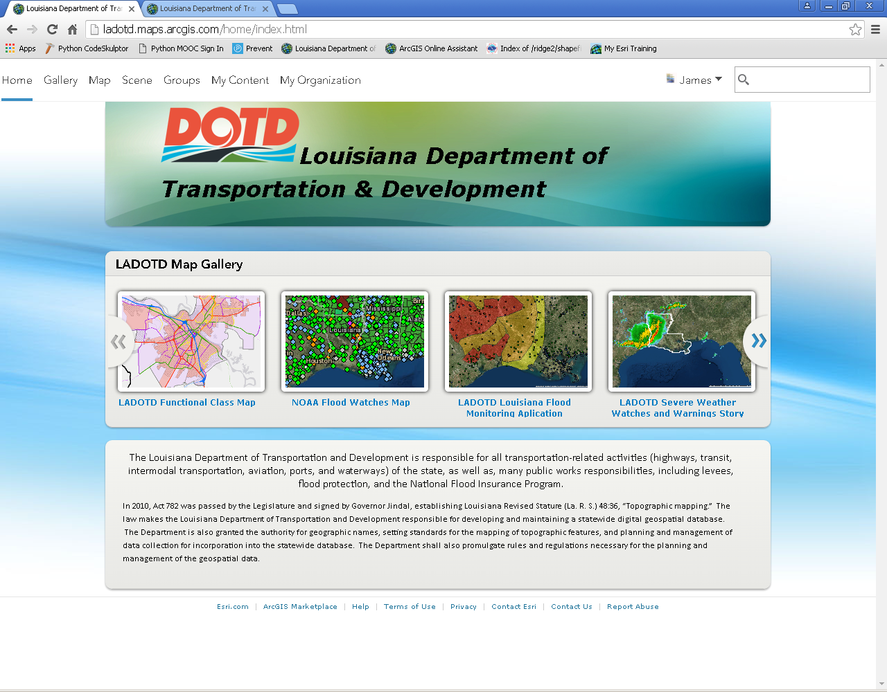
LADOTD ArcGIS Online Home Page
AGO provides an easy to find URL, the map gallery to features content related to the current emergency. The organization controls access to the public or targeted users.
Notes:
This is the LADOTD ArcGIS Online Hemepage. An important feature of this website is that it can be configured with text to reflect immediate conditions and display news. In addition, it features a “Map Gallery” that contains special maps that the site wants to feature. To place a map in the Gallery, the author simply needs to “Shake” it with the “Map Gallery Group.” To remove it, remove he share.

Slide 29
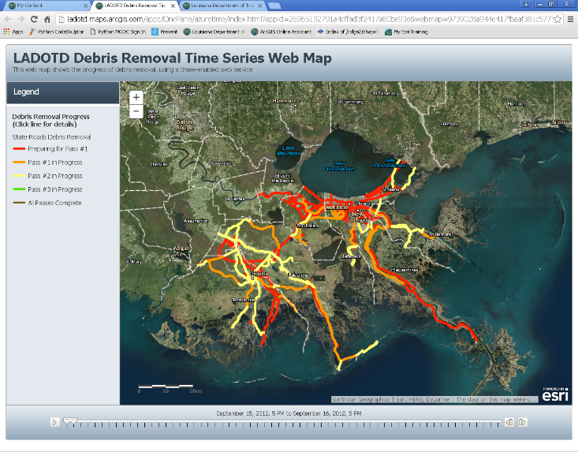
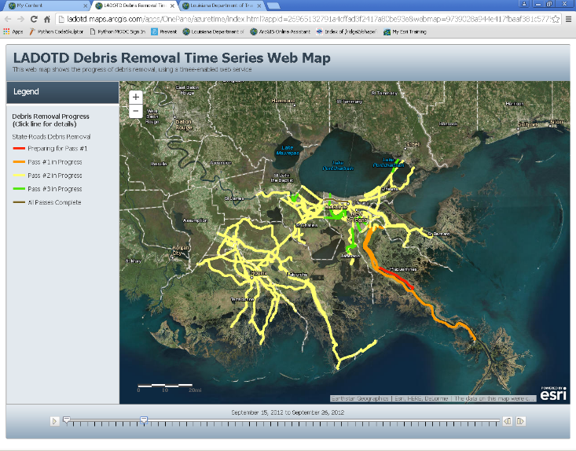
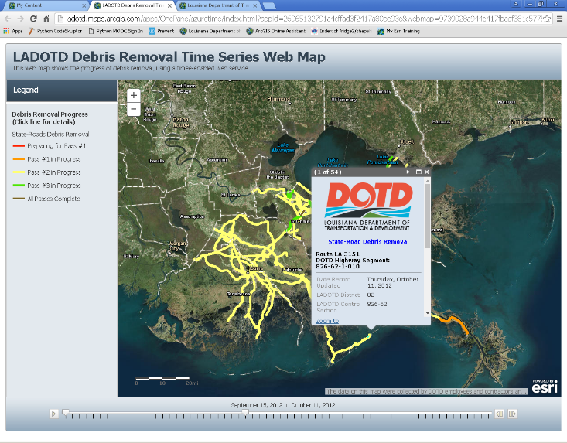
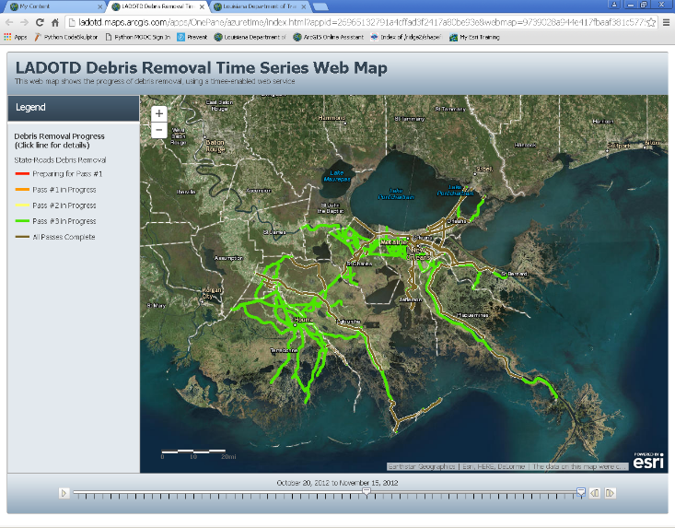
Public Relations
2012 Hurricane Isaac Debris Removal
LADOTD Public Information wanted a simple, easy to use map to keep the public informed of the progress of debris removal. AGO provided a time-enabled display.
Notes:
Debris removal is an important ESF-3 (Public Works) function for LADOTD. It is a time dependent process. The public wants the roads clear and debris removed as fast as possible. In 2012, Hurricane Isaac hit southeastern Louisiana and created a great deal of debris. LADOTD Public Relations wanted a simple to use map to display the Department’s process on debris removal along state-maintained roads. Daily progress was provided by a contractor, incorporated into a time-enabled geodatabase feature class, and update daily. ArcGIS Online provided the simple user-interface and even supported time-enabled data. In the Time-Enabled Map Application Template, users can watch the progress of the debris removal effort as colors move from red and orange to green. The map also supports pop-ups to allow the user to query a specific line segment and get the data for it.

Slide 30
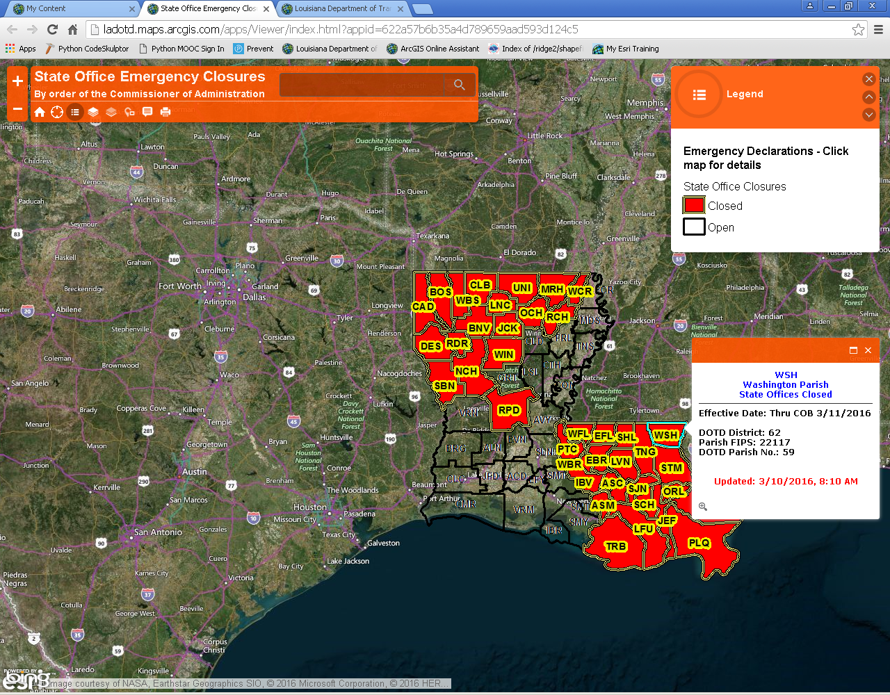
Information to the Public and State Workers
State Office Closures
Extreme weather, or other emergencies, may result in the closure of State Offices on a Parish-by-Parish basis. As declarations are made, this map is updated.
Notes:
During extremely inclement weather events, state offices are closed by order of the Louisiana Commissioner of Administration. The closures are done, primarily, on a Parish by Parish basis. It is important for the public to, as well as, state workers to be aware of these closures. As orders are issued, a map is updated to show the closed parishes.

Slide 31
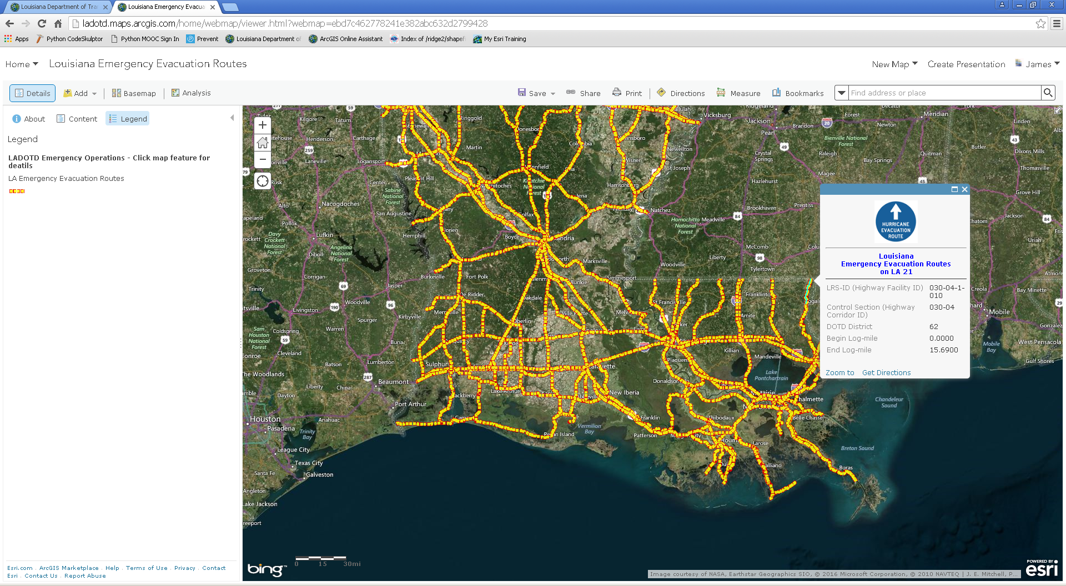
Information to the Public & Responders
Official Louisiana Evacuation Routes
Before, during, and after an event, both the public and first responders need to know designated Emergency Evacuation Routes. AGO is fast, easy to use, and available to mobile devices. The pending 2016 revisions will automatically update all these maps.
Notes:
Emergency Evacuating Routes are the backend of the Louisiana Emergency Evacuation Plan. It is essential that both state officials and the public are on the same page with respect to what are and what are not official Emergency Evacuation Routes. Pop-ups help provide specific information about a particular map feature.

Slide 32
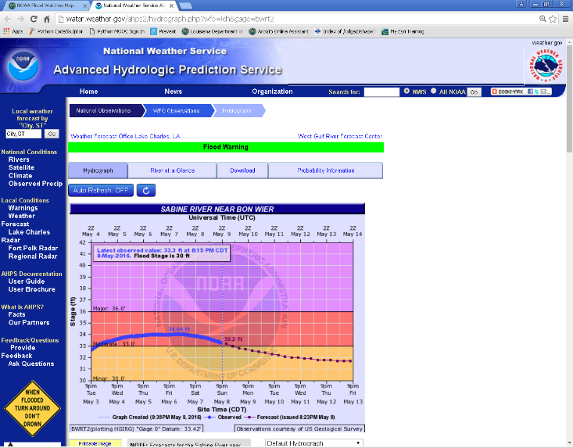
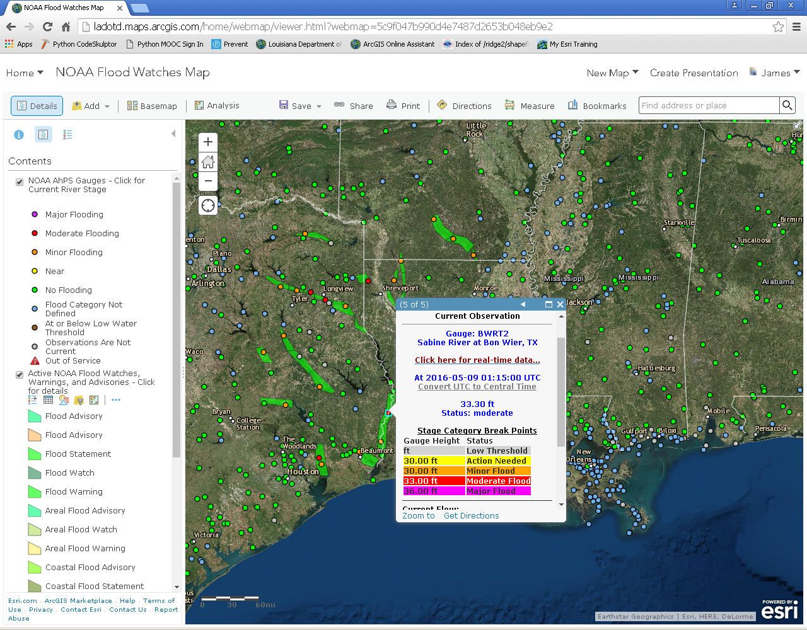
Situational Awareness
LADOTD’s NOAA Flood Watch Map
Delivering authoritative data – NOAA-National Weather Service Flood Watch polygons and near-real-time river gauge points from the Advanced Hydrologic Prediction Service (AHPS). Links on pop-ups go directly to the NOAA website, wish current information.
Notes:
Floods are a major cause of depth, annually. NOAA’s Advances Hydrologic Prediction Service (AHPS) provides river and stream gauge monitoring and forecasts. This web map allows the user to find available gauges in the area of their interest. They are colored by flood stage. Wen clicked, the pop-up displays current information, as well as, a link to the real-time AHPS gauge website.

Slide 33
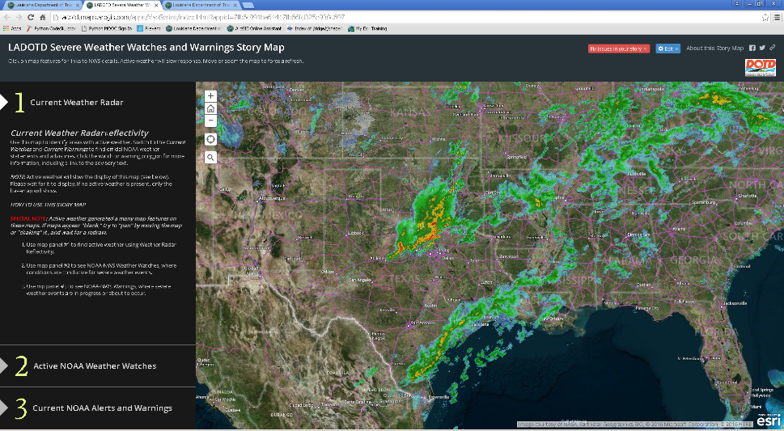
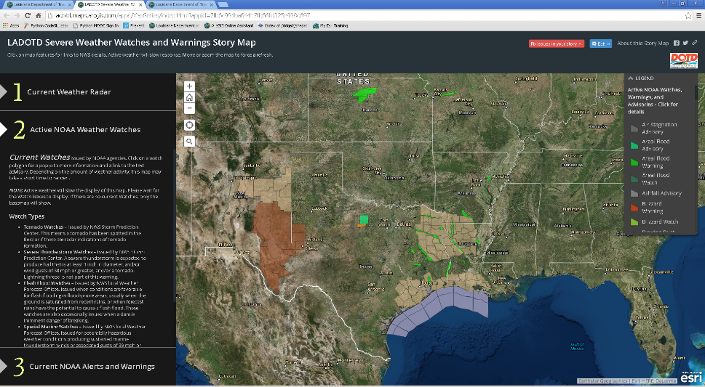
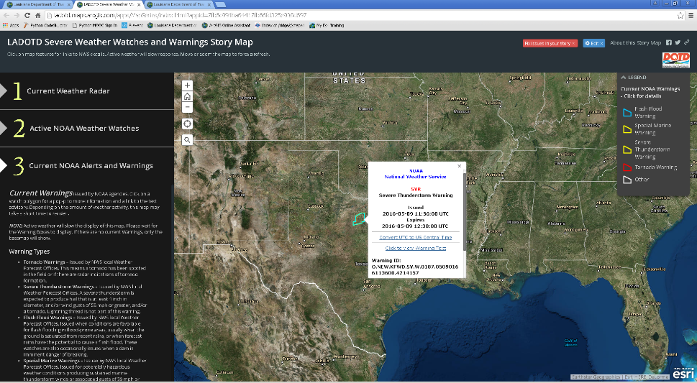
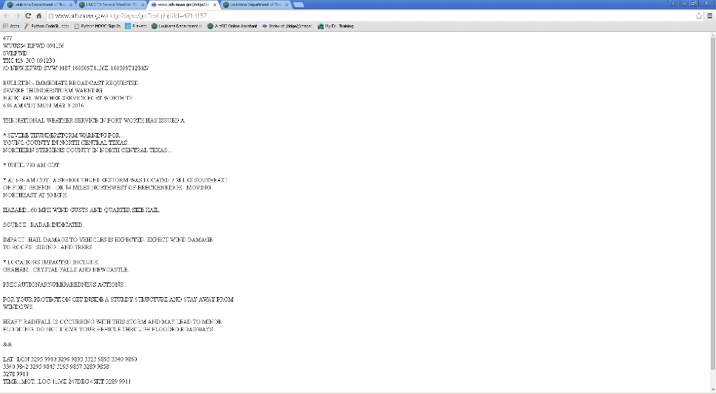
Situational Awareness
LADOTD’s Severe Weather Story Map
Delivering near-real-time, actionable data and authoritative information, directly from the source. This Story Map allows the user to find a place of interest and move between the maps showing current weather radar or NOAA Watches or NOAA Warnings.
Notes:
This is a Story Map with three maps. It is used because as the viewer moves from one map to another, the map extent is maintained and you are looking at the same place, with different active content. The active content is either real-time Weather Radar, from Iowa State University; Current Weather Watches, from NOAA; or Active Weather Warnings, also from NOAA. All of these are web services and are automatically updated every 5 minutes. The Watches and Warnings provide clickable pop-s with links to the actual text advisory.

Slide 34
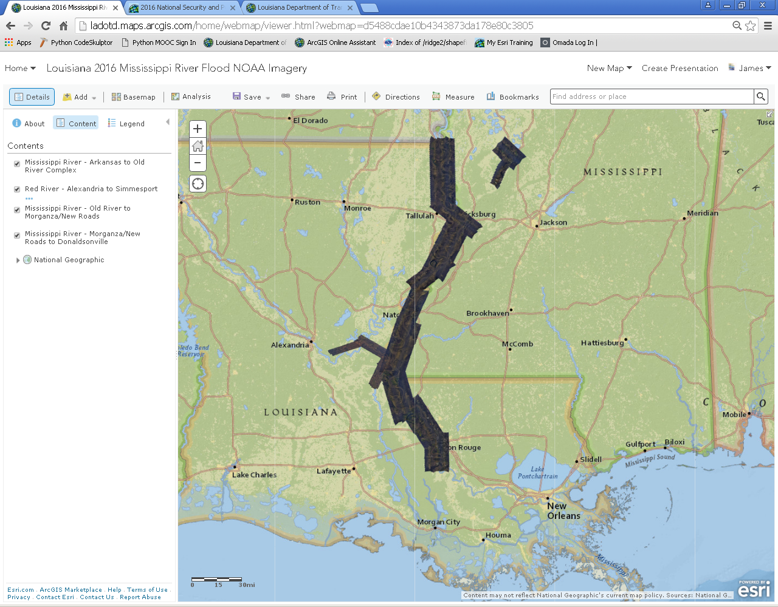
Official Imagery Delivered Quickly
January 2016 Mississippi River Flood
During disasters, aerial and satellite imager become generally available. Improvements in data acquisition, processing, and delivery have replaced slow and cumbersome data downloads or “hard drive deliveries” with web services that are consumed, directly.
Notes:
In January, 2016, he Mississippi River reached unprecedented flood levels. As the flood moved downstream federal resources captured imagery at near-high-water stages along the river. This ArcGIS Online site provides users with that imagery, which was available within d few days of acquisition. These services were also available to ArcGIS Desktop users through Open GIS Consortium (OGC) image services.

Slide 35
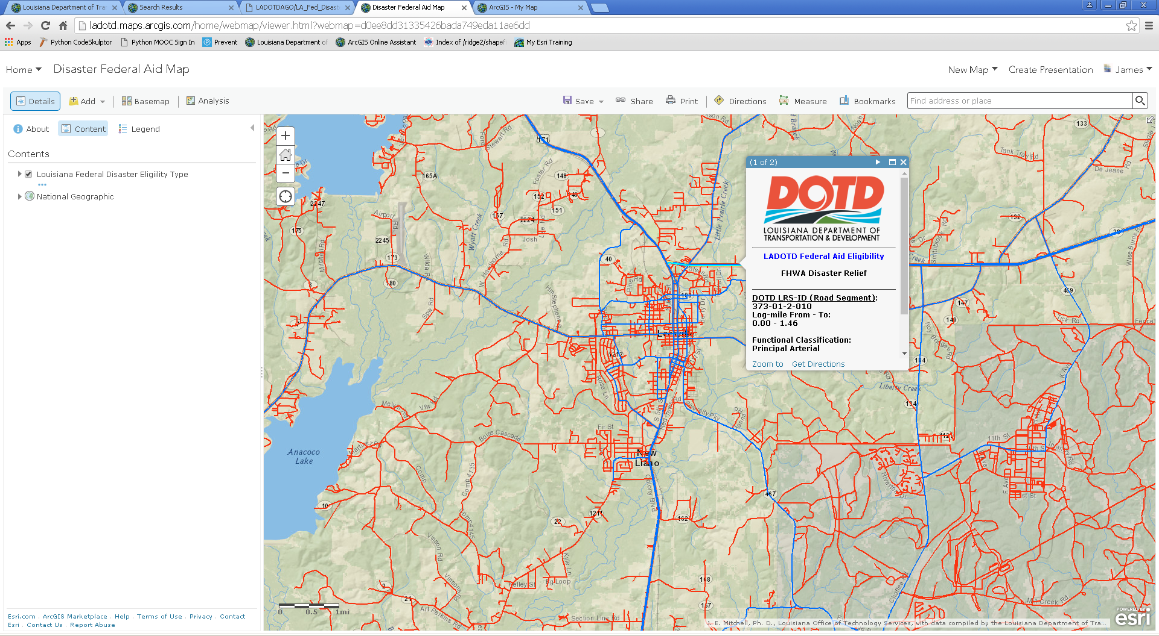
Disaster Response and Recovery
Louisiana Roads Federal Aid Eligibility
During the recovery phase of an event, debris removal and road repair are reimbursed via the Federal Highway Administration (FHWA) or FEMA, depending on the roadway classification. This map provides a simple way to find and identify Federal Aid eligibility.
Notes:
Disaster relief funding for roads depends on the Functional Classification of a road. This is a classification system, determined by the State DoT, local government, with guidance from the USDOT. This ArcGIS Online web map allows any user, anywhere (on the Internet), to see, by the symbology, if a road is FHWA or FEMA reimbursable. In addition, pop-ups provide a wan to explore and confirm the status of specific lines, with a click.

Slide 36
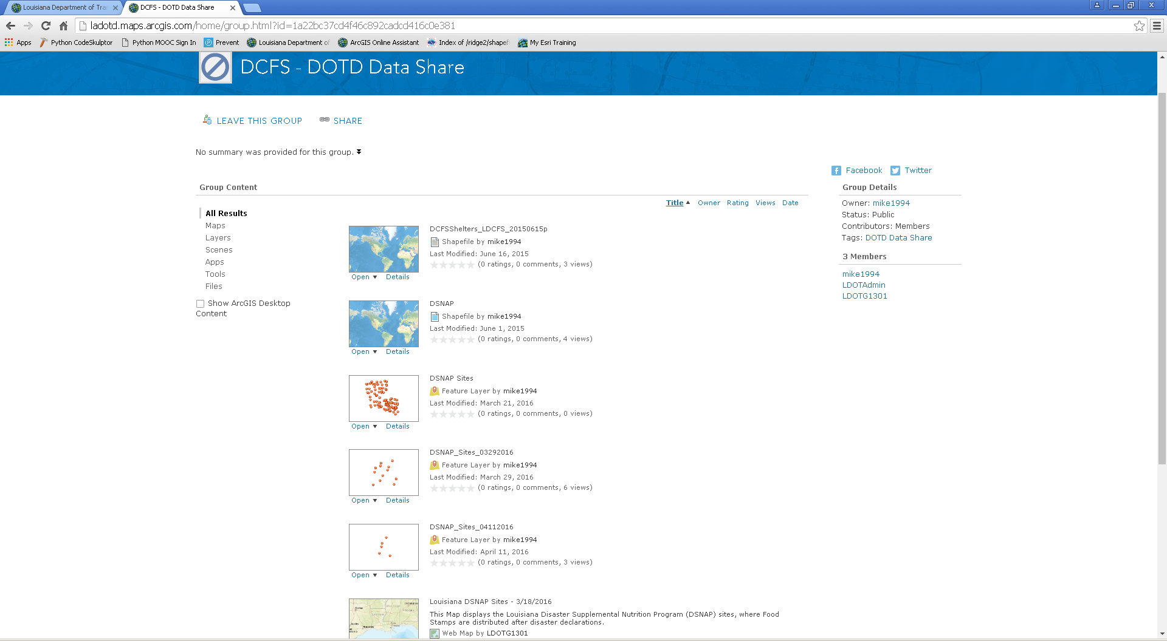

Interoperability and Data Sharing
LADOTD/LADCFS Data Collaboration
Using AGO Groups, organizations can collaborate on sharing data, maps, and apps. The Disaster Supplemental Nutrition Program (DSNAP) is operated by the Dept. of Children and Family Services (DCFS), with assistance from LADOTD.
Notes:
Supporting interoperability, while maintaining appropriate and secure access is accomplished through the use of “Groups.” LADOTD and LADCFS collaborate on the DSNAP program. LADCFS runs the sites, while LADOTD provides traffic and logistical support. LADCFS determines the sites and provides these locations through a point web service, shared through ArcGIS Online to the DCFS – DOTD Data Share Group. In this way, LADOTD AGO users, who are part of that group and consume and make maps and applications from that service.

Slide 37
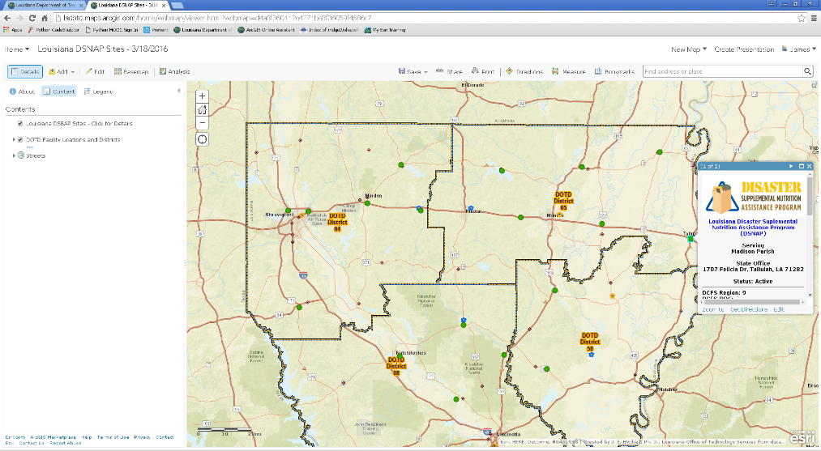
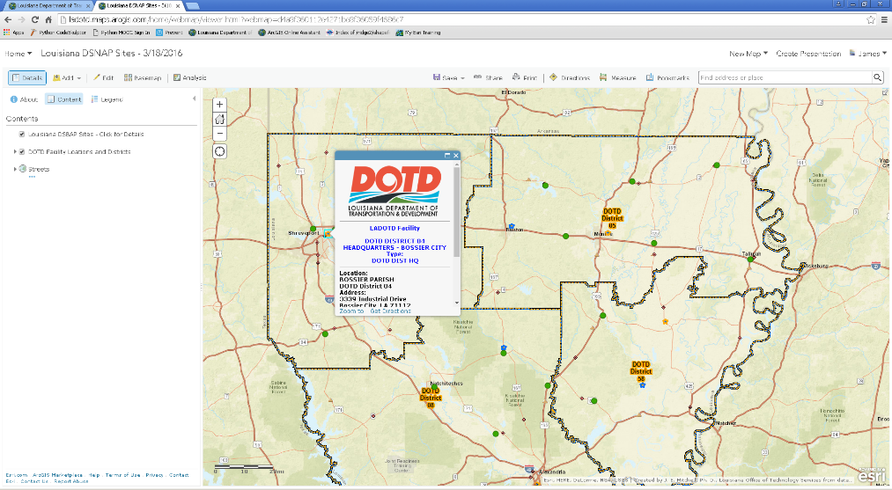
Information to the Public and State Workers
Disaster Supplemental Nutrition Program
The Department of Children and Family Services serves a DSNAP feature service. Throughout the event life-cycle the number and location of sites change. As ESF-6 Lead (Mass Care, Housing, and Human Services), DCFS manages this program.
The Department of Transportation and Development serves a Districts and Facilities service. As ESF-1 Lead (Transportation), DOTD assists DCFS with logistics and traffic plans for DSNAP sites.
Maps consume the web services. As conditions change, and revisions are posted, everyone receives immediate updates from the authoritative source.
Notes:
Using the shared data, maps and apps can be created that take advantage of resources from both organizations.

Slide 38
Keys to Successful Interoperability
Using a Service-Oriented Architecture
Documentation – web resources must be discoverable
  Complete Metadata
    Exhaustive Keywords
    Accurate and comprehensive Item Descriptions
    Descriptive Access and Use Constraints
High Availability
  Ensure that hardware, software, systems, and data are kept up to date
  Monitor system performance
  Perform data development off-line and push to production
  Automate processes
    Build ETL tools
    Build Models, using Model Builder and/or Python Scripts
Notes:
Today, enterprise GIS is based on a Service Oriented Architecture (SOA), where traditional Desktop GIS interacts with GIS services from GIS Servers, and web-based (Software as a Service, SaaS). To make it work, data and services must be well documented and highly available. When it is, users, both infernal and external, will use it and will want more.

Slide 39
Katrina –
Lessons Learned and
How GIS Can Do It Better, Now
For more information contact:
James E. Mitchell, Ph. D,
jim.mitchell@la.gov
225-379-1881
Notes:
For more information contact Jim Mitchell, at: jim.mitchell@la.gov or 225-3479-1881.

