Slide 1
LADOTD Web Services Supporting Interoperability and Information Delivery During Emergency Operations
by James E. Mitchell, Ph. D,
USGS Hurricane Season Geospatial Data Mining Workshop
June, 2016
Notes:
Ten years after Katrina, GIS technology provides more and better ways to share and deliver information.

Slide 2
GIS Web Services Are the Key to Interoperability
Data sharing is not sufficient to meet the real-time data demands of emergency operations – this requires interoperability
Downloading and ingesting data (ETL) takes too much time
Most ETL processes cannot keep up with real-time data streams
Service Oriented Architecture (SOA)
Automated, seamless interoperability provide from the source are limited only by the source system and network availability
Authoritative data is provided directly from the source
Actionable information provide directly by GIS services to the consumer of the service – no ETL
Distribute information directly to desktop GIS or through AGO, web applications, and mobile devices
Notes:
Today, GIS web services form the backbone of real interoperability between disparate systems. Using a Service Oriented Architecture (SOA), authoritative sources can collect, process, and serve data according to discipline–specific standards. This makes data, Accurate, Authoritative, Actionable, Accessible, and Affordable (“AAAAA” Data Standard).

Slide 3
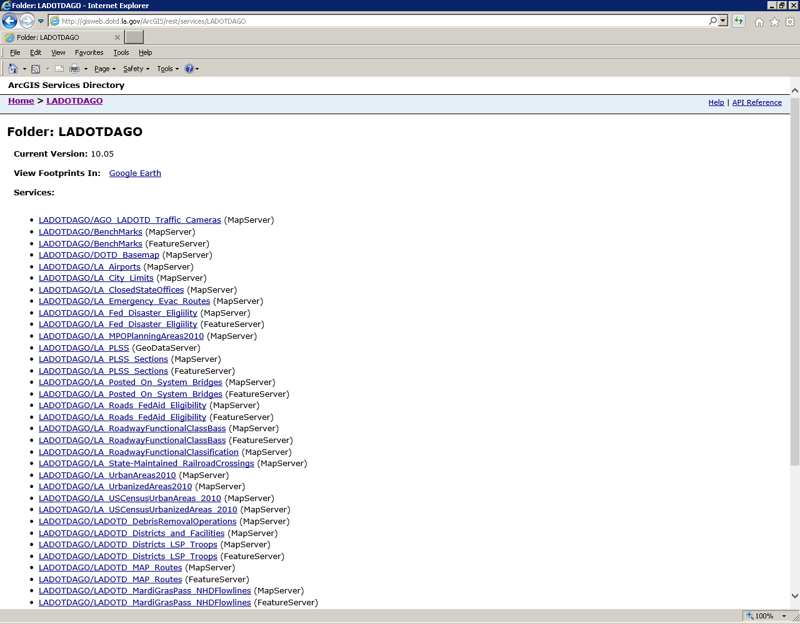
ArcGIS Server Services Folder http://GISweb.dotd.la.gov/ArcGIS/rest/services
Notes:
This is a typical ArcGIS Server Services Folder. It provides the means to share data an information to both web-based applications and desktop GIS. With the appropriate authority/security, anyone can use a web browser to explore the contents of this folder. It may contain subfolders, o organize the services, as desired. Users can select a MapServer or FeatureServer and open them in different applications, such as ArcGIS Online, ArcGIS Desktop, or JaveScript web mapping application. Limited descriptive information or metadata are also available.

Slide 4
LADOTD Emergency-Related Web Services
Web Services Folder/Service Name
LADOTDAGO/AGO_LADOTD_Traffic_Cameras
LADOTDAGO/DOTD_Basemap
LADOTDAGO/LA_Airports
LADOTDAGO/LA_ClosedStateOffices
LADOTDAGO/LA_Emergency_Evac_Routes
LADOTDAGO/LA_Fed_Disaster_Eligiility
LADOTDAGO/LA_Posted_On_System_Bridges
LADOTDAGO/LADOTD_DebrisRemovalOperations
LADOTDAGO/LADOTD_Districts_and_Facilities
LADOTDAGO/LADOTD_Districts_LSP_Troops
LADOTDAGO/LADOTD_MAP_Routes
LADOTDAGO/Louisiana_DSNAP_Sites
LADOTDAGO/Psurge_StormSurge
LADOTDAGO/USACE_River_Gauges
LADOTDAGO/USGS_HydroWatch_Gauges
MapServicesCached/EvacuationRoutes
MapServicesCached/LADOTD_Levee_Centerlines
MapServicesCached/OperationsGrid
Notes:
This is a brief listing of emergency operations-related web services available from LADOTD. Most of these services are designed to ArcGIS Online presentations. However, they are also available to ArcGIS Desktop users, as well as, anyone else who can consume the REST web services.

Slide 5
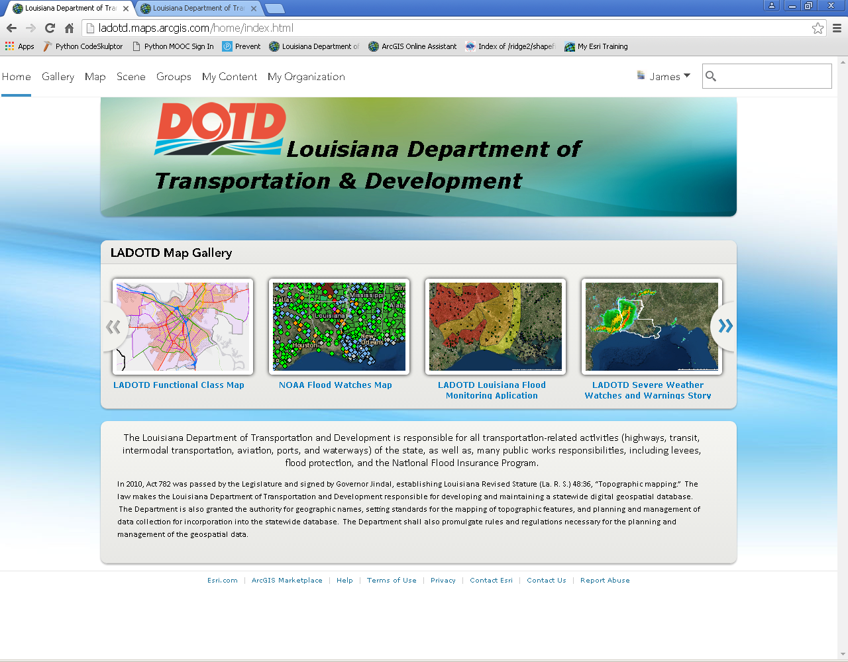
LADOTD ArcGIS Online Home Page
AGO provides an easy to find URL, the map gallery to features content related to the current emergency. The organization controls access to the public or targeted users.
Notes:
This is the LADOTD ArcGIS Online Hemepage. An important feature of this website is that it can be configured with text to reflect immediate conditions and display news. In addition, it features a “Map Gallery” that contains special maps that the site wants to feature. To place a map in the Gallery, the author simply needs to “Shake” it with the “Map Gallery Group.” To remove it, remove he share.

Slide 6
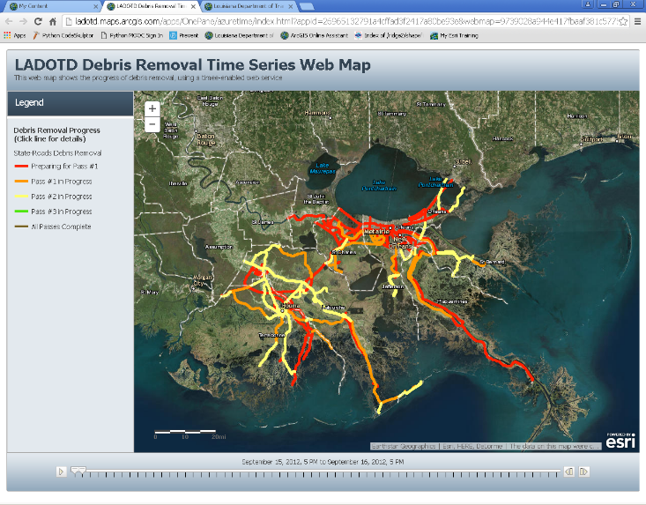
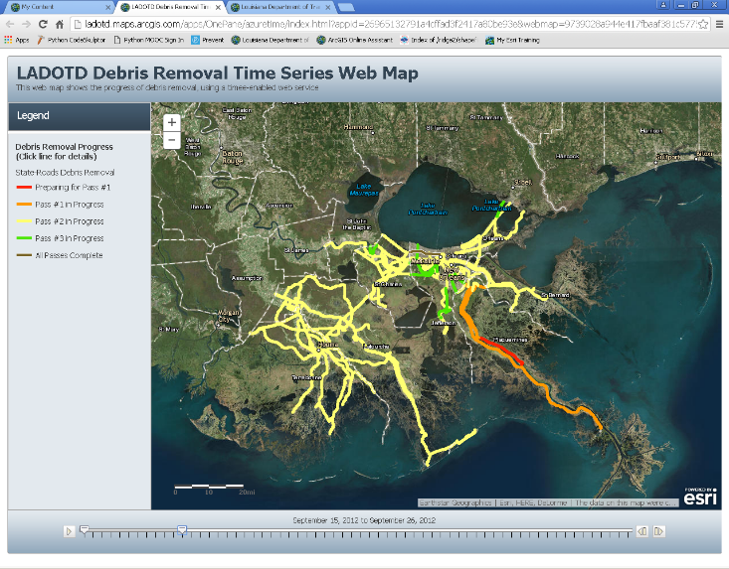
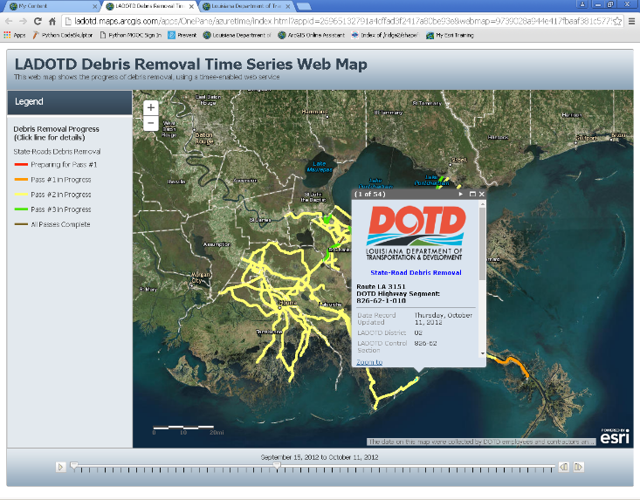
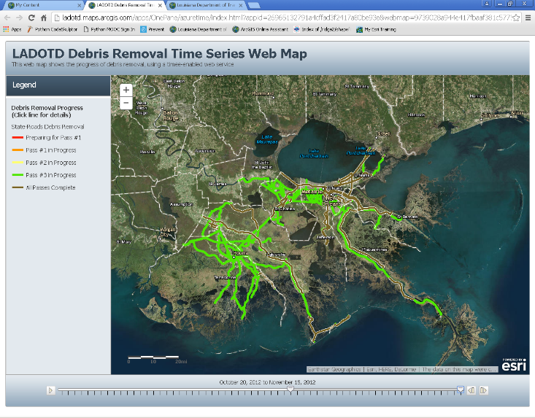
Public Relations 2012 Hurricane Isaac Debris Removal
LADOTD Public Information wanted a simple, easy to use map to keep the public informed of the progress of debris removal. AGO provided a time-enabled display.
Notes:
Debris removal is an important ESF-3 (Public Works) function for LADOTD. It is a time dependent process. The public wants the roads clear and debris removed as fast as possible. In 2012, Hurricane Isaac hit southeastern Louisiana and created a great deal of debris. LADOTD Public Relations wanted a simple to use map to display the Department’s process on debris removal along state-maintained roads. Daily progress was provided by a contractor, incorporated into a time-enabled geodatabase feature class, and update daily. ArcGIS Online provided the simple user-interface and even supported time-enabled data. In the Time-Enabled Map Application Template, users can watch the progress of the debris removal effort as colors move from red and orange to green. The map also supports pop-ups to allow the user to query a specific line segment and get the data for it.

Slide 7
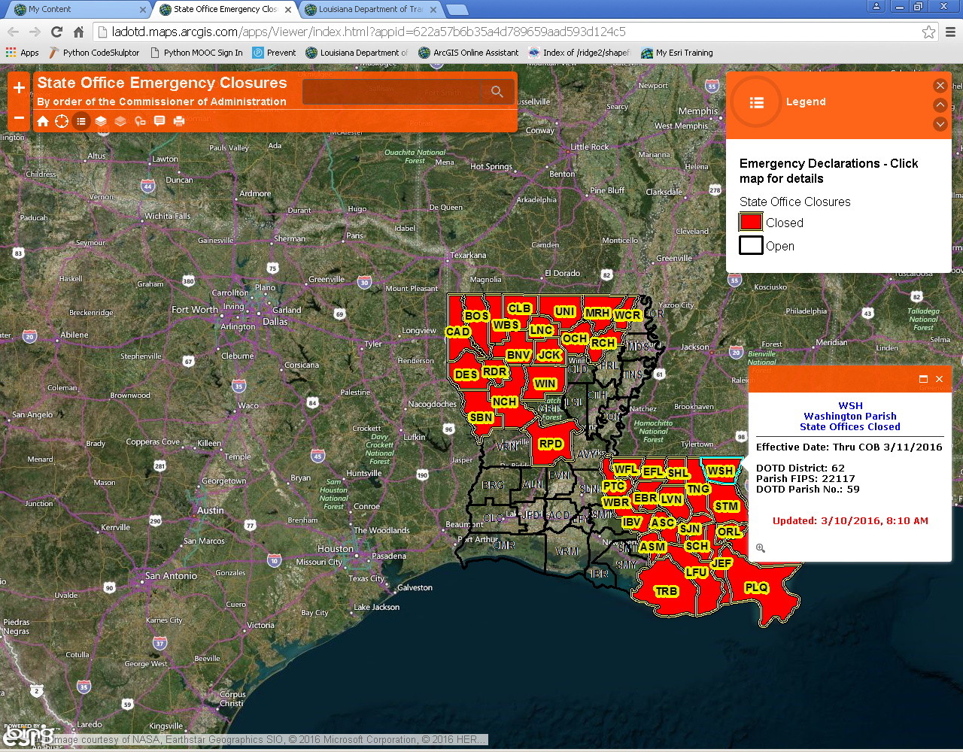
Information to the Public and State Workers State Office Closures
Extreme weather, or other emergencies, may result in the closure of State Offices on a Parish-by-Parish basis. As declarations are made, this map is updated.
Notes:
During extremely inclement weather events, state offices are closed by order of the Louisiana Commissioner of Administration. The closures are done, primarily, on a Parish by Parish basis. It is important for the public to, as well as, state workers to be aware of these closures. As orders are issued, a map is updated to show the closed parishes.

Slide 8
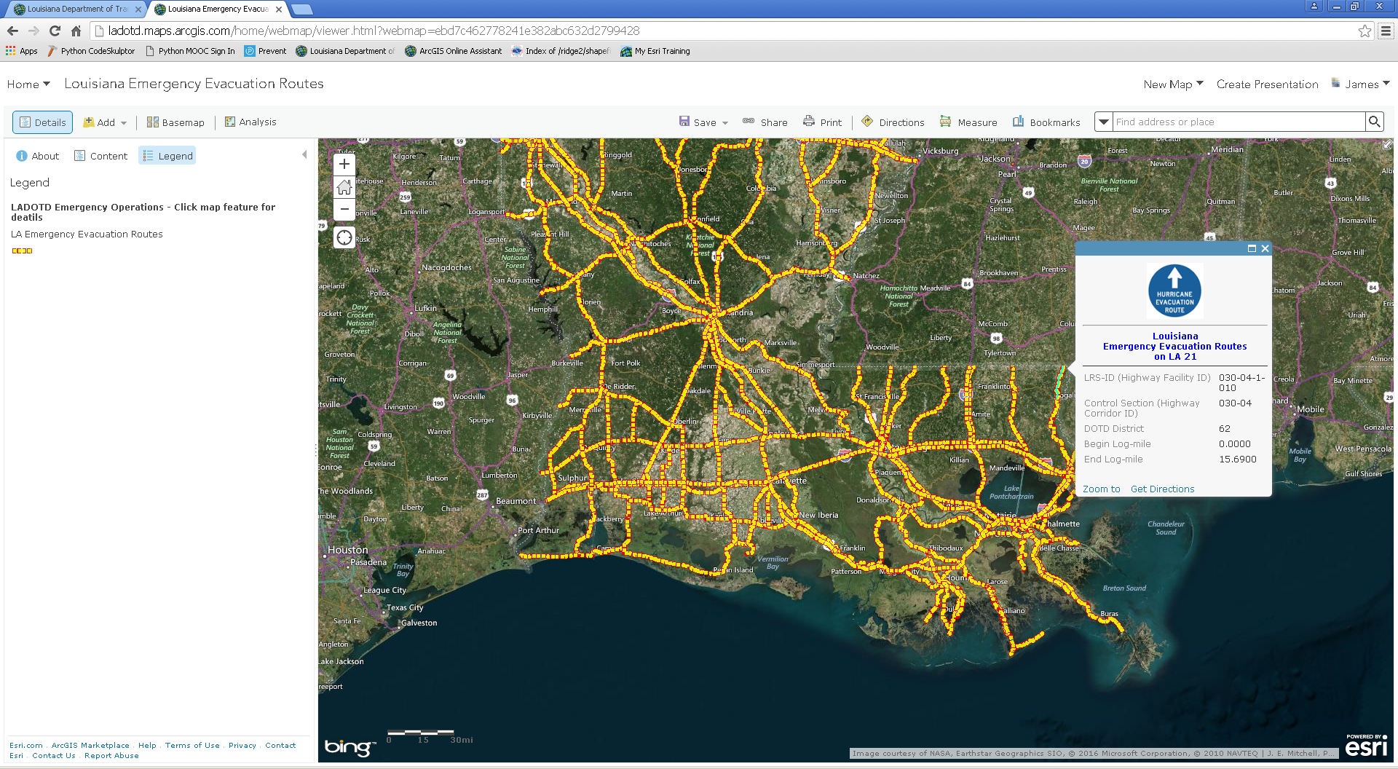
Information to the Public & Responders Official Louisiana Evacuation Routes
Before, during, and after an event, both the public and first responders need to know designated Emergency Evacuation Routes. AGO is fast, easy to use, and available to mobile devices. The pending 2016 revisions will automatically update all these maps.
Notes:
Emergency Evacuating Routes are the backend of the Louisiana Emergency Evacuation Plan. It is essential that both state officials and the public are on the same page with respect to what are and what are not official Emergency Evacuation Routes. Pop-ups help provide specific information about a particular map feature.

Slide 9
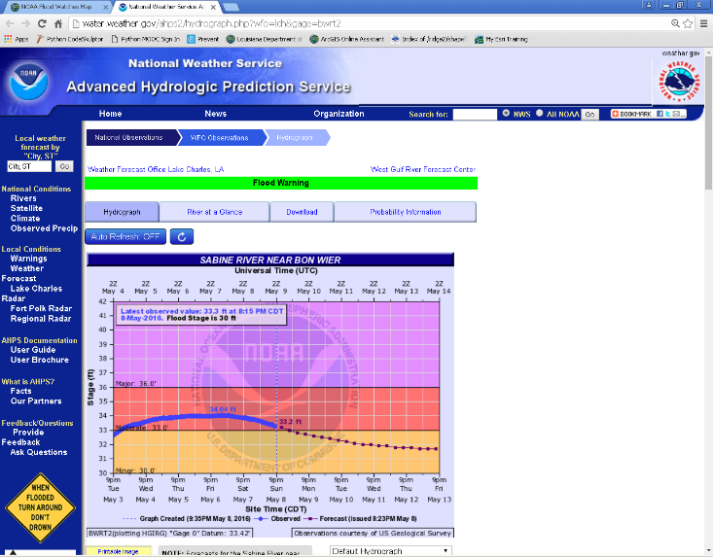
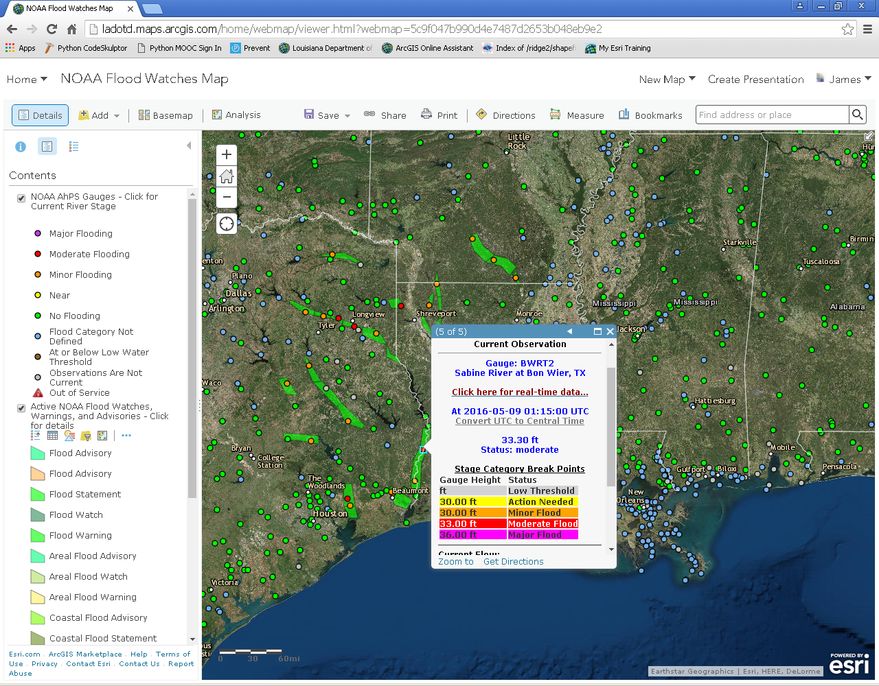
Situational Awareness LADOTD’s NOAA Flood Watch Map
Delivering authoritative data – NOAA-National Weather Service Flood Watch polygons and near-real-time river gauge points from the Advanced Hydrologic Prediction Service (AHPS). Links on pop-ups go directly to the NOAA website, wish current information.
Notes:
Floods are a major cause of depth, annually. NOAA’s Advances Hydrologic Prediction Service (AHPS) provides river and stream gauge monitoring and forecasts. This web map allows the user to find available gauges in the area of their interest. They are colored by flood stage. Wen clicked, the pop-up displays current information, as well as, a link to the real-time AHPS gauge website.

Slide 10
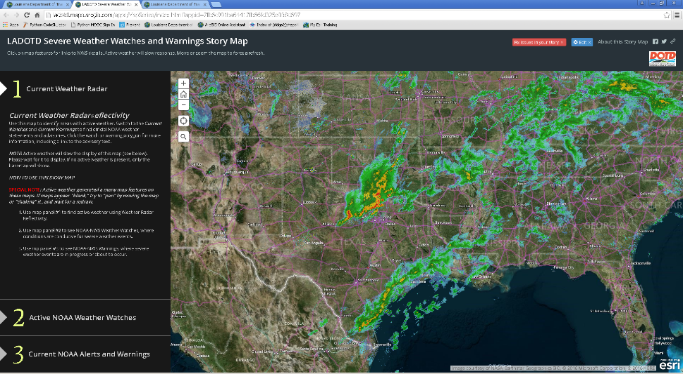
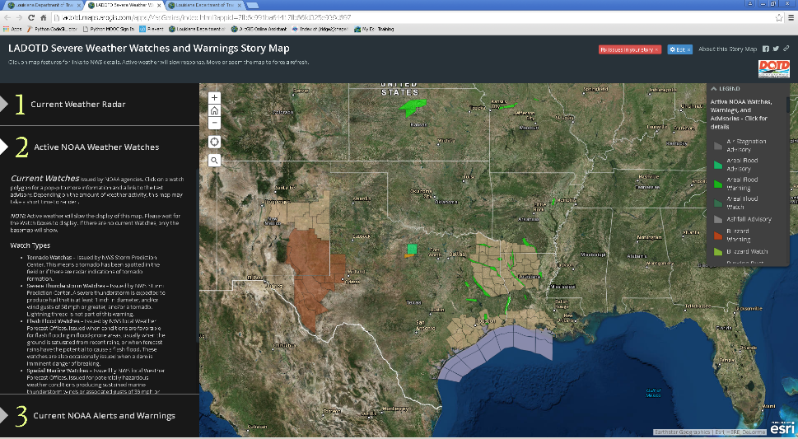
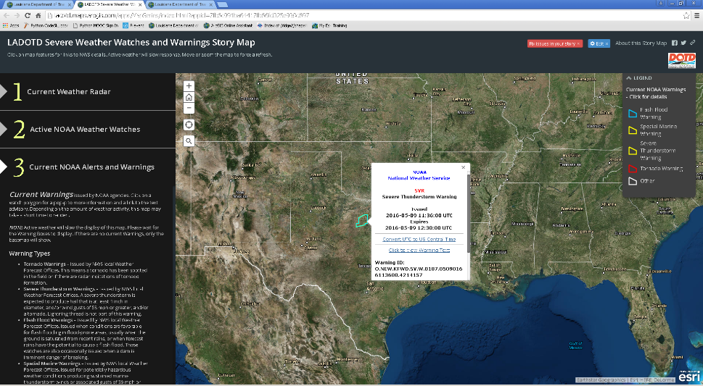
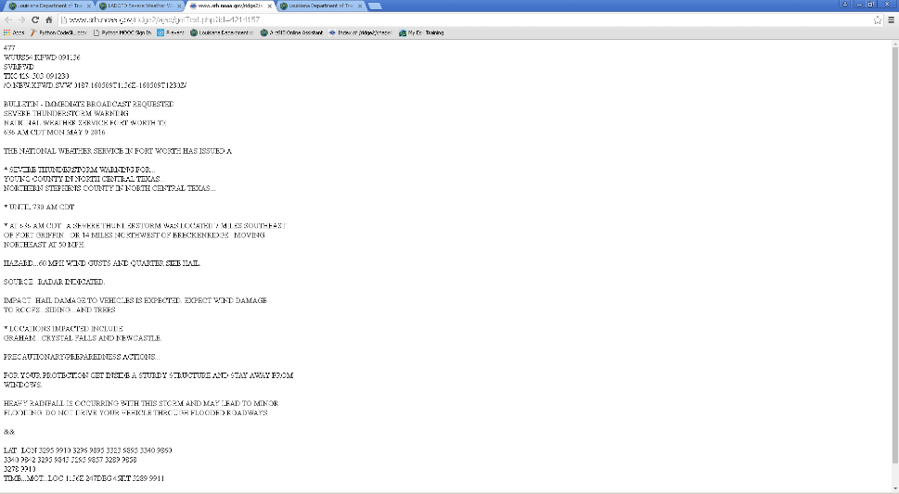
Situational Awareness LADOTD’s Severe Weather Story Map
Delivering near-real-time, actionable data and authoritative information, directly from the source. This Story Map allows the user to find a place of interest and move between the maps showing current weather radar or NOAA Watches or NOAA Warnings.
Notes:
This is a Story Map with three maps. It is used because as the viewer moves from one map to another, the map extent is maintained and you are looking at the same place, with different active content. The active content is either real-time Weather Radar, from Iowa State University; Current Weather Watches, from NOAA; or Active Weather Warnings, also from NOAA. All of these are web services and are automatically updated every 5 minutes. The Watches and Warnings provide clickable pop-s with links to the actual text advisory.

Slide 11
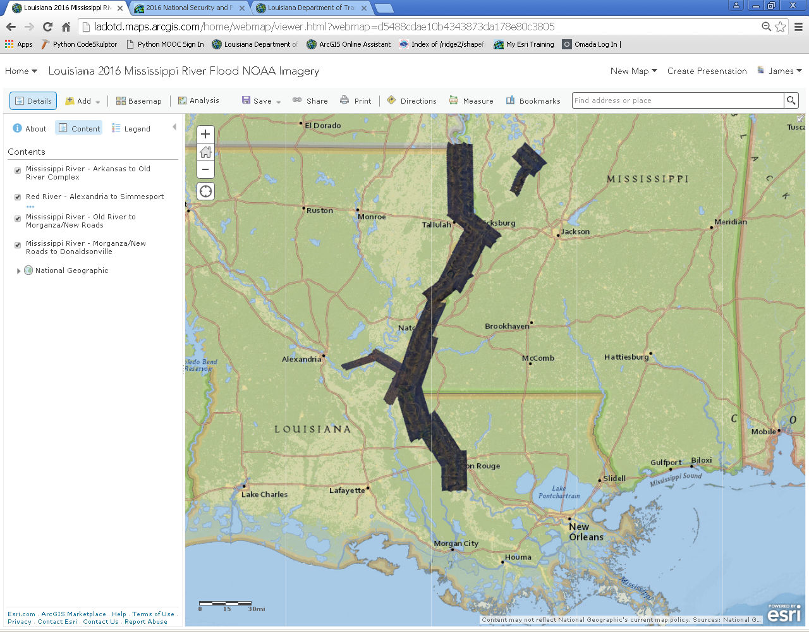
Official Imagery Delivered Quickly January 2016 Mississippi River Flood
During disasters, aerial and satellite imager become generally available. Improvements in data acquisition, processing, and delivery have replaced slow and cumbersome data downloads or “hard drive deliveries” with web services that are consumed, directly.
Notes:
In January, 2016, he Mississippi River reached unprecedented flood levels. As the flood moved downstream federal resources captured imagery at near-high-water stages along the river. This ArcGIS Online site provides users with that imagery, which was available within d few days of acquisition. These services were also available to ArcGIS Desktop users through Open GIS Consortium (OGC) image services.

Slide 12
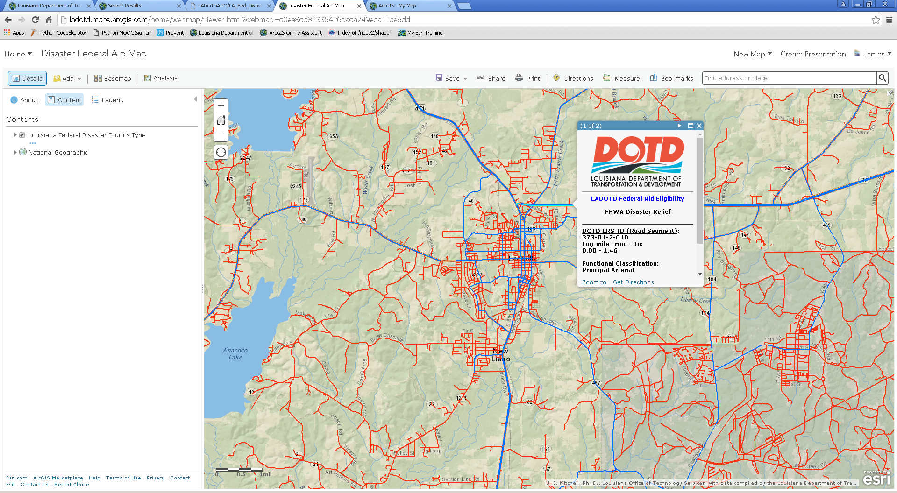
Disaster Response and Recovery Louisiana Roads Federal Aid Eligibility
During the recovery phase of an event, debris removal and road repair are reimbursed via the Federal Highway Administration (FHWA) or FEMA, depending on the roadway classification. This map provides a simple way to find and identify Federal Aid eligibility.
Notes:
Disaster relief funding for roads depends on the Functional Classification of a road. This is a classification system, determined by the State DoT, local government, with guidance from the USDOT. This ArcGIS Online web map allows any user, anywhere (on the Internet), to see, by the symbology, if a road is FHWA or FEMA reimbursable. In addition, pop-ups provide a wan to explore and confirm the status of specific lines, with a click.

Slide 13
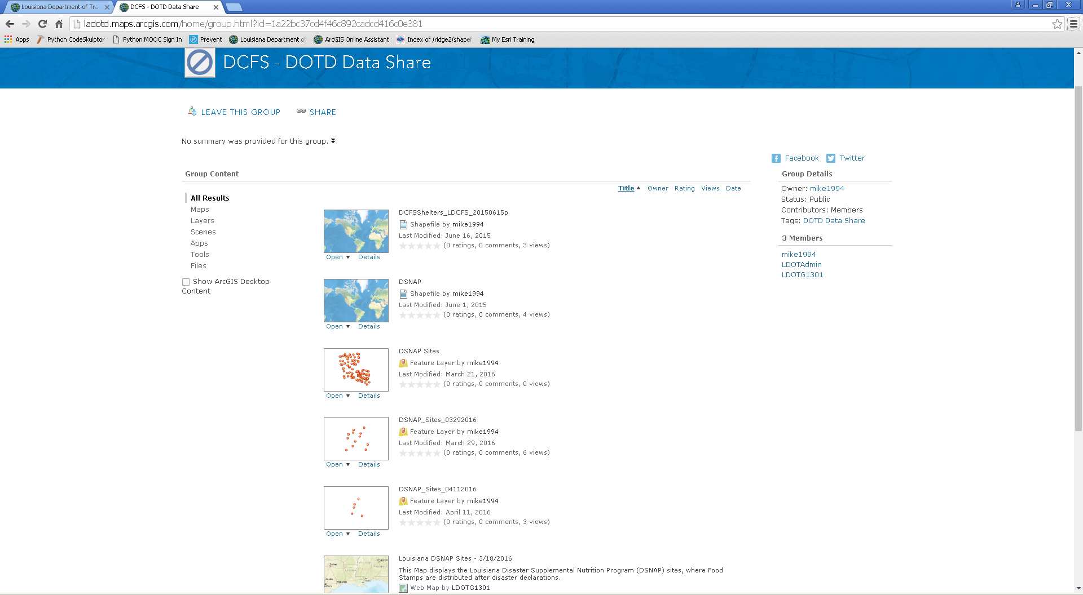
Interoperability and Data Sharing LADOTD/LADCFS Data Collaboration
Using AGO Groups, organizations can collaborate on sharing data, maps, and apps. The Disaster Supplemental Nutrition Program (DSNAP) is operated by the Dept. of Children and Family Services (DCFS), with assistance from LADOTD.
Notes:
Supporting interoperability, while maintaining appropriate and secure access is accomplished through the use of “Groups.” LADOTD and LADCFS collaborate on the DSNAP program. LADCFS runs the sites, while LADOTD provides traffic and logistical support. LADCFS determines the sites and provides these locations through a point web service, shared through ArcGIS Online to the DCFS – DOTD Data Share Group. In this way, LADOTD AGO users, who are part of that group and consume and make maps and applications from that service.

Slide 14
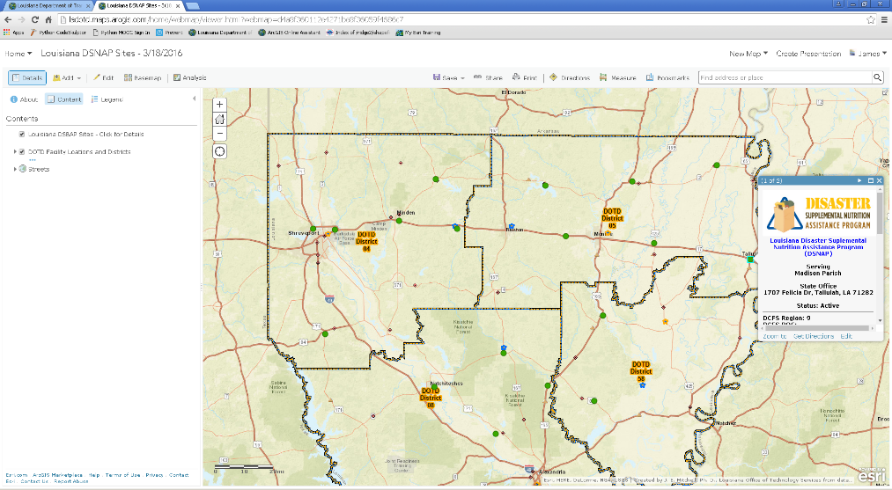
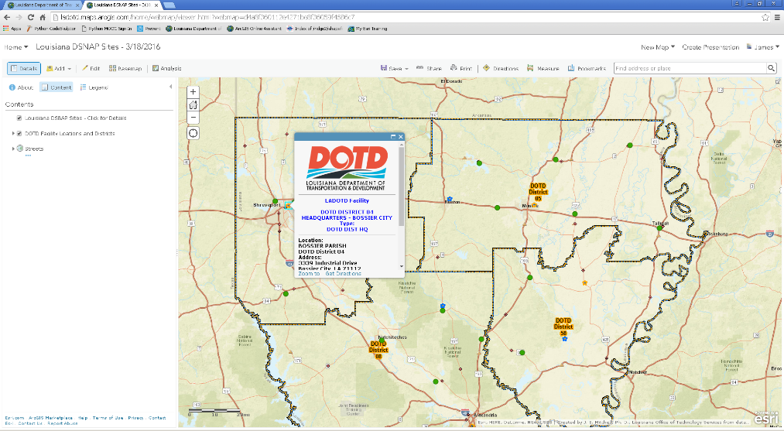
Information to the Public and State Workers Disaster Supplemental Nutrition Program
The Department of Children and Family Services serves a DSNAP feature service. Throughout the event life-cycle the number and location of sites change. As ESF-6 Lead (Mass Care, Housing, and Human Services), DCFS manages this program.
The Department of Transportation and Development serves a Districts and Facilities service. As ESF-1 Lead (Transportation), DOTD assists DCFS with logistics and traffic plans for DSNAP sites.
Maps consume the web services. As conditions change, and revisions are posted, everyone receives immediate updates from the authoritative source.
Notes:
Using the shared data, maps and apps can be created that take advantage of resources from both organizations.

Slide 15
Keys to Successful Interoperability and Actionable Information with SOA
Documentation – web resources must be discoverable
Complete Metadata
Comprehensive Keywords
Accurate and comprehensive Item Descriptions
Descriptive Access and Use Constraints
High Availability
Ensure that hardware, software, systems, and data are kept up to date
Monitor system performance
Perform data development off-line and push to production
Automate processes
Build ETL tools
Build Models, using Model Builder and/or Python Scripts
Notes:
Today, enterprise GIS is based on a Service Oriented Architecture (SOA), where traditional Desktop GIS interacts with GIS services from GIS Servers, and web-based (Software as a Service, SaaS). To make it work, data and services must be well documented and highly available. When it is, users, both infernal and external, will use it and will want more.

Slide 16
LADOTD Web Services Supporting Interoperability and Information Delivery During Emergency Operations
For more information contact:
James E. Mitchell, Ph. D,
jim.mitchell@la.gov
225-379-1881
Notes:
For more information contact Jim Mitchell, at: jim.mitchell@la.gov or 225-3479-1881.

